Slide 1
Employee Data Analysis using Excel
STUDENT NAME : V.GOMATHY
REGISTER NO : 2213331042094, asunm1333 2213331042094
DEPARTMENT : COMMERCE
COLLEGE : BHARATHI WOMEN'S COLLEGE

Slide 2
PROJECT TITLE
Employee Performance Analysis using Excel

Slide 3


AGENDA
Problem Statement
Project Overview
End Users
Our Solution and Proposition
Dataset Description
Modelling Approach
Results and Discussion
Conclusion
3/21/2024 Annual Review

Slide 4

PROBLEM STATEMENT
Organizations often struggle with efficiently evaluating and analyzing employee performance, leading to challenges in performance management, development, and decision-making. Without a structured approach, it becomes difficult to identify high performers, areas for improvement, and trends that could impact overall productivity and employee satisfaction.

Slide 5

PROJECT OVERVIEW
This project focuses on leveraging Excel to systematically analyze employee performance data. By using Excel's advanced features, such as pivot tables, charts, and formulas, the project aims to provide a comprehensive analysis of performance metrics. The goal is to offer insights into employee strengths and weaknesses, track progress over time, and support strategic HR decisions.

Slide 6

WHO ARE THE END USERS?
The primary users of this analysis tool are HR managers, team leaders, and senior executives who need to assess employee performance comprehensively. These stakeholders require a clear view of performance trends to make informed decisions regarding promotions, training needs, and performance improvement plans.

Slide 7

OUR SOLUTION AND ITS VALUE PROPOSITION
Our solution involves creating a robust Excel-based performance analysis tool that consolidates various performance metrics into a single, accessible format. The tool includes interactive dashboards, performance charts, and summary reports that enable users to evaluate performance trends, compare employee performance across different parameters, and make data-driven decisions to enhance overall workforce effectiveness.

Slide 8
Dataset Description
The dataset used in this analysis includes various performance-related metrics, such as individual performance ratings, productivity scores, attendance records, and qualitative feedback from supervisors. The data is collected over a specified period and is essential for evaluating employee performance comprehensively.

Slide 9

THE "WOW" IN OUR SOLUTION
The performance analysis revealed significant insights into employee performance trends, highlighting high achievers and identifying areas where performance could be improved. Visualizations, such as bar charts and line graphs, helped in interpreting complex data and communicating findings effectively. These insights can be used to inform performance reviews, identify training needs, and optimize team management strategies.
3/21/2024 Annual Review
9

Slide 10
MODELLING
The analysis process began with data cleaning and organization in Excel. This included removing duplicates, handling missing values, and standardizing data formats. Key performance indicators (KPIs) were calculated using Excel formulas. Pivot tables were used to summarize and analyze data, while charts and graphs provided visual insights into performance trends and patterns.
10

Slide 11
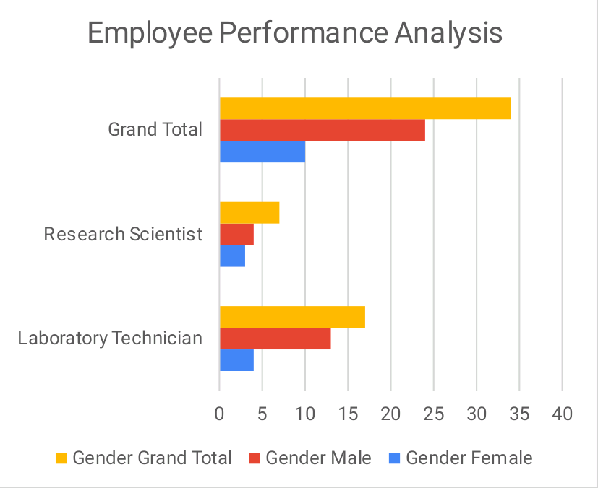
RESULTS
11

Slide 12
CONCLUSION
The Excel-based performance analysis tool proved to be an effective method for evaluating and understanding employee performance. It provided valuable insights that support better performance management and strategic decision-making. Future enhancements could involve integrating additional data sources, employing more sophisticated analytical techniques, or incorporating predictive analytics to further refine performance evaluations.

