Slide 1

Shipping Management System
Helping you ship consignments

Slide 2
PROJECT TEAM
Kushal Niroula [335697]

Slide 3
Project Goals
Help shipping organizations in handling their business
Helping administrative operatives in understanding their business
Tracking and aiding the work of low level operatives

Slide 4
Features
Create consignments
Create manifests
Assign manifests to vehicles
Track consignment
Track delivery person and vehicles
Track consignment storage
View and analyze consignment log
Email and SMS notification for events

Slide 5
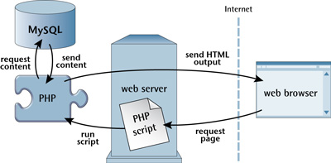
How Our Application Works
Backend
PHP
Zend with Doctrine
DI used : Zend DI
SQL
Frontend Technologies
HTML
CSS
JavaScript
Vue Js

Slide 6
Technology behind this app
UI and UX : Bootstrap, Vue Js, fetch API
Database – MYSQL , Doctrine ORM
Server Side Scripting – php , Heavily modified CodeIgniter framework.
Dependency Injection Framework : ZendDi
Config Engine : ZendConfig
JsHelpers: Rehmat/JsHelpers (https://github.com/RehmatFalcon/JsHelpers)

Slide 7

Conclusion
This is a project that I had undertaken for two main goals :
Completion of Practical Assessment for MCA III semester
Learning new technologies to solve business problems
Our software aims to help owners in identifying the parts that are causing bottlenecks and the parts that are performing well. This will allow the management to analyze and fix the bottleneck as soon as possible rather than after a long time which would have caused a lot of loss already.

