Slide 1
C Programming Workshop – Jan 7, 2018
Review of Jan. 7, 2018 Session Key Learning
1. Learn-C.org Tutorial: Hello World
#include <stdio.h>
int main() {
printf("Hello, World!");
return 0;
}
Include the standard input/output library. This should be added to all C programs. Other libraries can be added as needed
Every program needs a main routine that will execute code
Between the curly brackets
Print to the console window
2. Learn-C.org Tutorial: Variables and Types tutorial
Data types C has several types of variables, but there are a few basic types:
Integers – Positive or negative integers: char, int, short, long or long long.
Unsigned integers – Positive integers: unsigned char, unsigned int, unsigned short, unsigned long or unsigned long long.
Floating point numbers - real numbers (numbers with fractions): float and double.
Structures - will be explained later, in the Structures section.
NOTE! The different types of variables define their bounds. A char can range only from -128 to 127, whereas a long can range from -2,147,483,648 to 2,147,483,647 (long and other numeric data types may have another range on different computers, for example - from –9,223,372,036,854,775,808 to 9,223,372,036,854,775,807 on 64-bit computer).

Slide 2
C Programming Workshop; Prework – Jan 14, 2019
Learn about the “if and else” statements
Pre-Work Assignment (Optional but Helpful)
1. https://www.learn-c.org/en/Conditions
int foo = 1;
int bar = 2;
if (foo < bar) {
printf("foo is smaller than bar.");
} else if (foo == bar) {
printf("foo is equal to bar.");
} else {
printf("foo is greater than bar.");
}
Define two integers and give them values
This is the test condition
If the first test condition is true do this
a second test condition if the first condition is not true
If the second test condition is true due this
If none of the above are true do this

Slide 3
C Programming Workshop Prework – Jan 14, 2019
Learn “For” loops
Pre-Work Assignment (Optional but Helpful)
https://www.learn-c.org/en/For_loops
Define i as integer
Start with i = 0
End with i less then 10
Increment i by 1 on each loop
for (int i = 0; i < 10; i++) {
printf("%d\n", i);
}
Run this statement from i = 0 to i = 9 and then move
on to the next command
NOTE! Doing ++i will add one to i before the first iteration of the loop. The loop will start at one instead of zero.

Slide 4
C Programming Workshop Prework – Jan 19, 2018
Learn “while” loops
Pre-Work Assignment (Optional but Helpful)
https://www.learn-c.org/en/While_loops
Define n as an integer with value 0
int n = 0;
while (n < 10) {
n++;
}
Here is a test condition for the while loop
If the test condition is true execute statements inside
the curly brackets and then go back to the test
condition and see if it is still true. If the test condition
is ever false, move on to the next program segment

Slide 5
C Programming Workshop Prework – Jan 19, 2018
Learn Functions
Pre-Work Assignment (Optional but Helpful)
https://www.learn-c.org/en/Functions
/* function declaration */
int foo(int bar);
int main() {
/* calling foo from main */
printf("The value of foo is %d", foo(1));
}
int foo(int bar) {
return bar + 1;
}
Define the function name (foo) that will return an integer value the argument given to the function call is also an integer
The main program calls the function foo and sends a value of 1 into the function
This is where the function is defined. In this case it takes the number given to it and increments it by 1. Since the main program gives it a 1, the function will return a value of 2

Slide 6
MAIN LESSON: Jan 14, 2019: Create a Calculator Program
Load the c-language “calculator program” from the email on to one of two C compilers:
You can use the online compiler https://www.onlinegdb.com/online_c_compiler
This is an easy and fast way of checking out the program operation
b. You can download the Microsoft visual studio environment found
at https://visualstudio.microsoft.com/vs/whatsnew/. This is a very
Big download but it is a professional development environment.

Slide 7
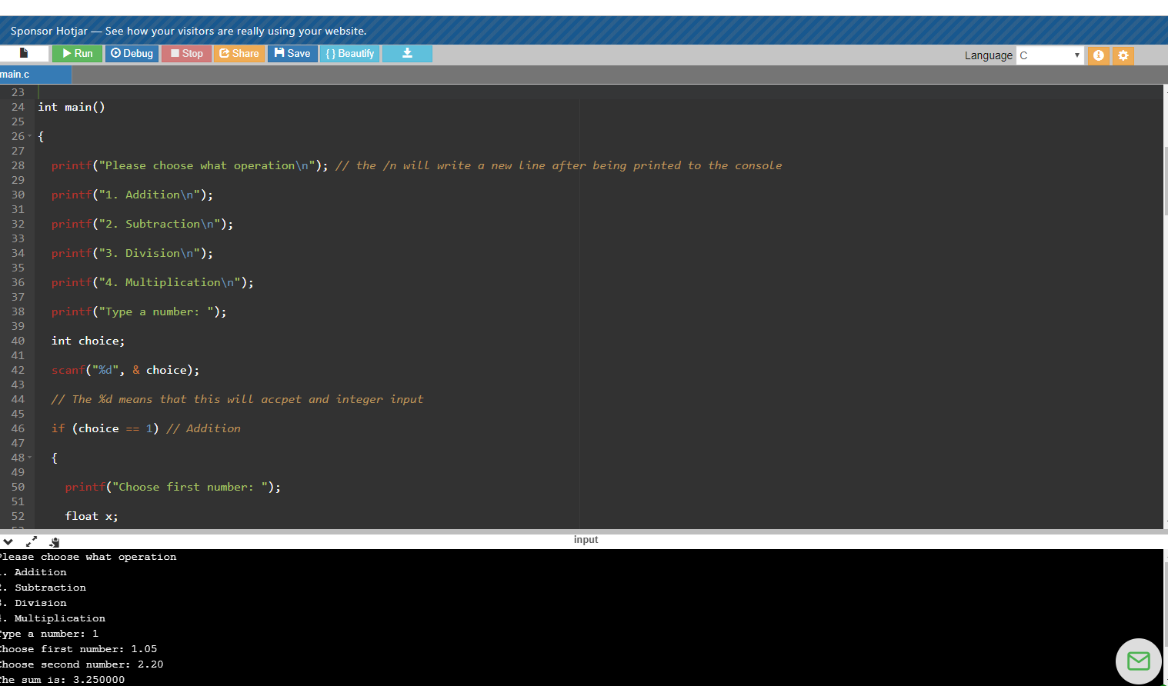
MAIN LESSON: Jan 14, 2018: Create a Calculator Program
a. Download the program to your C-compiler https://www.onlinegdb.com/online_c_compiler
And make sure it runs OK. It should provide and output like this.

Slide 8
MAIN LESSON: Jan 14, 2019: Understand the Calculator Program; then add functionality
Read through the program and understand how it works
Modify the program so that it has the option to calculate the average of 5 numbers.
c. You have completed the lesson for Jan. 14. Feel free to iterate on this example to learn more.

Slide 9

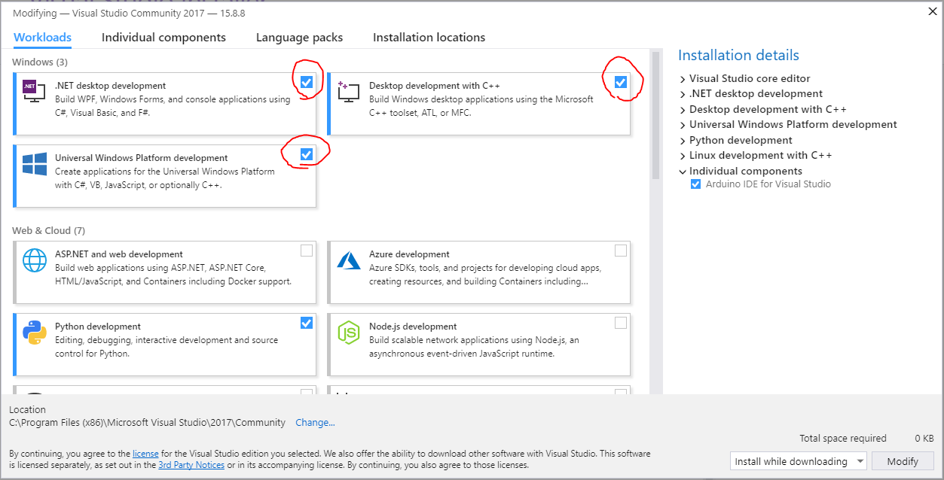
Installing Visual Studio
Download: https://goo.gl/JE8Czy
Install Community Edition
Acknowledge the License Terms and Privacy Statement.
Check these boxes:

