Slide 1
C, C++ workshop
Lecture #2
AUTHOR: Luis Gomez

Slide 2
Topics
Arrays
Structures
Pointers *
References &

Slide 3
Arrays
Def: Arrays are sets of data stored on a continuous allocation of memory.
How to declare an array of size j?
<type> my_array [ j ];
<type> my_array [] = { element 1, element 2, … element J };
Examples
Int decimal_numbers [] = {0, 1, 2, 3, 4, 5, 6, 7, 8, 9}
Int my_array [10]
Int multiplication_table [10][10]
Int cube [2][2][2]

Slide 4
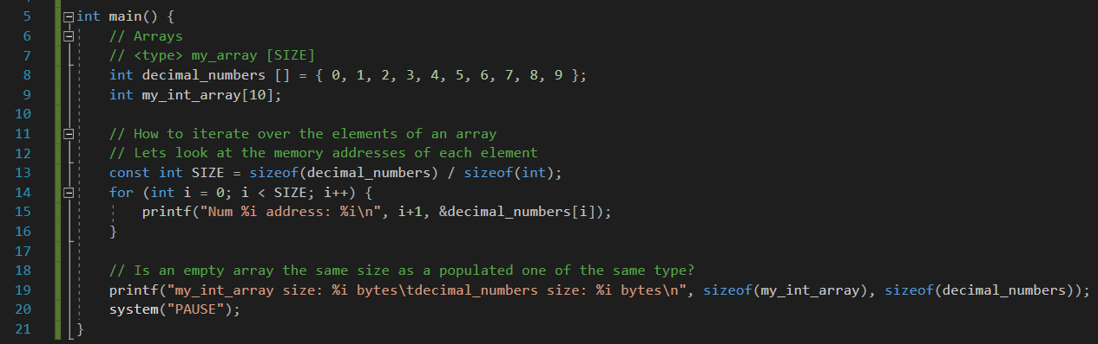
ex 1

Slide 5
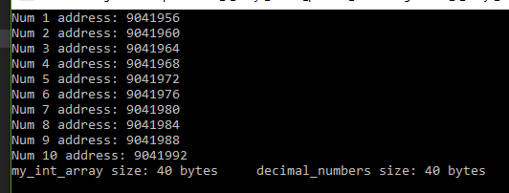
ex 1 output

Slide 6
ex continued…
sizeof(): built-in function that returns the number of bytes used to store value or type
sizeof(int) -> 4 bytes
sizeof(my_int_array) = 40 bytes
const int SIZE = sizeof(decimal_numbers) / sizeof(int)
This expression returns the number of elements in the decimal_numbers array

Slide 7
Pointers
& : address-of operator. Returns the memory address of a variable; also known as a pointer because it points to a memory address so to speak
Used for:
Pass by reference
Access objects with dynamic storage duration
Implement optional types
And more!

Slide 8
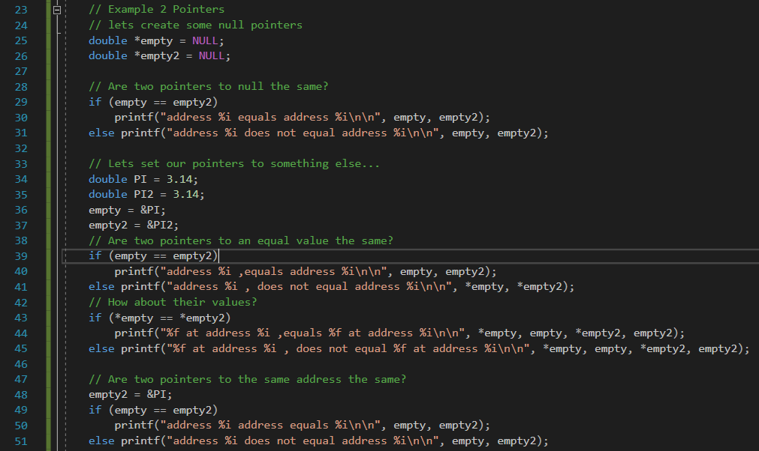
ex 2

Slide 9
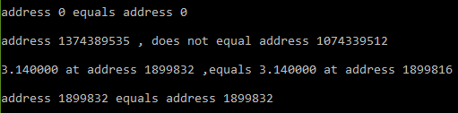
ex 2 output

Slide 10
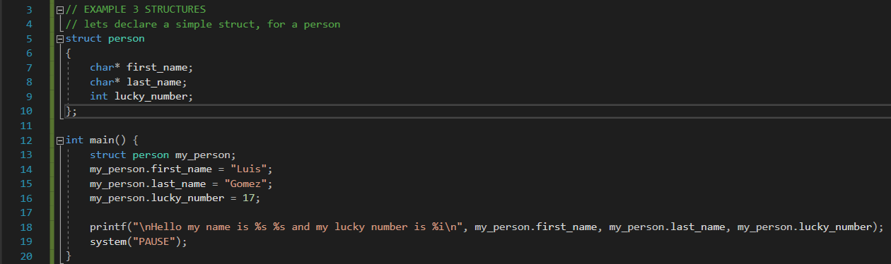
Structs, simple example

