Slide 1
Moneyball

Slide 2
Background
Millions of Americans play the lottery in hopes of striking it rich. The Mega Millions are especially popular because of their huge, lifechanging payouts

Slide 3
Motivation
Our goal was to create an application that utilized machine learning models to analyze historical trends in winning numbers to find an objective way to evaluate a set of lottery numbers
We also wanted our application to serve as a resource for potential users to research data that we highlighted as important/interesting

Slide 4
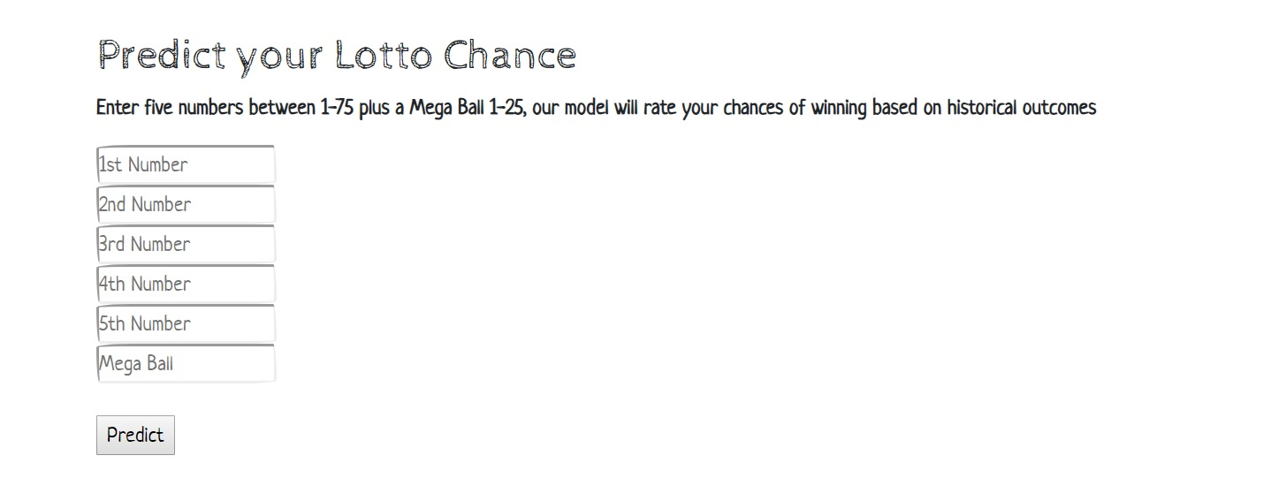
Application
Here the user can input 5 numbers of their choice and a Mega Ball to be evaluated by our machine learning model.
The model evaluates the set and assigns them a ranking based on historical trends.
The rankings are as follows
Best Chance
Better Chance
Good Chance
Average Chance
Low Chance
Slight Chance
Nominal Chance

Slide 5
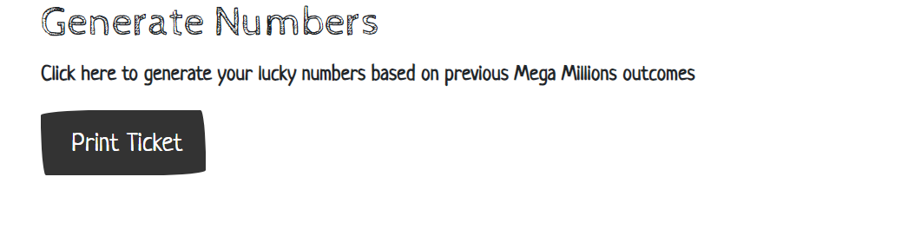
Application
Can’t decide on a set of numbers? No problem! Our application also allows the user receive a set of numbers with the highest ranking based off our model

Slide 6
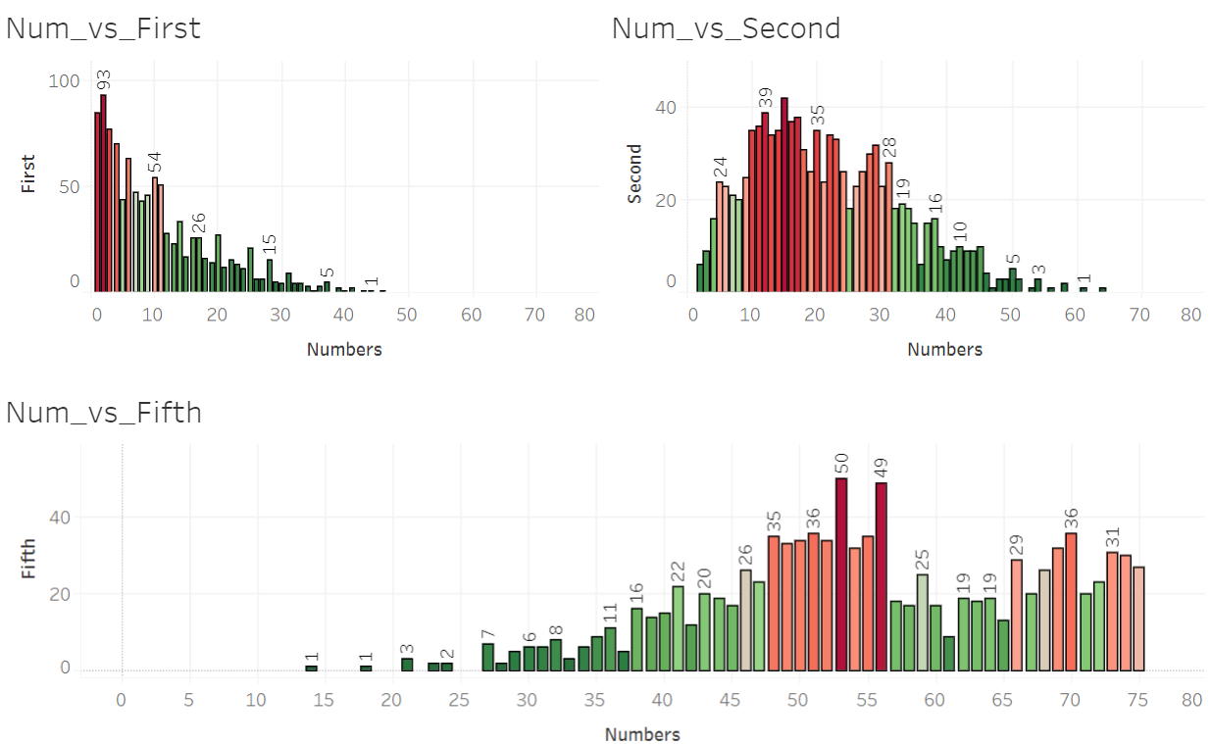
Application
Here is one of our many Tableau visualizations. Visualizations such as these offer our user an insight into the historical trends of winning Mega Millions numbers, which offers users a chance to make more informed decisions when choose their numbers.

