Slide 1
Virtual Assistant Call Management

Slide 2
Problem Statement
Receiving phone calls can be a hassle when you have a busy schedule. However, some calls are important and require your attention.
Even if you don't have the time to take every call, it's crucial to find a solution that ensures you don't miss any important calls
Helps users communicate with the other end of the phone and convey the information that needs to be shared.

Slide 3
Existing Solution
Voicemail is commonly used when the receiver cannot attend the calls but people do not mostly use it. Most people are not aware of voicemail, especially in India There are various reasons behind not using voicemail
Voicemail is commonly used when the receiver cannot attend the calls but people do not mostly use it. Most people are not aware of voicemail, especially in India. there are various reasons behind not using voicemail
Cost: Voicemail accounts are charged for by telecom companies. The caller leaving a voicemail is also charged at regular calling rates.
Inefficient :Voicemails can pile up quickly, and leaving voicemails can lead to back-and-forth missed calls.

Slide 4
Proposed Solution
Our innovative application is designed to provide a more engaging and effective communication experience for users.
This feature enhances communication and helps to build stronger relationships between users and their contacts.
This ensures that no customers miss any information.
The Application is user-friendly and so it can be easily handled by customers of any age group.
As we use Voicemailing services it is easy to access and acknowledge informations.

Slide 5
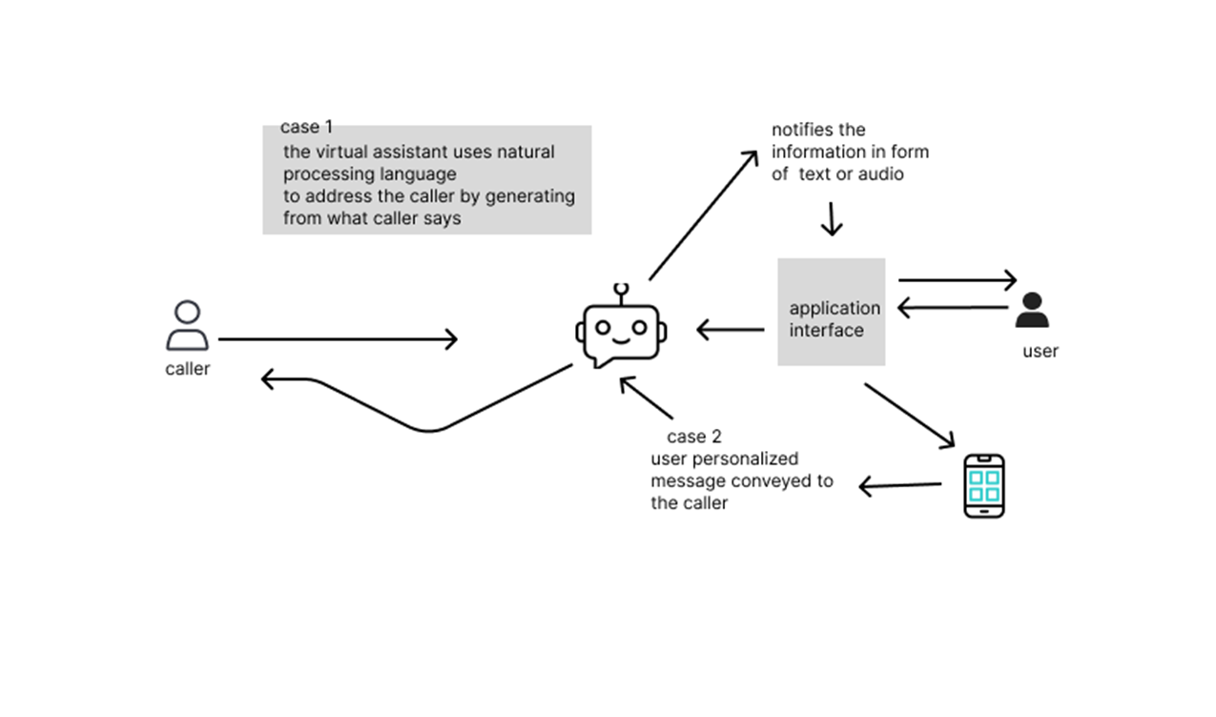
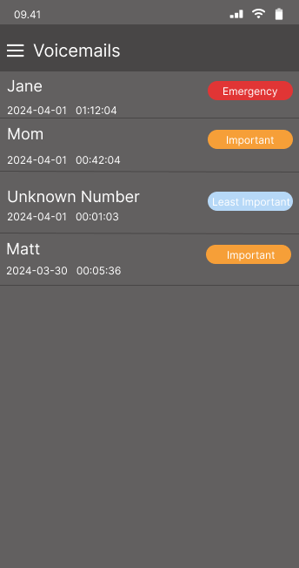
Basic Structure of Management

Slide 6


Technical Stack
PYTHON- used for backend infrastructure and it has a strong ecosystem.

Slide 7
Use Case
The User is a busy professional who receives a significant amount of phone calls throughout the day.
The user needs a simple way to manage calls and stay updated on messages.
The virtual assistant will record the message of the caller and then end the call.
Once the call ends, the virtual assistant sends the User a notification containing the caller's details and message.

Slide 8
Conclusion
A virtual assistant plays a crucial role in interacting with the user by processing their natural language and interacting with the caller.
This feature helps prioritize the emergency, important, and least important calls.

