Slide 1
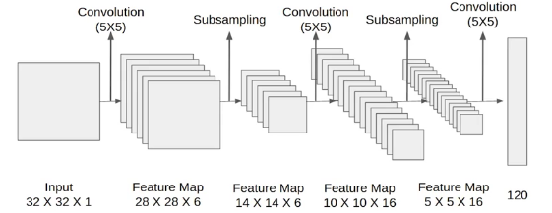
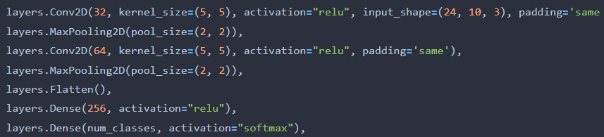
Number of features that the layer will learn
Size of the convolutional kernel
Activation function – Rectified Linear Unit
Padding zeros to the image so the output will be in the same spatial dimensions as the input.
Size of the convolutional kernel
Convert the 2D feature map output from the previous layers into a 1D vector
Fully connected layer with 256 units, then "relu" activation function is applied.
Output layer of the model. "softmax" activation function produces probability distributions over the classes.

Slide 2
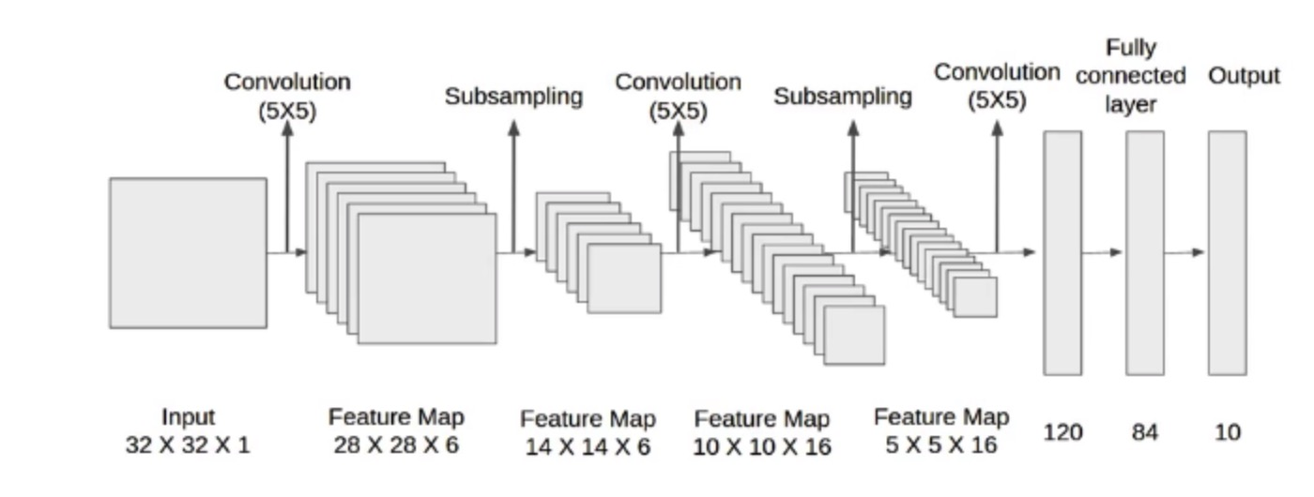








Flatten
$$256$$
$$20$$
$$4$$
$$34×10×3$$
$$34×10×12$$
$$17×5×12$$
$$17×5×16$$
$$8×2×16$$

Slide 3
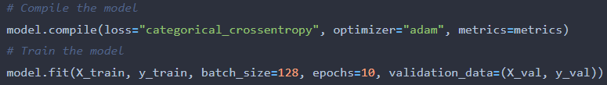
The suitable loss function for multi-class classification problems.
popular optimization algorithm that adapts the learning rate dynamically based on the gradients of the model parameters

Slide 4
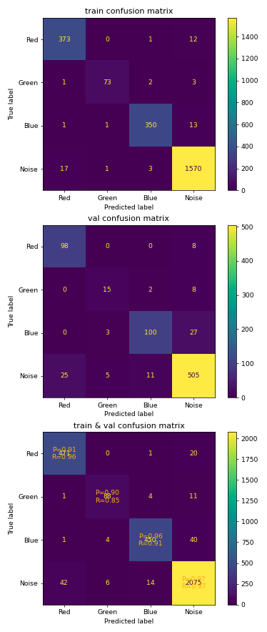

Slide 5
ADAM | SGD
Adaptive (therefore less sensitive to modification) | Constant | Learning Rate
V | V | Momentum
X | V | Bias Correction

Slide 6
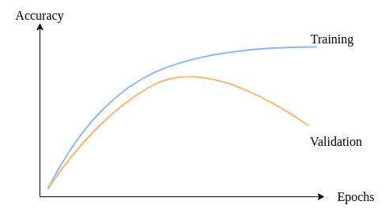
Accuracy
Training
Validation
Model Complexity

Slide 7
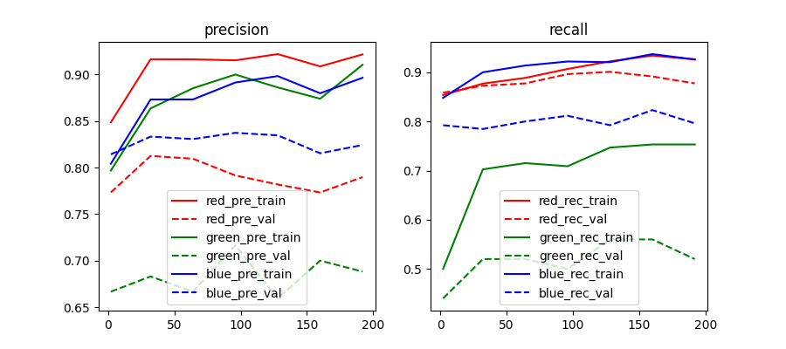


$$\text{first} \text{layer} \text{filter} \text{size}$$
$$\text{first} \text{layer} \text{filter} \text{size}$$

Slide 8
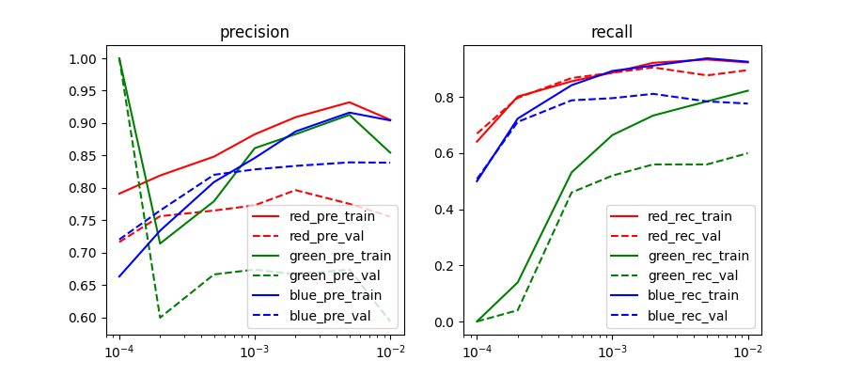


$$\text{Learning} \text{Rate}$$
$$\text{Learning} \text{Rate}$$

Slide 9
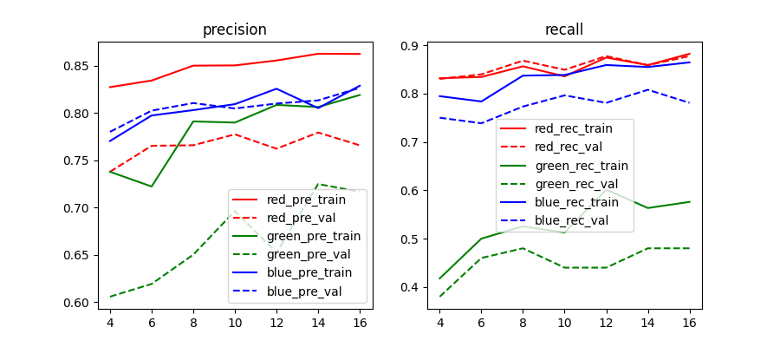


$$\text{second} \text{layer} \text{filter} \text{size}$$
$$\text{second} \text{layer} \text{filter} \text{size}$$

Slide 10
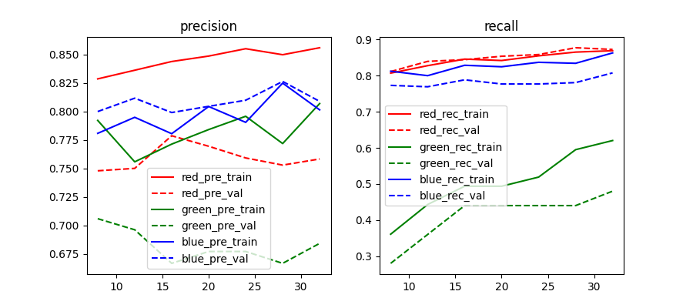


$$\text{third} \text{layer} \text{filter} \text{size}$$
$$\text{third} \text{layer} \text{filter} \text{size}$$

Slide 11
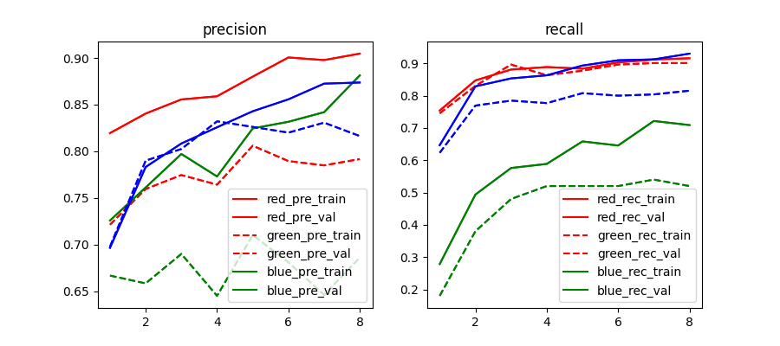


$$\text{convolution} \text{kernel} \text{size}$$
$$\text{convolution} \text{kernel} \text{size}$$

