Slide 1
Module 03 · Lecture 2
The HCI procedure
From the problem to the prototype: the process, the 10x10 method, and how to delve into the problem
Álvaro Figueira
Interação Pessoa-Máquina · DCC · FCUP
The worked example of the 10x10 method is adapted from “Sketching User Experiences: The Workbook” (Greenberg, Carpendale, Marquardt, Buxton, Morgan Kaufmann)
IPM
Álvaro Figueira · DCC / FCUP · 2026/27
M03 · 1

Slide 2
Creating a HCI is a process
There is a problem
We need to find a solution
Not a single leap: a sequence of steps, each one producing evidence for the next.
IPM
Álvaro Figueira · DCC / FCUP · 2026/27
M03 · 2

Slide 3
In the middle of this process
Create many different “solutions”
  The 10x10 methodology
  There are seven major steps
  Need to make assumptions
  Make a lot of sketches! (to be seen in the lab)
Build the prototype
  To be described later…
The process, so far
Prototype
Concept models, decisions
You need to be fast at sketching!
IPM
Álvaro Figueira · DCC / FCUP · 2026/27
M03 · 3
Notes:
10x10: Generate 10 different design concepts; produce 10 variations/details of the most promising concept.
Seguir com um treino de esboços usando cartas do Pictionary!

Slide 4
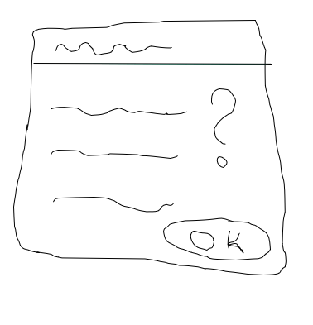
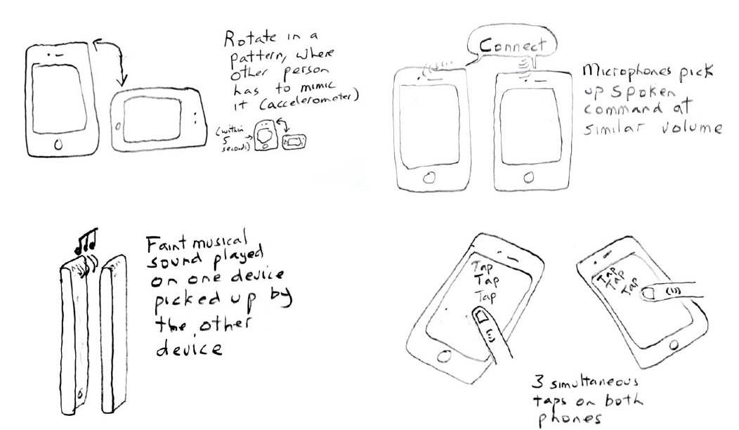
THE 10x10 METHOD · 7 STEPS
State the challenge, then expand
1
State your design challenge
What is the problem to solve?
Which are the client needs?
Produce a novel system that takes advantage of a particular technology
…
2
Generate ≥ 10 different design concepts that address the challenge (expand phase)
brainstorming
be as creative and diverse as possible
don't judge designs at creation time
sketches should capture the essence of the idea, not the details
IPM
Álvaro Figueira · DCC / FCUP · 2026/27
M03 · 4

Slide 5

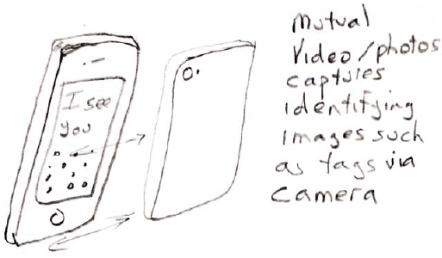
THE 10x10 METHOD · 7 STEPS
Reduce
3
Now, reduce the number of design concepts (reduce phase)
review all designs
discard the ones that don't have merit
explain and get feedback on the remaining designs from others
gather the reactions (including your own)
OR, based on reflection, repeat step 2 (i.e., improve it)
4
Choose the most promising concept(s)
Your starting point!
Don't trash the other designs!
IPM
Álvaro Figueira · DCC / FCUP · 2026/27
M03 · 5
Notes:
No ponto 4, dos 10 iniciais podem (por exemplo) ficar 6.

Slide 6
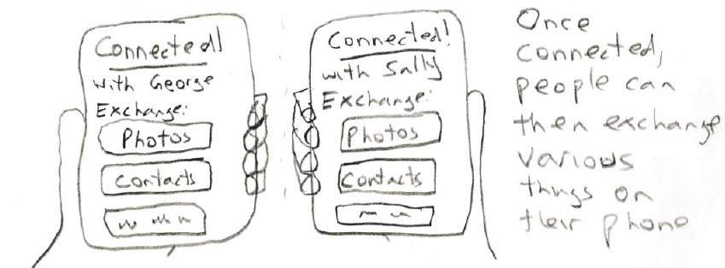
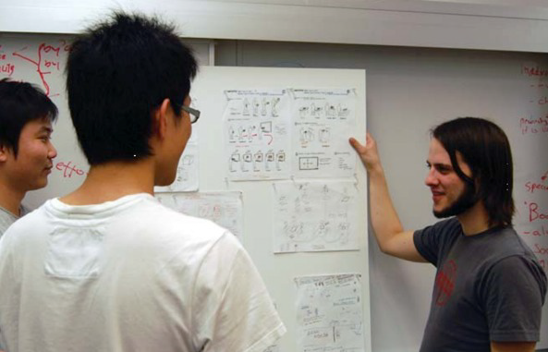
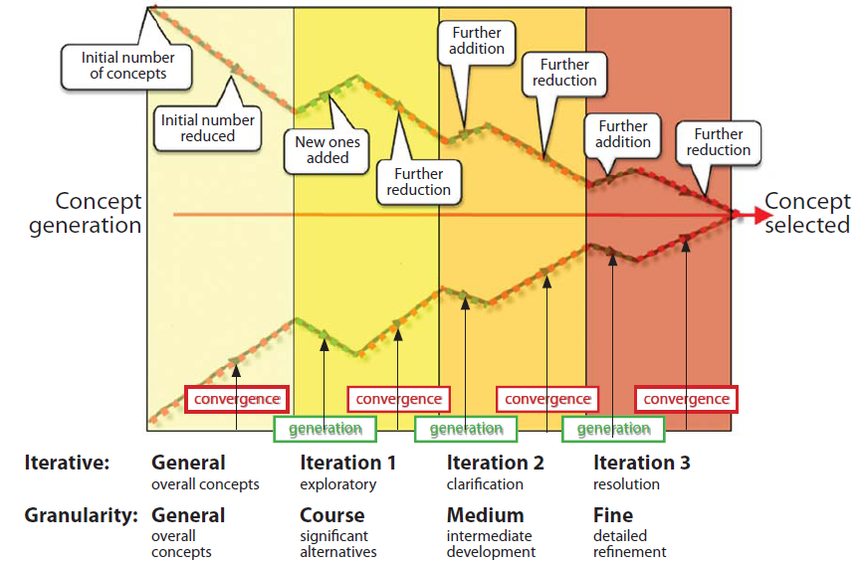
THE 10x10 METHOD · 7 STEPS
Expand again, present, iterate
5
Produce 10 details / variations of the surviving concepts
explore the concept
generate different ways of realising the concept
dig deeper in a particular way (i.e., show the details)
6
Present your ideas to a group
solicit feedback (positive, what could be improved, etc.), suggestions about redesigns
(coffee / donuts are welcome)
7
As your ideas change, sketch them out
that is, go back to step 1 (or 4), but deeper into the design funnel
IPM
Álvaro Figueira · DCC / FCUP · 2026/27
M03 · 6
Notes:
No ponto 5, deve-se expandir a melhor (OU os 6 sobreviventes) e fazer 10 hipóteses/variações para cada um.

Slide 7
10x10 IN PRACTICE · STEP 1
Worked example: the design challenge
How can two people connect their mobile devices for information exchange (e.g., photo transfer) without resorting to dialog boxes or other tedious interface requests?
Assumptions
the mobile device detects nearby phones
they can initially do some limited communication
you and the other person can perform some action that both phones recognise as a “handshake”, affirming that a full connection is desired. That is, it exploits a social convention: you both agree to do something.
IPM
Álvaro Figueira · DCC / FCUP · 2026/27
M03 · 7

Slide 8
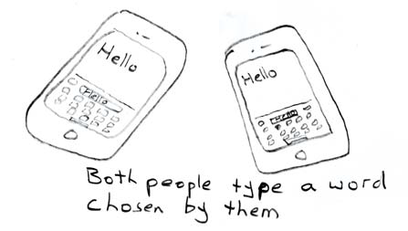
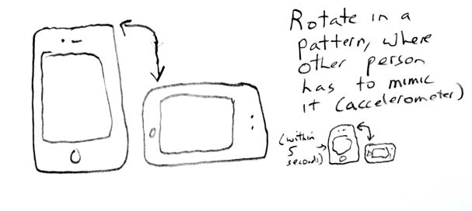
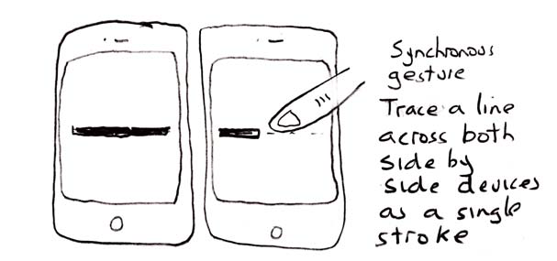
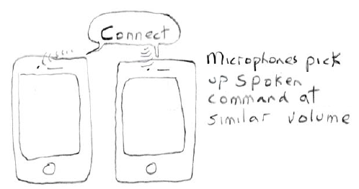
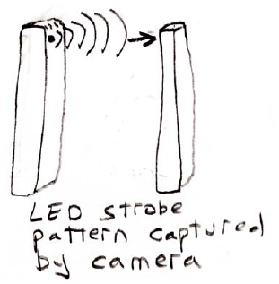
10x10 IN PRACTICE · STEP 2 · CONCEPTS i TO v
Generate 10 competing concepts
i) Enter an agreed-upon keyword
ii) Mimic a rotation pattern
iii) Tracing across displays
iv) Speak a command
v) Recognise a phone's flash strobe pattern
IPM
Álvaro Figueira · DCC / FCUP · 2026/27
M03 · 8

Slide 9
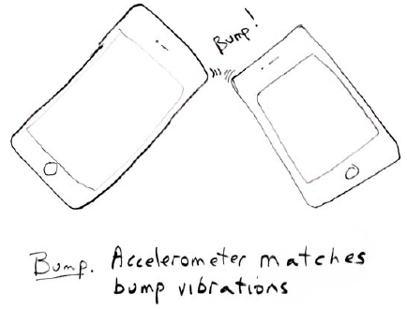
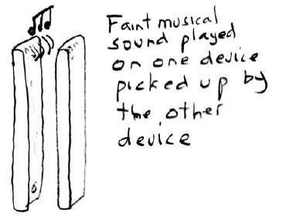
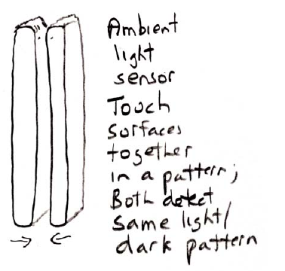
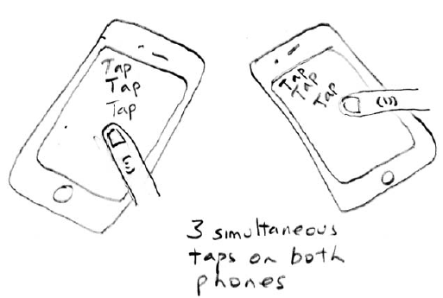
10x10 IN PRACTICE · STEP 2 · CONCEPTS vi TO x
Generate 10 competing concepts
vi) Bump two phones together (credit: Bump Technologies)
vii) Musical sequence
viii) Light / dark patterns
ix) Three simultaneous taps
x) Take a picture of an identifying feature on the other person's phone
IPM
Álvaro Figueira · DCC / FCUP · 2026/27
M03 · 9

Slide 10
10x10 IN PRACTICE · STEPS 3 AND 4
Reduce and / or repeat
Theme
you and the other person perform some action that both phones recognise as a “handshake” affirming that a full connection is desired. That is, it exploits a social convention where you both agree to do something.
Repeat?
Create other variations based on this notion, or other themes?
Choose (reduce)
Cameras are the lowest common denominator, so choose concept x: take a picture of an identifying feature on the other person's phone.
IPM
Álvaro Figueira · DCC / FCUP · 2026/27
M03 · 10

Slide 11
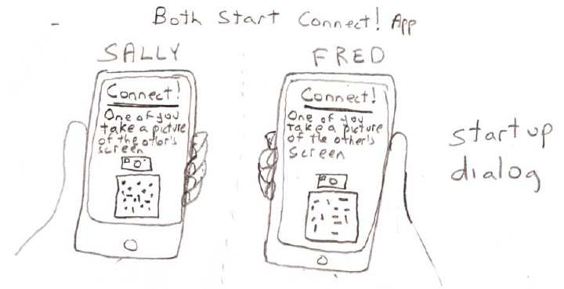
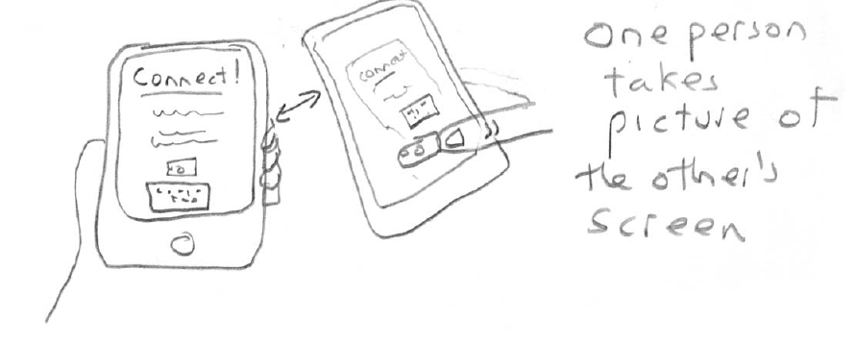
10x10 IN PRACTICE · STEP 5 · DETAILS a, b, c
Detail the chosen concept
1
2
3
IPM
Álvaro Figueira · DCC / FCUP · 2026/27
M03 · 11

Slide 12
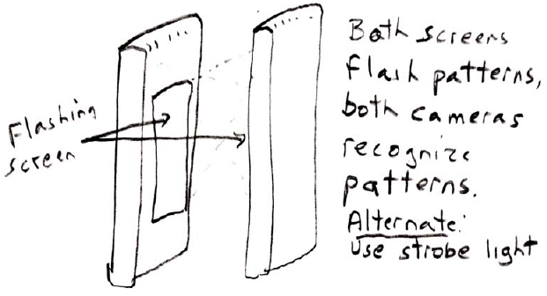
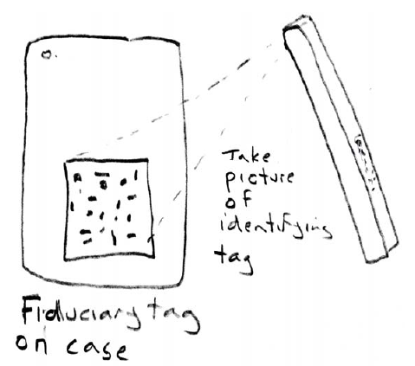
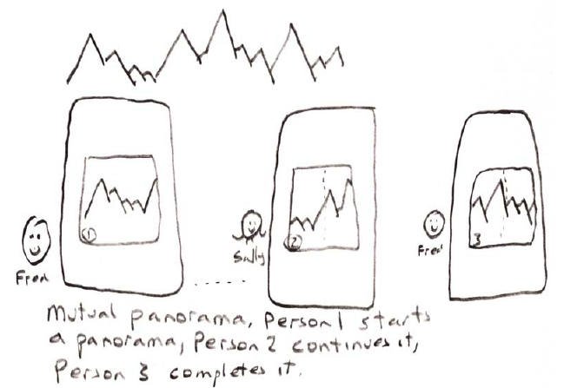
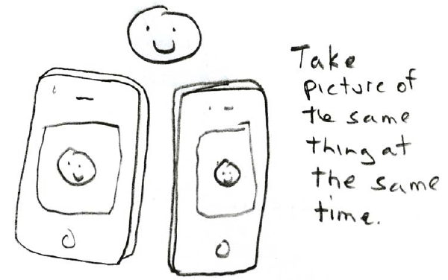
10x10 IN PRACTICE · STEP 5 · VARIATIONS
…and the variations
Flashing patterns
Fiduciary tags (for added security, both phones would have to do it)
Cooperative panorama
Same picture
IPM
Álvaro Figueira · DCC / FCUP · 2026/27
M03 · 12

Slide 13









Synopsis of the example
Create many ideas
Sketch a lot
Use good material
Make good use of space
Create legends/captions
Create sequences of user actions
Use color
Use arrows
Assess and evolve the ideas
IPM
Álvaro Figueira · DCC / FCUP · 2026/27
M03 · 13

Slide 14
But, before that you should…
Understand the problem
Know what you should do
Know what you can't do
Use rational arguments
Look for evidence
Understand what is worth
The process, so far
Prototype
Concept models, decisions
Study the user, personas, technology
IPM
Álvaro Figueira · DCC / FCUP · 2026/27
M03 · 14

Slide 15
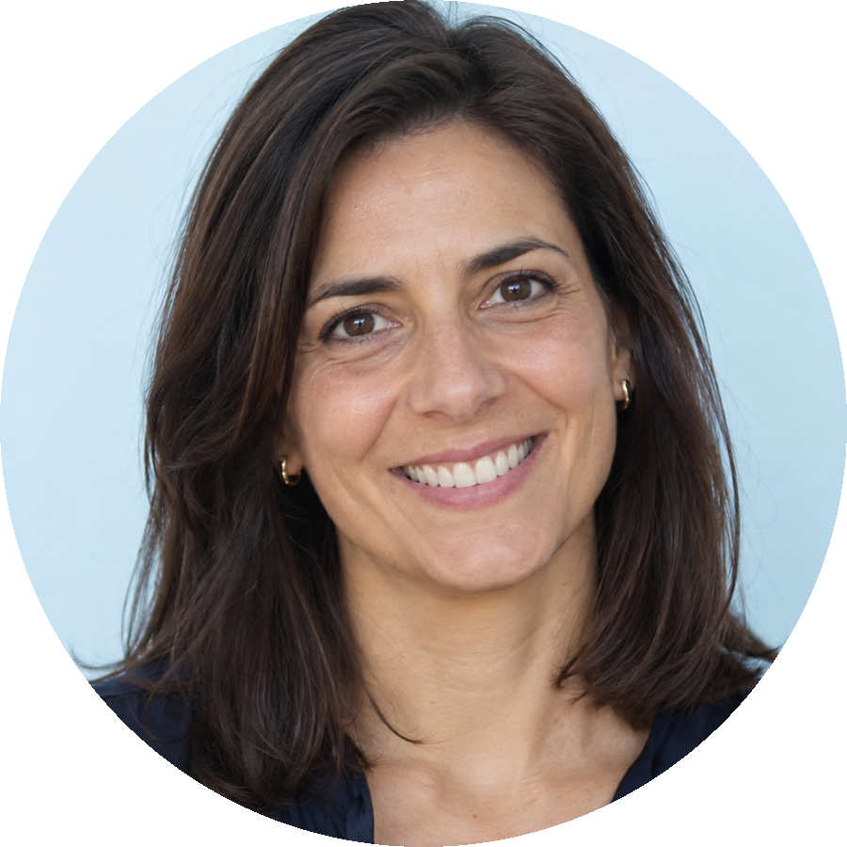
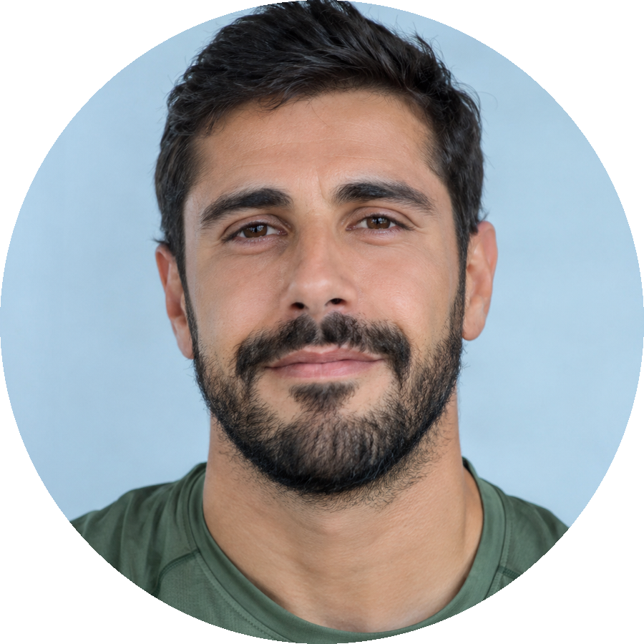
Creating personas
Segment your market, then pick an example person (imaginary) for each segment:
Susana, 42
Teaches Portuguese and History at a school in Gaia. Two children. Likes to read about diets, and tries a new one every January.
Rogério, 37
Market analyst at a retail company in Porto. Goes to the gym before work, three times a week.
Goal: keep track of what she eats without data entry
Frustration: apps that ask for every ingredient, and small text
Technology: her Android phone and WhatsApp, rarely a laptop
Context: evenings on the sofa after marking tests, 20 minutes
Goal: see his progress at a glance, without stopping
Frustration: watches with four buttons and hidden menus
Technology: a smartwatch, two monitors and spreadsheets all day
Context: at the gym at 7:30, hands busy, earphones in
Is there anyone left, between these two? Then you need more personas (3 or 4 at most)
Questionnaires and tests predict how they will behave with the product, and which background knowledge they have
IPM
Álvaro Figueira · DCC / FCUP · 2026/27
M03 · 15
Notes:
Segmentar o mercado e escolher uma pessoa-exemplo (imaginária) por segmento. As duas personas são exemplos: os detalhes de objetivos, frustrações e contexto são ilustrativos e podem ser trocados.

Slide 16
Rationalise the process
Provide evidence
Hence, evidence must be gathered and organised
Get evidence from those who know
The process, so far
Prototype
Concept models, decisions
Gather a lot of data!
Draw conclusions
Study the user, personas, technology
Gather data, aggregate results, conclude
Gather data from stakeholders and surveys, aggregate the results, draw conclusions
IPM
Álvaro Figueira · DCC / FCUP · 2026/27
M03 · 16

Slide 17
Which data, which stakeholders?
Study the subject!
Use the Internet
Ask people
Be proactive!
The process, so far
Prototype
Concept models, decisions
Stakeholders will allow you:
to better understand the context
Study the user, personas, technology
Gather data, aggregate results, conclude
to better understand the problems
Exploratory studies, stakeholders, milestones
to establish priorities in solving the problem
IPM
Álvaro Figueira · DCC / FCUP · 2026/27
M03 · 17
Notes:
E, em cada um desses objetivos, há feedback a ser aproveitado.

Slide 18




Hence, to understand the problem
Identify the stakeholders
Look for more information (several sources)
Discuss the problem with the other group members
Discuss the pros and cons
what you are capable of doing and what you aren't
IPM
Álvaro Figueira · DCC / FCUP · 2026/27
M03 · 18
Notes:
A estória: “o lojista dizia: eu não chego.... Não consigo... O negócio vai arruinar-se porque não chego, sozinho não consigo... E, depois, é um problema com as contas”. Então o problema foi resolvido arranjando outra pessoa para fazer a contabilidade. Mas, na realidade, o senhor não chegava às prateleiras mais altas onde estavam os registos das encomendas.

Slide 19
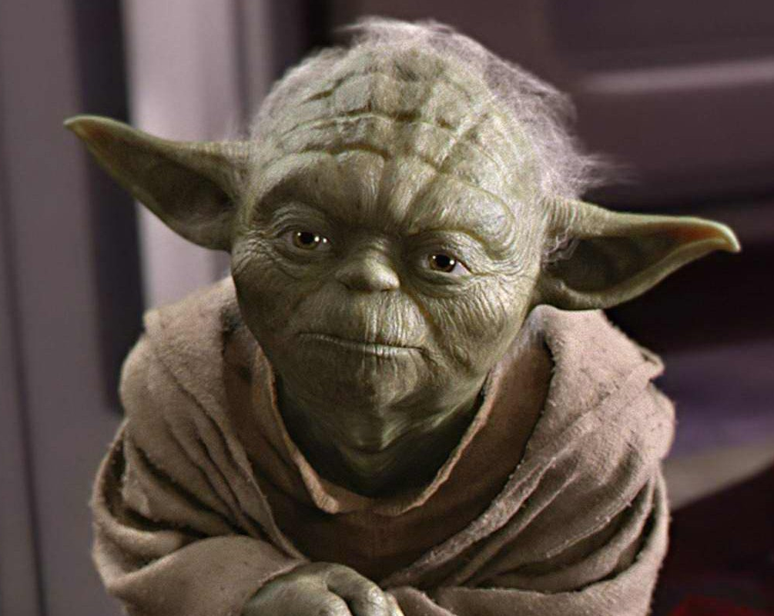
By now you should be getting the “picture”…
You: what to do?
Yoda: for information look
You: where?
Yoda: information, there where is
You: how do I know the information is right and accurate?
Yoda: you won't know
You: where to start?
Yoda: the beginning is to start
Yoda: hmmm…
IPM
Álvaro Figueira · DCC / FCUP · 2026/27
M03 · 19

Slide 20
Create your team
Don't waste time!
The process, so far
Add value to the team (different people)
Ensure all have the motivation
Ensure there are at least two communication channels between all: peer-to-peer and broadcast
Create agile ways to hold useful team meetings
Distribute tasks, systematically
Inform the group on individual findings before each milestone
In this course: the team leader rotates every session (Module 01)
Prototype
Concept models, decisions
Study the user, personas, technology
Gather data, aggregate results, conclude
Exploratory studies, stakeholders, milestones
Group formation
IPM
Álvaro Figueira · DCC / FCUP · 2026/27
M03 · 20

Slide 21
Conceptual model pipeline
Understand
Understand what you have to do
Create
Create models for solutions
Sketch
Sketch each model (make it fast!)
Describe
Describe the model using text
Evaluate
Evaluate the models
Improve
Improve the most promising
Four steps to produce candidate models, two to select and refine them. Then back to Sketch.
IPM
Álvaro Figueira · DCC / FCUP · 2026/27
M03 · 21

Slide 22



Evaluate the conceptual models
Create evaluation grids
One row per model, one column per criterion, one grid per evaluator
The more evaluators, the better. The more different they are, the better
Evaluators from other groups know the domain: that is what makes the critique informed
Create scales for the evaluations
Avoid neutral evaluations: use an even number of levels
Create heuristics for value aggregation in the grids
How the individual scores become the group's decision
IPM
Álvaro Figueira · DCC / FCUP · 2026/27
M03 · 22

Slide 23
Creating models for HCI
From your ideas create the associated conceptual models
Communicate the ideas through sketches
Assess your ideas (use the 10x10 method)
Get to the best idea and improve it using sketches
Reach your “maximum” (sketch + text)
The process, so far
Prototype
Concept models, decisions
Study the user, personas, technology
Gather data, aggregate results, conclude
At the end of the process, you should have a lot of evidence to provide!
Exploratory studies, stakeholders, milestones
Group formation
IPM
Álvaro Figueira · DCC / FCUP · 2026/27
M03 · 23

Slide 24
Assess your product!
Usability evaluation
It's not assessing a prototype!
It's assessing a concept
Make it objective
Make it measurable
The process, so far
Usability evaluation
Prototype
Concept models, decisions
Study the user, personas, technology
Gather data, aggregate results, conclude
In this course: cognitive walkthrough on the sketches, heuristic evaluation on the wireframes, usability tests on the prototype. Each one needs missions written as task flows (next slide).
Exploratory studies, stakeholders, milestones
Group formation
IPM
Álvaro Figueira · DCC / FCUP · 2026/27
M03 · 24

Slide 25
Task flows: how to write the missions
A task flow is one goal and the sequence of steps a user takes to reach it
One line per step: what the user does, what the system shows
Written from the user's goal, not from the interface: “release anchor 3”, not “click the anchor button”
Each panel owner writes the flows for the complex functions of their panel
The flows become the missions of the cognitive walkthrough and of the usability tests: evaluators follow them step by step and score each step
Example (monitoring panel)
Goal: check why anchor 3 is not holding and release its cable
1. Notice the alert on the stability panel
2. Open the detail of anchor 3
3. Read tension and depth
4. Choose “release cable”
5. Confirm and see the tension drop
Success: the alert clears within the mission
IPM
Álvaro Figueira · DCC / FCUP · 2026/27
M03 · 25
Notes:
Novo (2026/27), a partir do material das práticas. Os task flows são a forma de escrever as missões do passeio cognitivo e dos testes. Cada dono de painel escreve os flows das funcionalidades complexas do seu painel.

Slide 26
Report your work and findings
Final outputs
The process, so far
Report
The prototype (to be presented)
The final report (to be submitted)
  With all the work done in each stage
  Huge folder!
  Sketches, diagrams and graphs, text, colour
In this course: gather the evidence of every phase, and the before/after of each evaluation with the reason for the change
Usability evaluation
Prototype
Concept models, decisions
Study the user, personas, technology
Gather data, aggregate results, conclude
Exploratory studies, stakeholders, milestones
Group formation
IPM
Álvaro Figueira · DCC / FCUP · 2026/27
M03 · 26

Slide 27
The final sequence
Final report
PART 2 · PR2
prototype + second report + final presentation
Usability evaluation
Prototype
PART 1 · R1
first report + mid-term presentation (TBC)
Propose design concept models + make decisions
Study the “user” + create personas + study the technology
Gather data from stakeholders + surveys/inquiries + aggregate results + draw conclusions
Exploratory studies + define stakeholders + establish milestones
Group / team formation
IPM
Álvaro Figueira · DCC / FCUP · 2026/27
M03 · 27
Notes:
As duas faixas marcam as duas partes do trabalho: R1 (primeiro relatório e apresentação intercalar) até aos modelos concetuais, PR2 (protótipo, avaliação e relatório final) daí em diante.

Slide 28
Situations from last years
(problems and solutions from the students)
IPM
Álvaro Figueira · DCC / FCUP · 2026/27
M03 · 28
Notes:
Placeholder a preencher em cada ano com fotos ou resultados da última aula prática.

Slide 29
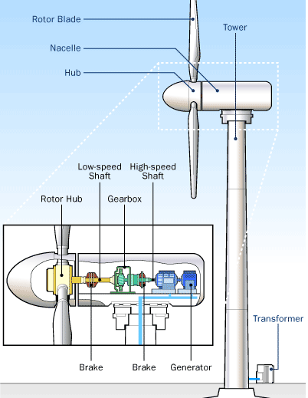
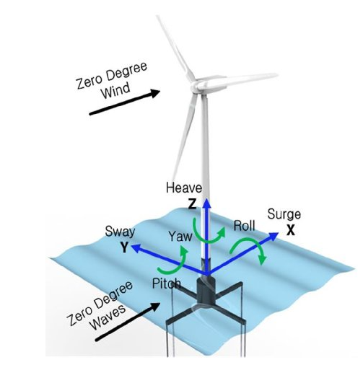
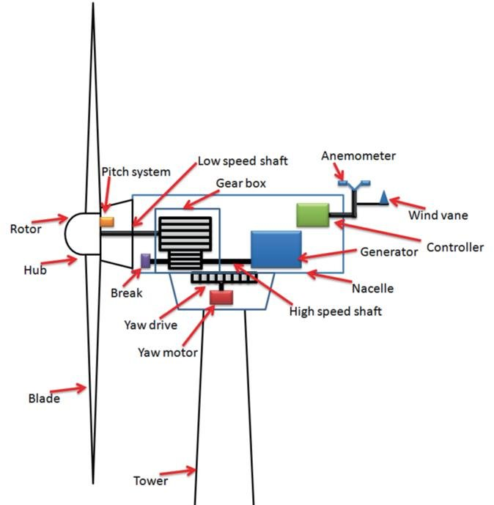
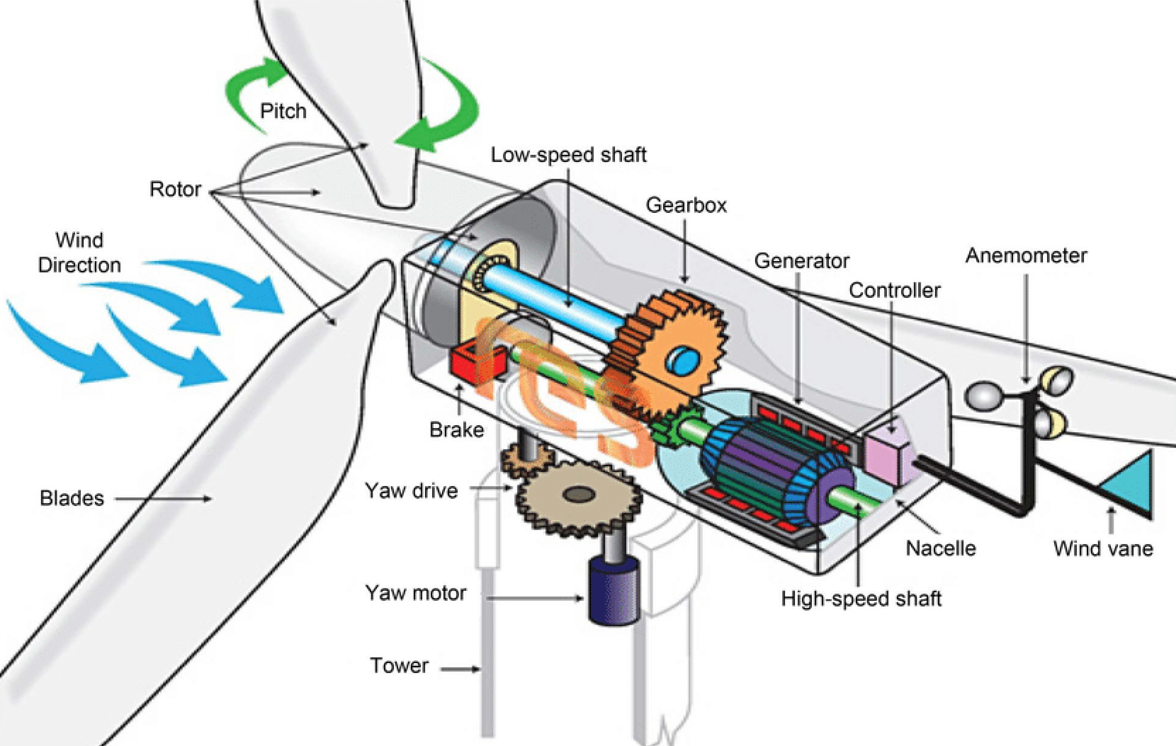
PROJECT EXAMPLE FROM A PREVIOUS YEAR
Example of decomposition: the offshore wind turbine
IPM
Álvaro Figueira · DCC / FCUP · 2026/27
M03 · 29

Slide 30
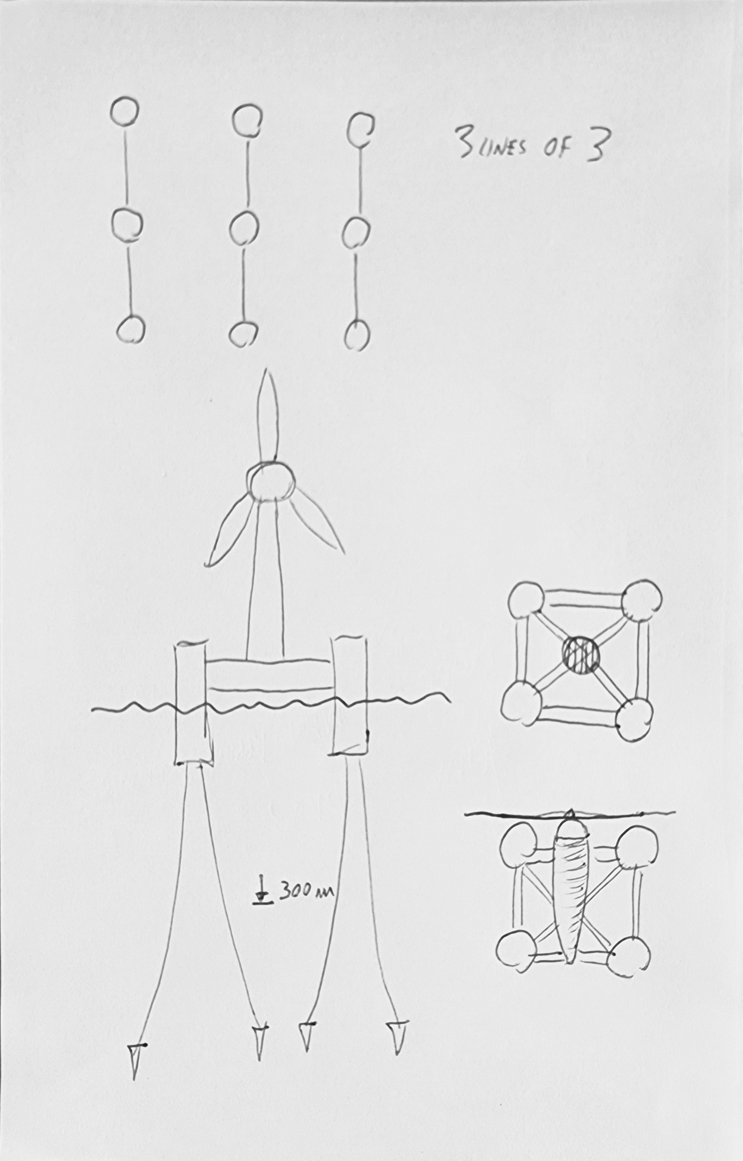
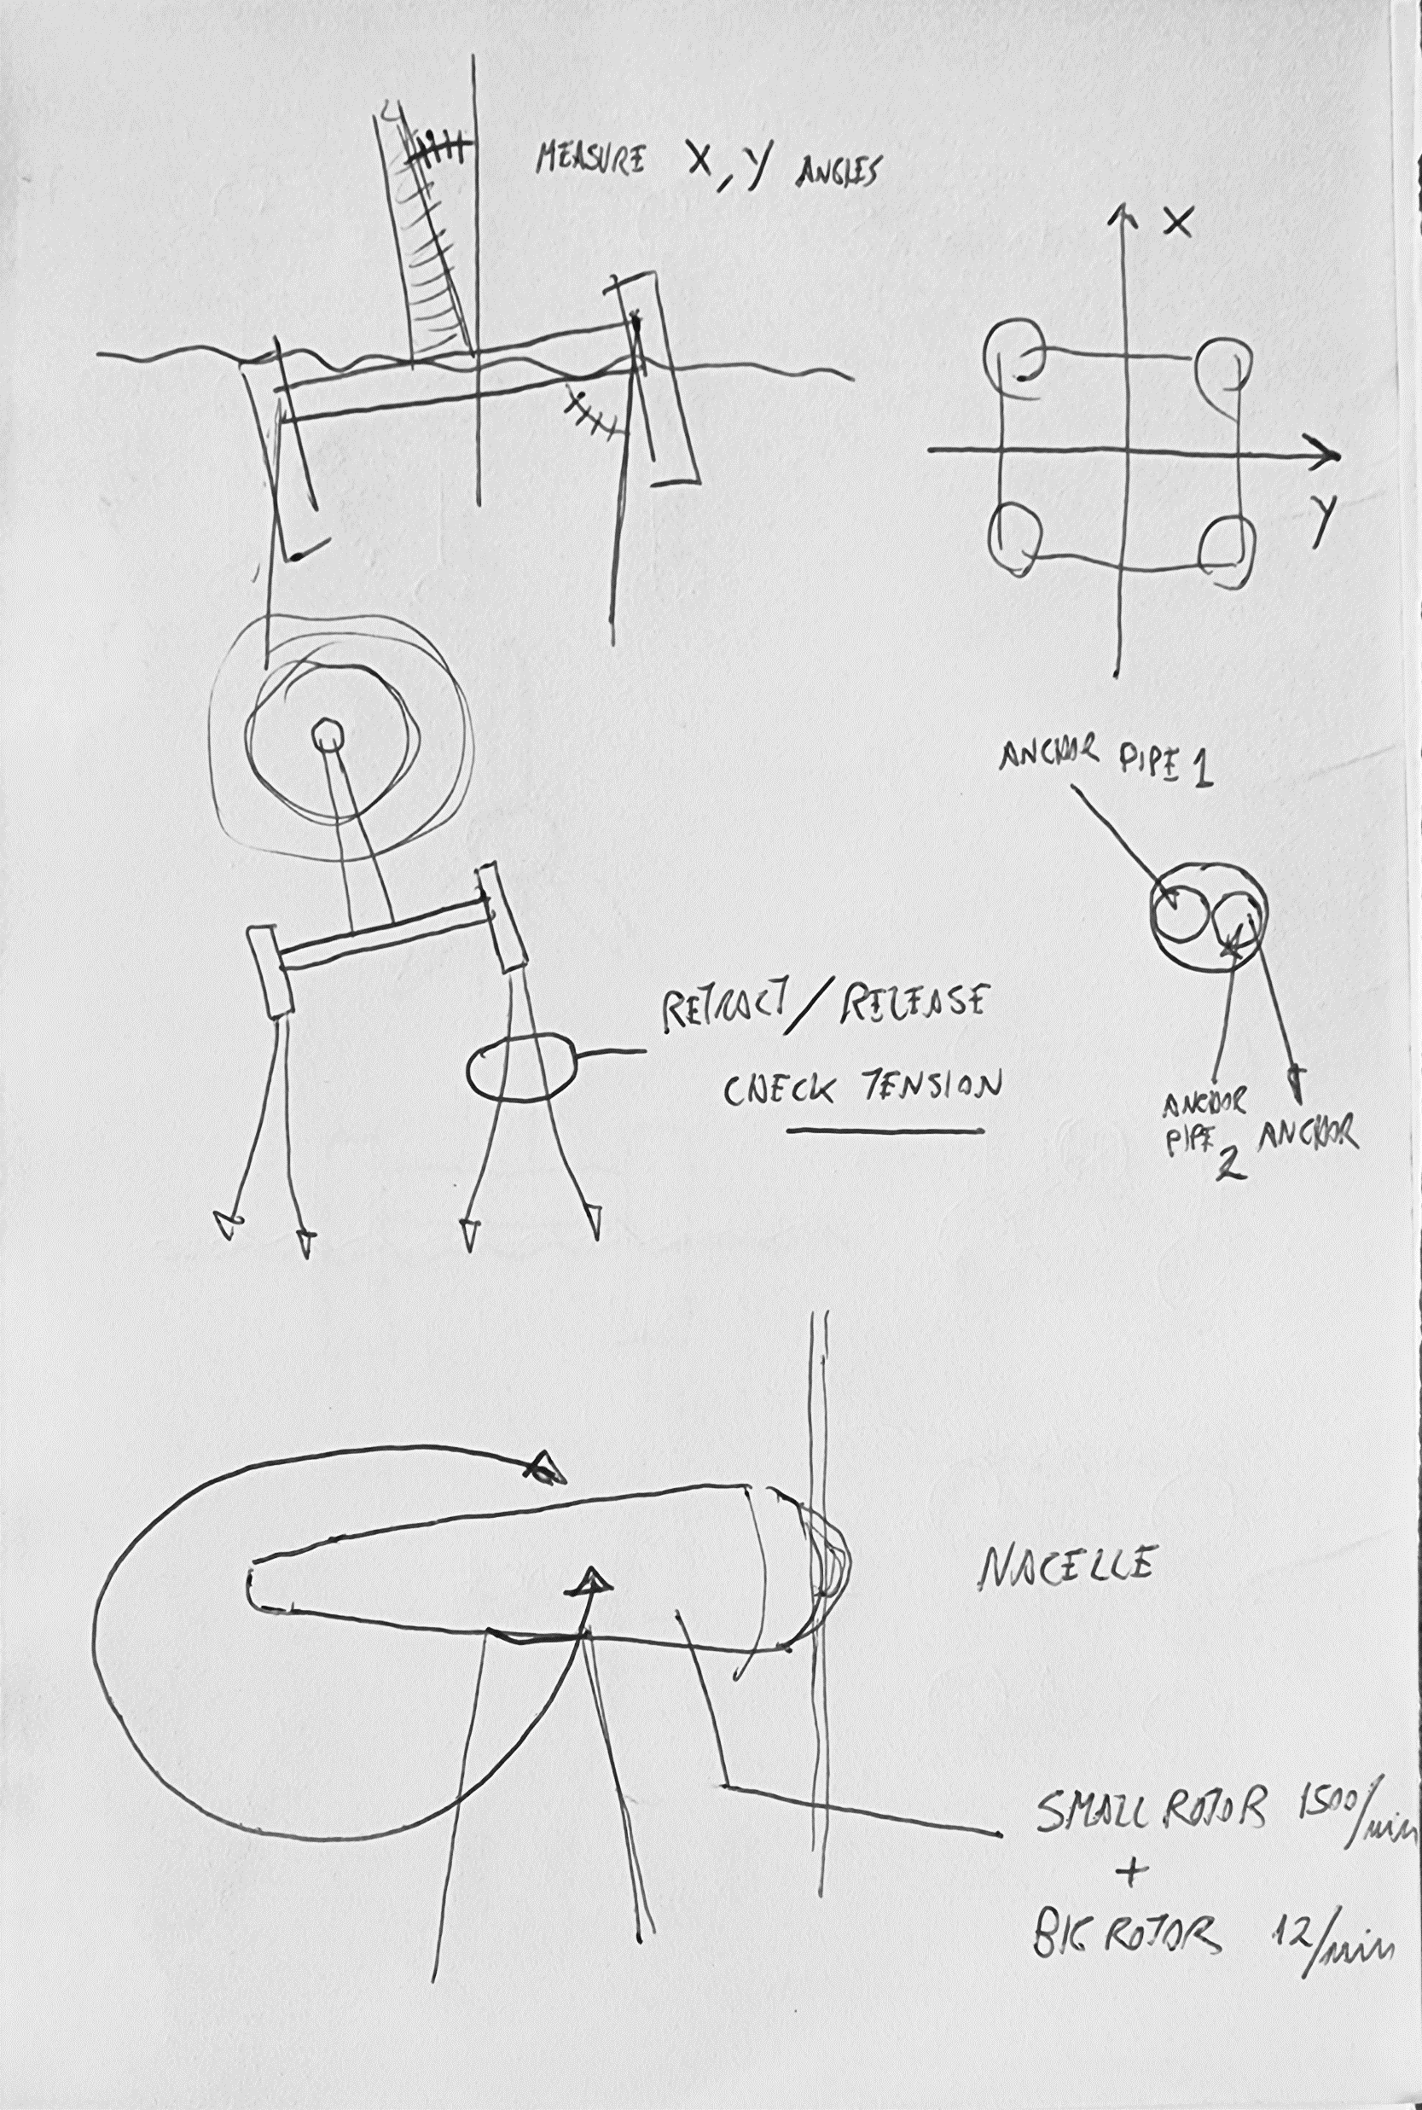
From the problem to the first sketches
IPM
Álvaro Figueira · DCC / FCUP · 2026/27
M03 · 30

Slide 31
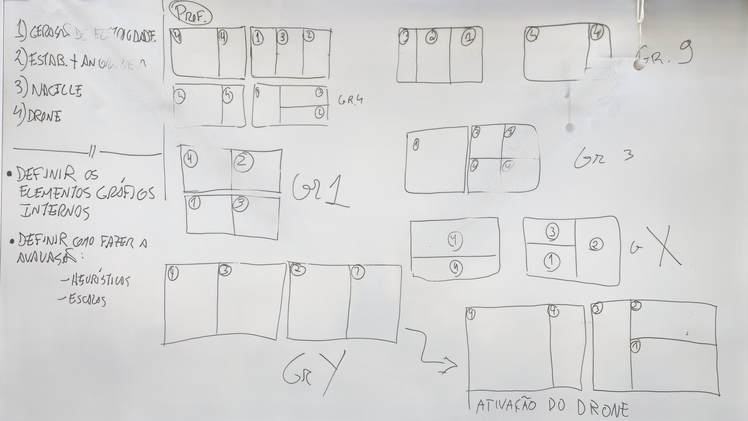
Whiteboard, previous year
IPM
Álvaro Figueira · DCC / FCUP · 2026/27
M03 · 31

Slide 32





Problemas
1
2
3
4
5
Monitorizar a geração de eletricidade
Lançar âncoras e recolher âncoras
Estabilizar a plataforma com as âncoras
Gerir a Nacelle (orientação de pás e cabeça)
Gestão do drone
IPM
Álvaro Figueira · DCC / FCUP · 2026/27
M03 · 32

Slide 33
Problemas (+ detalhe)
Monitorizar a geração de eletricidade
  Tentar mostrar tudo o que é possível para melhor deteção de problemas
Lançar âncoras e recolher âncoras
  É preciso saber a profundidade? Algum controlo extra? Poderão ficar presas?
Estabilizar a plataforma com as âncoras
  De que forma? Como gerir a pressão?
Gerir a Nacelle (orientação de pás e cabeça)
  A orientação das pás e da cabeça com controlos separados
Gestão do drone
  Descolar/retornar, missão normal, controlo manual
IPM
Álvaro Figueira · DCC / FCUP · 2026/27
M03 · 33

Slide 34
Problemas (+++ detalhe): estabilizar a plataforma com as âncoras
Como representar a estabilização graficamente em 2D?
  Como representar a estabilidade em 2 eixos?
  A partir de que ponto há ameaça à estabilidade?
Como gerir a estabilidade com as âncoras?
  Como monitorizar as 8 ou 6 âncoras?
  A profundidade deve entrar nesta equação de que forma?
  Que tipo de ações podem ser realizadas? Libertar/recolher cabo? Soltar cabo?
  Como resolver problemas de âncoras presas?
Qual a relação entre o controlo automático e o manual?
IPM
Álvaro Figueira · DCC / FCUP · 2026/27
M03 · 34

Slide 35
In the next practical lecture what will you do first?
IPM
Álvaro Figueira · DCC / FCUP · 2026/27
M03 · 35

