Slide 1
Mockup 1º Trabalho Prático HTML e CSS
Sistema de Informação Empresariais – 2020/2021
Gonçalo Martins (up201604140)

Slide 2
1ª Versão do Mockup

Slide 3

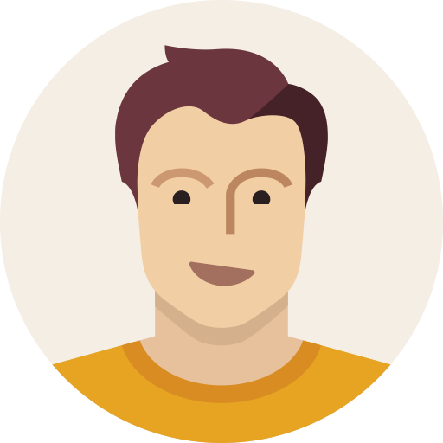
ABOUT ME EDUCATION SKILLS LANGUAGES PROJECTS HOBBIES DOWNLOADS CONTACT
ABOUT ME
GONÇALO MARTINS
Electrical & Computer Engineering
ABOUT ME
I am currently a student in the last year of the BSC + MSc in Electrical and Computer Engineering at FEUP, Porto, Portugal
My major is Automation and my specialization is Robotics and Systems
I am a hard working and commited person who is always ready to learn new things and expand my knowledge
My areas of interest are:
Autonomous Navigation
Industrial Automation
Smart Systems
Robotics and Programming

Slide 4
ABOUT ME EDUCATION SKILLS LANGUAGES PROJECTS HOBBIES DOWNLOADS CONTACT
ABOUT ME
cover {Padding-top: 50px;
Padding-bottom: 50px;
Line-height: 5px;}
avatar{width 120px;
height: 120px;
border-radius: 50%;}
Cover h1{font: 40px Overpass;}
GONÇALO MARTINS
font: 20px Lato;
color: rgb(191,191,191);
Electrical & Computer Engineering
body{
background-color: #231E1B;
text-allign: center;
font 18px “Lato”, sans-serif;
}
ABOUT ME
I am currently a student in the last year of the BSC + MSc in Electrical and Computer Engineering at FEUP, Porto, Portugal
My major is Automation and my specialization is Robotics and Systems
I am a hard working and commited person who is always ready to learn new things and expand my knowledge
My areas of interest are:
Autonomous Navigation
Industrial Automation
Smart Systems
Robotics and Programming

Slide 5
ABOUT ME EDUCATION SKILLS LANGUAGES PROJECTS HOBBIES DOWNLOADS CONTACT
ABOUT ME
box{margin: 25px 50px;
padding: 10px}
GONÇALO MARTINS
box h1{
font 32px “Exo 2”
Color: #00B0F0;
Margin-bottom: 30px;}
Electrical & Computer Engineering
25px
ABOUT ME
50px
30px
I am currently a student in the last year of the BSC + MSc in Electrical and Computer Engineering at FEUP, Porto, Portugal
My major is Automation and my specialization is Robotics and Systems
I am a hard working and commited person who is always ready to learn new things and expand my knowledge
My areas of interest are:
Autonomous Navigation
Industrial Automation
Smart Systems
Robotics and Programming
50px
25px

Slide 6
ABOUT ME EDUCATION SKILLS LANGUAGES PROJECTS HOBBIES DOWNLOADS CONTACT
ABOUT ME
SKILLS
Navbar a:hover{
background-color: grey
Navbar .current{
background-color: 00B0F0;}
a:link{texto-decoration: none;
color: #90E0EF;}
GONÇALO MARTINS
navbar{
Font: 20px “Lato”;
color: white,
background-color: black;
}
a:hover{color: #00B0F0;}
Electrical & Computer Engineering
ABOUT ME
I am currently a student in the last year of the BSC + MSc in Electrical and Computer Engineering at FEUP, Porto, Portugal
My major is Automation and my specialization is Robotics and Systems
I am a hard working and commited person who is always ready to learn new things and expand my knowledge
My areas of interest are:
Autonomous Navigation
Industrial Automation
Smart Systems
Robotics and Programming

Slide 7



ABOUT ME EDUCATION SKILLS LANGUAGES PROJECTS HOBBIES CONTACT
EDUCATION
ABOUT ME EDUCATION SKILLS LANGUAGES PROJECTS HOBBIES DOWNLOADS CONTACT
EDUCATION
EDUCATION
Filipa de Vilhena High School
(2013– 2016)
High School
Course: Sciences and Technology
Faculty of Engineering of the University of Porto
(2016 – present)
BSc + MSc in Electrical and Computer Engineering
Major: Automation
Specialization: Robotics and Systems
Budapest University of Technology and Economics
(2019 – 2020)
MSc in Electrical Engineering and Computer Science
Semester abroad by the ERASMUS+ program

Slide 8
ABOUT ME EDUCATION SKILLS LANGUAGES PROJECTS HOBBIES CONTACT
EDUCATION
ABOUT ME EDUCATION SKILLS LANGUAGES PROJECTS HOBBIES DOWNLOADS CONTACT
EDUCATION
navbar
box
EDUCATION
Box h1
ASPECTOS EM COMUM
Filipa de Vilhena High School
(2013– 2016)
High School
Course: Sciences and Technology
Faculty of Engineering of the University of Porto
(2016 – present)
BSc + MSc in Electrical and Computer Engineering
Major: Automation
Specialization: Robotics and Systems
Budapest University of Technology and Economics
(2019 – 2020)
MSc in Electrical Engineering and Computer Science
Semester abroad by the ERASMUS+ program

Slide 9
ABOUT ME EDUCATION SKILLS LANGUAGES PROJECTS HOBBIES CONTACT
EDUCATION
ABOUT ME EDUCATION SKILLS LANGUAGES PROJECTS HOBBIES DOWNLOADS CONTACT
EDUCATION
.TextImgBox{
Padding: 10px;
margin 10px 150px 30px;}
box
EDUCATION
Filipa de Vilhena High School
(2013– 2016)
High School
Course: Sciences and Technology
150px
150px
Faculty of Engineering of the University of Porto
(2016 – present)
BSc + MSc in Electrical and Computer Engineering
Major: Automation
Specialization: Robotics and Systems
Budapest University of Technology and Economics
(2019 – 2020)
MSc in Electrical Engineering and Computer Science
Semester abroad by the ERASMUS+ program
TextImgBox .text{
display: inline-block;
width: 50%
text-align: left;}
TextImgBox .image{
display: inline-block;
vertical-align: top;
width: 20%}

Slide 10
ABOUT ME EDUCATION SKILLS LANGUAGES PROJECTS HOBBIES CONTACT
EDUCATION
ABOUT ME EDUCATION SKILLS LANGUAGES PROJECTS HOBBIES DOWNLOADS CONTACT
EDUCATION
EDUCATION
h3{font: 24px “Overpass”}
100 x 100
Filipa de Vilhena High School
(2013– 2016)
High School
Course: Sciences and Technology
p.data{font: 16px “Lato”
Color: #BFBFBF}
100 x 100
Faculty of Engineering of the University of Porto
(2016 – present)
BSc + MSc in Electrical and Computer Engineering
Major: Automation
Specialization: Robotics and Systems
p{font: 18px “Lato”}
100 x 100
p.descricao{font: 16px “Lato”
color: #D9D9D9
margin-left: 40px}
Budapest University of Technology and Economics
(2019 – 2020)
MSc in Electrical Engineering and Computer Science
Semester abroad by the ERASMUS+ program

Slide 11



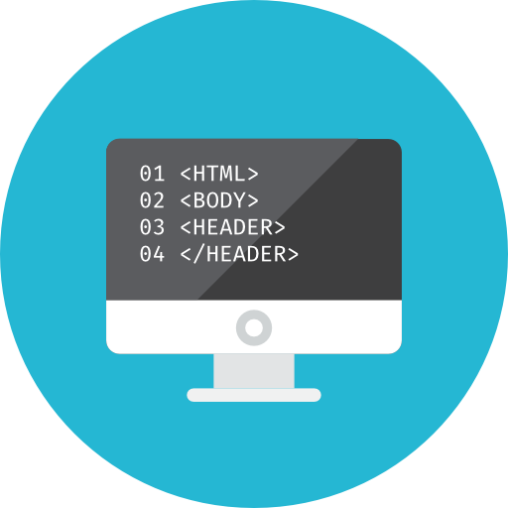
ABOUT ME EDUCATION SKILLS LANGUAGES PROJECTS HOBBIES CONTACT
ABOUT ME EDUCATION SKILLS LANGUAGES PROJECTS HOBBIES DOWNLOADS CONTACT
HOBBIES
HOBBIES
HOBBIES
Watch TVShows & Movies
Favourites TVShows: Friends, Breaking Bad, Prison Break
Favourite Movies: Die Hard, Avengers, Harry Potter
Sports
“The body achieves what the mind believes”
Weekly practising in the gym and also play regulary
Football and Padel
Travelling
Already did an Europe Interrail and a trip to the Balkans
Next plans: South America and Asia
Programming
Programming can be fun, usefull and great way
to spend time.
I usally do some small programs to practise and learn
new languages

Slide 12
ABOUT ME EDUCATION SKILLS LANGUAGES PROJECTS HOBBIES CONTACT
ABOUT ME EDUCATION SKILLS LANGUAGES PROJECTS HOBBIES DOWNLOADS CONTACT
HOBBIES
HOBBIES
navbar
box
HOBBIES
Box h1
.TextImgBox
TextImgBox .text
Watch TVShows & Movies
Favourites TVShows: Friends, Breaking Bad, Prison Break
Favourite Movies: Die Hard, Avengers, Harry Potter
TextImgBox .image
Sports
“The body achieves what the mind believes”
Weekly practising in the gym and also play regulary
Football and Padel
p.descricao
Travelling
Already did an Europe Interrail and a trip to the Balkans
Next plans: South America and Asia
h3
ASPECTOS EM COMUM com “Education”
Programming
Programming can be fun, usefull and great way
to spend time.
I usally do some small programs to practise and learn
new languages

Slide 13
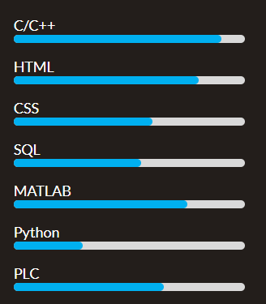
ABOUT ME EDUCATION SKILLS LANGUAGES PROJECTS HOBBIES CONTACT
ABOUT ME EDUCATION SKILLS LANGUAGES PROJECTS HOBBIES DOWNLOADS CONTACT
SKILLS
SKILLS
SKILLS
Technological
Soft Skills
Teamwork
Wilingness to learn
Problem Solving
Organization
Resilience
Active Listening
Self-Motivation

Slide 14
ABOUT ME EDUCATION SKILLS LANGUAGES PROJECTS HOBBIES CONTACT
ABOUT ME EDUCATION SKILLS LANGUAGES PROJECTS HOBBIES DOWNLOADS CONTACT
SKILLS
SKILLS
navbar
box
SKILLS
Box h1
ASPECTOS EM COMUM
Technological
Soft Skills
Teamwork
Wilingness to learn
Problem Solving
Organization
Resilience
Active Listening
Self-Motivation

Slide 15
ABOUT ME EDUCATION SKILLS LANGUAGES PROJECTS HOBBIES CONTACT
ABOUT ME EDUCATION SKILLS LANGUAGES PROJECTS HOBBIES DOWNLOADS CONTACT
box-parent{
display: flex;
margin 20px 50px;}
SKILLS
SKILLS
box-child{
display: 1;
text-allign:left;
margin-left: 25%}
SKILLS
20px
Technological
Soft Skills
Teamwork
Wilingness to learn
Problem Solving
Organization
Resilience
Active Listening
Self-Motivation
50px
50px
20px
20px

Slide 16




ABOUT ME EDUCATION SKILLS LANGUAGES PROJECTS HOBBIES CONTACT
LANGUAGES
ABOUT ME EDUCATION SKILLS LANGUAGES PROJECTS HOBBIES DOWNLOADS CONTACT
LANGUAGES
LANGUAGES
 | Portuguese | Native
 | English | Advanced
 | Spanish | Upper Intermediate
 | German | Elementary

Slide 17
ABOUT ME EDUCATION SKILLS LANGUAGES PROJECTS HOBBIES CONTACT
LANGUAGES
ABOUT ME EDUCATION SKILLS LANGUAGES PROJECTS HOBBIES DOWNLOADS CONTACT
LANGUAGES
navbar
box
LANGUAGES
Box h1
table{
border: 2px solid #00B0F0;
border-colapse: colapse;
table-layout: auto;
width: 40%;
margin 50px;
backgorund-color: #0D0D0D}
 | Portuguese | Native
 | English | Advanced
 | Spanish | Upper Intermediate
 | German | Elementary
tr{
text-align: center;
padding: 10px;
}
tr-nth-child(even){
backgorund-color: #262626
}

Slide 18
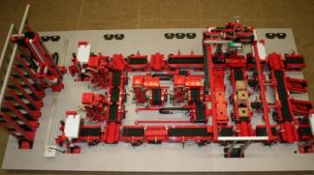
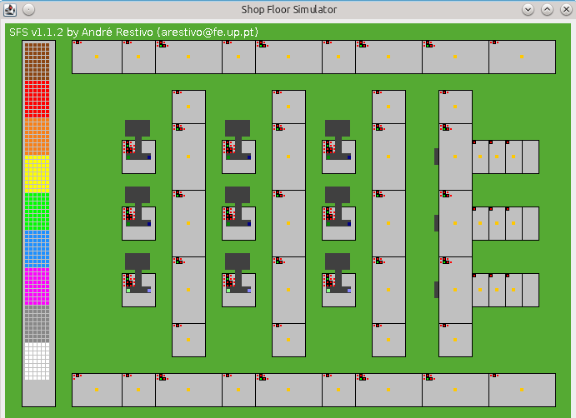

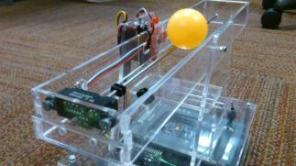
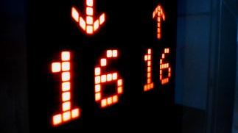
ABOUT ME EDUCATION SKILLS LANGUAGES PROJECTS HOBBIES CONTACT
ABOUT ME EDUCATION SKILLS LANGUAGES PROJECTS HOBBIES DOWNLOADS CONTACT
PROJECTS
PROJECTS
PROJECTS
Production line automation
MES platform development
Ball & Beam Controller
Elevator LED display with uC

Slide 19
ABOUT ME EDUCATION SKILLS LANGUAGES PROJECTS HOBBIES CONTACT
ABOUT ME EDUCATION SKILLS LANGUAGES PROJECTS HOBBIES DOWNLOADS CONTACT
PROJECTS
PROJECTS
PROJECTS
.figurebox{
display: flex;
flex-wrap: wrap;
justify-contente: center;}
figure{
Padding: 4px;
margin: 10px 80px;
}
Production line automation
MES platform development
figcaption{
Backgorund-color: black;
}
Ball & Beam Controller
Elevator LED display with uC

Slide 20



ABOUT ME EDUCATION SKILLS LANGUAGES PROJECTS HOBBIES CONTACT
ABOUT ME EDUCATION SKILLS LANGUAGES PROJECTS HOBBIES DOWNLOADS CONTACT
LANGUAGES
DOWNLOADS
DOWNLOADS

Slide 21
ABOUT ME EDUCATION SKILLS LANGUAGES PROJECTS HOBBIES CONTACT
DOWNLOADS
ABOUT ME EDUCATION SKILLS LANGUAGES PROJECTS HOBBIES DOWNLOADS CONTACT
ABOUT ME EDUCATION SKILLS LANGUAGES PROJECTS HOBBIES DOWNLOADS CONTACT
LANGUAGES
DOWNLOADS
navbar
box
DOWNLOADS
Box h1
ASPECTOS EM COMUM

Slide 22
ABOUT ME EDUCATION SKILLS LANGUAGES PROJECTS HOBBIES CONTACT
ABOUT ME EDUCATION SKILLS LANGUAGES PROJECTS HOBBIES DOWNLOADS CONTACT
LANGUAGES
DOWNLOADS
DOWNLOADS
buttonbox
200x200 px
200x200 px
200x200 px
80x80 px
80x80 px
80x80 px

Slide 23


ABOUT ME EDUCATION SKILLS LANGUAGES PROJECTS HOBBIES CONTACT
CONTACT
ABOUT ME EDUCATION SKILLS LANGUAGES PROJECTS HOBBIES DOWNLOADS CONTACT
CONTACT
footer
CONTACT
Copyright © Gonçalo Martins 2020

Slide 24
2ª Versão do Mockup

Slide 25
Informações:
Link: https://paginas.fe.up.pt/~up201604140/SIEM/aboutme.html
Browsers preferenciais: Google Chrome, Mozila Firefox
Resolução do ecrã na implementação: 1366px x 768px
Responsividade incluída

Slide 26
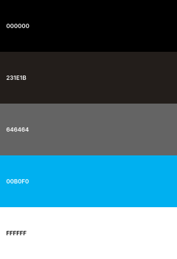
Color Palette
(aka black)
Navbar | Footer | Project
(aka lightblack)
Background
(aka gray)
Navbar hover | Botão Hover | Recipiente Skill Bar | Download button
(aka blue)
Elemento Atual Navbar| Botão| Titulo h1 | Border
(aka white)
Texto

Slide 27
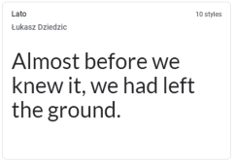
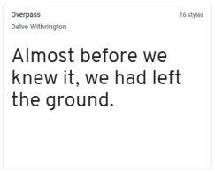
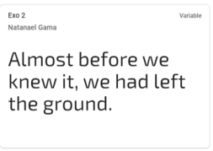
Font Palette
body:
font-size: 18px;
color: white
h2:
font-size: 24px;
color: white;
h1:
font-size: 32px;
color: blue;

Slide 28
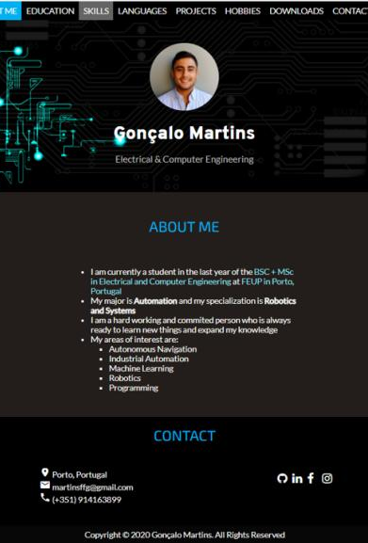
About me

Slide 29
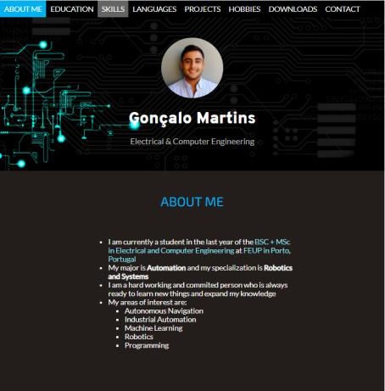
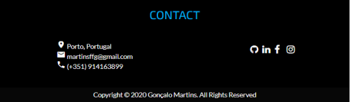
Navbar active:
background-color: blue
Navbar:
background-color: black
font: 18px "Lato"
color: white
padding: 10px
Navbar hover:
background-color: gray
cover h2:
font-size: 32px
#cover h1:
font: 40px "Overpass"
color: white
avatar:
width: 150px
height: 150px
border-radius:50%
h1
A: hover:
color: blue;
body

Slide 30
Navbar
cover:
backgorund-size:cover
text-align: center
padding: 50px 20px
main:
margin: 25px 50px
padding: 10px
text-align: center
footer:
background-color: black;
Footer box:
Display: flex:
justify-content: space-around

Slide 31
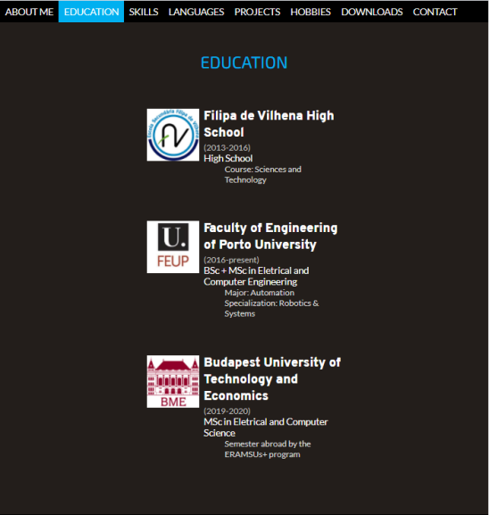
Education

Slide 32
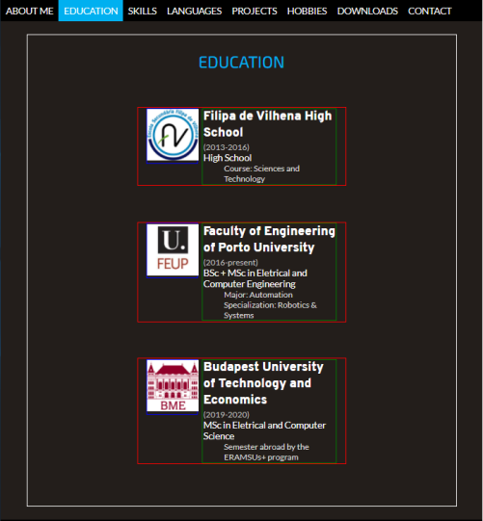
card:
width: 50%
margin: 70px auto
main
card image:
width: 25%
margin-right: 5px
display:inline-block
vertical-align: top
card text:
width: 65%
display:inline-block
vertical-align: top
text-align: left
h2
descricao:
Font-size:16px
color: lightgray
margin-left: 40px (tab)
card iamge img:
width: 100px
height: 100px
data:
color: gray
font-size: 16px

Slide 33
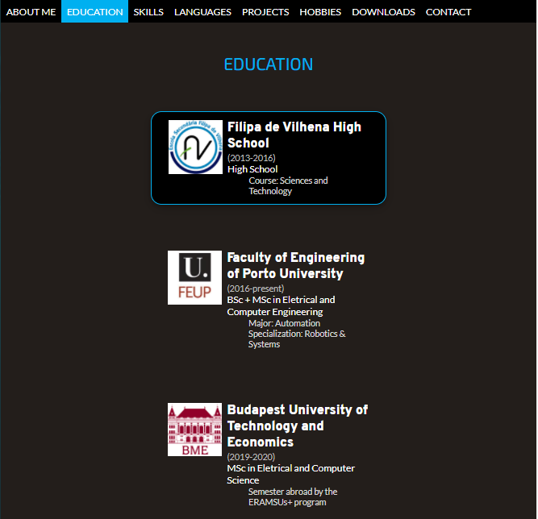
card:hover:
backgorund-color: black
border: 2px solid blue
border-radius: 20px
box-shadow:

Slide 34
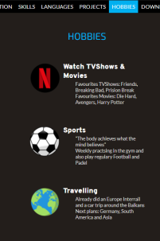
Card image
card
Card text
h2
descricao
Reutilização noutras páginas (Hobbies)

Slide 35
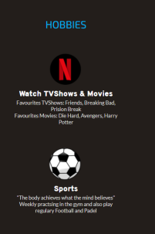
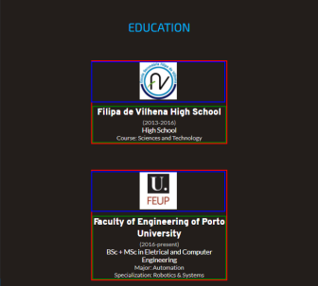
@media (max-width: 900px)
card:
display: flex
align-items: center
justify-content: center
flex-direction: column
text:
width: 100%
text-align: center
image:
width: 100%
Responsividade

Slide 36
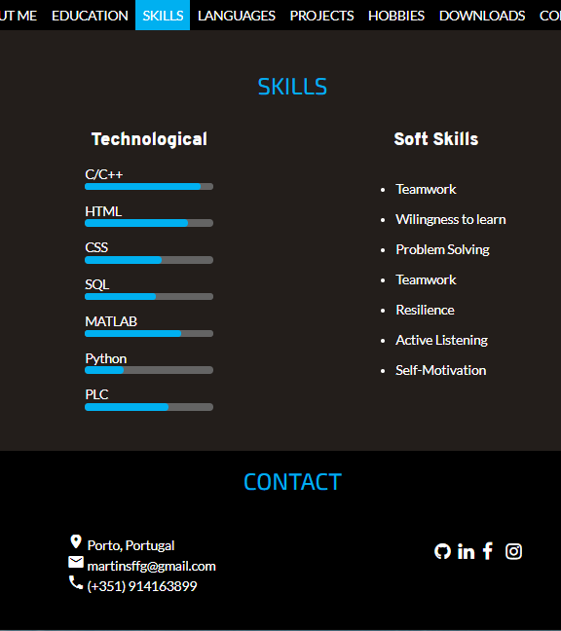
Skills

Slide 37
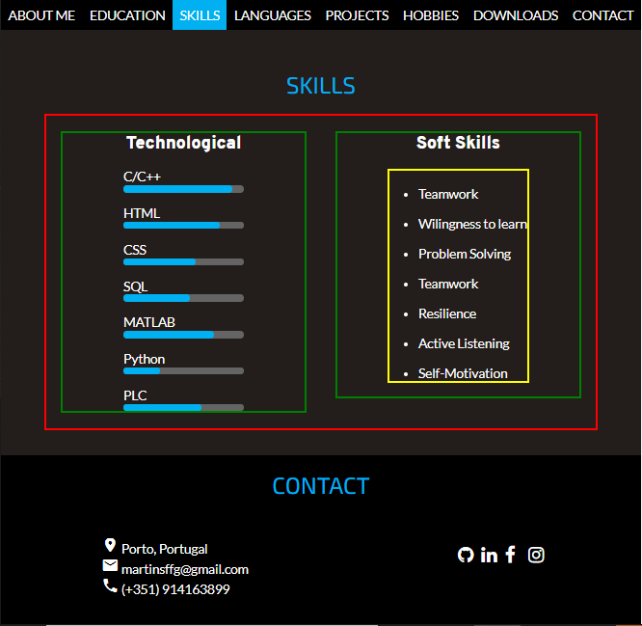
flex-container:
margin: 0 auto
display:flex
flex-wrap: wrap
align-items: flex-start
flex-child:
flex:1
margin: 20px
soft ul:
display: inline-block
text-align: left
skills:
backgorund-color: blue
padding: 5px
border-radious: 5px
bar:
backgorund-color: gray
widht: 50%
border-radious: 5px
margin-left: 25%

Slide 38
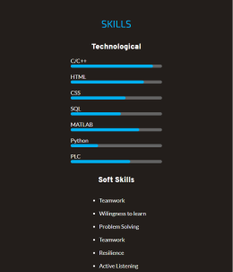
@media (max-width: 800px)
flex-child:
flex: 100%
Responsividade

Slide 39
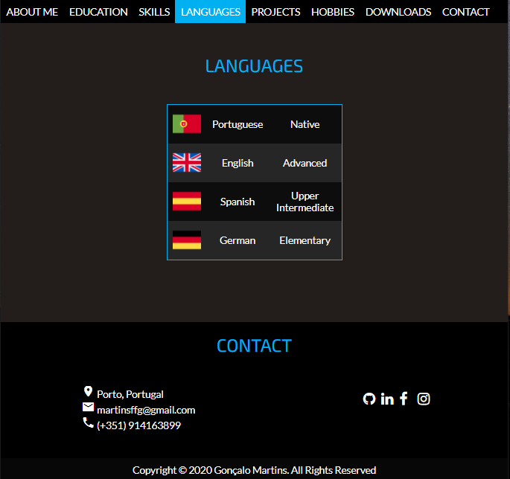
Languages

Slide 40
table:
background-color: #0D0D0D
border: 2px blue
width: 40%
border-colapse: colapse
td:
text-align: center
padding: 10px
tr:nth-child(even):
background-color: #262626

Slide 41
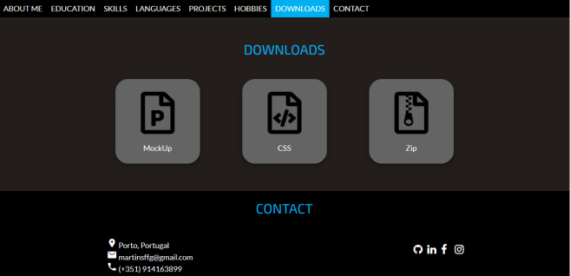
Downloads

Slide 42
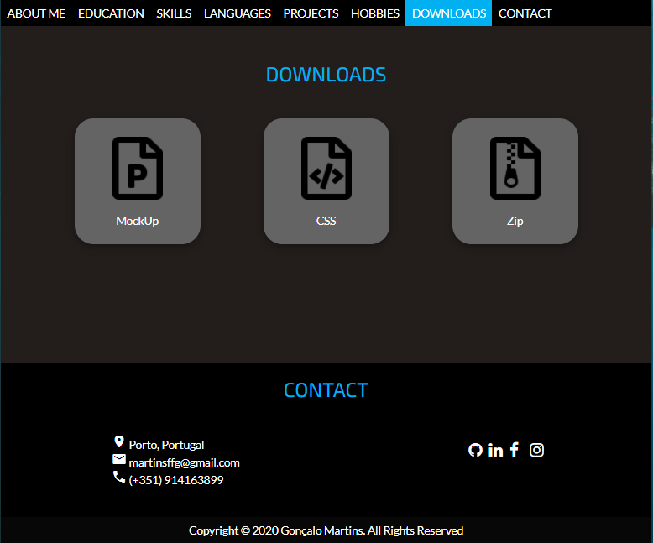
iconbox:
display: block
justify-content: center
align-items: center
iconbox:
height: 200px
width: 200px
border-radius: 30px
background-color: gray
box-shadow: …
margin: 30px 50px
iconbox img:hover:
position: relative;
top: -5px
iconbox img:
height: 100px
width: 80px

Slide 43
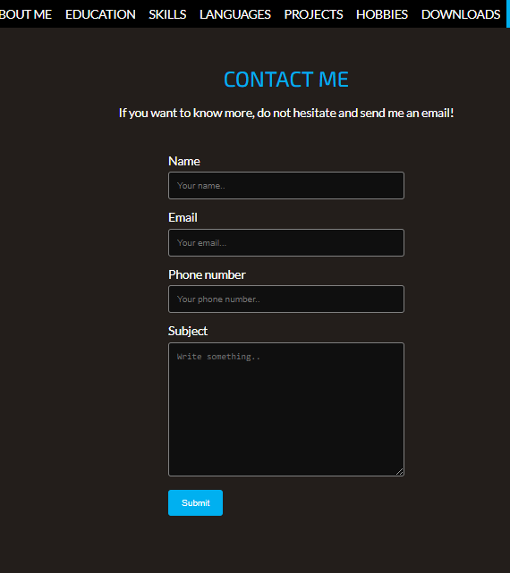
Contact

Slide 44
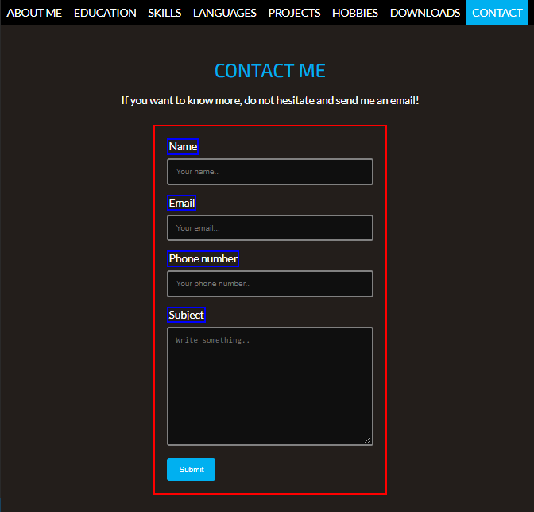
contact-container:
width: 50%
margin: 30px auto
padding: 20px
contact-container:
display: flex
justify-contente: center
input[type=text], select, textarea:
background-color: rgb(15,15,15)
color: white
border: 3px gray
border-radius: 4px
width: 100%
padding: 12px
label:
float: left
input[type=text], select, textarea:
resize: vertical
box-sizing: border-box
input[type=submit]:
background-color: blue
color: white
border: none
padding 12px 20px
input[type=submit]:
float: left
cursor: pointer
hover:
background-color: gray

Slide 45
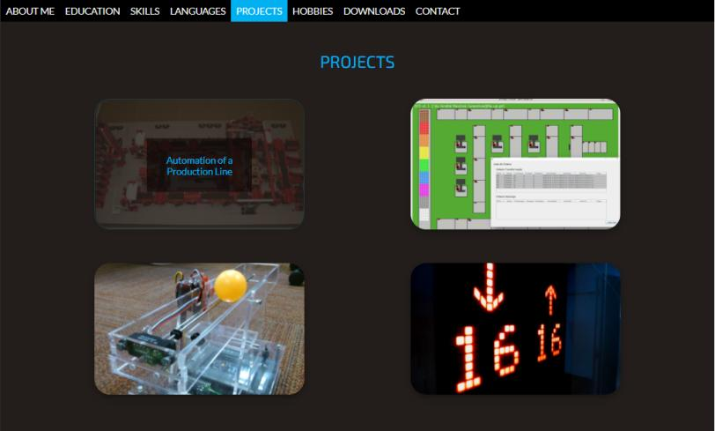
Projects

Slide 46
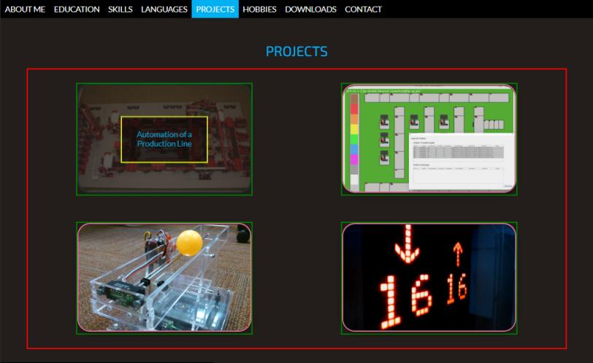
gallery:
display: flex
flex-wrap: wrap
flex-direction: row
align-items: center
justify-content: center
overlay:
position: absolute
Top: 50%
left: 50%
transform: translate(-50%,-50%)
padding: 30px
opacity: 0
hover:
opacity: 1
single-img:
margin: 30px 101px
position: relative
single-img img:
object-fit: cover
box-shadow: ..
opacity: 1
hover:
opacity: 0.2
border: 2px blue

Slide 47
overlay:
background-color: rgba(0,0,0,0.5)
single-img img:
width: 400px
height: 250px

Slide 48
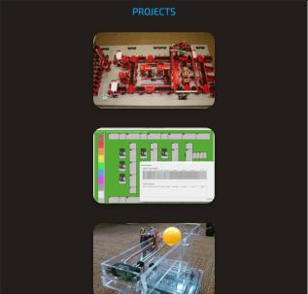
Responsividade

Slide 49
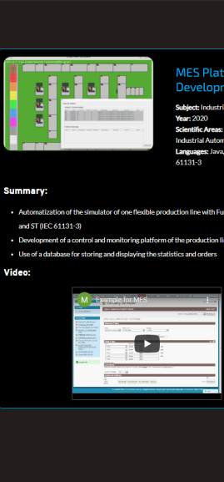
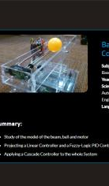
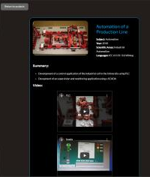
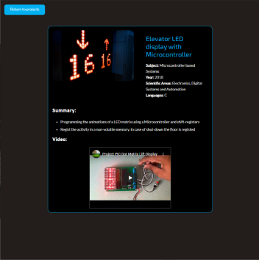
Layout de cada descrição do projeto

Slide 50
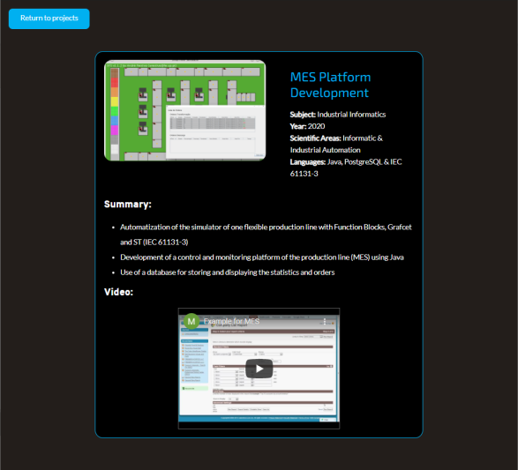
button:
background-color: blue
color: white
width: 200px
height: 50px
border-radius: 10px
margin-top-left: 20px
padding: 12px 20px
float: left;
hover:
background-color: gray
h1
h3

Slide 51
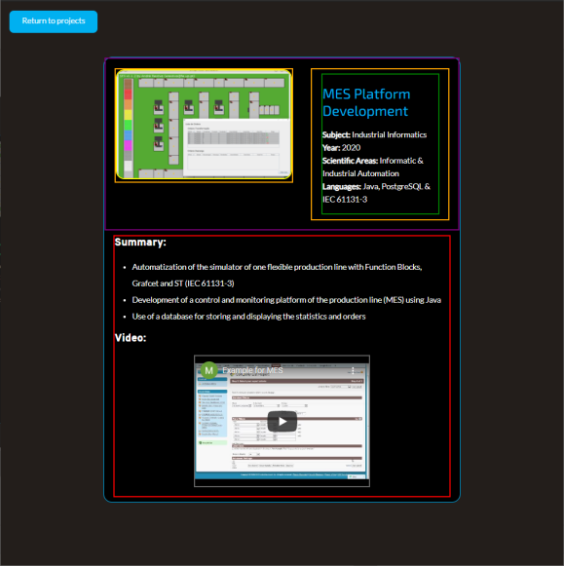
project:
background-color: black
border: 2px blue
width: 70%
margin: 20px auto
flex-container
flex-child
project-image:
width: 400px
height: 250px
border-radius: 20px
project-label:
yext-align: left
line-height: 0.8cm
margin: 10px 20px
iframe:
width: 400px
height: 300px
max-widht: 100%
border: 1px solid gray
display: block
margin: 2px auto

Slide 52
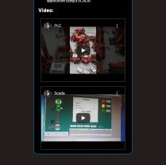
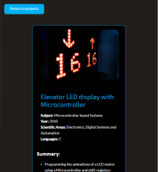
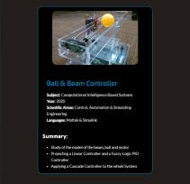
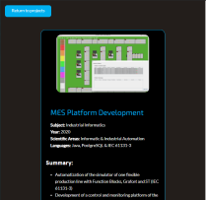
Responsividade

