Slide 1
Mockup 1º Trabalho Prático HTML e CSS
Sistema de Informação Empresariais – 2020/2021
Gonçalo Martins (up201604140)

Slide 2
Informações:
Link: https://paginas.fe.up.pt/~up201604140/SIEM/aboutme.html
Browsers preferenciais: Google Chrome, Mozila Firefox
Resolução do ecrã na implementação: 1366px x 768px
Responsividade incluída

Slide 3
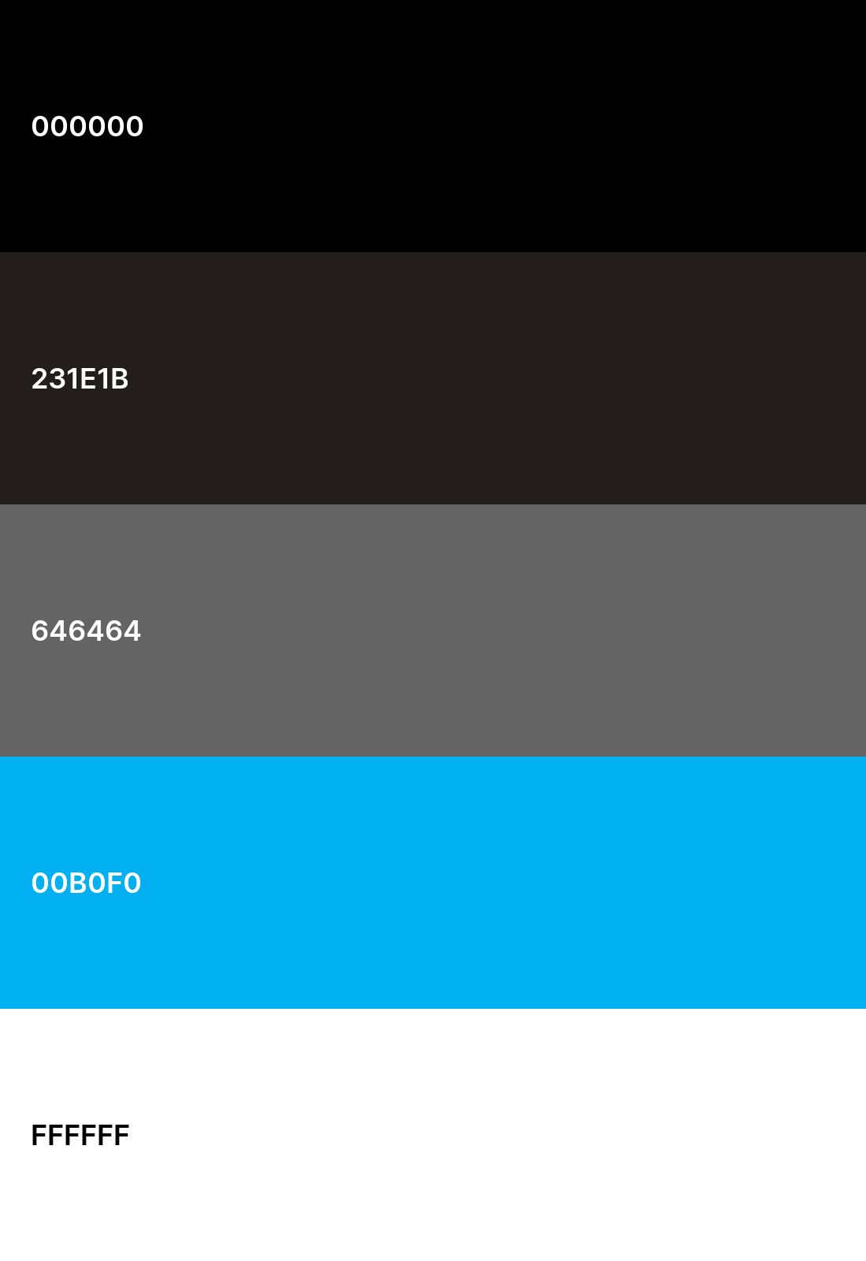
Color Palette
(aka black)
Navbar | Footer | Project
(aka lightblack)
Background
(aka gray)
Navbar hover | Botão Hover | Recipiente Skill Bar | Download button
(aka blue)
Elemento Atual Navbar| Botão| Titulo h1 | Border
(aka white)
Texto

Slide 4
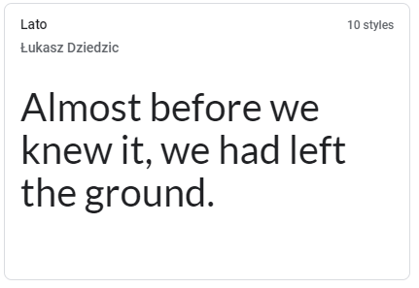
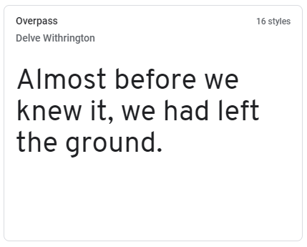
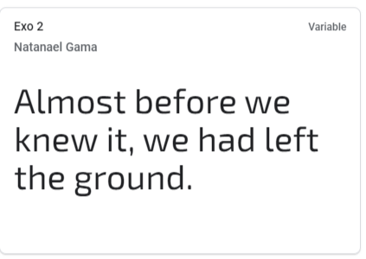
Font Palette
body:
font-size: 18px;
color: white
h2:
font-size: 24px;
color: white;
h1:
font-size: 32px;
color: blue;

Slide 5
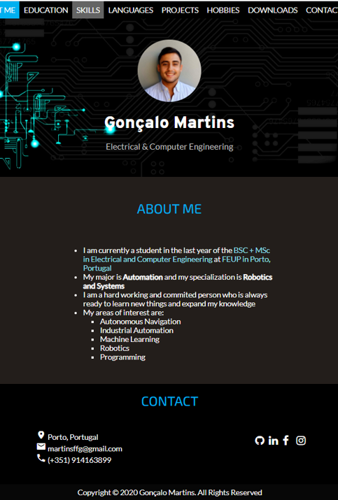
About me

Slide 6
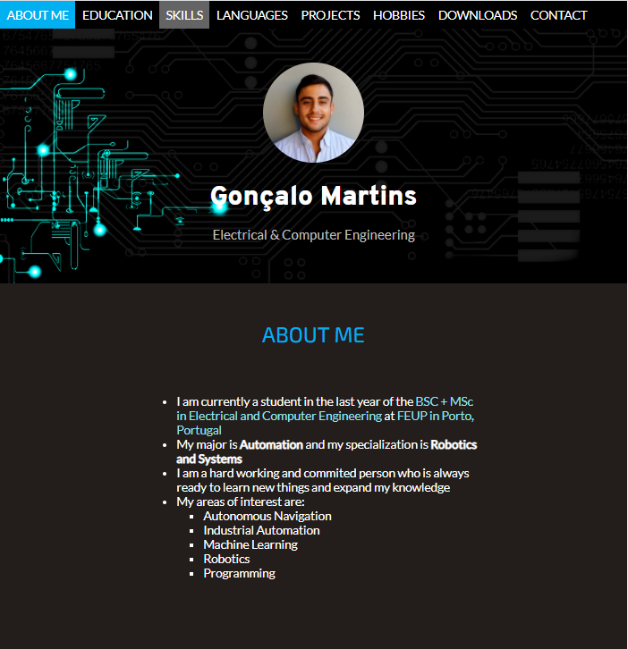
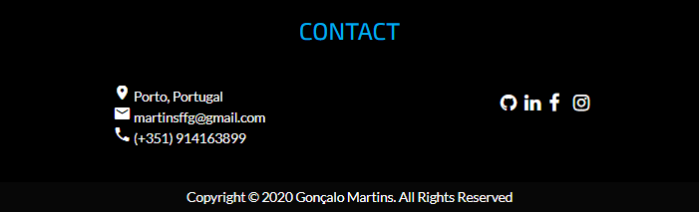

Navbar active:
background-color: blue
Navbar:
background-color: black
font: 18px "Lato"
color: white
padding: 10px
Navbar hover:
background-color: gray
cover h2:
font-size: 32px
#cover h1:
font: 40px "Overpass"
color: white
avatar:
width: 150px
height: 150px
border-radius:50%
h1
A: hover:
color: blue;
body

Slide 7
Navbar
cover:
backgorund-size:cover
text-align: center
padding: 50px 20px
main:
margin: 25px 50px
padding: 10px
text-align: center
footer:
background-color: black;
Footer box:
Display: flex:
justify-content: space-around

Slide 8
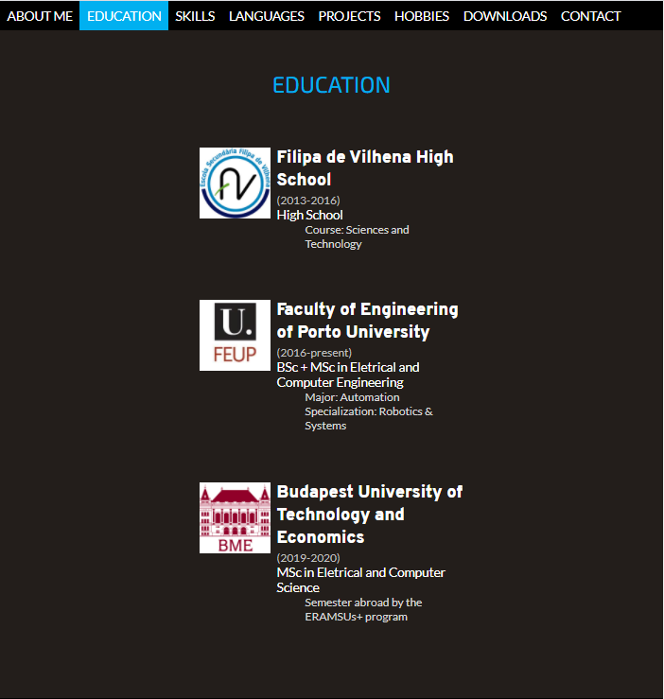
Education

Slide 9
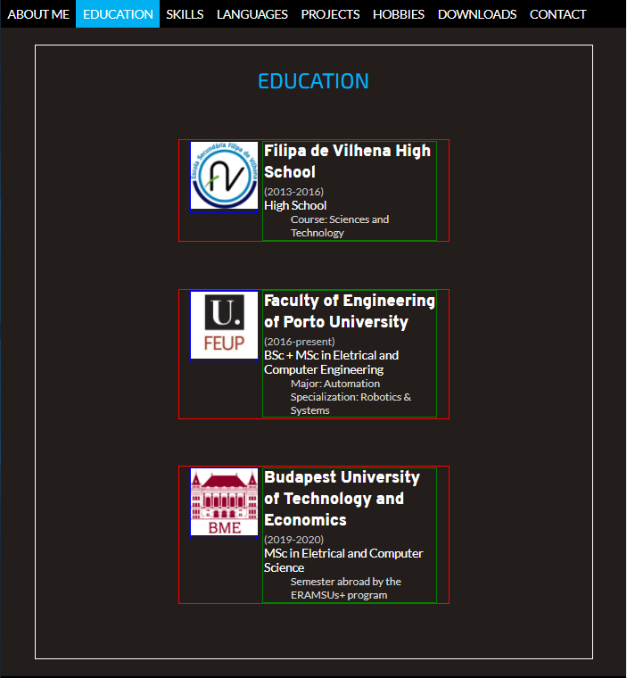
card:
width: 50%
margin: 70px auto
main
card image:
width: 25%
margin-right: 5px
display:inline-block
vertical-align: top
card text:
width: 65%
display:inline-block
vertical-align: top
text-align: left
h2
descricao:
Font-size:16px
color: lightgray
margin-left: 40px (tab)
card iamge img:
width: 100px
height: 100px
data:
color: gray
font-size: 16px

Slide 10
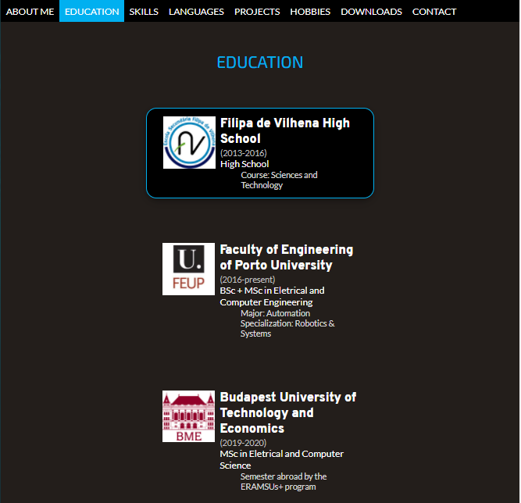
card:hover:
backgorund-color: black
border: 2px solid blue
border-radius: 20px
box-shadow:

Slide 11
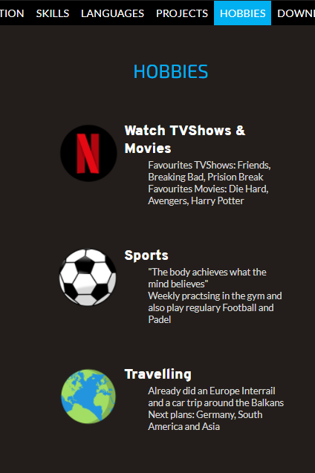
Card image
card
Card text
h2
descricao
Reutilização noutras páginas (Hobbies)

Slide 12
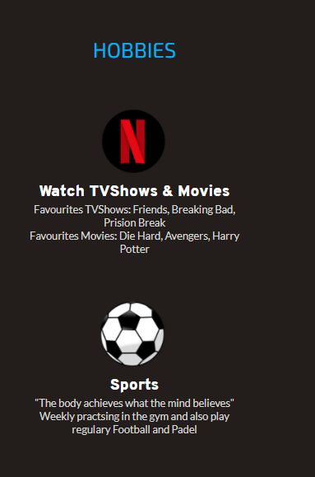
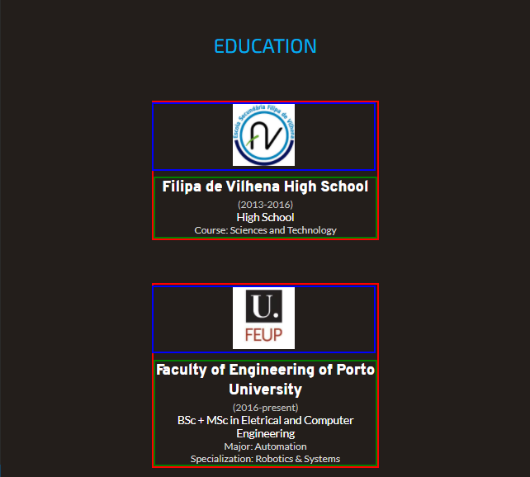
@media (max-width: 900px)
card:
display: flex
align-items: center
justify-content: center
flex-direction: column
text:
width: 100%
text-align: center
image:
width: 100%
Responsividade

Slide 13
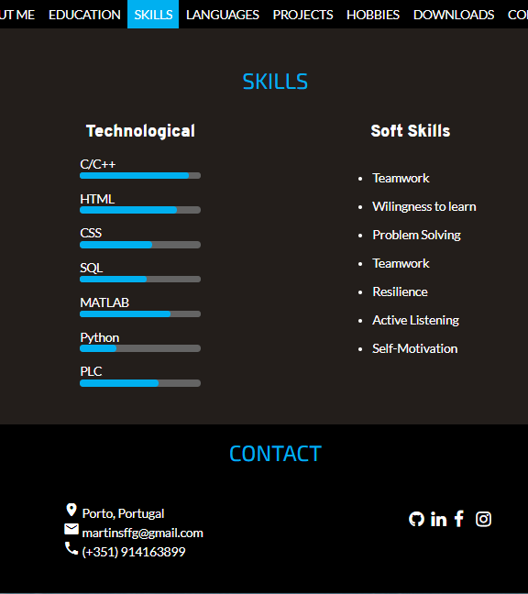
Skills

Slide 14
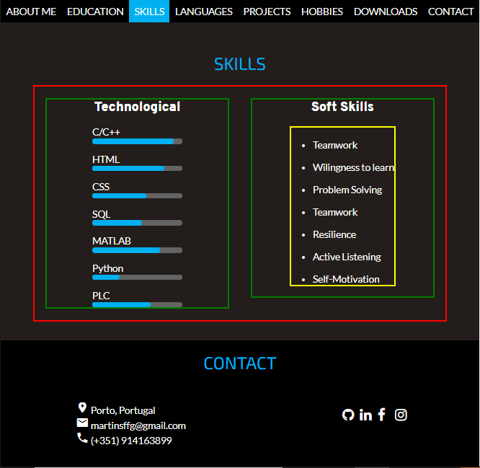
flex-container:
margin: 0 auto
display:flex
flex-wrap: wrap
align-items: flex-start
flex-child:
flex:1
margin: 20px
soft ul:
display: inline-block
text-align: left
skills:
backgorund-color: blue
padding: 5px
border-radious: 5px
bar:
backgorund-color: gray
widht: 50%
border-radious: 5px
margin-left: 25%

Slide 15
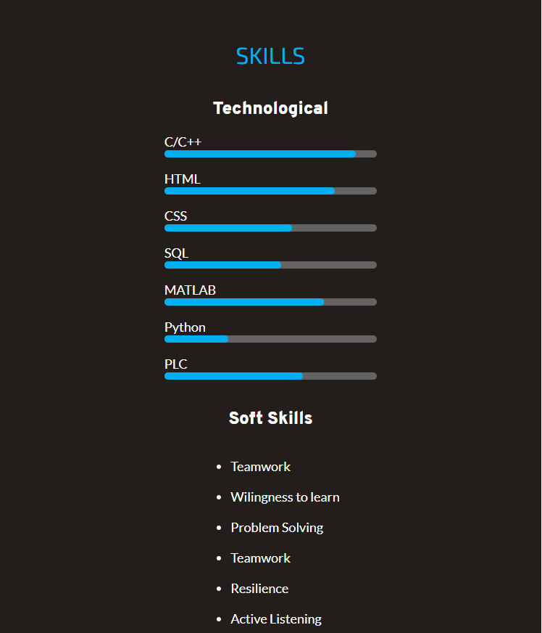
@media (max-width: 800px)
flex-child:
flex: 100%
Responsividade

Slide 16
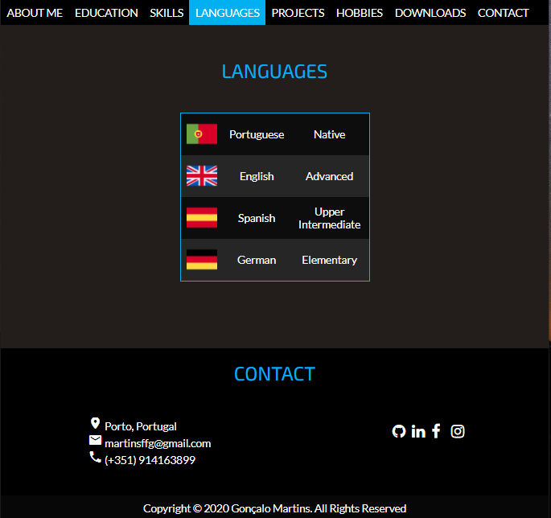
Languages

Slide 17
table:
background-color: #0D0D0D
border: 2px blue
width: 40%
border-colapse: colapse
td:
text-align: center
padding: 10px
tr:nth-child(even):
background-color: #262626

Slide 18
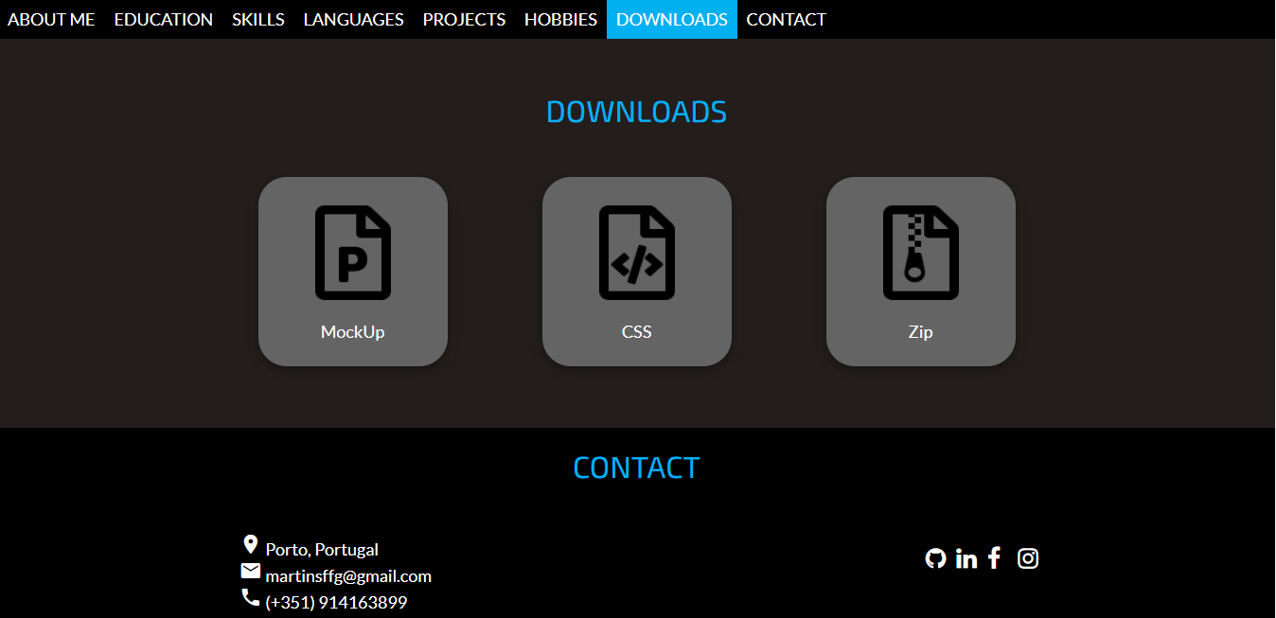
Downloads

Slide 19
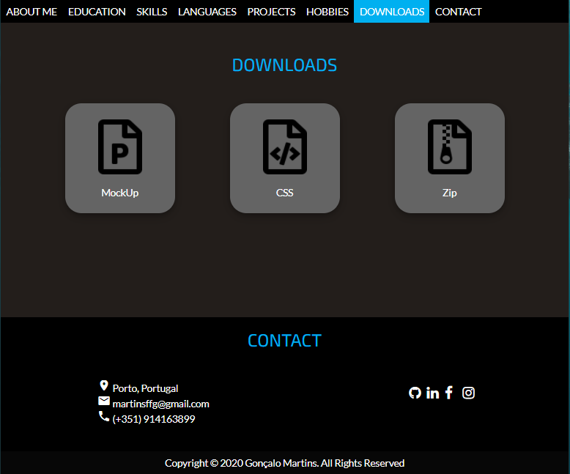
iconbox:
display: block
justify-content: center
align-items: center
iconbox:
height: 200px
width: 200px
border-radius: 30px
background-color: gray
box-shadow: …
margin: 30px 50px
iconbox img:hover:
position: relative;
top: -5px
iconbox img:
height: 100px
width: 80px

Slide 20
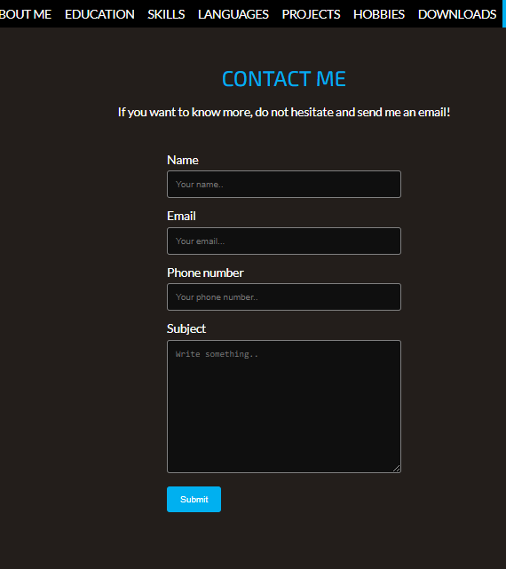
Contact

Slide 21
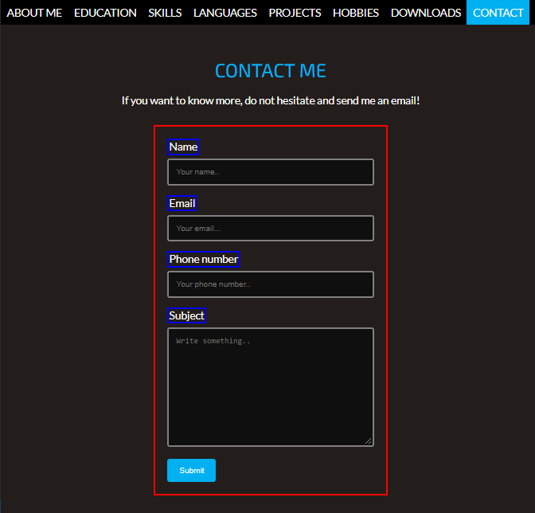
contact-container:
width: 50%
margin: 30px auto
padding: 20px
contact-container:
display: flex
justify-contente: center
input[type=text], select, textarea:
background-color: rgb(15,15,15)
color: white
border: 3px gray
border-radius: 4px
width: 100%
padding: 12px
label:
float: left
input[type=text], select, textarea:
resize: vertical
box-sizing: border-box
input[type=submit]:
background-color: blue
color: white
border: none
padding 12px 20px
input[type=submit]:
float: left
cursor: pointer
hover:
background-color: gray

Slide 22
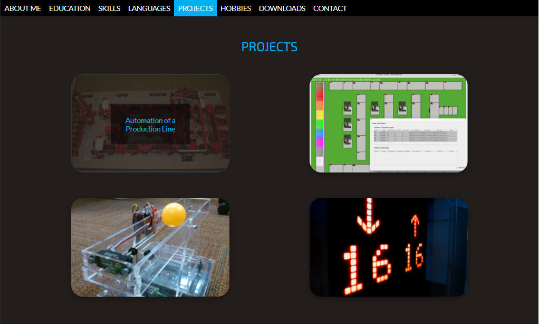
Projects

Slide 23
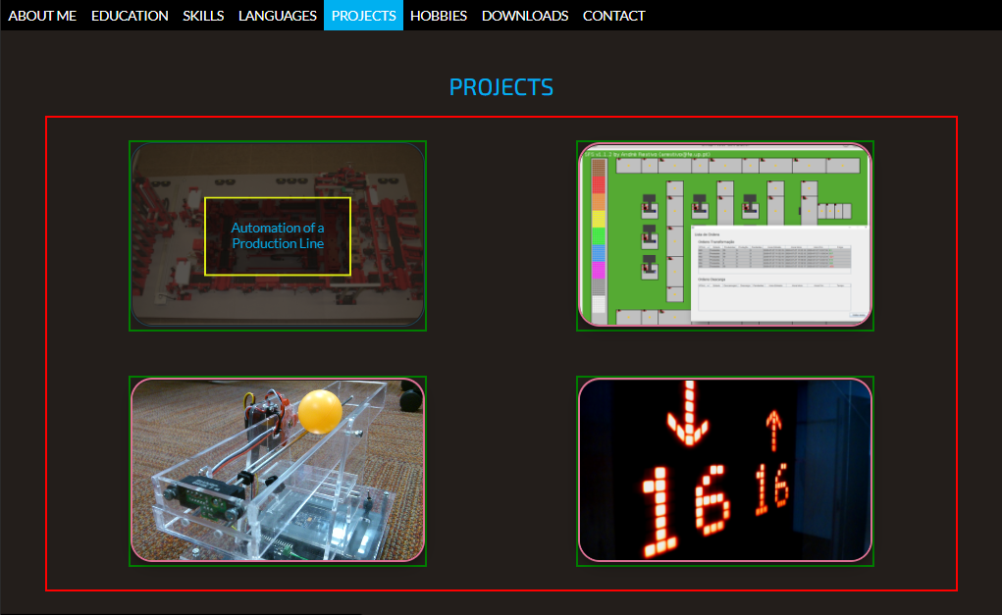
gallery:
display: flex
flex-wrap: wrap
flex-direction: row
align-items: center
justify-content: center
overlay:
position: absolute
Top: 50%
left: 50%
transform: translate(-50%,-50%)
padding: 30px
opacity: 0
hover:
opacity: 1
single-img:
margin: 30px 101px
position: relative
single-img img:
object-fit: cover
box-shadow: ..
opacity: 1
hover:
opacity: 0.2
border: 2px blue

Slide 24
overlay:
background-color: rgba(0,0,0,0.5)
single-img img:
width: 400px
height: 250px

Slide 25
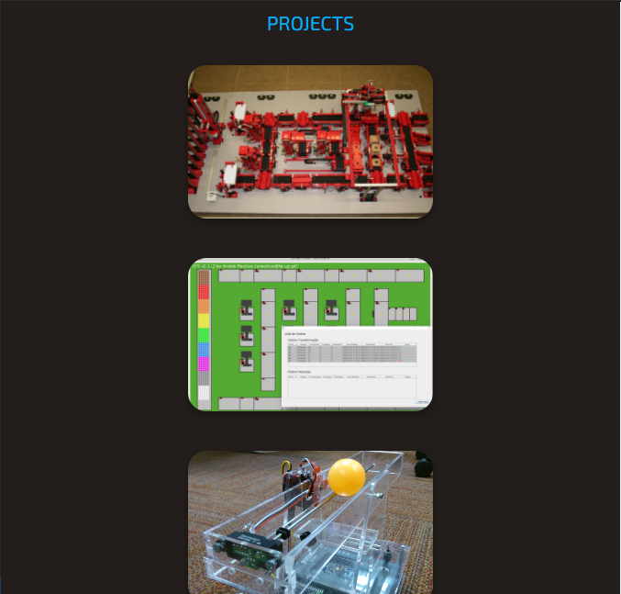
Responsividade

Slide 26
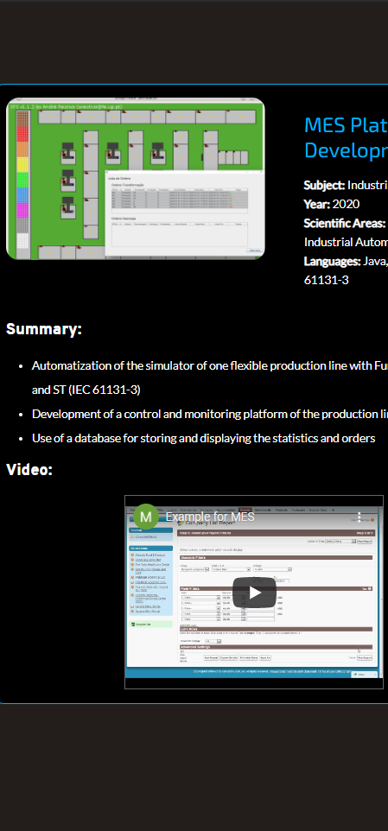
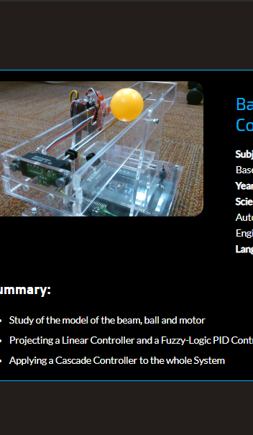
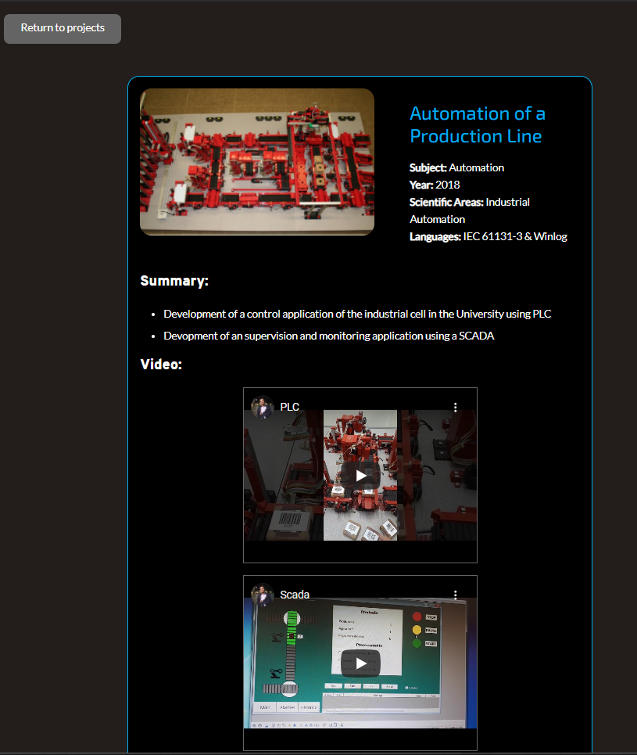
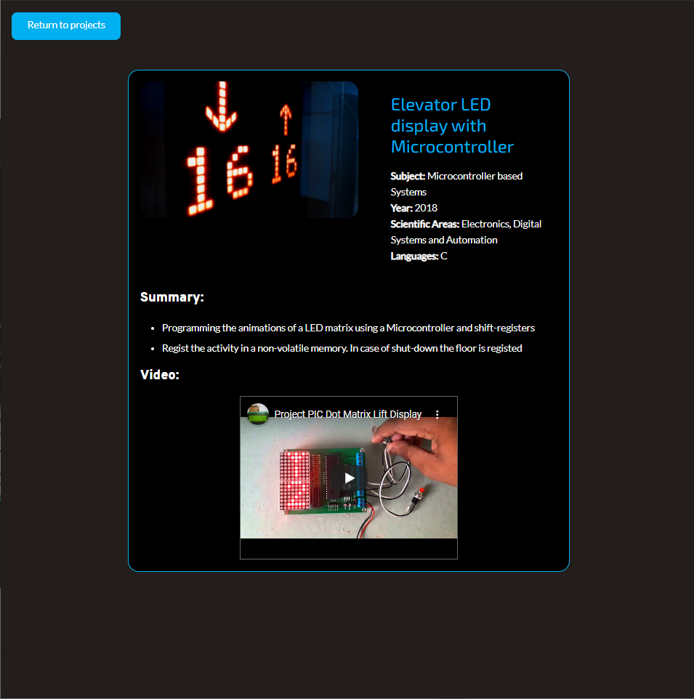
Layout de cada descrição do projeto

Slide 27
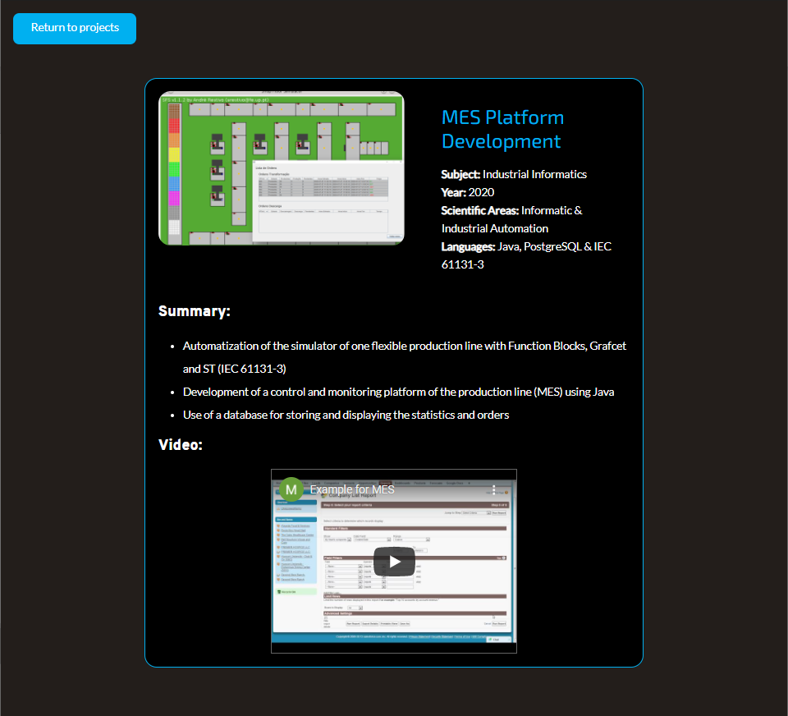
button:
background-color: blue
color: white
width: 200px
height: 50px
border-radius: 10px
margin-top-left: 20px
padding: 12px 20px
float: left;
hover:
background-color: gray
h1
h3

Slide 28
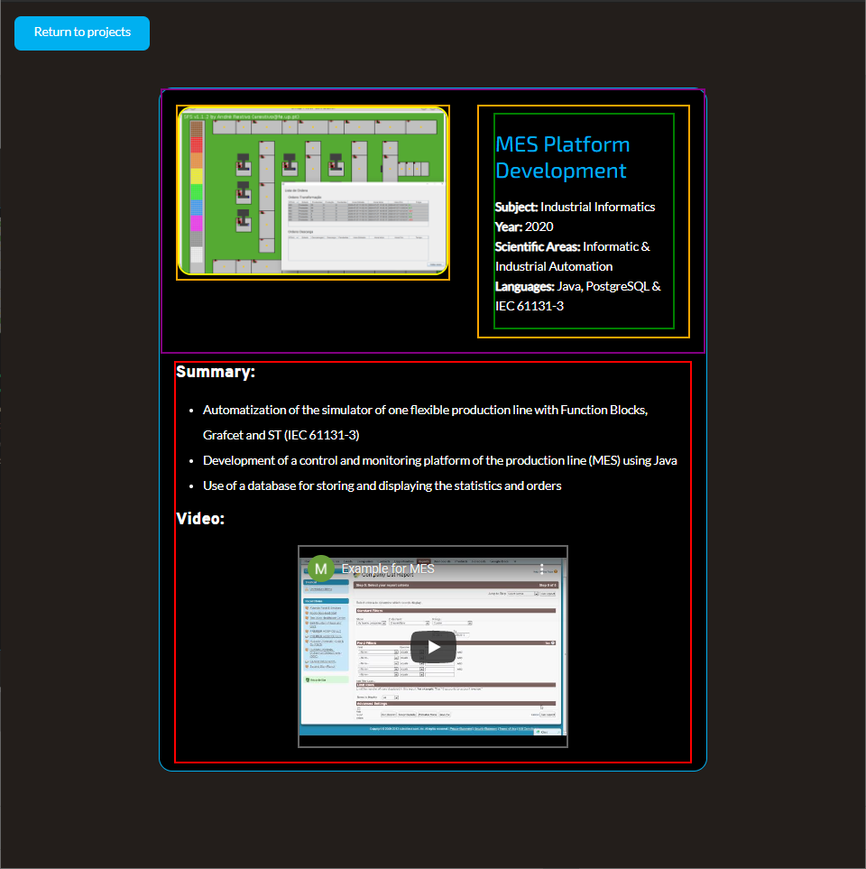
project:
background-color: black
border: 2px blue
width: 70%
margin: 20px auto
flex-container
flex-child
project-image:
width: 400px
height: 250px
border-radius: 20px
project-label:
yext-align: left
line-height: 0.8cm
margin: 10px 20px
iframe:
width: 400px
height: 300px
max-widht: 100%
border: 1px solid gray
display: block
margin: 2px auto

Slide 29
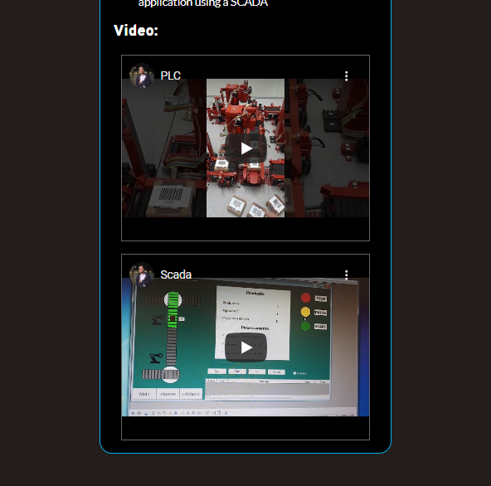
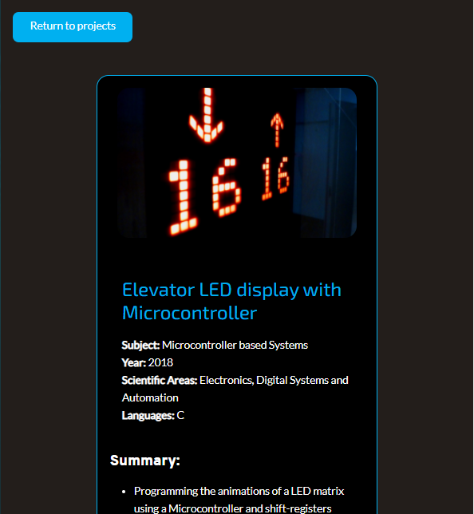
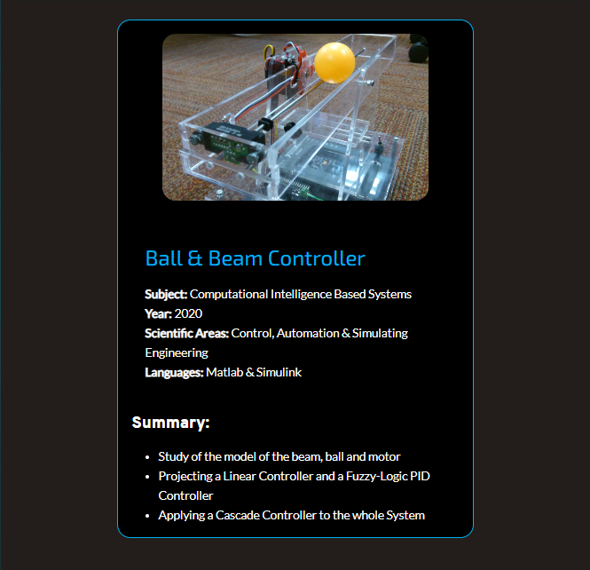
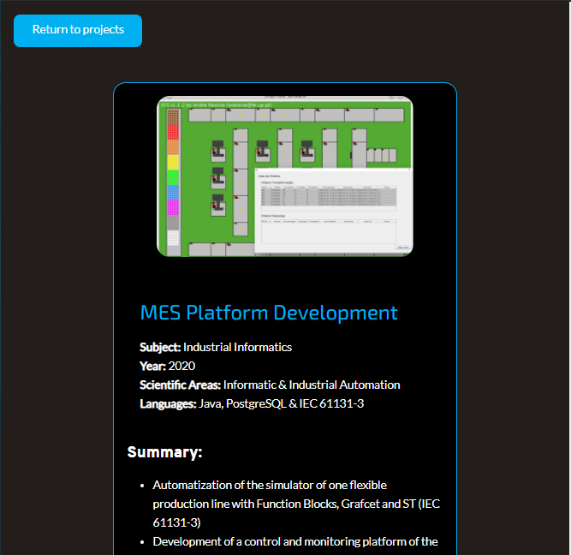
Responsividade

