Slide 1


ABOUT ME EDUCATION SKILLS LANGUAGES PROJECTS HOBBIES DOWNLOADS CONTACT
ABOUT ME
GONÇALO MARTINS
Electrical & Computer Engineering
ABOUT ME
I am currently a student in the last year of the BSC + MSc in Electrical and Computer Engineering at FEUP, Porto, Portugal
My major is Automation and my specialization is Robotics and Systems
I am a hard working and commited person who is always ready to learn new things and expand my knowledge
My areas of interest are:
Autonomous Navigation
Industrial Automation
Smart Systems
Robotics and Programming

Slide 2
ABOUT ME EDUCATION SKILLS LANGUAGES PROJECTS HOBBIES DOWNLOADS CONTACT
ABOUT ME
cover {Padding-top: 50px;
Padding-bottom: 50px;
Line-height: 5px;}
avatar{width 120px;
height: 120px;
border-radius: 50%;}
Cover h1{font: 40px Overpass;}
GONÇALO MARTINS
font: 20px Lato;
color: rgb(191,191,191);
Electrical & Computer Engineering
body{
background-color: #231E1B;
text-allign: center;
font 18px “Lato”, sans-serif;
}
ABOUT ME
I am currently a student in the last year of the BSC + MSc in Electrical and Computer Engineering at FEUP, Porto, Portugal
My major is Automation and my specialization is Robotics and Systems
I am a hard working and commited person who is always ready to learn new things and expand my knowledge
My areas of interest are:
Autonomous Navigation
Industrial Automation
Smart Systems
Robotics and Programming

Slide 3
ABOUT ME EDUCATION SKILLS LANGUAGES PROJECTS HOBBIES DOWNLOADS CONTACT
ABOUT ME
box{margin: 25px 50px;
padding: 10px}
GONÇALO MARTINS
box h1{
font 32px “Exo 2”
Color: #00B0F0;
Margin-bottom: 30px;}
Electrical & Computer Engineering
25px
ABOUT ME
50px
30px
I am currently a student in the last year of the BSC + MSc in Electrical and Computer Engineering at FEUP, Porto, Portugal
My major is Automation and my specialization is Robotics and Systems
I am a hard working and commited person who is always ready to learn new things and expand my knowledge
My areas of interest are:
Autonomous Navigation
Industrial Automation
Smart Systems
Robotics and Programming
50px
25px

Slide 4
ABOUT ME EDUCATION SKILLS LANGUAGES PROJECTS HOBBIES DOWNLOADS CONTACT
ABOUT ME
SKILLS
Navbar a:hover{
background-color: grey
Navbar .current{
background-color: 00B0F0;}
a:link{texto-decoration: none;
color: #90E0EF;}
GONÇALO MARTINS
navbar{
Font: 20px “Lato”;
color: white,
background-color: black;
}
a:hover{color: #00B0F0;}
Electrical & Computer Engineering
ABOUT ME
I am currently a student in the last year of the BSC + MSc in Electrical and Computer Engineering at FEUP, Porto, Portugal
My major is Automation and my specialization is Robotics and Systems
I am a hard working and commited person who is always ready to learn new things and expand my knowledge
My areas of interest are:
Autonomous Navigation
Industrial Automation
Smart Systems
Robotics and Programming

Slide 5



ABOUT ME EDUCATION SKILLS LANGUAGES PROJECTS HOBBIES CONTACT
EDUCATION
ABOUT ME EDUCATION SKILLS LANGUAGES PROJECTS HOBBIES DOWNLOADS CONTACT
EDUCATION
EDUCATION
Filipa de Vilhena High School
(2013– 2016)
High School
Course: Sciences and Technology
Faculty of Engineering of the University of Porto
(2016 – present)
BSc + MSc in Electrical and Computer Engineering
Major: Automation
Specialization: Robotics and Systems
Budapest University of Technology and Economics
(2019 – 2020)
MSc in Electrical Engineering and Computer Science
Semester abroad by the ERASMUS+ program

Slide 6
ABOUT ME EDUCATION SKILLS LANGUAGES PROJECTS HOBBIES CONTACT
EDUCATION
ABOUT ME EDUCATION SKILLS LANGUAGES PROJECTS HOBBIES DOWNLOADS CONTACT
EDUCATION
navbar
box
EDUCATION
Box h1
ASPECTOS EM COMUM
Filipa de Vilhena High School
(2013– 2016)
High School
Course: Sciences and Technology
Faculty of Engineering of the University of Porto
(2016 – present)
BSc + MSc in Electrical and Computer Engineering
Major: Automation
Specialization: Robotics and Systems
Budapest University of Technology and Economics
(2019 – 2020)
MSc in Electrical Engineering and Computer Science
Semester abroad by the ERASMUS+ program

Slide 7
ABOUT ME EDUCATION SKILLS LANGUAGES PROJECTS HOBBIES CONTACT
EDUCATION
ABOUT ME EDUCATION SKILLS LANGUAGES PROJECTS HOBBIES DOWNLOADS CONTACT
EDUCATION
.TextImgBox{
Padding: 10px;
margin 10px 150px 30px;}
box
EDUCATION
Filipa de Vilhena High School
(2013– 2016)
High School
Course: Sciences and Technology
150px
150px
Faculty of Engineering of the University of Porto
(2016 – present)
BSc + MSc in Electrical and Computer Engineering
Major: Automation
Specialization: Robotics and Systems
Budapest University of Technology and Economics
(2019 – 2020)
MSc in Electrical Engineering and Computer Science
Semester abroad by the ERASMUS+ program
TextImgBox .text{
display: inline-block;
width: 50%
text-align: left;}
TextImgBox .image{
display: inline-block;
vertical-align: top;
width: 20%}

Slide 8
ABOUT ME EDUCATION SKILLS LANGUAGES PROJECTS HOBBIES CONTACT
EDUCATION
ABOUT ME EDUCATION SKILLS LANGUAGES PROJECTS HOBBIES DOWNLOADS CONTACT
EDUCATION
EDUCATION
h3{font: 24px “Overpass”}
100 x 100
Filipa de Vilhena High School
(2013– 2016)
High School
Course: Sciences and Technology
p.data{font: 16px “Lato”
Color: #BFBFBF}
100 x 100
Faculty of Engineering of the University of Porto
(2016 – present)
BSc + MSc in Electrical and Computer Engineering
Major: Automation
Specialization: Robotics and Systems
p{font: 18px “Lato”}
100 x 100
p.descricao{font: 16px “Lato”
color: #D9D9D9
margin-left: 40px}
Budapest University of Technology and Economics
(2019 – 2020)
MSc in Electrical Engineering and Computer Science
Semester abroad by the ERASMUS+ program

Slide 9




ABOUT ME EDUCATION SKILLS LANGUAGES PROJECTS HOBBIES CONTACT
ABOUT ME EDUCATION SKILLS LANGUAGES PROJECTS HOBBIES DOWNLOADS CONTACT
HOBBIES
HOBBIES
HOBBIES
Watch TVShows & Movies
Favourites TVShows: Friends, Breaking Bad, Prison Break
Favourite Movies: Die Hard, Avengers, Harry Potter
Sports
“The body achieves what the mind believes”
Weekly practising in the gym and also play regulary
Football and Padel
Travelling
Already did an Europe Interrail and a trip to the Balkans
Next plans: South America and Asia
Programming
Programming can be fun, usefull and great way
to spend time.
I usally do some small programs to practise and learn
new languages

Slide 10
ABOUT ME EDUCATION SKILLS LANGUAGES PROJECTS HOBBIES CONTACT
ABOUT ME EDUCATION SKILLS LANGUAGES PROJECTS HOBBIES DOWNLOADS CONTACT
HOBBIES
HOBBIES
navbar
box
HOBBIES
Box h1
.TextImgBox
TextImgBox .text
Watch TVShows & Movies
Favourites TVShows: Friends, Breaking Bad, Prison Break
Favourite Movies: Die Hard, Avengers, Harry Potter
TextImgBox .image
Sports
“The body achieves what the mind believes”
Weekly practising in the gym and also play regulary
Football and Padel
p.descricao
Travelling
Already did an Europe Interrail and a trip to the Balkans
Next plans: South America and Asia
h3
ASPECTOS EM COMUM com “Education”
Programming
Programming can be fun, usefull and great way
to spend time.
I usally do some small programs to practise and learn
new languages

Slide 11
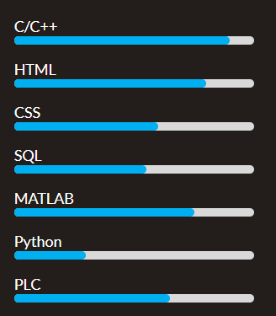
ABOUT ME EDUCATION SKILLS LANGUAGES PROJECTS HOBBIES CONTACT
ABOUT ME EDUCATION SKILLS LANGUAGES PROJECTS HOBBIES DOWNLOADS CONTACT
SKILLS
SKILLS
SKILLS
Technological
Soft Skills
Teamwork
Wilingness to learn
Problem Solving
Organization
Resilience
Active Listening
Self-Motivation

Slide 12
ABOUT ME EDUCATION SKILLS LANGUAGES PROJECTS HOBBIES CONTACT
ABOUT ME EDUCATION SKILLS LANGUAGES PROJECTS HOBBIES DOWNLOADS CONTACT
SKILLS
SKILLS
navbar
box
SKILLS
Box h1
ASPECTOS EM COMUM
Technological
Soft Skills
Teamwork
Wilingness to learn
Problem Solving
Organization
Resilience
Active Listening
Self-Motivation

Slide 13
ABOUT ME EDUCATION SKILLS LANGUAGES PROJECTS HOBBIES CONTACT
ABOUT ME EDUCATION SKILLS LANGUAGES PROJECTS HOBBIES DOWNLOADS CONTACT
box-parent{
display: flex;
margin 20px 50px;}
SKILLS
SKILLS
box-child{
display: 1;
text-allign:left;
margin-left: 25%}
SKILLS
20px
Technological
Soft Skills
Teamwork
Wilingness to learn
Problem Solving
Organization
Resilience
Active Listening
Self-Motivation
50px
50px
20px
20px

Slide 14




ABOUT ME EDUCATION SKILLS LANGUAGES PROJECTS HOBBIES CONTACT
LANGUAGES
ABOUT ME EDUCATION SKILLS LANGUAGES PROJECTS HOBBIES DOWNLOADS CONTACT
LANGUAGES
LANGUAGES
 | Portuguese | Native
 | English | Advanced
 | Spanish | Upper Intermediate
 | German | Elementary

Slide 15
ABOUT ME EDUCATION SKILLS LANGUAGES PROJECTS HOBBIES CONTACT
LANGUAGES
ABOUT ME EDUCATION SKILLS LANGUAGES PROJECTS HOBBIES DOWNLOADS CONTACT
LANGUAGES
navbar
box
LANGUAGES
Box h1
table{
border: 2px solid #00B0F0;
border-colapse: colapse;
table-layout: auto;
width: 40%;
margin 50px;
backgorund-color: #0D0D0D}
 | Portuguese | Native
 | English | Advanced
 | Spanish | Upper Intermediate
 | German | Elementary
tr{
text-align: center;
padding: 10px;
}
tr-nth-child(even){
backgorund-color: #262626
}

Slide 16
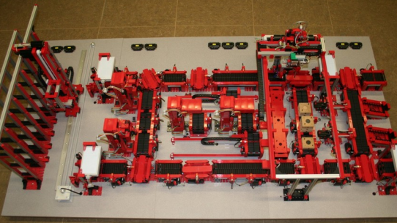
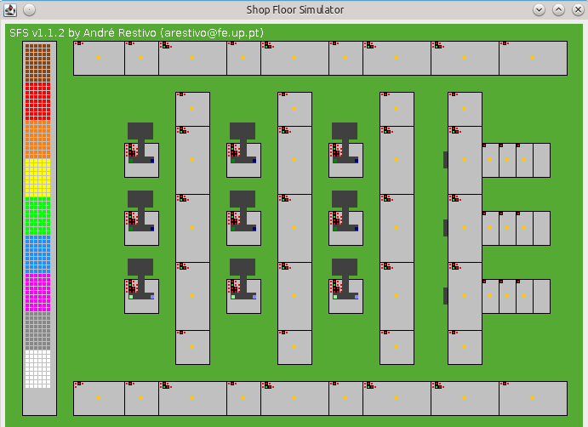
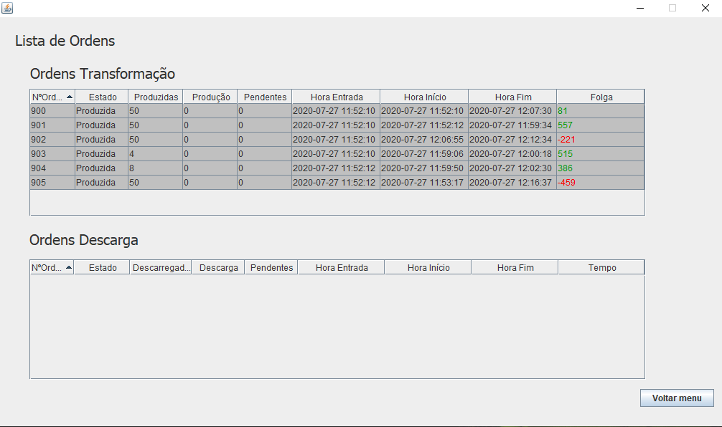
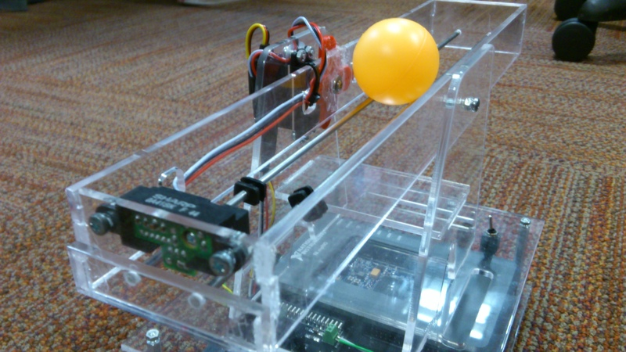
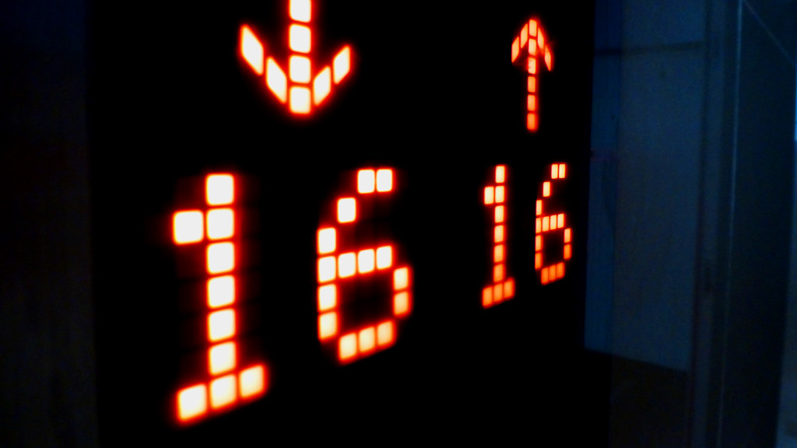
ABOUT ME EDUCATION SKILLS LANGUAGES PROJECTS HOBBIES CONTACT
ABOUT ME EDUCATION SKILLS LANGUAGES PROJECTS HOBBIES DOWNLOADS CONTACT
PROJECTS
PROJECTS
PROJECTS
Production line automation
MES platform development
Ball & Beam Controller
Elevator LED display with uC

Slide 17
ABOUT ME EDUCATION SKILLS LANGUAGES PROJECTS HOBBIES CONTACT
PROJECTS
ABOUT ME EDUCATION SKILLS LANGUAGES PROJECTS HOBBIES DOWNLOADS CONTACT
ABOUT ME EDUCATION SKILLS LANGUAGES PROJECTS HOBBIES DOWNLOADS CONTACT
PROJECTS
PROJECTS
navbar
box
PROJECTS
Box h1
ASPECTOS EM COMUM
Production line automation
MES platform development
Ball & Beam Controller
Elevator LED display with uC

Slide 18
ABOUT ME EDUCATION SKILLS LANGUAGES PROJECTS HOBBIES CONTACT
ABOUT ME EDUCATION SKILLS LANGUAGES PROJECTS HOBBIES DOWNLOADS CONTACT
PROJECTS
PROJECTS
PROJECTS
.figurebox{
display: flex;
flex-wrap: wrap;
justify-contente: center;}
figure{
Padding: 4px;
margin: 10px 80px;
}
Production line automation
MES platform development
figcaption{
Backgorund-color: black;
}
Ball & Beam Controller
Elevator LED display with uC

Slide 19



ABOUT ME EDUCATION SKILLS LANGUAGES PROJECTS HOBBIES CONTACT
ABOUT ME EDUCATION SKILLS LANGUAGES PROJECTS HOBBIES DOWNLOADS CONTACT
LANGUAGES
DOWNLOADS
DOWNLOADS

Slide 20
ABOUT ME EDUCATION SKILLS LANGUAGES PROJECTS HOBBIES CONTACT
DOWNLOADS
ABOUT ME EDUCATION SKILLS LANGUAGES PROJECTS HOBBIES DOWNLOADS CONTACT
ABOUT ME EDUCATION SKILLS LANGUAGES PROJECTS HOBBIES DOWNLOADS CONTACT
LANGUAGES
DOWNLOADS
navbar
box
DOWNLOADS
Box h1
ASPECTOS EM COMUM

Slide 21
ABOUT ME EDUCATION SKILLS LANGUAGES PROJECTS HOBBIES CONTACT
ABOUT ME EDUCATION SKILLS LANGUAGES PROJECTS HOBBIES DOWNLOADS CONTACT
LANGUAGES
DOWNLOADS
DOWNLOADS
buttonbox
200x200 px
200x200 px
200x200 px
80x80 px
80x80 px
80x80 px

Slide 22


ABOUT ME EDUCATION SKILLS LANGUAGES PROJECTS HOBBIES CONTACT
CONTACT
ABOUT ME EDUCATION SKILLS LANGUAGES PROJECTS HOBBIES DOWNLOADS CONTACT
CONTACT
footer
CONTACT
Copyright © Gonçalo Martins 2020

