Slide 1
Skin Disease Diagnosis with Adversarial Training and Diffusion Models
Gonçalo Rodrigues Silva
Filipe Silva
Pétia Georgieva
Develop a diffusion model and use adversarial training to improve skin lesion diagnosis by generating synthetic data that enhances deep learning classifier performance.

Slide 2
Context
Skin cancer is a growing global health concern, requiring early and accurate diagnosis.[1]
Deep learning models, especially CNNs, have shown promise in classifying skin lesion.[1]
Limited labeled data poses a major challenge for training effective models.
[1] Choy, S. P., Kim, B. J., Paolino, A., Tan, W. R., Lim, S. M. L., Seo, J., ... & Mahil, S. K. (2023). Systematic review of
deep learning image analyses for the diagnosis and monitoring of skin disease. NPJ Digital Medicine, 6(1), 180.

Slide 3
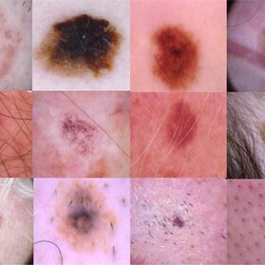
Objectives
Develop and train a CNN classifier using medical images from a publicly available datasets (e.g., ISIC, HAM10000).
Develop a diffusion model to generate synthetic skin lesion images.
Implement adversarial (iterative) training to enhance the classifier’s ability to handle challenging cases.
Evaluate the classifier’s performance, with and without synthetic data, to assess its effectiveness.
Fig.1 – HAM10000 dataset examples

Slide 4
Macro Strategies
Data-Centric Approach
Model Development and Optimization
Iterative Adversarial Training
Evaluation and Feedback Loop
Scalability and Reproducibility

Slide 5
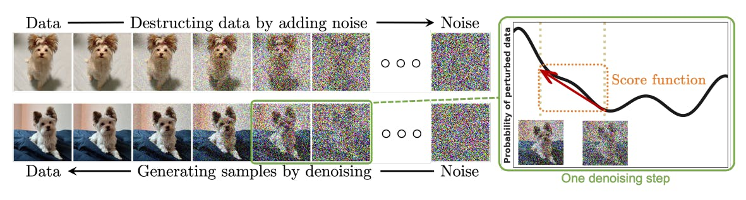
Work done
The diffusion model progressively adds noise to data and then reverses the process by denoising it to generate new, realistic samples from the noisy data.
Fig.2 – Diffusion model

Slide 6
Future work
Continue research of State of the Art:
Datasets
Difusion models
Pre-trained CNN models
Familiarize with dataset’s structure and implementation details.
Understand more deeply how diffusion models work.

