Slide 1
Skin Disease Diagnosis with Adversarial Training and Diffusion Models
Gonçalo Rodrigues Silva
Filipe Silva
Pétia Georgieva
Develop a diffusion model and use adversarial training to improve skin lesion diagnosis by generating synthetic data that enhances deep learning classifier performance.

Slide 2
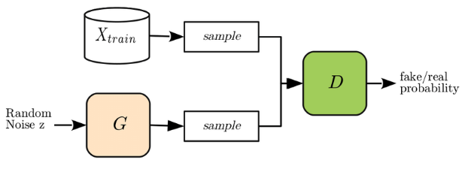
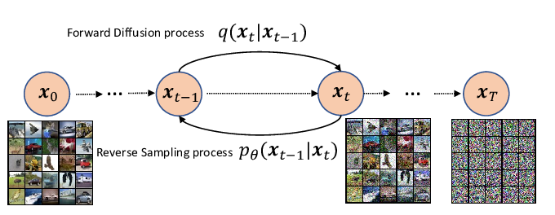
Work done / results
Study about Difference of GANs and Diffusion Models
Fig1.Classic GAN diagram
Fig2. Diffusion model workflow

Slide 3
Work done / results
Significant advance in the Related Work writing
Sections about Medical Imaging and Deep Learning, Skin Lesion Data Scarcity, and introduction to Generative models is complete.
Introduction to the overall theme
Problems in the available data and traditional techniques of data augmentation
Generative models (GANs)
Stablished a better-though-out Dissertation Outline for the sections that will still be written.
Analysed basic implementation of diffusion models
Gave me more understanding of what I read about the subject

Slide 4
Future work / challenges
Continue writing on related work
Start section of Diffusion models and explain the multiple variations and math behind it
Try to finish first draft
Continue to research more comparison papers between diffusion models and certain implementations.
Stablish what datasets will be used

