Slide 1
Book Club
Introductory
OC RUG

Slide 2


1. Intro
What is this book club
The idea is to push us to read books by reading it and discussing it together. This will help all of us to raise up.
First book R for data science

Slide 3
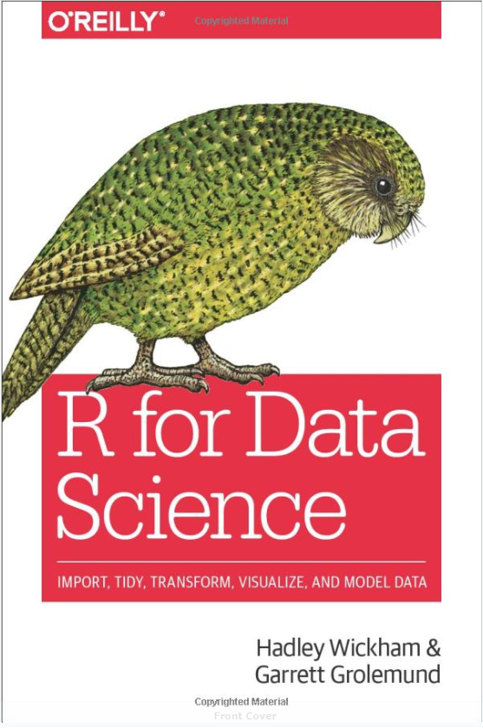
For R beginners
How to get your data into R, transform it, visualise it and model it.
How to use the grammar, literate programming, and reproducible research to save time.
How to manage cognitive resources to facilitate discoveries when wrangling, visualising and exploring data
Available online (free) https://r4ds.had.co.nz

Slide 4
2. Logistics
How this club is working
We read one part everytime, and discuss those chapters in details. We may also work through questions/exercise together.
Session host Pretend you are teaching these chapters to laymen
Attendees Have the opportunity to ask questions and discuss the content.

Slide 5
3. First week
If the book club works well for us, future books could include much more deeper topic such as predictive model building
First week
Part one : explore
Come and discuss Share your exploratory workflow :
Visualization with ggplot
Data transformation
Chapters 1, 2, and 3

Slide 6
4. Time & loc
When to meet Once a week on a wednesday evening 7:00-8:30 PM
Where to meet TBD
What to bring Laptop with R installed Book

