Slide 1
Class 2Nx2NB Group 322 SPRINT 3
Group members:
Diogo Santo (1212039)
Paulo Moreira (1212044)
Rafael Carolo (1212047)
Ricardo Gonçalves (1221720)
Tassio Gomes (1170065) (BDDAD)

Slide 2
Sprint planning – Sprint 3
Planned Start Date: 27-11-2023 Real Start Date: 30-11-2023
Planned Finished Date: 03-01-2024 Real Finish Date: 03-01-2024
SPRINT BACKLOG
Number of stories | 31
Number of bugs | 0
Number of tasks | 31
Number of Management Tasks | 17
Number of team members | Planned: 5 Actual: 5
Total planned estimation vs execution | Planned hours: 253 Executed hours: 253

Slide 3
Sprint planning
Assignment US | Commited? | Todo | Doing | Testing | Done | Blocked
US LP10 | 30-11-2023 |  |  |  | X
US LP11 | 30-11-2023 |  |  |  | X

Slide 4
Sprint planning
Assignment US | Commited? | Todo | Doing | Testing | Done | Blocked
US BD24 | 30-11-2023 |  |  |  | X
US BD25 | 30-11-2023 |  |  |  | X
US BD26 | 30-11-2023 |  |  |  | X
US BD27 | 30-11-2023 |  |  |  | X
US BD28 | 30-11-2023 |  |  |  | X
US BD29 | 30-11-2023 |  |  |  | X
US BD30 | 30-11-2023 |  |  |  | X
US BD31 | 30-11-2023 |  |  |  | X
US BD32 | 30-11-2023 |  |  |  | X
US BD33 | 30-11-2023 |  |  |  | X
US BD34 | 30-11-2023 |  |  |  | X

Slide 5
Sprint planning
Assignment US | Commited? | Todo | Doing | Testing | Done | Blocked
US AC06 | 30-11-2023 |  |  |  | X
US AC07 | 30-11-2023 |  |  |  | X
US AC08 | 30-11-2023 |  |  |  | X
US AC09 | 30-11-2023 |  |  |  | X
US AC10 | 30-11-2023 |  |  |  | X
US AC11 | 30-11-2023 |  |  |  | X
US AC12 | 30-11-2023 |  |  |  | X
US AC13 | 30-11-2023 |  |  |  | X

Slide 6
Sprint planning
Assignment US | Commited? | Todo | Doing | Testing | Done | Blocked
US FA05 | 30-11-2023 |  |  |  | X
US FA06 | 30-11-2023 |  |  |  | X
US FA07 | 30-11-2023 |  |  |  | X
US FA08 | 30-11-2023 |  |  |  | X

Slide 7
Sprint planning
Assignment US | Commited? | Todo | Doing | Testing | Done | Blocked
US EI06 | 30-11-2023 |  |  |  | X
US EI07 | 30-11-2023 |  |  |  | X
US EI08 | 30-11-2023 |  |  |  | X
US EI09 | 30-11-2023 |  |  |  | X
US EI10 | 30-11-2023 |  |  |  | X
US EI11 | 30-11-2023 |  |  |  | X

Slide 8
Work by team member

Slide 9
Work by type

Slide 10
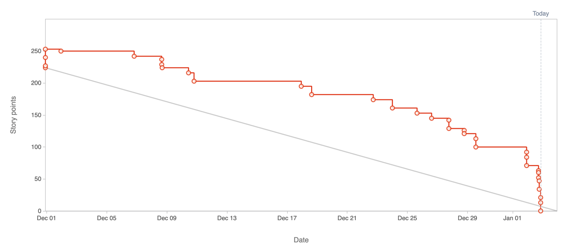
Sprint Burndown Chart

Slide 11
Sprint Retrospective
Date: 03-01-2024
What went well?
Communication
Tasks organization and inter support
What went wrong?
Sprint workload distribution.
What we’ve learned?
Breakdown tasks into smaller sub-tasks to have ongoing work sooner, with impact on the deliverable.

Slide 12
Sprint Retrospective
Date: 03-01-2024
Action items:
Close sprint on JIRA.
Submit all documents on each required platform.

