Slide 1
Class 2Nx2NB Group 322 SPRINT 2
Group members:
Diogo Santo (1212039)
Paulo Moreira (1212044)
Rafael Carolo (1212047)
Ricardo Gonçalves (1221720)
Tassio Gomes (1170065) (BDDAD)

Slide 2
Sprint planning – Sprint 1
Planned Start Date: 30-10-2023 Real Start Date: 03-11-2023
Planned Finished Date: 26-11-2023 Real Finish Date: 26-11-2023
SPRINT BACKLOG
Number of stories | 35
Number of bugs | 0
Number of tasks | 35
Number of Management Tasks | 16
Number of team members | Planned: 5 Actual: 5
Total planned estimation vs execution | Planned hours: 232 Executed hours: 216

Slide 3
Sprint planning
Assignment US | Commited? | Todo | Doing | Testing | Done | Blocked
US LP03 | 03-11-2023 |  |  |  | X
US LP04 | 03-11-2023 |  |  |  | X
US LP05 | 03-11-2023 |  |  |  | X
US LP06 | 03-11-2023 |  |  |  | X
US LP07 | 03-11-2023 |  |  |  | X
US LP08
US LP09 | 03-11-2023 |  |  |  | X

Slide 4
Sprint planning
Assignment US | Commited? | Todo | Doing | Testing | Done | Blocked
US BD11 | 03-11-2023 |  |  |  | X
US BD12 | 03-11-2023 |  |  |  | X
US BD13 | 03-11-2023 |  |  |  | X
US BD14 | 03-11-2023 |  |  |  | X
US BD15 | 03-11-2023 |  |  |  | X
US BD16 | 03-11-2023 |  |  |  | X
US BD17 | 03-11-2023 |  |  |  | X
US BD18 | 03-11-2023 |  |  |  | X
US BD19 | 03-11-2023 |  |  |  | X
US BD20 | 03-11-2023 |  |  |  | X
US BD21 | 03-11-2023 |  |  |  | X
US BD22 | 03-11-2023 |  |  |  | X
US BD23 | 03-11-2023 |  |  |  | X

Slide 5
Sprint planning
Assignment US | Commited? | Todo | Doing | Testing | Done | Blocked
US AC01 | 03-11-2023 |  |  |  | X
US AC02 | 03-11-2023 |  |  |  | X
US AC03 | 03-11-2023 |  |  |  | X
US AC04 | 03-11-2023 |  |  |  | X
US AC05 | 03-11-2023 |  |  |  | X

Slide 6
Sprint planning
Assignment US | Commited? | Todo | Doing | Testing | Done | Blocked
US FA01 | 03-11-2023 |  |  |  | X
US FA02 | 03-11-2023 |  |  |  | X
US FA03 | 03-11-2023 |  |  |  | X
US FA04 | 03-11-2023 |  |  |  | X

Slide 7
Sprint planning
Assignment US | Commited? | Todo | Doing | Testing | Done | Blocked
US EI01 | 03-11-2023 |  |  |  | X
US EI02 | 03-11-2023 |  |  |  | X
US EI03 | 03-11-2023 |  |  |  | X
US EI04 | 03-11-2023 |  |  |  | X
US EI05

Slide 8
Work by team member

Slide 9
Work by type

Slide 10
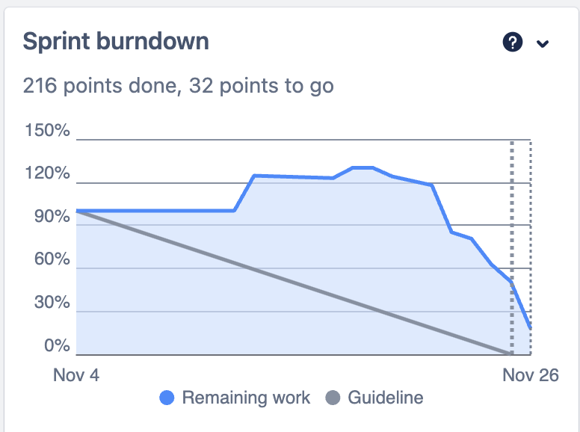
Sprint Burndown Chart

Slide 11
Sprint Retrospective
Date: 26-11-2023
What went well?
Communication
Tasks organization and inter support
What went wrong?
Sprint workload distribution. Mainly performed during the last two weeks.
What we’ve learned?
Breakdown tasks into smaller sub-tasks to have ongoing work sooner, with impact on the deliverable.

Slide 12
Sprint Retrospective
Date: 26-11-2023
Action items:
Set up all the work hours / points before sprint 3 start, on JIRA.
Close sprint on JIRA.
Submit all documents on each required platform.

