Slide 1
Class 2Nx2NB Group 322 SPRINT 1
Group members:
Diogo Santo (1212039)
Paulo Moreira (1212044)
Rafael Carolo (1212047)
Ricardo Gonçalves (1221720)
Tassio Gomes (1170065) (BDDAD)

Slide 2
Sprint planning – Sprint 1
Planned Start Date: 01-10-2023 Real Start Date: 06-10-203
Planned Finished Date: 29-10-2023 Real Finish Date: 29-10-2023
SPRINT BACKLOG
Number of stories | 11
Number of bugs | 0
Number of tasks | 11
Number of Management Tasks | 16
Number of team members | Planned: 5 Actual: 5
Total planned estimation vs execution | Planned hours: 95 Executed hours: 95

Slide 3
Sprint planning
Assignment US | Commited? | Todo | Doing | Testing | Done | Blocked
US LP01 | 06-10-2023 |  |  |  | X
US LP02 | 06-10-2023 |  |  |  | X
US BD01 | 06-10-2023 |  |  |  | X
US BD02 | 06-10-2023 |  |  |  | X
US BD03 | 06-10-2023 |  |  |  | X
US BD04 | 06-10-2023 |  |  |  | X
US BD05 | 06-10-2023 |  |  |  | X
US BD06 | 06-10-2023 |  |  |  | X
US BD07 | 06-10-2023 |  |  |  | X
US BD08 | 06-10-2023 |  |  |  | X
US BD09 | 06-10-2023 |  |  |  | X

Slide 4
Work by team member

Slide 5
Work by type

Slide 6
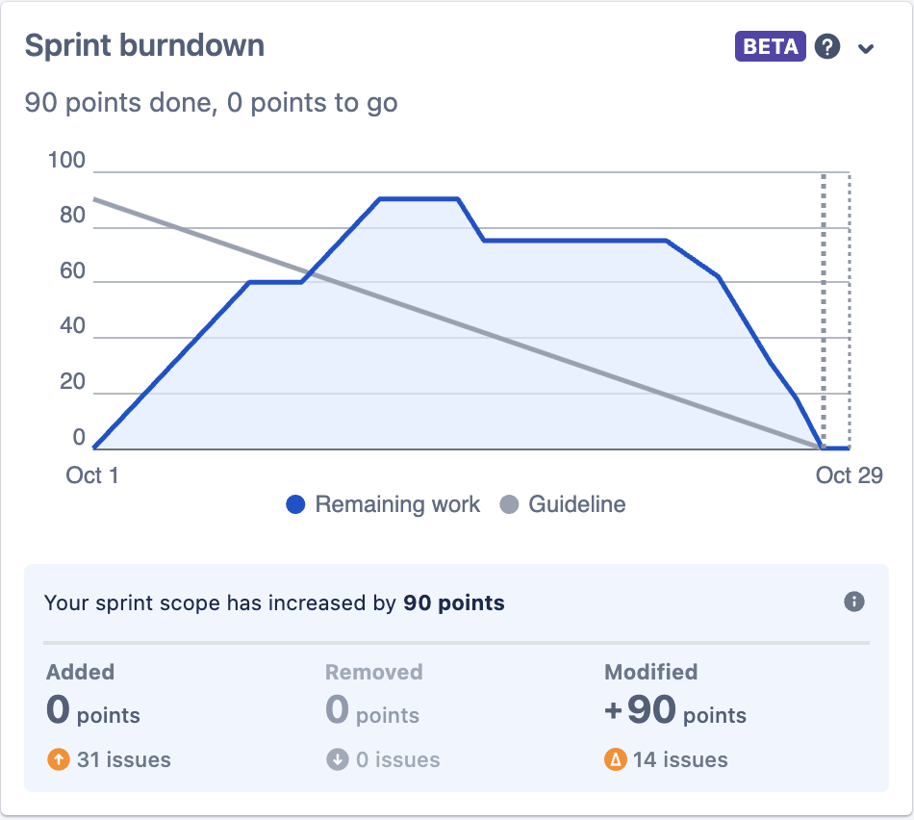
Sprint Burndown Chart

Slide 7
Sprint Retrospective
Date: 29-10-2023
What went well?
Communication
Tasks organization and inter support
What went wrong?
Initialization of sprint on JIRA.
What we’ve learned?
Set up all the work hours / points before sprint start on JIRA.

Slide 8
Sprint Retrospective
Date: 29-10-2023
Action items:
Set up all the work hours / points before sprint 2 start, on JIRA.
Close sprint on JIRA.
Submit all documents on each required platform.

