Slide 1
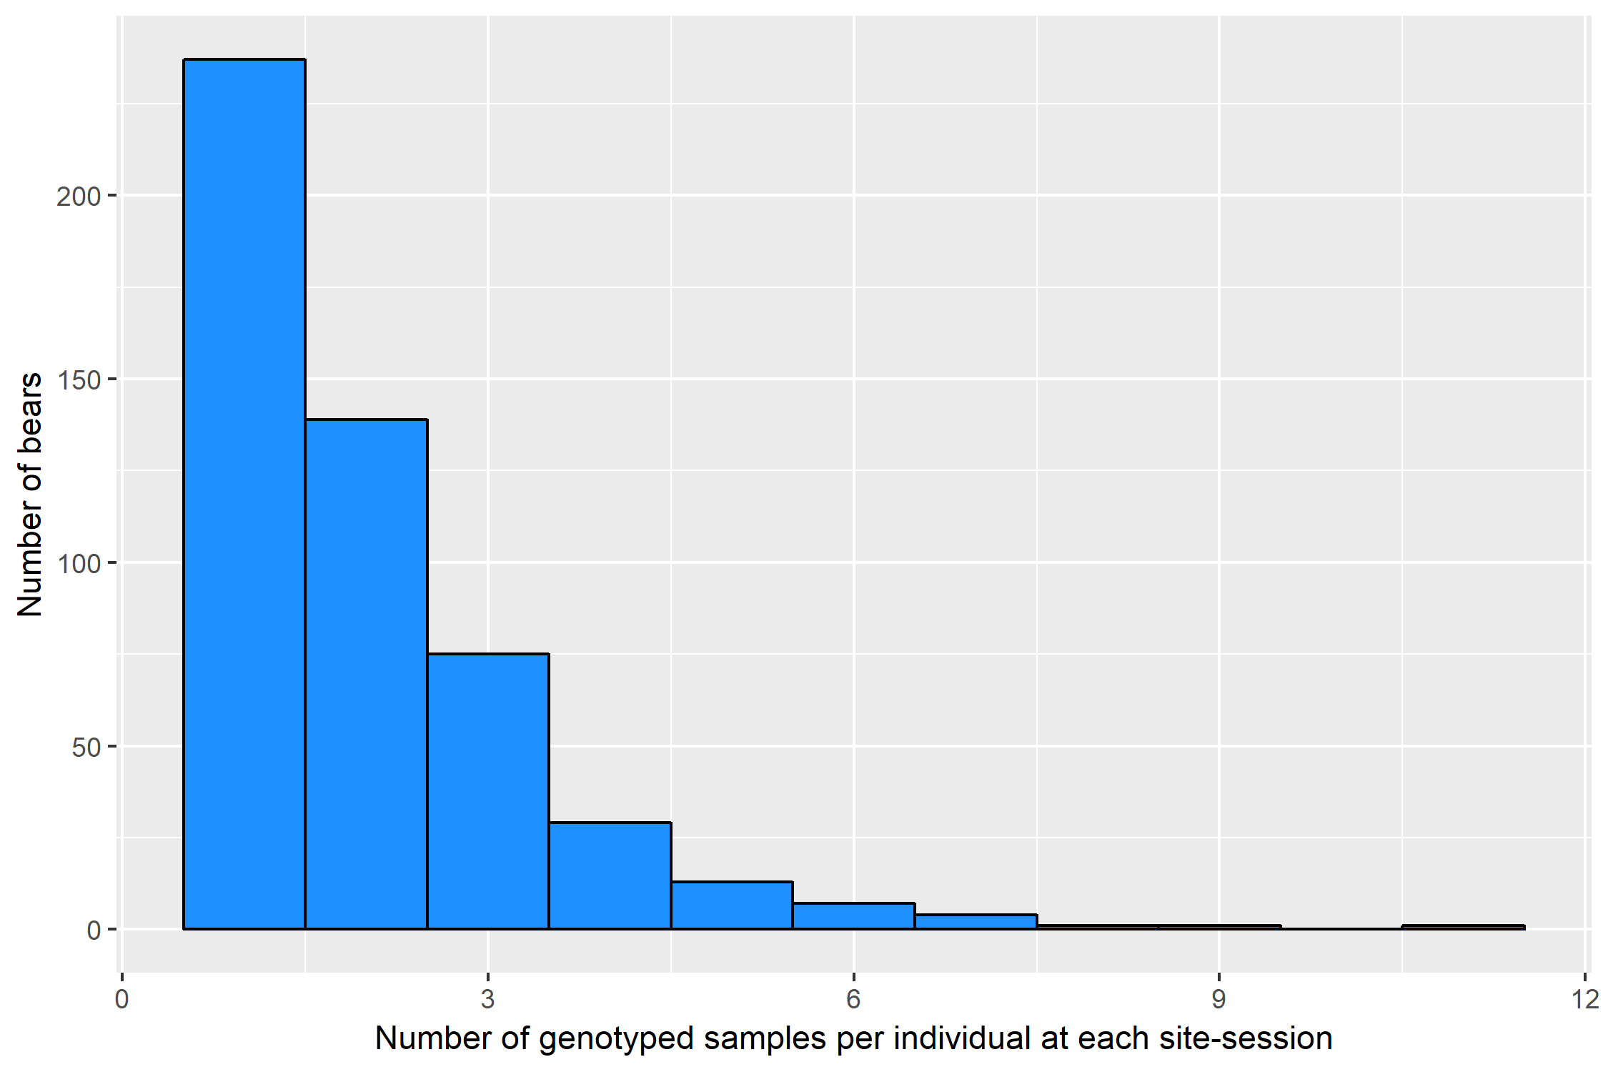
46.7% of individuals that left hair at a given trap during a sampling session were detected just once at that site-session
25.8% of individuals that left hair at a given trap during a sampling session were detected three or more times at that site-session

