Slide 1
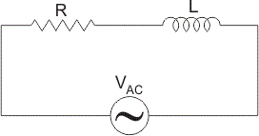
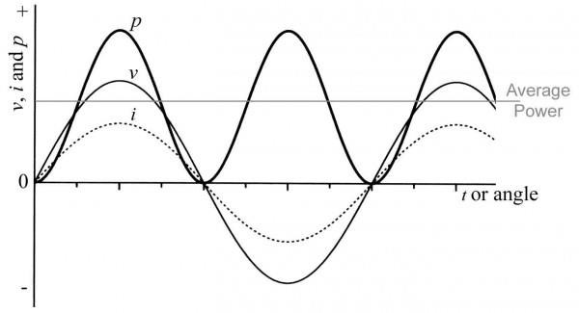
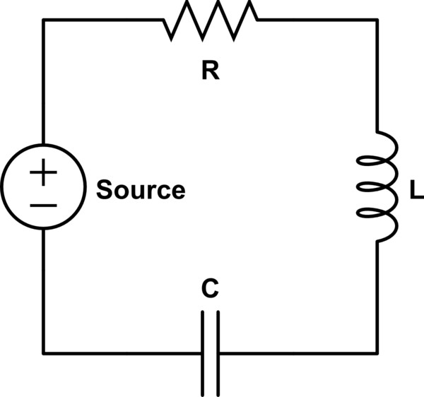
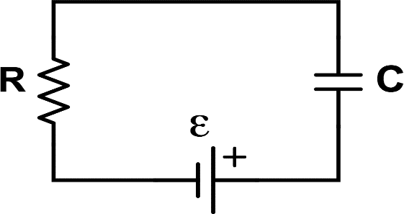
Unit-6
Single Phase AC Series Circuits
1
Prepared by:
Dharmesh Dabhi
M & V Patel Department of Electrical Engineering
CHARUSAT

Slide 2








Content
2
R-L and R-C Series Circuit
Power in AC Circuits R-L-C Series Circuit
Resonance in R-L-C Series Circuit Examples

Slide 4
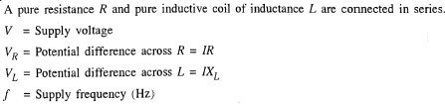
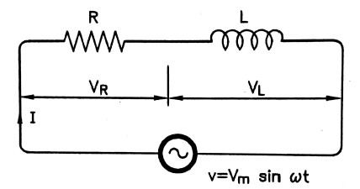

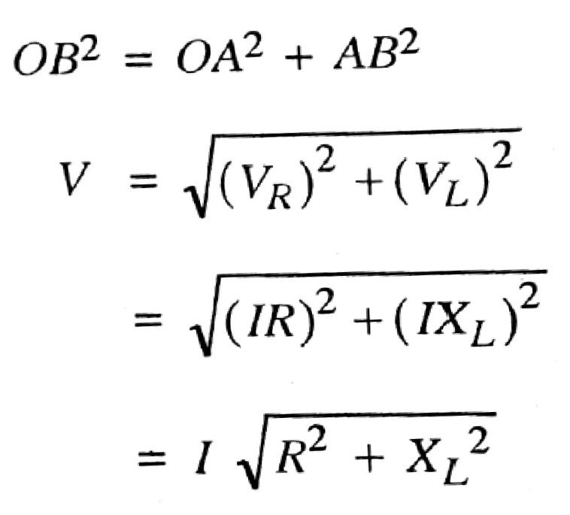
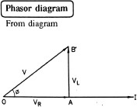

R-L Series Circuit
3

Slide 5


4

Slide 6
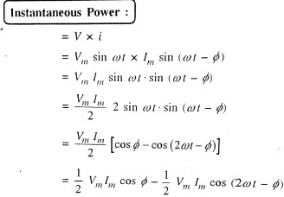
5

Slide 7
6

Slide 8
7
Power Waveform:-
Waveform of v and i:-

Slide 11
Active, Reactive and Apparent Power
8

Slide 15
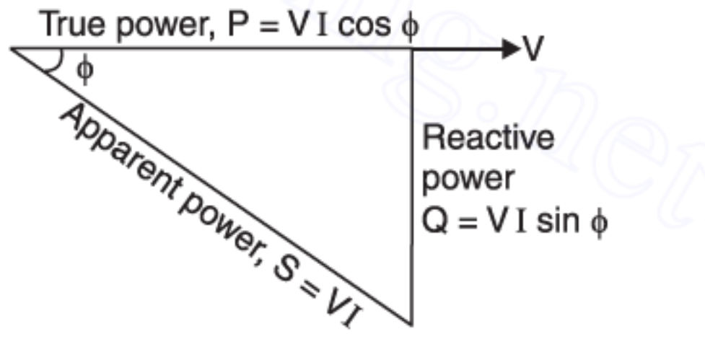

POWER TRIANGLE

Slide 16
POWER FACTOR

Slide 17
SIGNIFICANCE OF POWER FACTOR

Slide 20
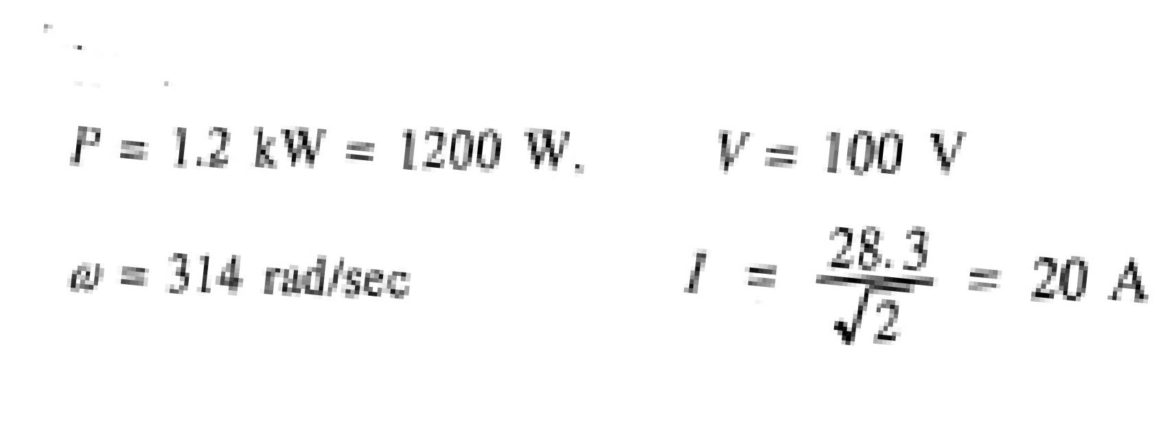
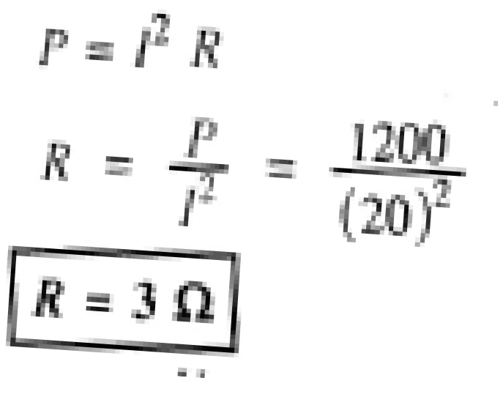


12
A power dissipation of 1.2kW occurs when a sinusoidal voltage of 100 volts r.m.s. is applied to an R-L series circuit and a current flow is given by i=28.3*sin(314t - ø). determine: (i) Impedance, resistance and inductive reactance (ii) Power factor of the circuit and (iii) Voltage across R and L. Draw vector diagram showing current and all voltages.
Ans:-

Slide 21

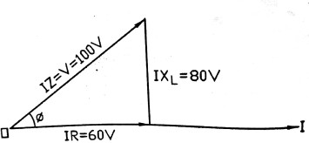


13

Slide 22
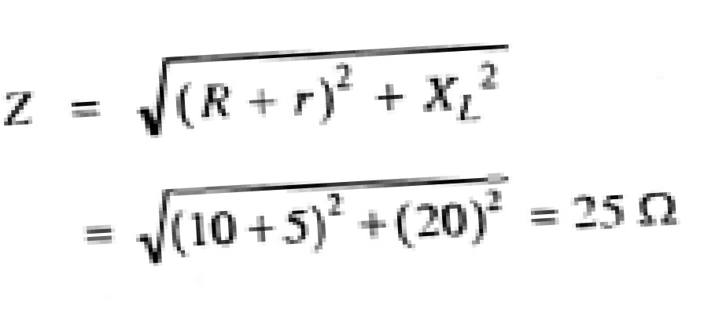



A choke coil having a resistance of 10Ω and a inductance of 63.7mH is connected in series with a resistance of 5 Ω. The circuit is connected across 230V, 50Hz supply. Calculate (i) current (ii) voltage across the coil (iii) power factor (iv) voltage across 5Ω resistor (v) power. Draw complete phasor diagram.
14

Slide 23
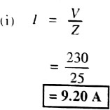
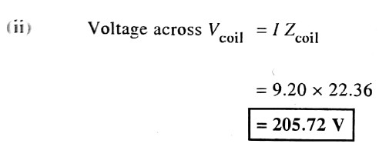
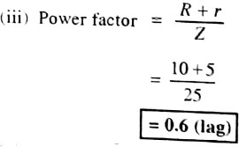
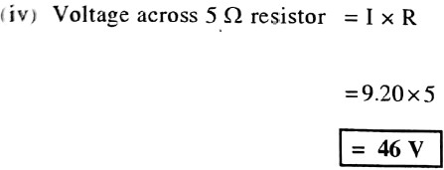
15

Slide 24
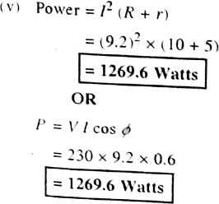
16

Slide 26
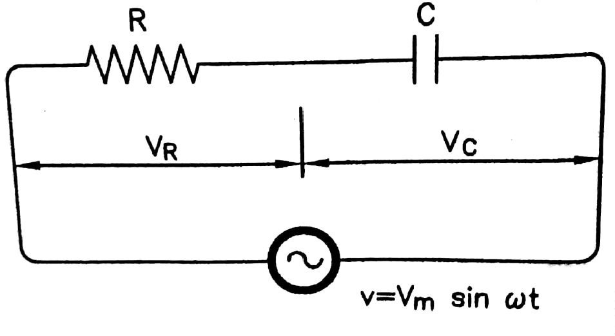
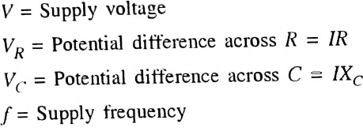

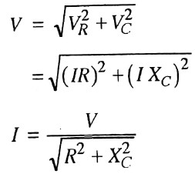

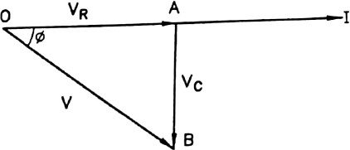
R-C Series Circuit
17

Slide 27

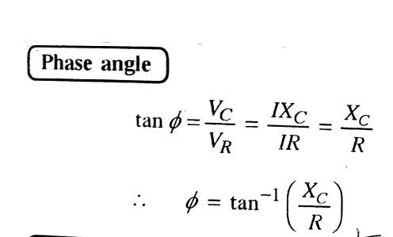
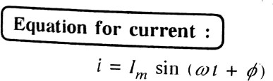
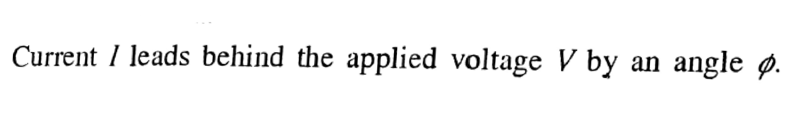
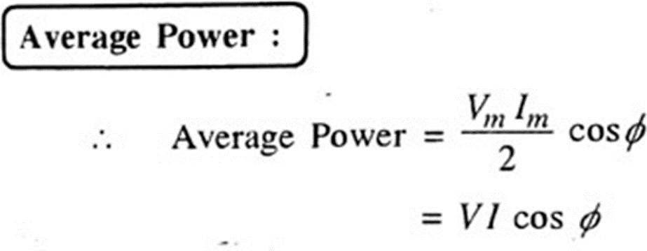
18

Slide 28

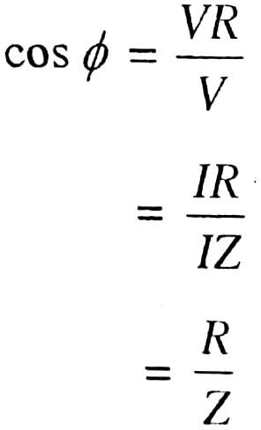
19

Slide 29







21
1. A resistor & a capacitor are connected in series across 230 V, ac supply. The current taken by the circuit is 6A for 50 Hz frequency. The current is reduced to 5 A., when the frequency of supply is decreased to 40 Hz. Determine the value of resistor & the capacitor.
Ans:-

Slide 30

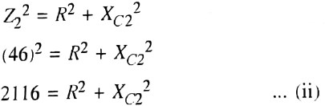

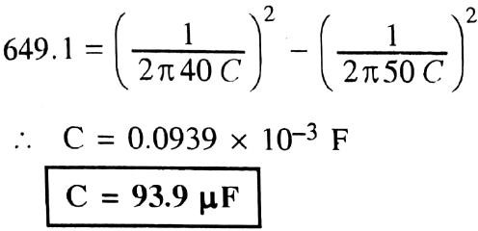
22

Slide 31
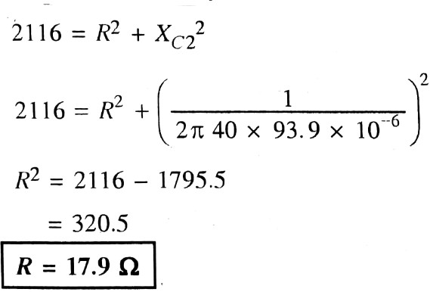
23

Slide 32

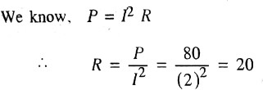

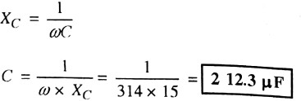

2.A capacitor and a resistor are connected in series to an ac supply of 50 V, 50 Hz. The current is 2A and the power dissipated in the circuit is 80 W. Determine the value of resistor & the capacitor.
24

Slide 35
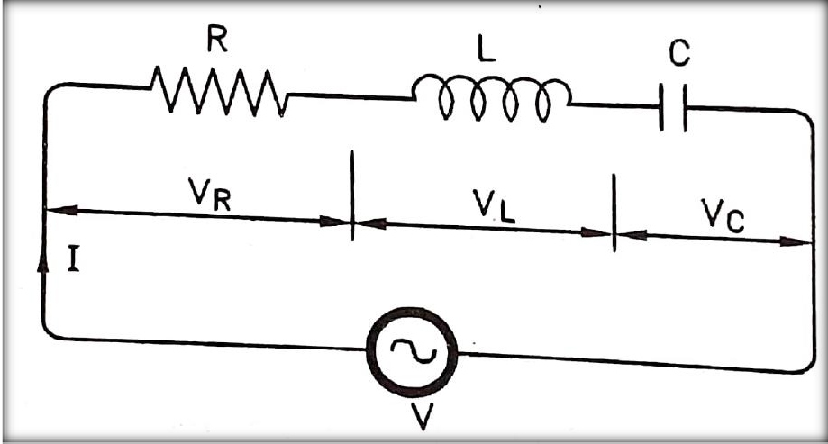
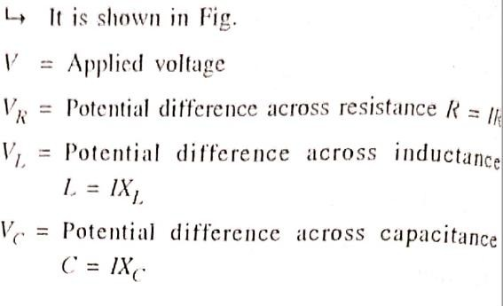
Series R-L-C Circuit
25

Slide 40
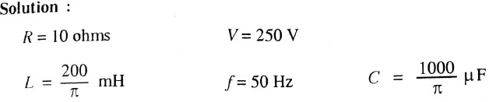
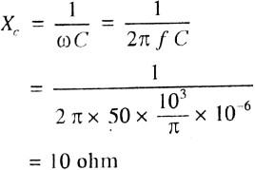
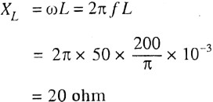
1. A series circuit has resistance of 10 ohms, inductance 200/п mH
and capacitance 1000/ п micro-farad. Calculate:
29
The current, flowing in the circuit of supply voltage 250 V, 50 Hz.
Power factor for the circuit.
Power drawn from the supply.
Also draw the phasor diagram.

Slide 41
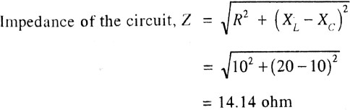
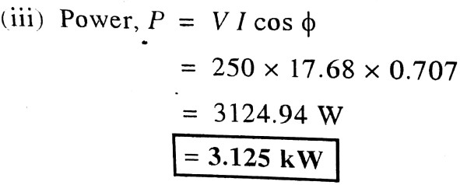
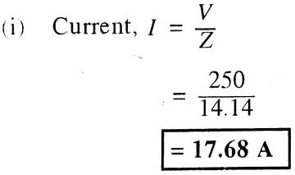
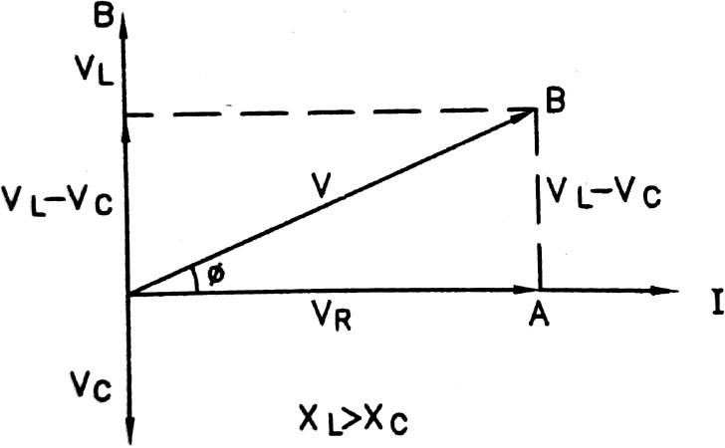
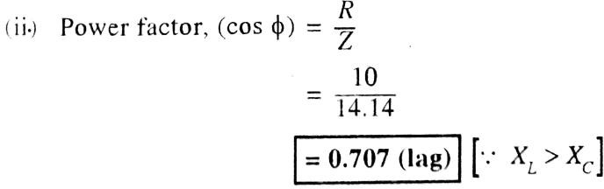
30

Slide 42
RESONANCE in A.C circuit

Slide 43
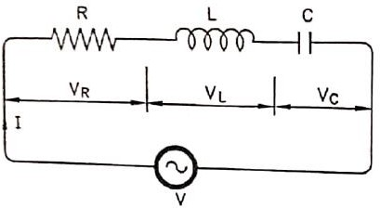
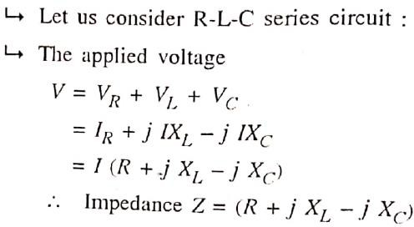
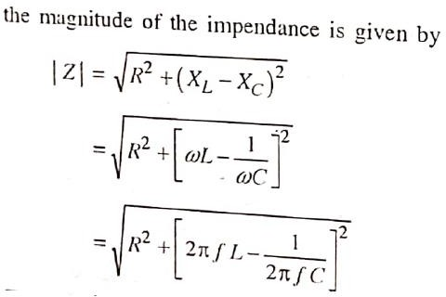
Resonance in R-L-C Series Circuit
31

Slide 44
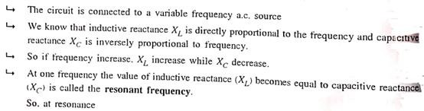
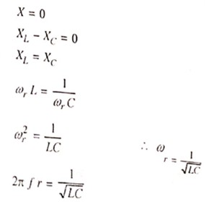
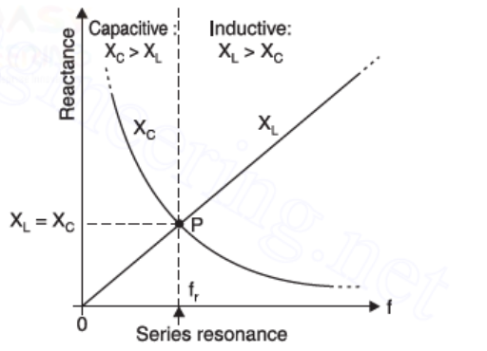
32
Resonance Curve

Slide 45
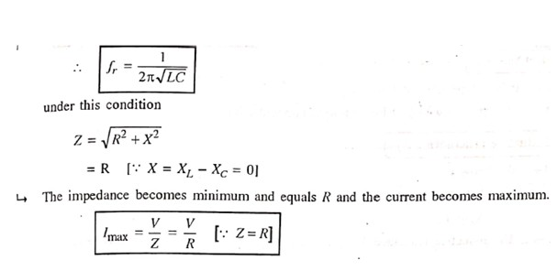
33

Slide 46

Q-FACTOR
34

Slide 47


35

Slide 48



Bandwidth of Resonant circuit
36

Slide 49


1. An RLC series circuit has R=10 Ω, L=10 mH and C= 1μF has an applied voltage of 230 V at resonant frequency. Calculate the resonant frequency, the current in the circuit and voltages across the each elements at resonance. Find also the Q-factor and bandwidth.
37

Slide 50





38

Slide 51
fr=723.79 Hz
Q=Factor=113.62

