Slide 1


DEVELOPED BY:
TEAM NAME:
GONE SHIVAKUMAR
MATHLETES
MANCHALA NIKHIL BHARADWAJ
SYEDA SARA SARWATH
YADA NAVEEN

Slide 2


PNEUMONIA PREDICTION USING X-RAY IMAGE
REMOTE SUMMER INTERNSHIP PROGRAM

Slide 3

TOPICS
INTRODUCTION
OVERVIEW
TOOLS REQUIRED
ADVANTAGES
FUTURE SCOPE

Slide 4

THE RISK OF PNEUMONIA IS IMMENSE FOR MANY, ESPECIALLY IN DEVELOPING NATIONS WHERE BILLIONS FACE ENERGY POVERTY AND RELY ON POLLUTING FORMS OF ENERGY.
THE PROPOSED PREDICTION MODEL IS IMPLEMENTED BY CONVOLUTIONAL DEEP NEURAL NETWORKS (CNN) USING PYTHON PROGRAMMING LANGUAGE AND THE MODEL IS CONVERTED INTO A WEBSITE APPLICATION.
INTRODUCTION
DEMONSTRATION OF THE EFFICIENCY OF THE PROPOSED METHOD WITH THE MINIMIZATION OF THE COMPUTATIONAL COST AS THE FOCAL POINT WAS CONDUC -TED AND COMPARED WITH THE EXISTING STATE-OF-THE-ART PNEUMONIA CLASSIFICATION NETWORKS.
P

Slide 5
PNEUMONIA IS AMONG THE TOP DISEASES WHICH CAUSE MOST OF THE DEATHS ALL OVER THE WORLD.
HOWEVER, IT IS DIFFICULT TO JUDGE THE PNEUMONIA JUST BY LOOKING AT CHEST X-RAYS.
THE AIM OF THIS STUDY IS TO SIMPLIFY THE PNEUMONIA DETECTION PROCESS FOR EXPERTS AS WELL AS FOR NOVICES.
OVERVIEW
WE SUGGEST A NOVEL DEEP LEARNING FRAMEWORK FOR THE DETECTION OF PNEUMONIA USING THE CONCEPT OF TRANSFER LEARNING. IN THIS APPROACH, FEATURES FROM IMAGES ARE EXTRACTED USING DIFFERENT NEURAL NETWORK MODELS PRE-TRAINED ON IMAGENET, WHICH THEN ARE FED INTO A CLASSIFIER FOR PREDICTION.

Slide 6

SOFTWARE REQUIRED
GOOGLE COLLAB / JUPYTER
SUBLIME TEXT / SPYDER IDE
DEEP LEARNING ALGORITHM (CONVOLUTIONAL NEURAL NETWORK)
PYTHON (NUMPY,KERAS,TENSORFLOW)
HTML
FLASK

Slide 7
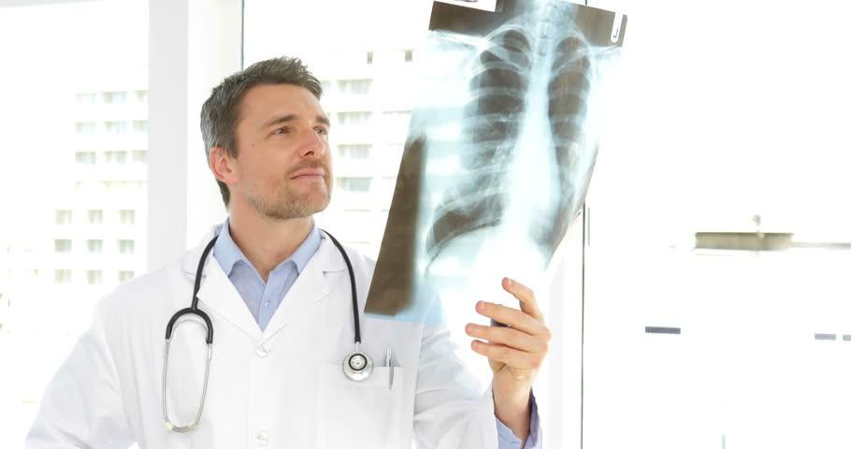
ADVANTAGES
Doctors can predict the pneumonia disease more accurately using this deep learning model.
By using this model we can precisely predict pneumonia.

Slide 8

FUTURE SCOPE
It is no doubt that the predictive model can be improved even better by performing data augmentation or implementing a transfer learning concept which facilitates the model a room for improvement. Therefore, this will be added as further enhancement in the upcoming stories.
The developed model can be further extended for the end users .

Slide 9
THANK YOU

