Slide 1
MPC for reference tracking
Rebuild the optimization problem

Slide 2
Overview of the MPC tracking problem.
The tracking problem is very different from the stuff about LQR taught in previous exercises. The main challenges are
how could we rebuild the optimization problem[1][2].
The structure of the new optimization problem might be very annoying thus we must spend more effort to determine and further to implement it. That’s the part of setting the matrices from task list formula (2).

Slide 3
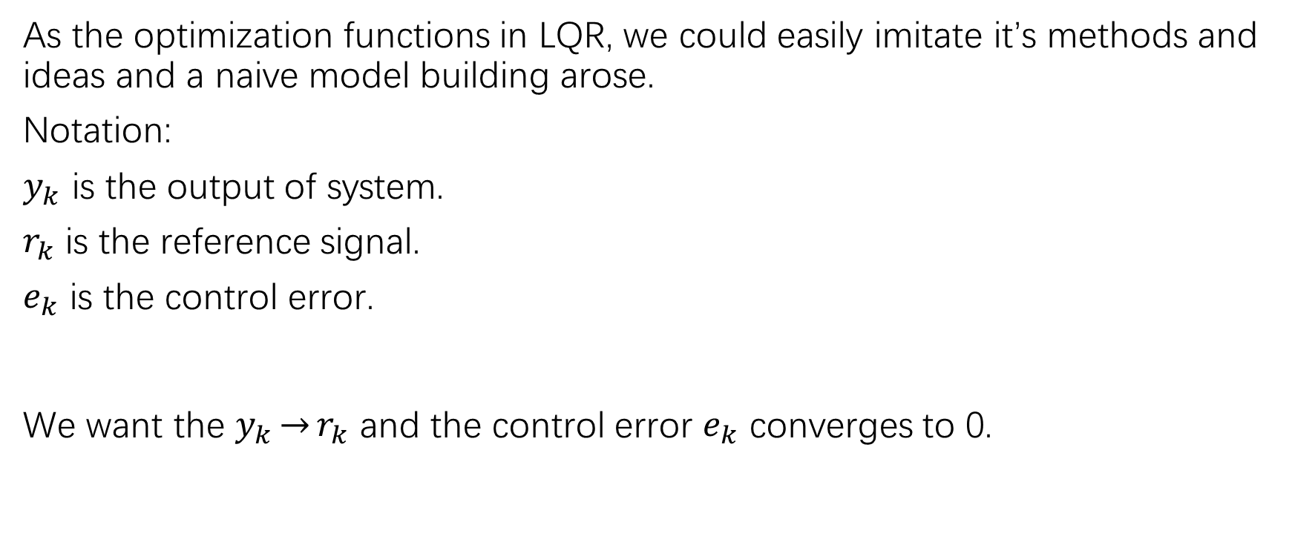
1. Naive approach
As the optimization functions in LQR, we could easily imitate it’s methods and ideas and a naive model building arose.
Notation:
$y_{k}$ is the output of system.
$r_{k}$ is the reference signal.
$e_{k}$ is the control error.
We want the $y_{k}\underset{→}{}r_{k}$ and the control error $e_{k}$ converges to 0.

Slide 4
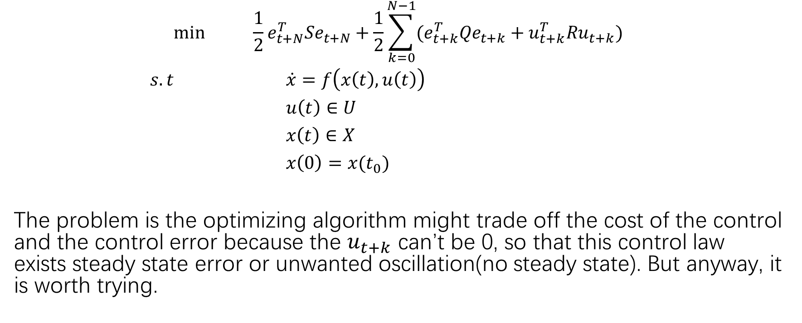
Optimization Problem
$$\min{ \frac{1}{2}e_{t+N}^{T}Se_{t+N}+\frac{1}{2}\sum_{k=0}^{N−1}{(e_{t+k}^{T}{Qe}_{t+k}+u_{t+k}^{T}Ru_{t+k})}}$$
$s.t$ $\dot{x}=f\left(x\left(t\right),u\left(t\right)\right)$
$u\left(t\right)∈U$
$x\left(t\right)∈X$
$x\left(0\right)=x(t_{0})$
The problem is the optimizing algorithm might trade off the cost of the control and the control error because the $u_{t+k}$ can’t be 0, so that this control law exists steady state error or unwanted oscillation(no steady state). But anyway, it is worth trying.

Slide 5
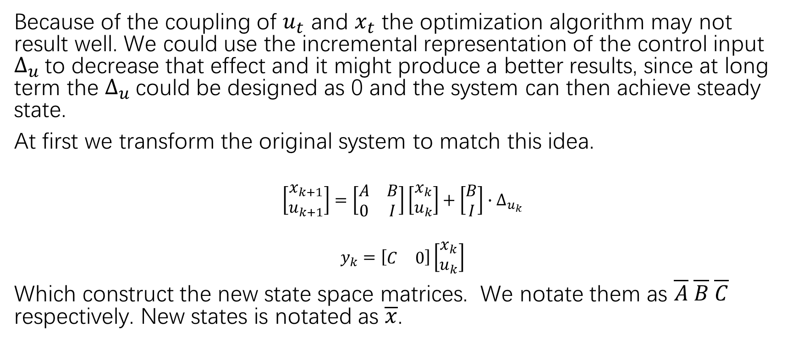
2. A more sophisticated construction of the optimization problem.
Because of the coupling of $u_{t}$ and $x_{t}$ the optimization algorithm may not result well. We could use the incremental representation of the control input $∆_{u}$to decrease that effect and it might produce a better results, since at long term the $∆_{u}$could be designed as 0 and the system can then achieve steady state.
At first we transform the original system to match this idea.
$$\left[\begin{matrix}x_{k+1} \\ u_{k+1}\end{matrix}\right]=\left[\begin{matrix}A & B \\ 0 & I\end{matrix}\right]\left[\begin{matrix}x_{k} \\ u_{k}\end{matrix}\right]+\left[\begin{matrix}B \\ I\end{matrix}\right]∙∆_{u_{k}}$$
$$y_{k}=\left[\begin{matrix}C & 0\end{matrix}\right]\left[\begin{matrix}x_{k} \\ u_{k}\end{matrix}\right]$$
Which construct the new state space matrices. We notate them as $\overline{A} \overline{B} \overline{C}$ respectively. New states is notated as $\overline{x}$.

Slide 6
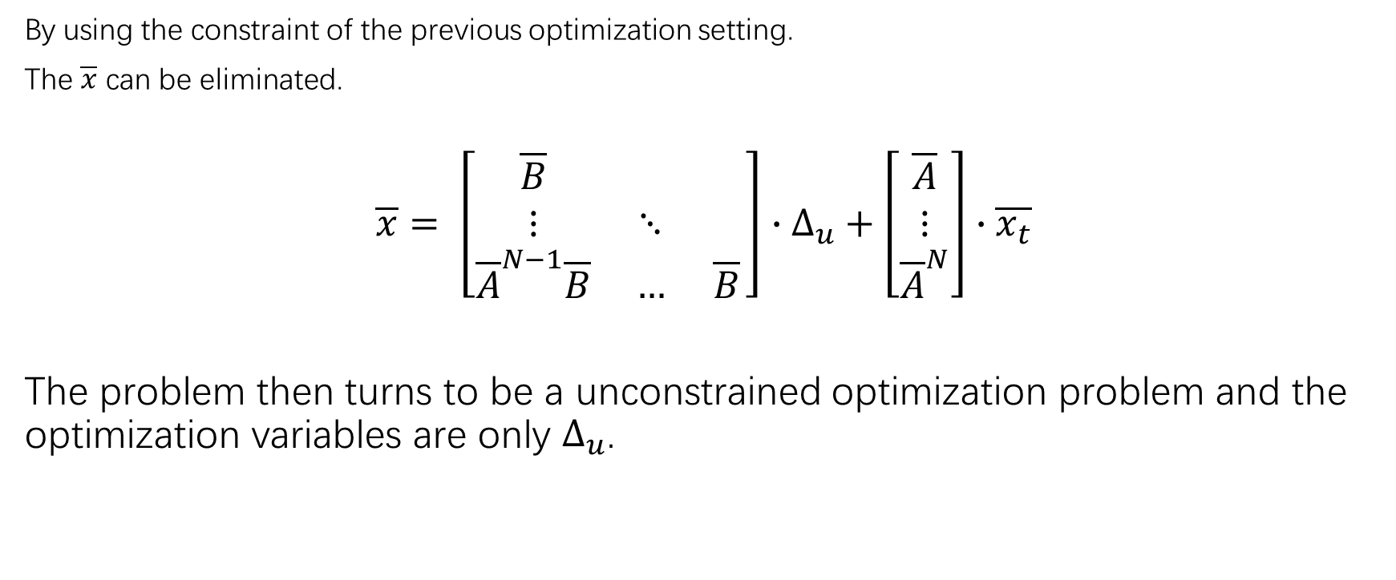
“sequential approach”
By using the constraint of the previous optimization setting.
The $\overline{x}$ can be eliminated.
$$\overline{x}= \left[\begin{matrix}\overline{B} & & \\ ⋮ & ⋱ & \\ {\overline{A}}^{N−1}\overline{B} & … & \overline{B}\end{matrix}\right]∙∆_{u}+\left[\begin{matrix}\overline{A} \\ ⋮ \\ {\overline{A}}^{N}\end{matrix}\right]∙\overline{x_{t}}$$
The problem then turns to be a unconstrained optimization problem and the optimization variables are only $∆_{u}$.

Slide 7
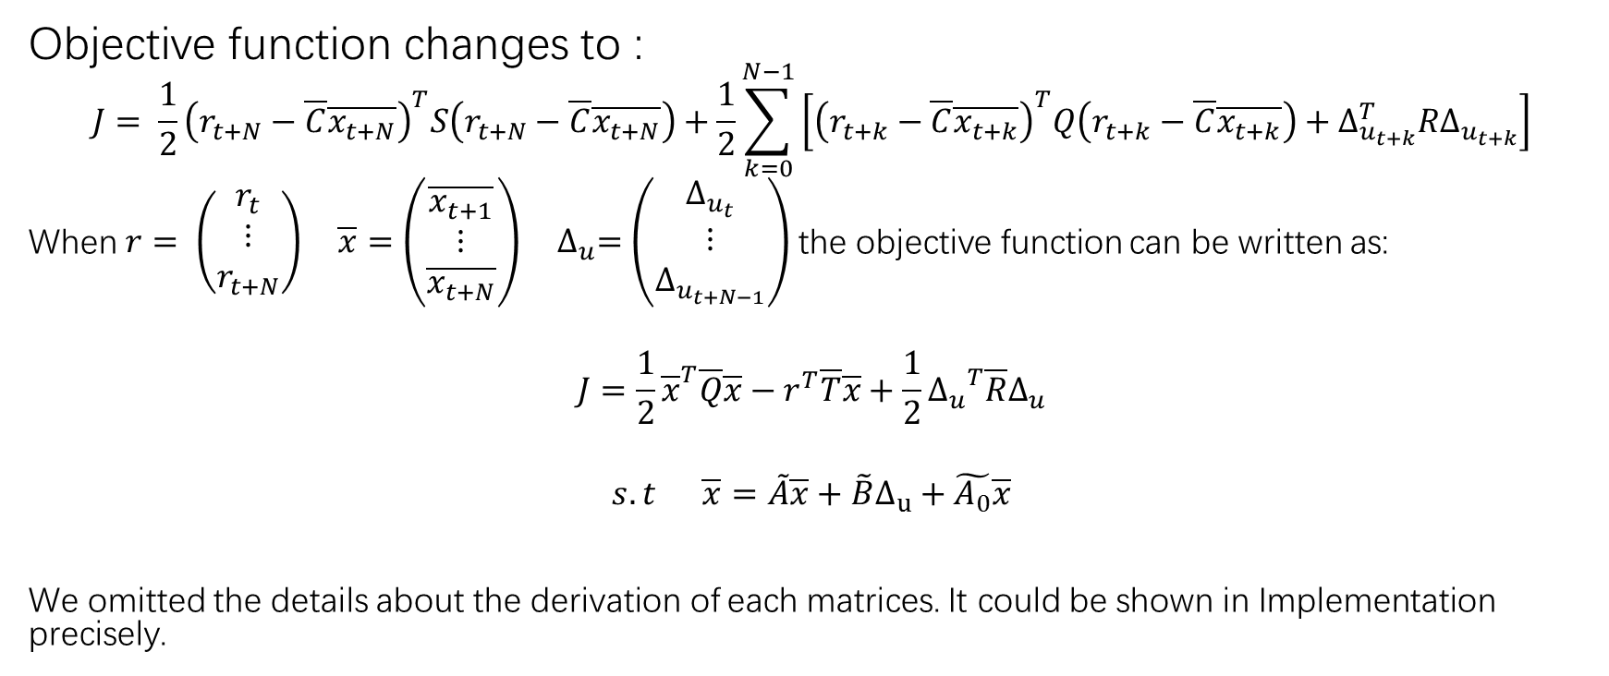
The new optimization setting. (simultaneous approach)
Objective function changes to :
$$J= \frac{1}{2}{\left(r_{t+N}−\overline{C}\overline{x_{t+N}}\right)}^{T}S\left(r_{t+N}−\overline{C}\overline{x_{t+N}}\right)+\frac{1}{2}\sum_{k=0}^{N−1}{\left[{\left(r_{t+k}−\overline{C}\overline{x_{t+k}}\right)}^{T}Q\left(r_{t+k}−\overline{C}\overline{x_{t+k}}\right)+∆_{u_{t+k}}^{T}R∆_{u_{t+k}}\right]}$$
When $r= \left(\begin{matrix}r_{t} \\ ⋮ \\ r_{t+N}\end{matrix}\right) \overline{x}=\left(\begin{matrix}\overline{x_{t+1}} \\ ⋮ \\ \overline{x_{t+N}}\end{matrix}\right)$ $∆_{u}=\left(\begin{matrix}∆_{u_{t}} \\ ⋮ \\ ∆_{u_{t+N−1}}\end{matrix}\right)$ the objective function can be written as:
$$J=\frac{1}{2}{\overline{x}}^{T}\overline{Q}\overline{x}−r^{T}\overline{T}\overline{x}+\frac{1}{2}{∆_{u}}^{T}\overline{R}∆_{u}$$
$$s.t \overline{x}=\tilde{A}\overline{x}+\tilde{B}∆_{u}+\tilde{A_{0}}\overline{x}$$
We omitted the details about the derivation of each matrices. It could be shown in Implementation precisely.

