Slide 1
MPC Tracking
What we have now:
Identified model
Full state estimator
Approach:
Formulate optimization problems to complete the prediction of the specified horizon of MPC.
Simultaneous approach
Sequential approach

Slide 2
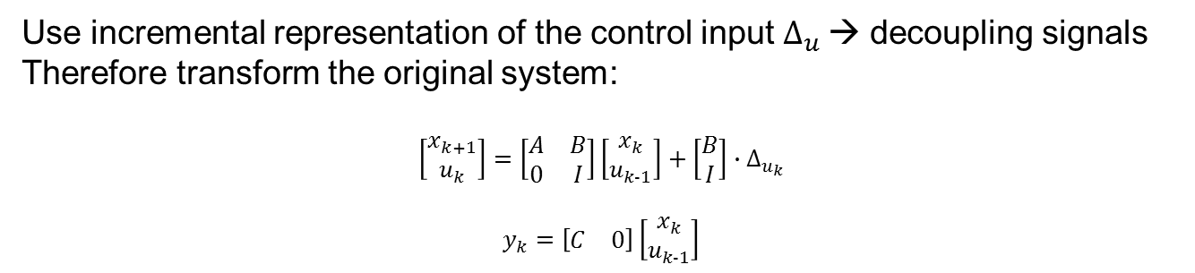

MPC Tracking (Optimization problem forming)
Use incremental representation of the control input $∆_{u}$→ decoupling signals
Therefore transform the original system:
$$\left[\begin{matrix}x_{k+1} \\ u_{k}\end{matrix}\right]=\left[\begin{matrix}A & B \\ 0 & I\end{matrix}\right]\left[\begin{matrix}x_{k} \\ u_{k-1}\end{matrix}\right]+\left[\begin{matrix}B \\ I\end{matrix}\right]∙∆_{u_{k}}$$
$$y_{k}=\left[\begin{matrix}C & 0\end{matrix}\right]\left[\begin{matrix}x_{k} \\ u_{k-1}\end{matrix}\right]$$
Simultaneous approach
$J=\frac{1}{2}{\overline{x}}^{T}\overline{Q}\overline{x}−r^{T}\overline{T}\overline{x}+\frac{1}{2}{∆_{u}}^{T}\overline{R}∆_{u}$
$$s.t \overline{x}=\tilde{A}\overline{x}+\tilde{B}∆_{u}+\tilde{A_{0}}\overline{x_{t}}$$
Sequential approach
$$J= \frac{1}{2}∆_{u}^{T}\overset{̿}{H}∆_{u}+\left[\begin{matrix}{\tilde{x}}_{t}^{T} & r^{T}\end{matrix}\right]∙F^{T}∙∆_{u}$$
$$s.t \sum_{k=0}^{N−1}{∆_{u}\left(t+k\right)∈[u_{min},u_{max}]}$$

Slide 3
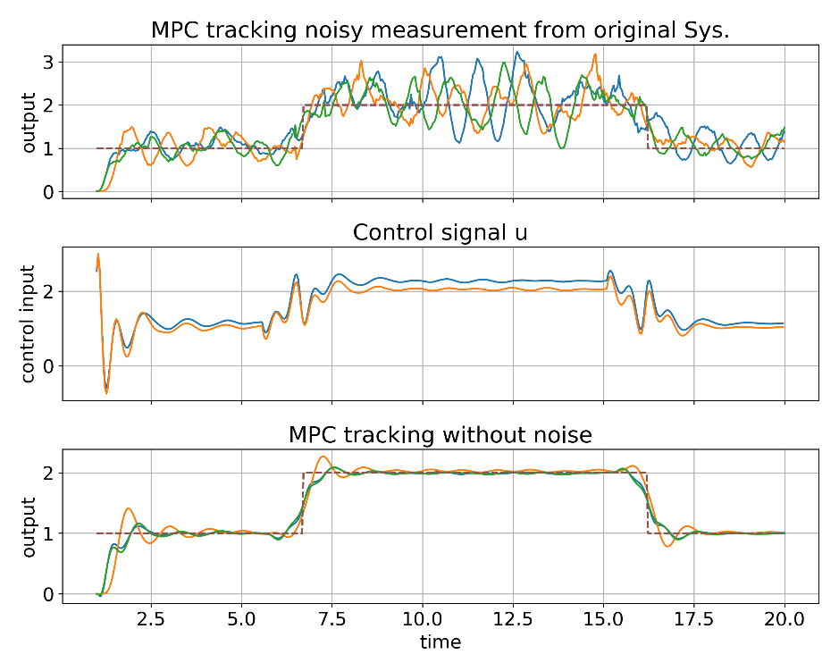
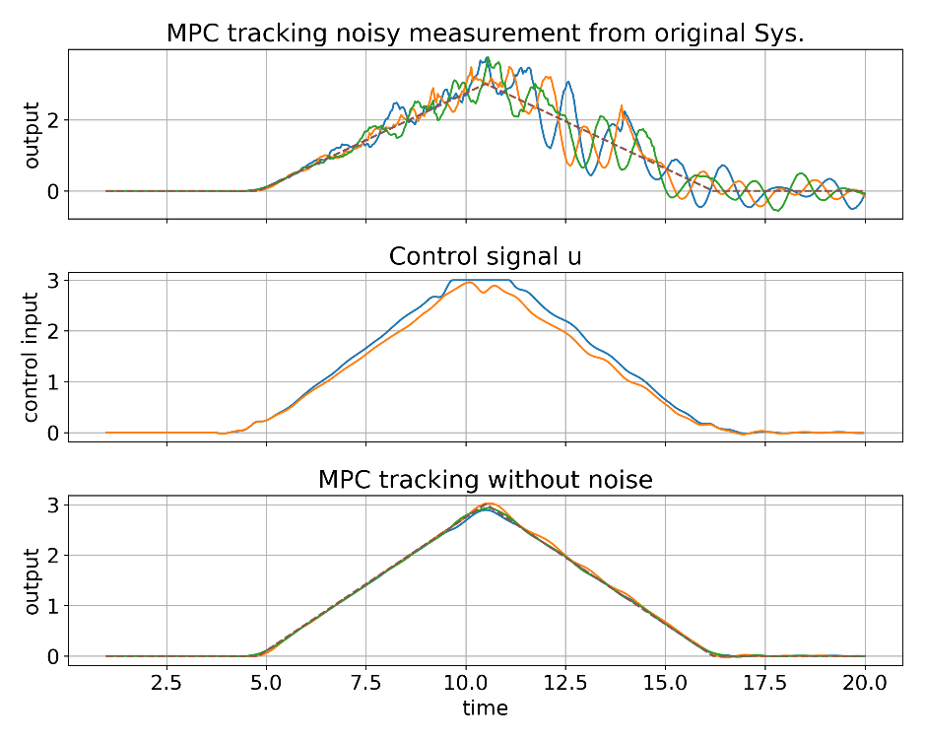
MPC Tracking(Performance: Horizon = 30,sampling time = 0.04s)
Constant value signal
Ramp signal

Slide 4
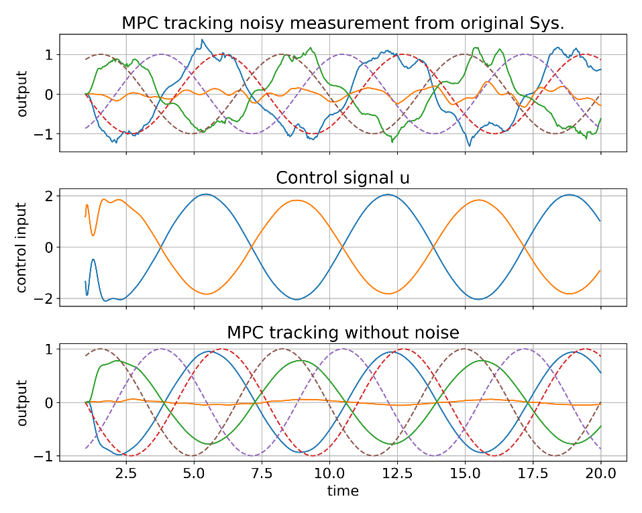
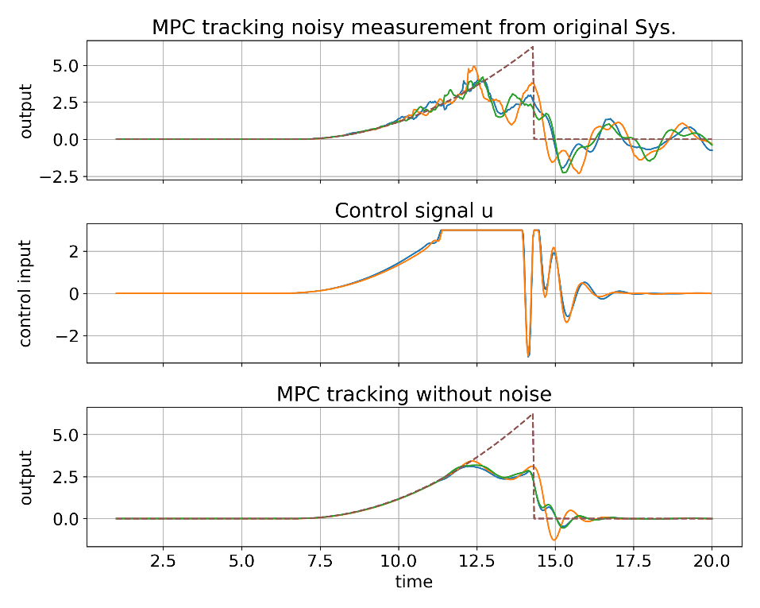
MPC Tracking(Performance: Horizon = 30,sampling time = 0.04s)
Trigonometric signal
Acceleration signal

