Slide 1

Computational Analysis of the Roles of ER-Golgi Network in the Cell Cycle
Haijun Gong, PhD
Department of Mathematics and Computer Science
Saint Louis University
St. Louis, MO, USA
August 1, 2014
InCoB2014, Sydney, Australia
Notes:
1

Slide 2
Outlines
ER-Golgi Network
Discrete-value Model of Signaling Pathways
Synchronous & Asynchronous Model Checking
Formal Analysis
Conclusions
07/16/09
07/16/09
07/16/09
07/16/09
07/16/09

Slide 3
ER-Golgi Network
Endoplasmic reticulum (ER) and Golgi apparatus: regulate the assembling, folding, sorting and transport of newly synthesized secretory proteins in the final stages of biosynthesis.
ER stress-induced signaling pathways and malfunction of Golgi apparatus are associated with the pathogenesis of cancer and Alzheimer’s disease (AD).
Pathway regulated by the ER-Golgi network can sense the external stress or stimulus, possibly leading to the activation of both pro-survival and apoptosis signaling pathways if the threshold of stress-signaling is exceeded.
Targeting ER-Golgi-regulated apoptosis-survival signaling pathways could be novel therapeutic targets for cancer and AD treatment.

Slide 4
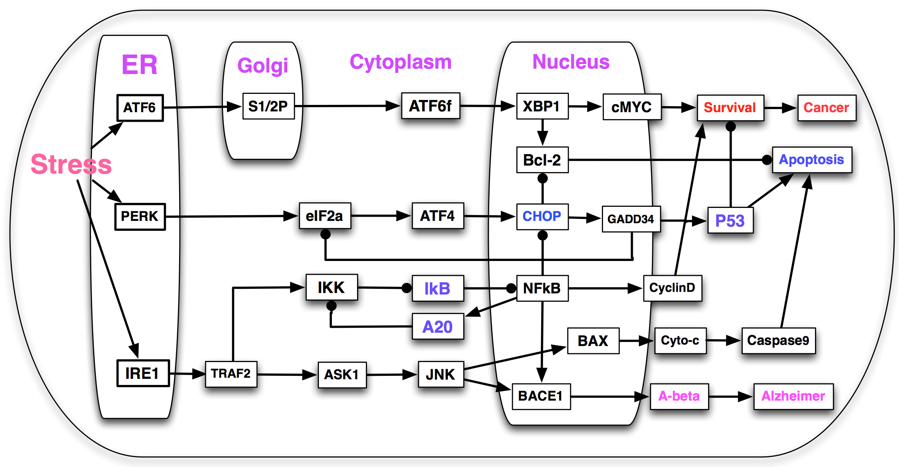
Signaling Pathway
Notes:
It is not realistic to use continuous models simulate a big network before you know most of parameters. Instead of using traditional technique to simulate, we marry symbolic model checking with boollean network to study the signal transduction.

Slide 5
Key Signaling Pathways
ATF 6 + S1/2P → ATF6f → XBP1→{cMYC,Bcl-2} →Survival.
PERK → eIF2α → ATF4 → CHOP → GADD34 → P53 → Apoptosis.
IRE1 → TRAF2 → ASK1 → JNK → BACE1 → Aβ → Alzheimer Disease
TRAF2 → IKK ⊣ IκB ⊣ NFκB → {CyclinD,BACE1,A20}:
JNK → BAX → Cytochrome c → Caspase9 → Apoptosis.

Slide 6
Challenges for Modeling
Large number of components with many unknown parameters.
It is time-consuming and not realistic to use traditional methods (ODE, SDE, SSA, Boolean Simulation) to analyze a large network with an astronomical number of states!
One of systems biologist’s interests is to verify the signal transduction sequences that will drive the network to a pre-specified state at or before a pre-specified time.
Notes:
Successfully check… in hardware and digital circuits study. We implant and marry SMV with boolean network of cancer study.

Slide 7
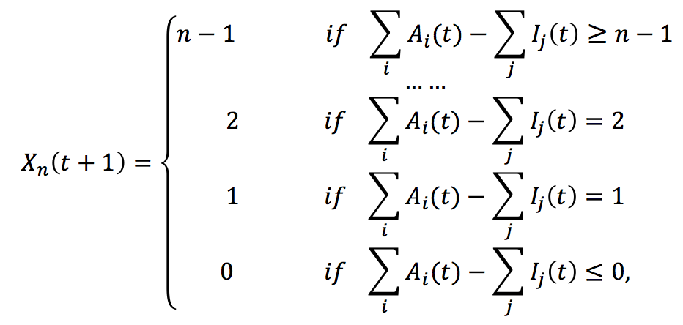
Discrete Value Model
Each node represents a regulatory component in the pathway.
State (expression level) of each node takes discrete values at any time: {0,1,...,n-1}, namely, 0=inhibited, ..., n-1=overexpressed.
State of each node can take n possible values {0,1,...,n-1}, so the network with m proteins has n^{m} possible states.
The evolution (state update) of each node from time t to t+1 is described by a discrete state transfer function, which is regulated by the parental Activators and Inhibitors.
07/16/09
07/16/09
07/16/09
07/16/09
Notes:
an activator node can promote or activate the expression of its downstream nodes, while the inhibitor node will inhibit or repress the expression of its downstream nodes.
In a discrete value model, each node represents a protein or a lipid involved in the signaling pathway. The expression level (state value) of each regulatory component (node) in the pathway can take discrete values at any specific time, for example {0, 1, 2, ..., n}, namely, 0 = not expressed, ... , n = overexpressed
evolution (state update) of each node from time t to t+1 is described by a discrete state transfer function, which is dependent on the state of the neighboring nodes. In this work, we assume each node can take a value of {0, 1, 2} (it can be extended to n discrete values). Similar to our previous work [8,9,24], the neighboring nodes are classified as activators or inhibitors: an activator node can promote or activate the expression of its downstream nodes, while the inhibitor node will inhibit or repress the expression of its downstream nodes.

Slide 8
ER-Golgi-regulated Signaling Pathway
30 nodes, the state of each node can take {0, 1, 2}.
> 3³⁰ = 20 trillion possible states!
Model Checking method can solve this problem gracefully: can check up to 10¹⁰⁰ possible states!
Notes:
It is not realistic to use continuous models simulate a big network before you know most of parameters. Instead of using traditional technique to simulate, we marry symbolic model checking with boollean network to study the signal transduction.

Slide 9
Model Checking
Model checking is an automatic verification technique for the hardware systems (digital circuits, CPU).
Developed independently by Clarke and Emerson and by Queille and Sifakis in early 1980’s, 2007 Turing Award.
Model checking is the process of determining whether or not a given model M satisfies a desired property – ƒ written in temporal logic.
Model Checking Problem: Give a desired property ƒ, a Model/System M with initial state s, decide M, s |= ƒ.
Verification procedure is an intelligent exhaustive search of the state space of the model.
Clarke EM, Grumberg O, Peled DA: Model Checking. MIT Press 1999

Slide 10

Intel Pentium FDIV Bug
66MHz Intel Pentium
with the FDIV bug
Thomas R. Nicely found a bug in the 94’s Intel Pentium
Try 4195835 – 4195835 / 3145727 * 3145727 = ?
Should return 0
But, In 94’ Pentium, it returns 256.
Five entries are missing in the lookup table used by the floating point division algorithm
Cost: $500 million

Slide 11

Model Verification
Model: Program or circuit
Specification/Property
State Transition System
Temporal Logic Formula
(CTL, LTL, etc.)
Safety Property:
bad state unreachable:
Initial State
Model Checker
Satisfied / True !

Slide 12
Model Falsification
Model: Program or circuit
Specification/Property
State Transition System
Temporal Logic Formula
(CTL, LTL, etc.)
Safety Property:
bad state unreachable?
Initial State
Model Checker
Not Satisfied / False !

Slide 13
Counterexamples
Temporal Logic Formula
(CTL, LTL, etc.)
Safety Property:
bad state unreachable?
Initial State
Model Checker
Not Satisfied!
Counterexample
Initial State

Slide 14
LTL - Linear Temporal Logic
Linear Time Logic operators: X, F, G, U …
Atomic Propositions;
Boolean Operations ( Not ¬(!), And ˄(&), Or ˅(|) )
For example, a = (p1 > p2) ˄ !(p3 > p4)
a “a is true now”
a
X a “a is true in the neXt state”
a

Slide 15
LTL - Linear Temporal Logic
Fa “a will be true in the Future”
a
Ga “a will be Globally true”
a
a
a
a
a
Complexity of Model Checking:
LTL algorithm O(|M|∙2^{|f|})
a U b “a will hold true Until b becomes true”
a
a
a
a
b

Slide 16
Branching Time
Computation Tree
State Transition Graph
Unwind
Path quantifiers:
A: for all computation paths
E: for some computation path
CTL temporal operators: AX, AG, AF, AU; EX, EG, EF, EU
Computation Tree Logic (CTL)
Notes:
Ben-Ari, Manna, Pnueli

Slide 17
CTL: Computation Tree Logic
p
p
p
p
AF p: “p will necessarily
become true”
EF p: “p will possibly
become true”

Slide 18
CTL: Computation Tree Logic
p
p
p
p
p
p
p
p
p
p
EG p: “p is a potential
invariant”
AG p: “p is an invariant”

Slide 19
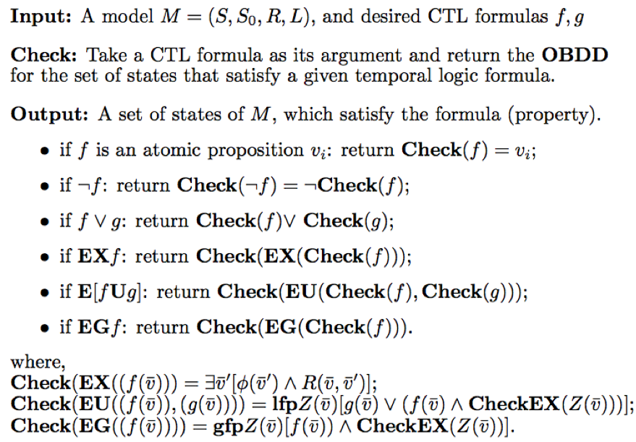
Symbolic Model Checking Algorithm
Symbolic Model Verifier (SMV) is the first model checker based on ordered binary decision diagram (OBDD) to verify CTL property.
SMV can check up to 10¹⁰⁰ possible states!
Clarke EM, Grumberg O, Peled DA:
Book:
Model Checking.
MIT Press 1999
Notes:
Clarke EM, Grumberg O, Peled DA: Model Checking. MIT Press 1999

Slide 20
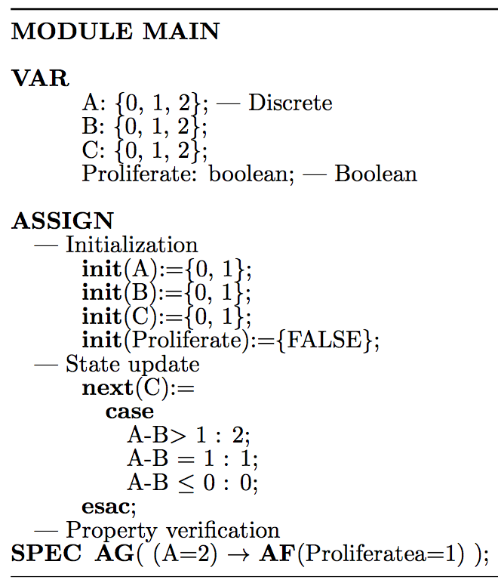
Synchronous Symbolic Model Checking
A
SMV code has 3 parts:
VAR:
declare variables
ASSIGN:
“init” defines the initial states; “next” update the state transition of the model
SPEC:
Each property is encoded as a CTL formula
C
B
Notes:
explicit-state model checking requires an individual representation of each state,
Complexity of CTL algorithm O(|M|∙|f|)
many systems have an astronomically large number of states, way too many to represent each state explicitly,
symbolic model checking allows a single compact representation (a BDD) to represent many states,
it is possible to efficiently perform the necessary operations on the forms (BDDs) used by symbolic model checking.

Slide 21
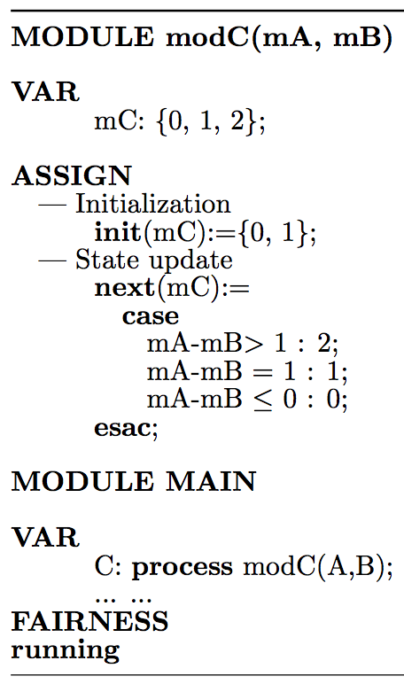
Asynchronous Symbolic Model Checking
Asynchronous SMV code can have several modules;
Each module corresponds to one asynchronous process
In the “main” module, each asynchronous process for a declared variable should be instantiated using the keyword “process”
Notes:
explicit-state model checking requires an individual representation of each state,
Complexity of CTL algorithm O(|M|∙|f|)
many systems have an astronomically large number of states, way too many to represent each state explicitly,
symbolic model checking allows a single compact representation (a BDD) to represent many states,
it is possible to efficiently perform the necessary operations on the forms (BDDs) used by symbolic model checking.

Slide 22
Formal Analysis (I)
Overexpressed IRE1 or PERK due to ER stress will promote the production of
Amyloid-β (Aβ), leading to the pathogenesis of Alzheimer’s disease.
Temporal logic formulas in Alzheimer’s disease
IRE1=2 → AF (Aβ ≥ 1 & Alzheimer = True)
PERK=2 → AF (Aβ ≥ 1 & Alzheimer = True)
IRE1(PERK) = j → AF(Caspase9 ≥ 1 & Apoptosis = True)
j=2 (prolonged stress): True
Prolonged ER stress can also induce the ”Apoptosis”. Verified by both synchronous & Asynchronous SMV.
But, j=1: False
SMV model checker outputs a counterexample to show why it is false.
Notes:
ER stress promotes the production of amyloid-beta peptides, a main composition of amyloid plaques, which is a major hallmark of Alzheimer’s disease.

Slide 23
Formal Analysis (II)
Identification of Key proteins
AG{ TRAF2 = 2 → AF(Aβ ≥ 1 & Alzheimer = True)}
AG{ NFkB = 2 → AF(Aβ ≥ 1 & Alzheimer = True)}
AG{ ASK1 = 2 → AF(Aβ ≥ 1 & Alzheimer = True)}
AG{ NFkB = 2 → AF(P53 = 0 & Cancer = True)}
These properties were verified by synchronous SMV, but falsified by asynchronous SMV.
However,
AG{ TRAF2 = 2 → EF(Aβ ≥ 1 & Alzheimer = True)}
AG{ NFkB = 2 → EF(Aβ ≥ 1 & Alzheimer = True)}
AG{ ASK1 = 2 → EF(Aβ ≥ 1 & Alzheimer = True)}
Verified by asynchronous SMV also!
Notes:
overexpression of RAGE or Dishevelled (DVL) will promote the expression of NFκB in both types of cells. This is consistent with Kang et al’s discovery [17], expression of the receptor for advanced glycation endproducts (RAGE) can limit apoptosis and promote pancreatic cancer cell’s survival. The oncoprotein AKT and IKK’s expression is elevated in many cancers [32,33]. Our previous work [6,7], using stochastic simulation and ordinary differential equation methods, predicted a dose-dependent P53, NFκB and CyclinE response curve to the increase of AKT and IKK.
in the RB- or PTEN-treated cells, there EXISTS a path, such that both cancer cell and stellate cell could reach the “Apoptosis” state finally, and the oncoprotein ERK and Cyclin D’s expression is repressed. It explained why some single-gene targeted therapies had anti-tumor effects in some pre-clinical studies. However, property 10’ and 11’ were falsified by the SMV model checker, which means, targeting RB or PTEN in the cancer cell can NOT, for ALL paths, eventually promote the cells to enter a state that “Apoptosis” is ON and “Proliferate & Angiogenesis” are OFF. These properties demonstrate that, the crosstalk between different signaling pathways may be responsible for the pancreatic cancer cell survival even if some pathways are blocked by certain single-gene targeted therapies.

Slide 24
Formal Analysis (III)
3) Dynamic Behaviors
NFkB-A20 negative feedback loop, leading to the oscillation of NFkB in the nucleus
AG { (NFkB≥ 1 → AF(NFkB=0)) & (NFkB=0 → AF(NFkB≥ 1)) }
AG { (NFkB≥ 1 → AF(A20≥ 1 )) & (A20 ≥ 1 → AF(NFkB = 0)) }
These properties were verified by synchronous SMV, but falsified by asynchronous SMV.
However,
AG { (NFkB≥ 1 → EF(NFkB=0)) & (NFkB=0 → EF(NFkB≥ 1)) }
AG { (NFkB≥ 1 → EF(A20≥ 1 )) & (A20 ≥ 1 → EF(NFkB = 0)) }
Verified by asynchronous SMV also!
Notes:
In other words, S1 is a necessary checkpoint for S2. This property demonstrated that, before reaching the cancerous state, the tumor suppressor P53 should have lost functions or been repressed, while oncoproteins Cyclin D or HIF1 are overexpressed or continuously activated in the cells. This property is consistent with existing experimental results that P53 is frequently mutated and Cyclin D is overexpressed in many pancreatic cancers.
Recent experimental study [35] in a single cell observed a dynamic phenomenon of P53 and MDM2, whose expression levels in the nucleus continuously oscillated for more than 72 hours following γ irradiation. This phenomenon was studied in our previous statistical model checking based on stochastic simulations [6,7] and Boolean network models in a single cell in response to HMGB1 stimulus [8]. Property 14 demonstrates that, this phenomenon also exists in the discrete value model of cancer cells and stellate cells due to a self-contained negative feedback loop. Moreover, our multi-cellular model predicts that (Properties 15-18), the external stimulus, for example, overexpression of Wnt, Hedgehog and AGE molecules around the cancer cell, can also induce the oscillation of P53 and MDM2’s expression levels in the nucleus in the surrounding stellate and cancer cells.

Slide 25
Conclusions
Symbolic Model Checking allows efficient and automatic verification of temporal and dynamic properties in both synchronous and asynchronous models.
Identify several proteins: TRAF2, IKK, NFkB, ASK1, whose mutation can promote pathogenesis of Alzheimer’s disease, induce uncontrolled growth and inhibit apoptosis.
Current and Further work: Combine Machine Learning and Model Checking to infer Gene Regulatory Network

Slide 26
This work supported by the New Faculty Start-up Grant and President’s Research Funds at Saint Louis University Thank you!
Acknowledgement
Questions?

