Slide 1
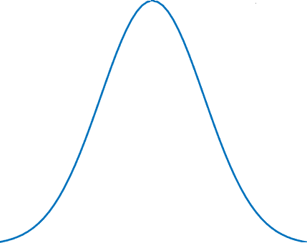
Uncertainty Data Set
EVCS Data set
7689 Normal data
311 error data
t = 1
…
Probability
7688 Normal data
311 error data
t = 2
…
1 Normal data
…
…
(7689 – a) each Normal data
(311-b) error data
a Normal data
b error data
t = n
Error count
…
…
n : EVCS number ( same as a + b)
Normal data
Error data
…

Slide 2
Error rate parameter
Recovery time : dynamic
Binary parameter
Recovery time : static
EV
Arrival & Departure time
Charging & Discharge loss
EV
Initial SoC
Communication Delay
EV
Battery Fault
EVCS
Communication error

Slide 3
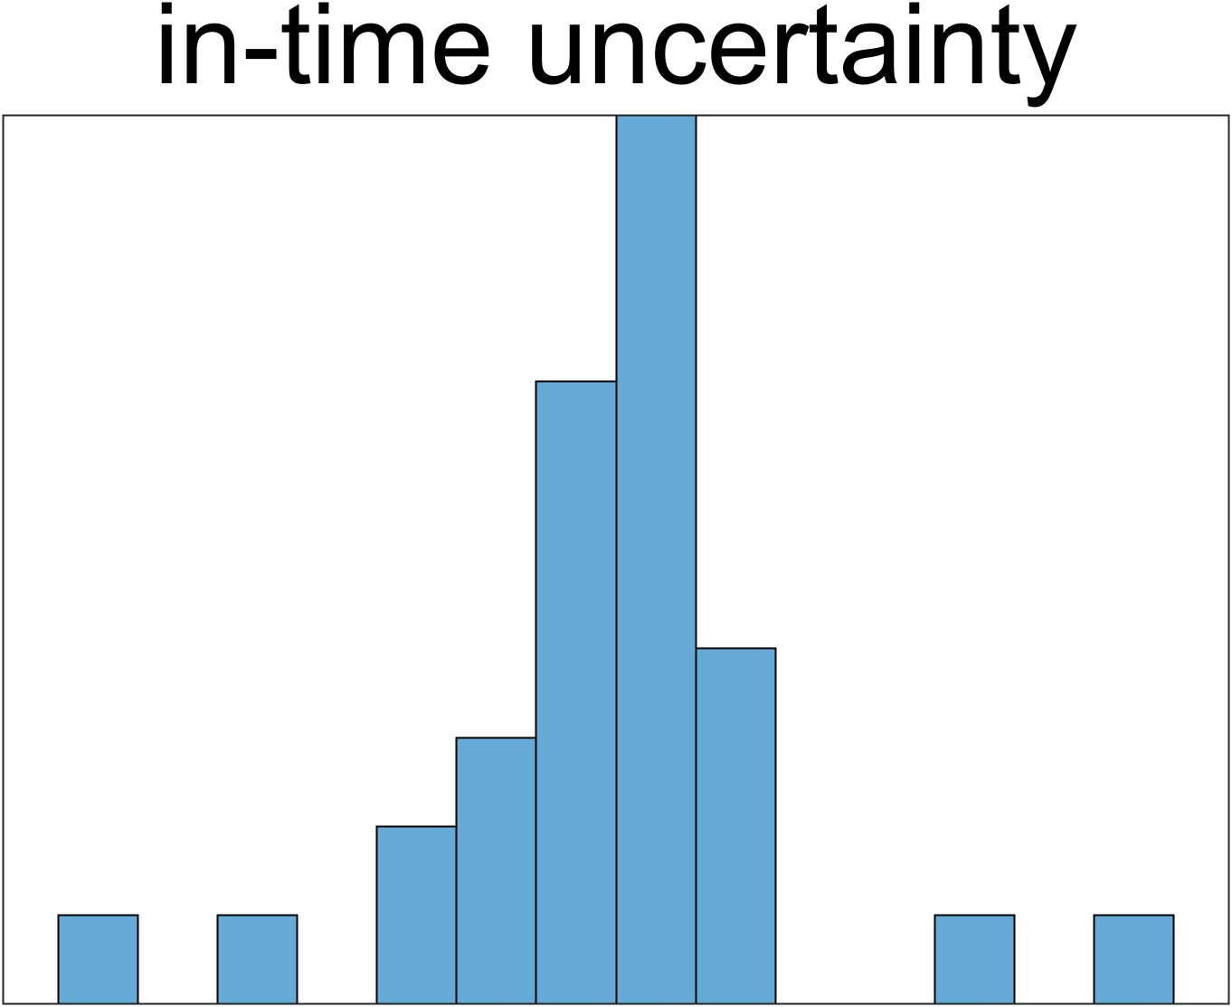
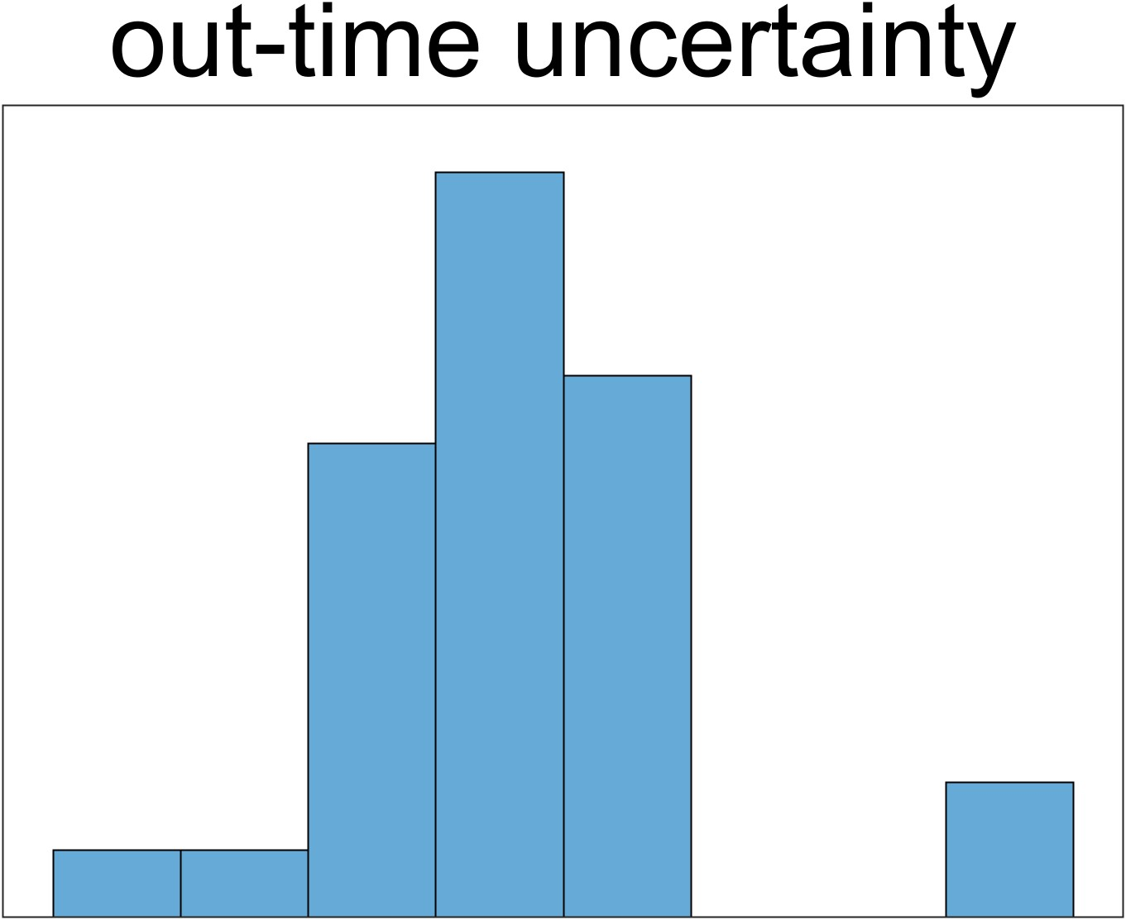
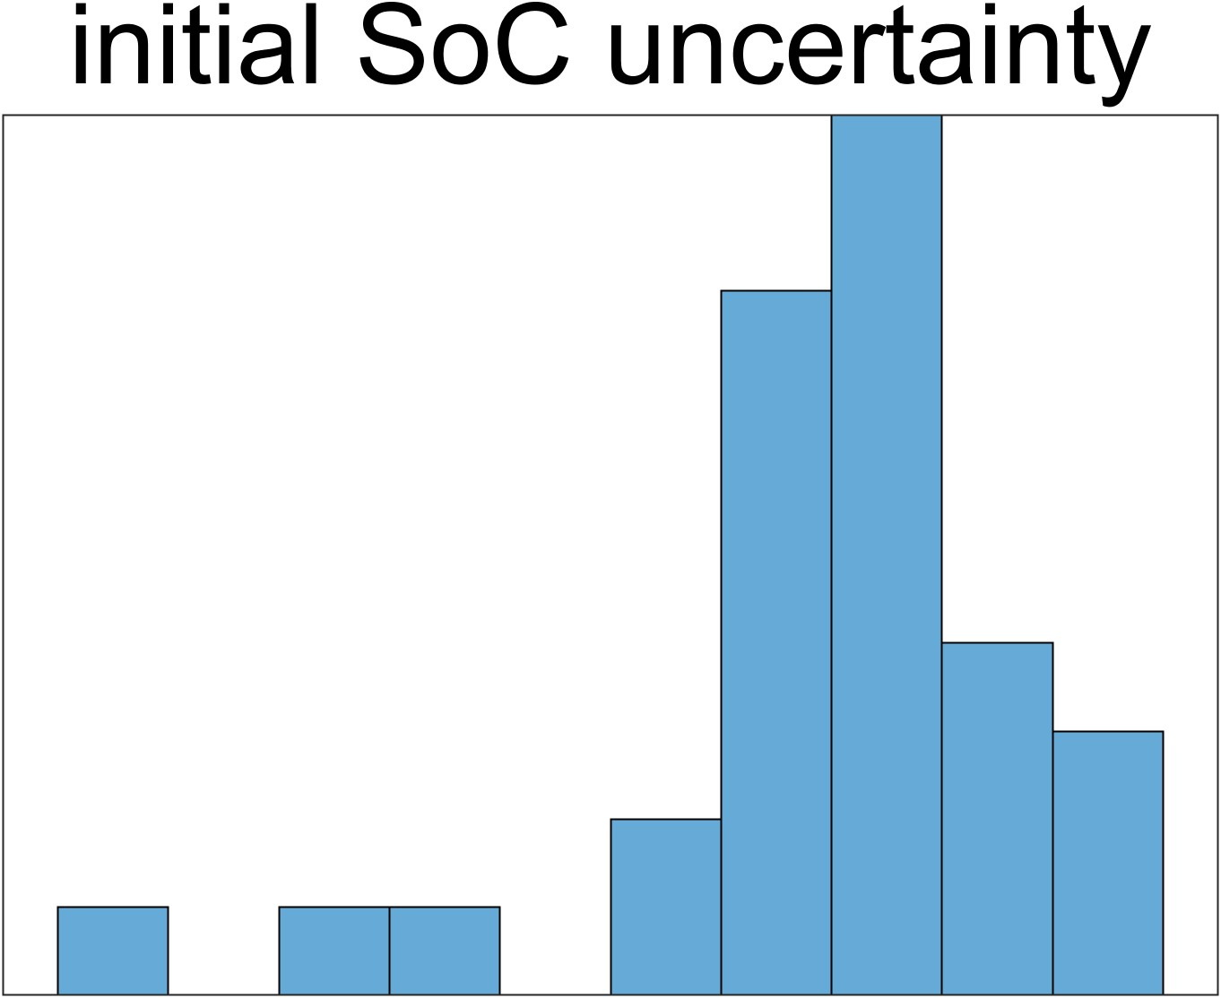
Number
Change Rate [%]

Slide 4
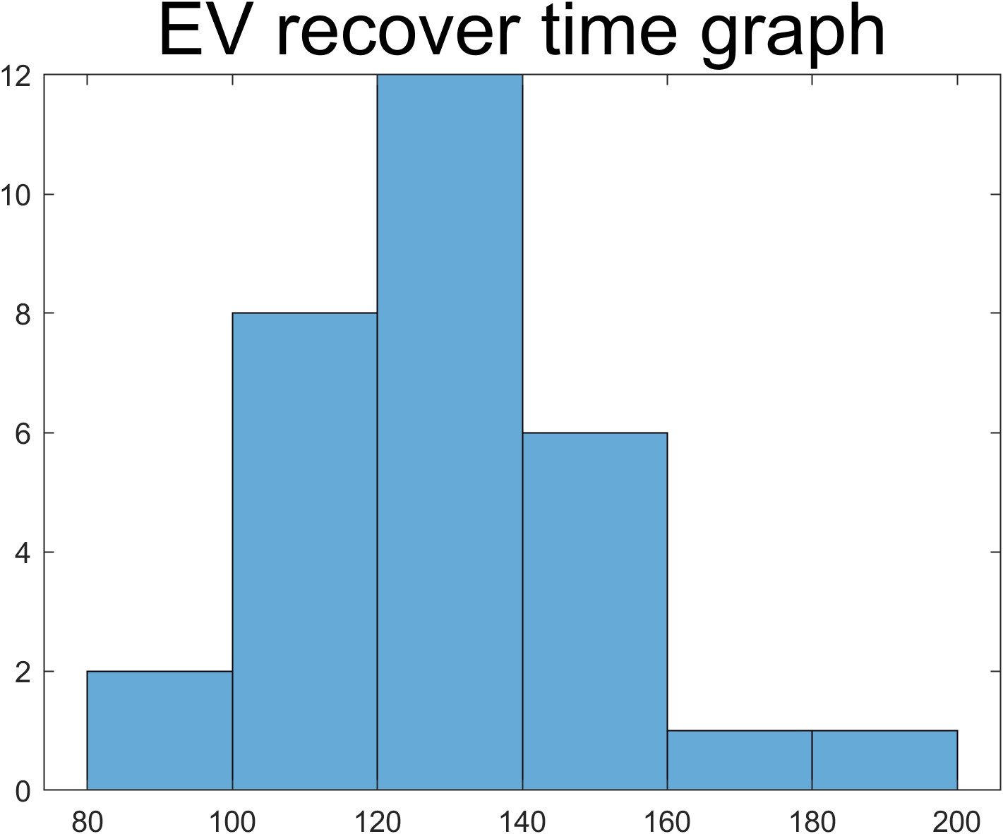
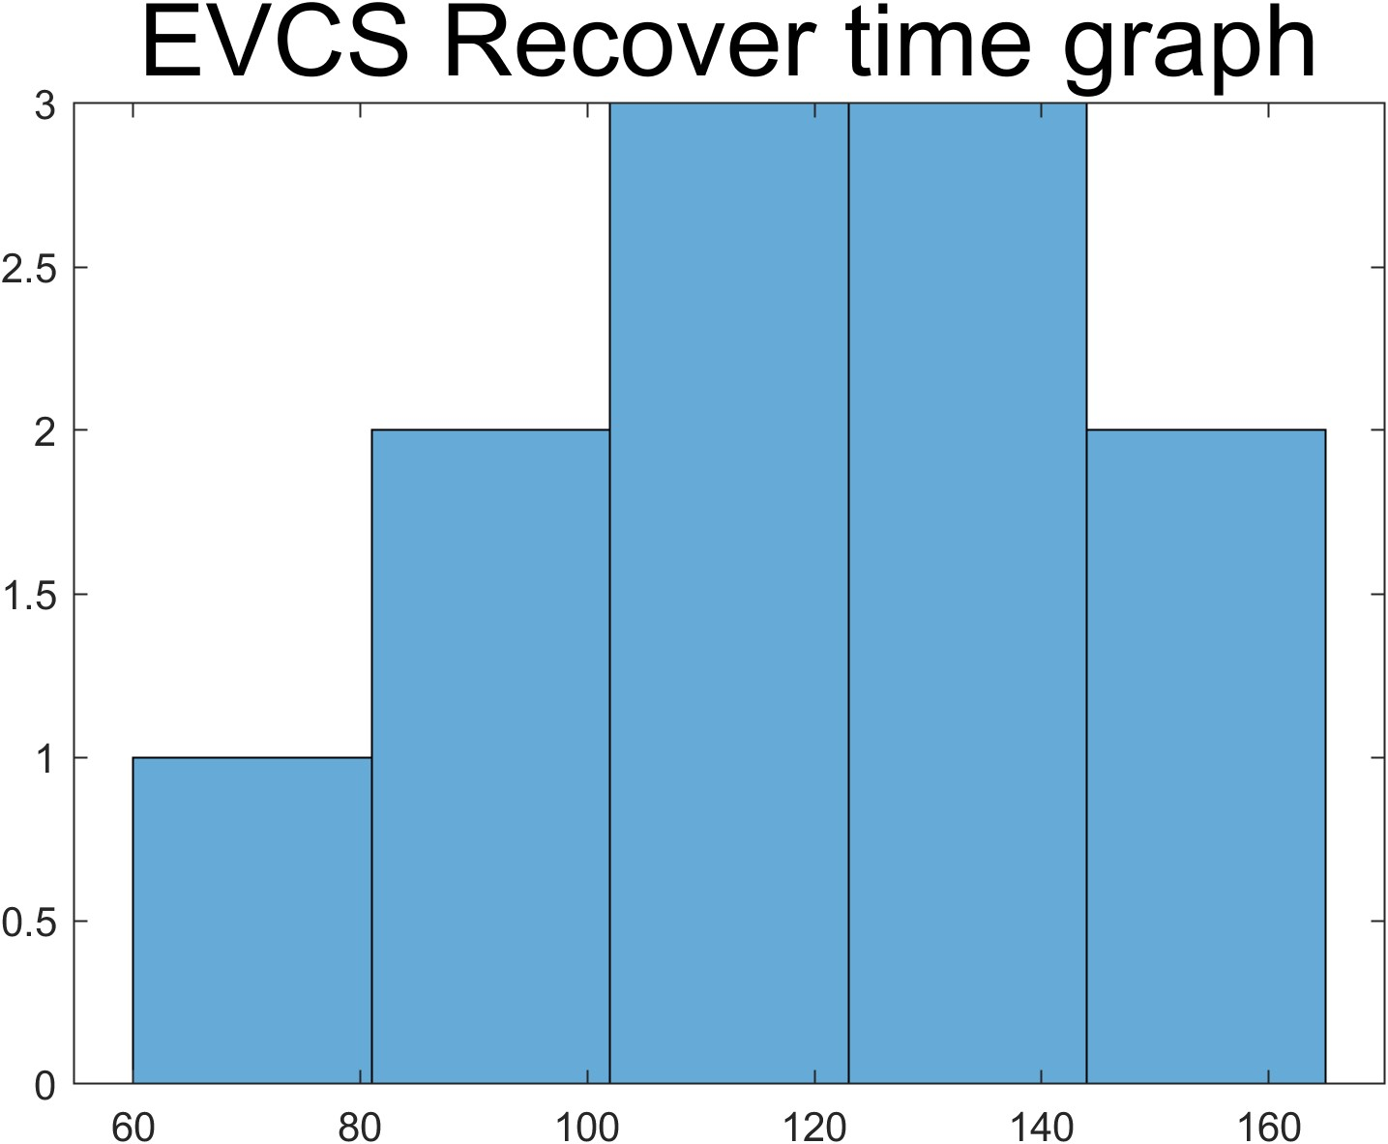
Number
Time value [time-slot]

Slide 5
