Slide 1
CNR
CRAFT N ROAM
AI Travel Decision Simulator & 3D Walk
Craft a transparent plan. Roam the winner in 3D.
Nonthapat T. · Jeeraporn Y. · Chaiphan N. · Jirun T.
Generative AI · Final Project Presentation
https://github.com/GongNT/travel-3d-simulator

Slide 2
The Problem
Trip planning means balancing budget, time, and taste across dozens of options — and every existing tool skips the reasoning.
Listing sites
AI chatbots
Either way
Google Maps, TripAdvisor, Yelp show everything and decide nothing.
One suggestion, no visible tradeoffs — a black box.
No way to get a real feel for a place before you commit.
https://github.com/GongNT/travel-3d-simulator

Slide 3
Craft, Then Roam
A transparent, traveler-adjustable decision engine, followed by a review-grounded 3D preview of the winner.
1. Craft the plan
2. Roam in 3D
Traveler describes their trip in free text (69 tokens)
LLM parses it into structured weights
Deterministic engine scores & ranks 5 curated spots
Sliders let travelers fine-tune live, for free
Traveler unlocks all spots in 3D once (89 tokens)
LLM reads that spot's curated reviews
Extracts ground / sky / palette / props (fixed catalog)
Seeded layout builds a walkable Three.js scene
https://github.com/GongNT/travel-3d-simulator

Slide 4
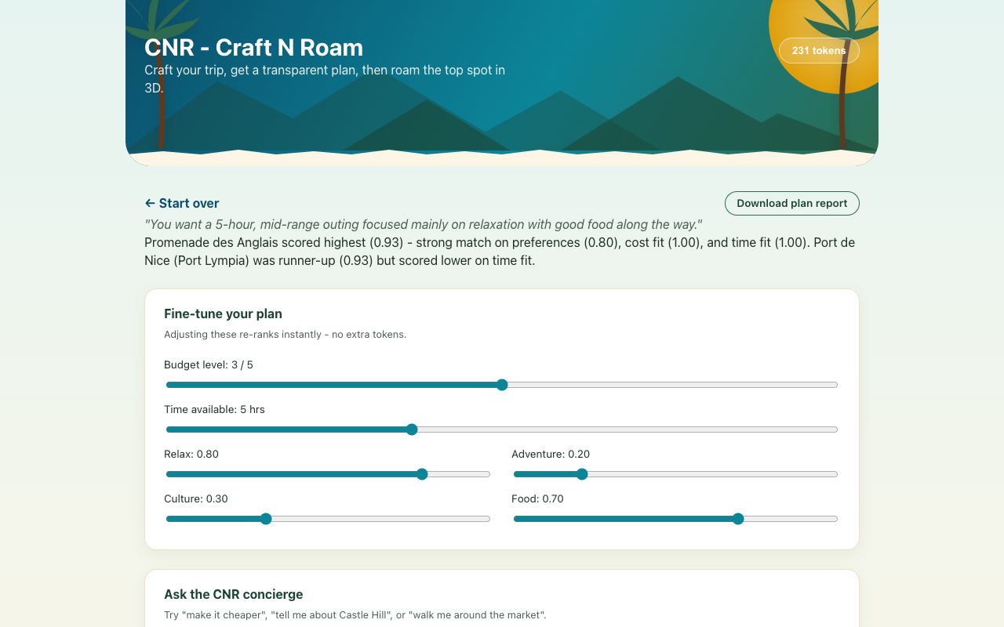
Demo — Craft a Transparent Plan
"A relaxed five-hour trip, mid-range budget, good food"
Promenade des Anglais scores 0.93 — strong match, perfect cost & time fit
Sliders adjust budget, time, and category balance
Re-ranks instantly — no extra tokens, no black box
https://github.com/GongNT/travel-3d-simulator

Slide 5
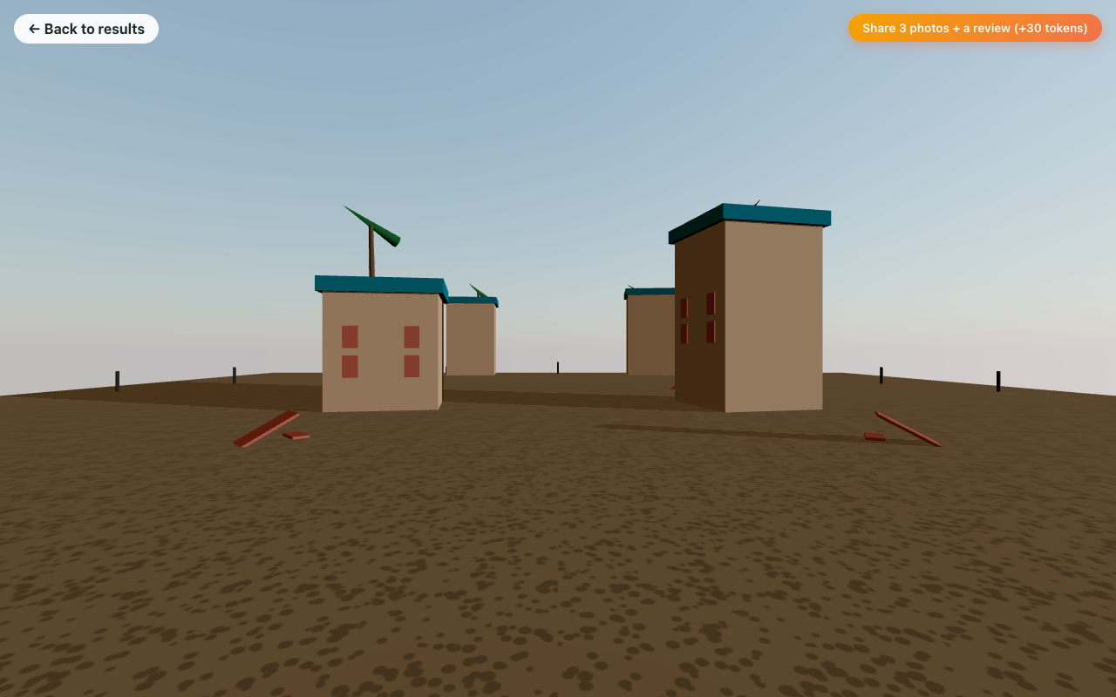
Demo — Roam the Winner
LLM reads Promenade des Anglais' reviews
Picks ground, sky, palette, and props from a fixed catalog
A seeded algorithm places everything — same input, same scene
Explorable in first person: WASD + mouse-look
Share 3 photos + a review per spot, earn 30 tokens back
Stylized, not photorealistic — by design (see limitations).
https://github.com/GongNT/travel-3d-simulator

Slide 6
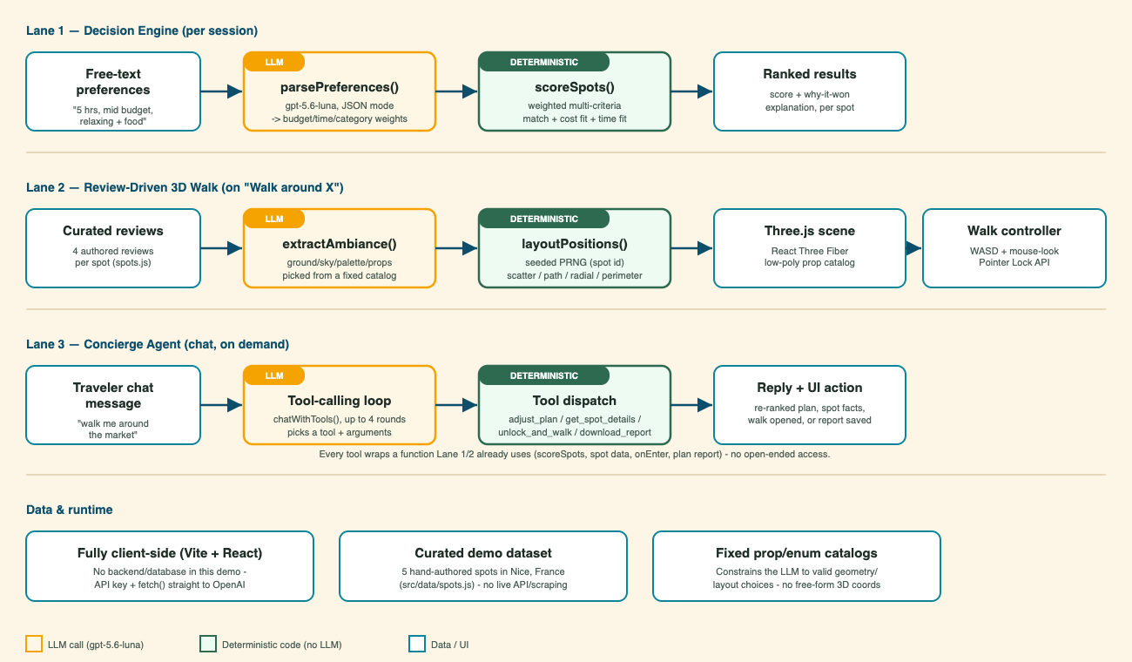
How the AI Is Used
Three lanes of narrow LLM steps; every decision and every agent tool call bottoms out in ordinary deterministic code.
https://github.com/GongNT/travel-3d-simulator

Slide 7
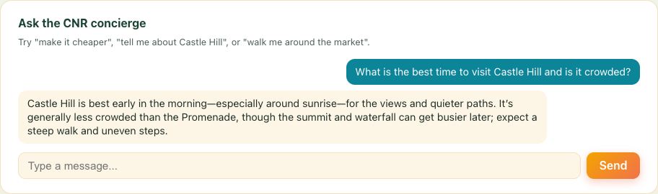
Demo — Ask the Concierge (Lane 3)
A real tool-calling agent - four tools, each a thin wrapper around a function the app already trusted.
adjust_plan - "make it cheaper" re-ranks live
get_spot_details - answers grounded in curated reviews
unlock_and_walk - "walk me around the market" opens the 3D scene
download_report - saves the plan report
Capped at 4 tool-call rounds per turn - no runaway loops.
https://github.com/GongNT/travel-3d-simulator

Slide 8
One Design Principle
Lanes 1-2: the LLM translates, it never decides. Lane 3 may act - but only through tools that wrap trusted code.
LLM calls
Deterministic code
Free text -> structured weights
Reviews -> structured ambiance spec
Fixed JSON schema, fixed enum catalogs
Validated & clamped before use
Weighted multi-criteria scoring
Live plan-editor re-ranking
Seeded PRNG for 3D layout
Same inputs -> same outputs, always
https://github.com/GongNT/travel-3d-simulator

Slide 9
A Real Integration Bug We Hit
gpt-5.6-luna rejects function-tool calling combined with its default reasoning_effort on /v1/chat/completions.
invalid_request_error — param: reasoning_effort
"Function tools with reasoning_effort are not supported for gpt-5.6-luna in /v1/chat/completions."
Fix: request raw JSON (response_format: json_object) instead of tool-calling, and pass reasoning_effort: "none" explicitly.
https://github.com/GongNT/travel-3d-simulator

Slide 10
One Honest Limitation
The 3D scenes are stylized, low-poly interpretations — not photorealistic reconstructions of the real locations.
True 3D reconstruction needs dozens of calibrated, overlapping photos (photogrammetry / NeRF) — not review text or a handful of casual photos. We chose to be upfront about this rather than overclaim, and built a deterministic, review-grounded stylized scene instead. The token economy is the same story: presented in full, built as local state only — no real payment happens anywhere in this demo.
Also flagged: WASD movement needs a final real-browser verification pass (automated headless testing was inconclusive due to background-tab throttling).
https://github.com/GongNT/travel-3d-simulator

Slide 11
The Business Model (Presentation Only)
Simulated in the demo as local app state — no real payment processing exists today.
Item | Price
Small token bundle | $0.80 -> 100 tokens
Large token bundle | $4.00 -> 600 tokens (~17% off)
Generate a plan (search) | 69 tokens (~$0.46-0.55)
Unlock 3D walking (all spots) | 89 tokens (~$0.60-0.71, one-time)
Share 3 photos + a review, per spot | +30 tokens back
Margin check
Actual LLM cost per search: a fraction of a cent. Priced at 69 tokens (~$0.50), that is roughly two orders of magnitude of margin before hosting, support, and refunds.
https://github.com/GongNT/travel-3d-simulator

Slide 12
What's Next
Headline idea: crowdsourced photos, real rewards
Travelers upload up to 3 of their own photos per spot -> vision model extracts richer ambiance -> traveler earns a real 30-token reward per spot. Fully legitimate (user-submitted, not scraped). Needs accounts, storage, and moderation — a real backend, deliberately out of scope for now.
Real payments
Booking add-ons
Mobile controls
Server-side API key
More destinations
Usability study
Roadmap timeline (details in the report)
https://github.com/GongNT/travel-3d-simulator

Slide 13
Thank you
Craft a transparent plan. Roam the winner in 3D.
https://github.com/GongNT/travel-3d-simulator

