Slide 1
Probabilistic Models for Images
Markov Random Fields
Applications in Image Segmentation and Texture Modeling
Ying Nian Wu
UCLA Department of Statistics
IPAM July 22, 2013

Slide 2
Outline
Basic concepts, properties, examples
Markov chain Monte Carlo sampling
Modeling textures and objects
Application in image segmentation

Slide 3

Markov Chains
Pr(future|present, past) = Pr(future|present)
future past | present
Markov property: conditional independence
limited dependence
Makes modeling and learning possible

Slide 4
Markov Chains (higher order)
Temporal: a natural ordering
Spatial: 2D image, no natural ordering

Slide 5







Markov Random Fields
Markov Property
all the other pixels
Nearest neighborhood, first order neighborhood
From Slides by S. Seitz - University of Washington

Slide 6





Markov Random Fields
Second order neighborhood

Slide 7
Markov Random Fields
Can be generalized to any undirected graphs (nodes, edges)
Neighborhood system: each node is connected to its neighbors
neighbors are reciprocal
Markov property: each node only depends on its neighbors
Note: the black lines on the left graph are illustrating the 2D grid for the image pixels
they are not edges in the graph as the blue lines on the right

Slide 8


Markov Random Fields
What is

Slide 9



Hammersley-Clifford Theorem
normalizing constant, partition function
potential functions of cliques
Cliques for this neighborhood
From Slides by S. Seitz - University of Washington

Slide 10

Hammersley-Clifford Theorem
Gibbs distribution
a clique: a set of pixels, each member is the neighbor of any other member
Cliques for this neighborhood
From Slides by S. Seitz - University of Washington

Slide 11
Hammersley-Clifford Theorem
Gibbs distribution
a clique: a set of pixels, each member is the neighbor of any other member
Cliques for this neighborhood
……etc, note: the black lines are for illustrating 2D grids, they are not edges in the graph

Slide 12




Ising model
Cliques for this neighborhood
From Slides by S. Seitz - University of Washington

Slide 13


Ising model
pair potential
Challenge: auto logistic regression

Slide 14


Gaussian MRF model
continuous
pair potential
Challenge: auto regression

Slide 15
Sampling from MRF Models
Markov Chain Monte Carlo (MCMC)
Gibbs sampler (Geman & Geman 84)
Metropolis algorithm (Metropolis et al. 53)
Swedeson & Wang (87)
Hybrid (Hamiltonian) Monte Carlo

Slide 16
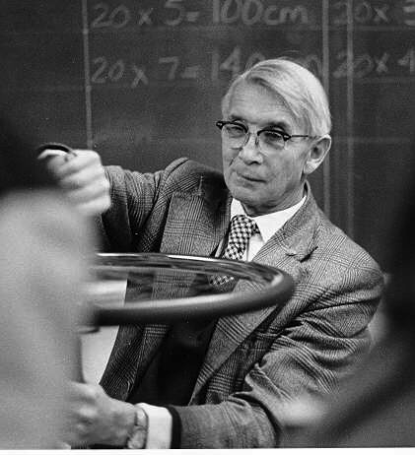
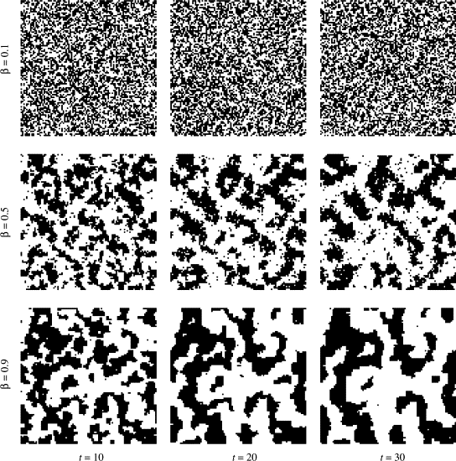

Slide 17


Gibbs Sampler
Simple one-dimension distribution
Repeat:
Randomly pick a pixel
Sample given the current values of

Slide 18
Gibbs sampler for Ising model
Challenge: sample from Ising model

Slide 19




Metropolis Algorithm
energy function
Repeat:
Proposal: Perturb I to J by sample from K(I, J) = K(J, I)
If change I to J
otherwise change I to J with prob

Slide 20
Metropolis for Ising model
Ising model: proposal --- randomly pick a pixel and flip it
Challenge: sample from Ising model

Slide 21




Modeling Images by MRF
Ising model
Hidden variables, layers, RBM
Exponential family model, log-linear model
maximum entropy model
unknown parameters
features (may also need to be learned)
reference distribution

Slide 22

Modeling Images by MRF
Given
How to estimate
Maximum likelihood
Pseudo-likelihood (Besag 1973)
Contrastive divergence (Hinton)

Slide 23
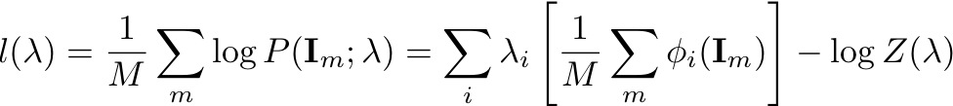
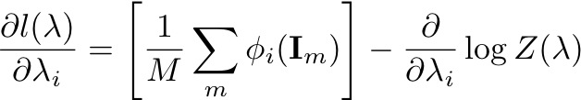

Maximum likelihood
Given
Challenge: prove it

Slide 24
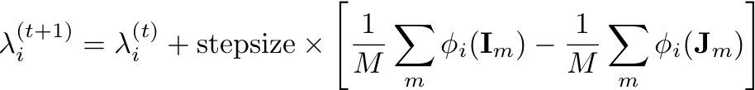
Stochastic Gradient
Given
Generate
Analysis by synthesis

Slide 25
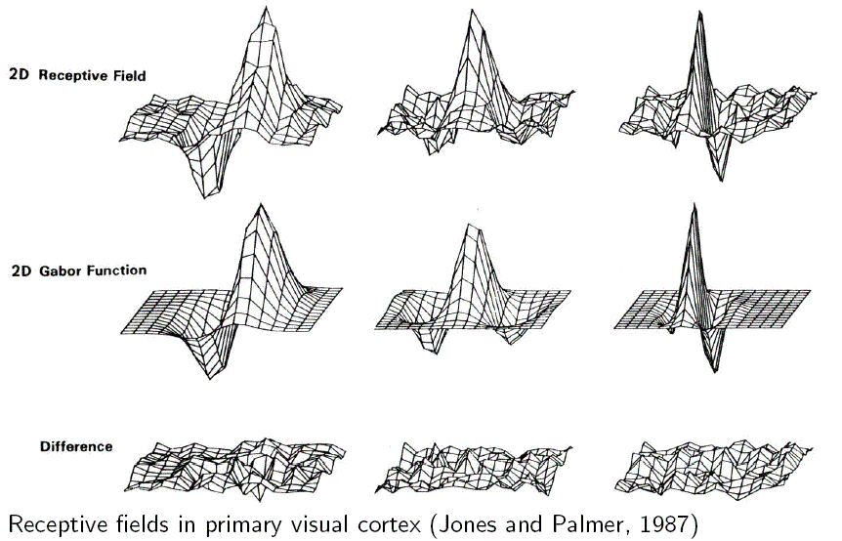

Texture Modeling

Slide 26
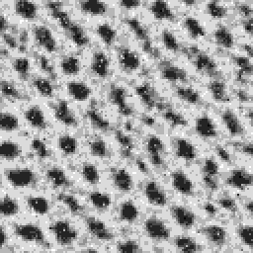
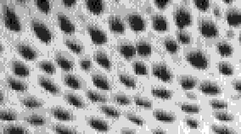

Slide 27
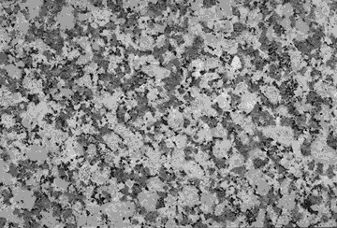
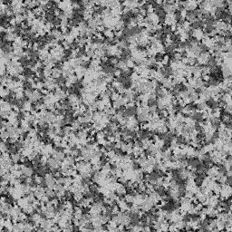

Slide 28
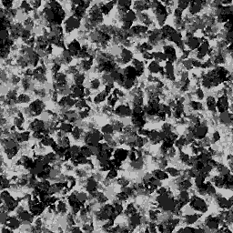
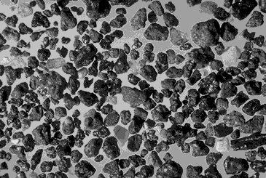

Slide 29



Slide 30
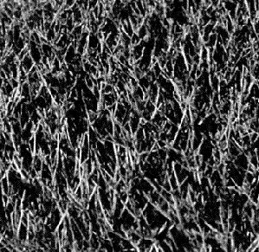
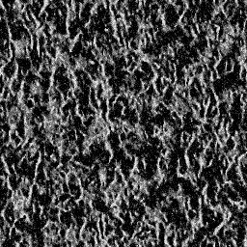

Slide 31
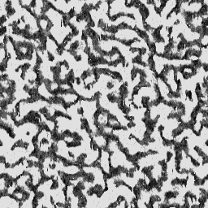
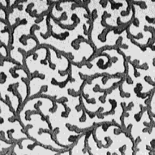

Slide 32
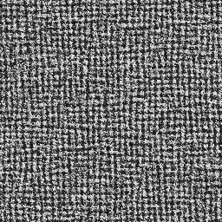
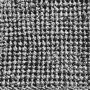

Slide 33
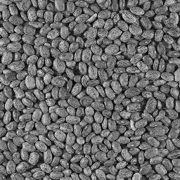
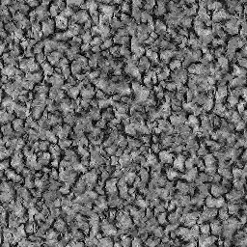

Slide 34
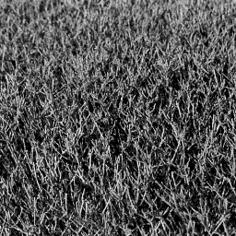
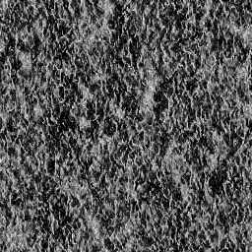

Slide 35
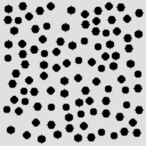


Slide 36
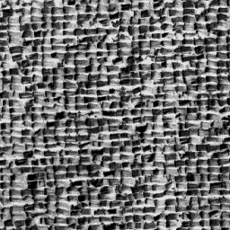
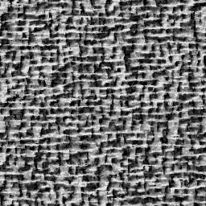

Slide 37































































Slide 38



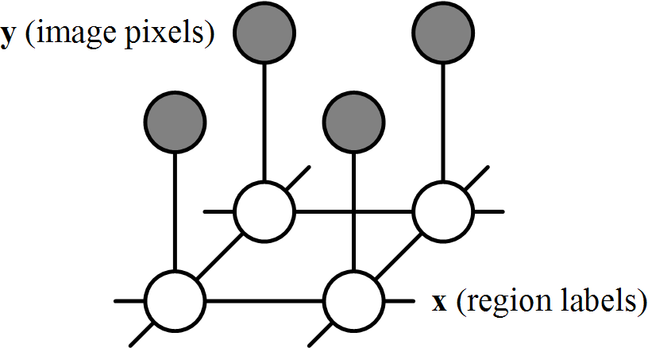

Modeling image pixel labels as MRF (Ising)
MRF for Image Segmentation
Bayesian posterior
real image
1
label image
Slides by R. Huang – Rutgers University

Slide 39
Model joint probability
region labels
model param.
image pixels
image-label
compatibility
Function
enforcing
Data
Constraint
label-label
compatibility
Function
enforcing Smoothness constraint
label
image
local
Observations
neighboring
label nodes
Slides by R. Huang – Rutgers University

Slide 40
MRF for Image Segmentation
Slides by R. Huang – Rutgers University

Slide 41
Inference in MRFs
Classical
Gibbs sampling, simulated annealing
Iterated conditional modes
State of the Art
Graph cuts
Belief propagation
Linear Programming
Tree-reweighted message passing
Slides by R. Huang – Rutgers University

Slide 42
Summary
MRF, Gibbs distribution
Gibbs sampler, Metropolis algorithm
Exponential family model

