Slide 1
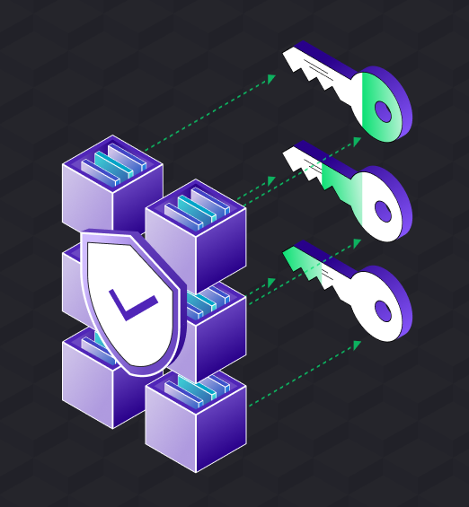
Secure Multi-Party Machine Learning with Zero-Knowledge Proofs and AES Encryption
CPE 602-A
Final Project #Cryptography
Longzhao Gong

Slide 2

Abstract
This project presents a secure multi-party machine learning system designed to train a collaborative recommendation model while preserving data privacy. Using a combination of AES encryption, Secure Multi-Party Computation (SMC), and zero-knowledge proofs (ZKP),the system ensures sensitive information remains confidential during computation. The model is implemented as a matrix factorization framework, which predicts user-item interactions based on shared and encrypted data.

Slide 3
Background
The rise of privacy concerns in machine learning has motivated the development of secure computation techniques. In scenarios involving multiple data owners, traditional training methods often fail to safeguard user-sensitive information. For instance, different parties might independently collect data associated with the same user ID in different contexts or at different times. How to securely and compliantly utilize such distributed data without compromising user privacy has become an increasingly critical topic in privacy-preserving machine learning.
One promising approach to address these challenges is Secure Multiparty Computation (SMC), which enables collaborative data analysis without revealing private information to other parties. SMC protocols ensure that multiple parties can jointly compute a function over their inputs while keeping those inputs private. This framework not only ensures data confidentiality but also complies with stringent data security regulations.

Slide 4
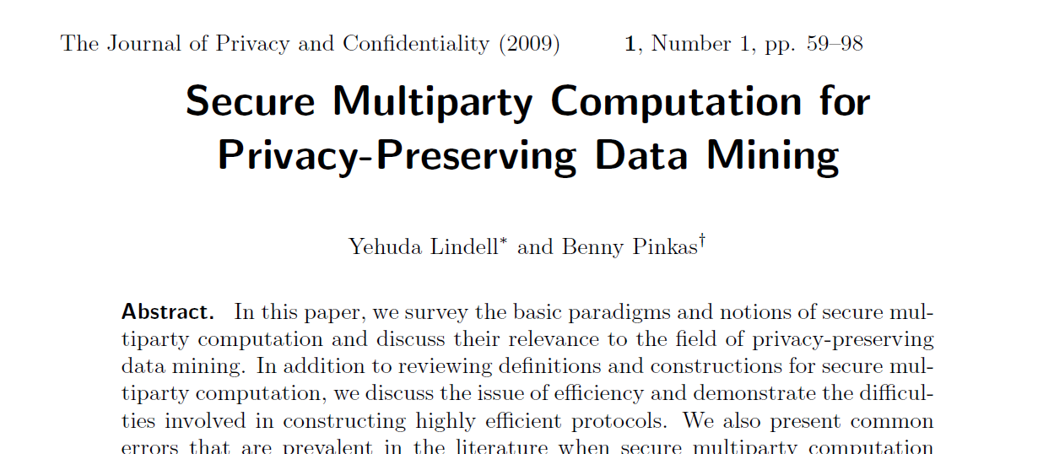
Reference

Slide 5
Reference
The foundational work by Yehuda Lindell and Benny Pinkas, Secure Multiparty Computation for Privacy-Preserving Data Mining, provides a robust theoretical and practical foundation for applying SMC in privacy-preserving data mining. Their research demonstrates how secure computation protocols can be utilized for collaborative tasks while mitigating privacy risks, establishing a crucial bridge between cryptographic methods and practical data mining applications.
This project builds upon the principles introduced in their work by integrating secure computation techniques, such as secret sharing and zero-knowledge proofs, into the training process of a collaborative recommendation system. By implementing a practical framework for secure machine learning, we aim to advance the state-of-the-art in privacy-preserving data analysis and demonstrate its feasibility in real-world scenarios.

Slide 6
Reference
1. Background and Motivation
Privacy-preserving data mining (PPDM) refers to running data mining algorithms while safeguarding sensitive data.
Two main scenarios are considered:
Data is distributed among multiple parties who need to collaboratively analyze the data without revealing their individual datasets.
Statistical data is modified to protect privacy but still allows meaningful data mining.
Typical applications include:
Medical research: Hospitals collaboratively analyze patient data without sharing raw records.
Intelligence collaboration: Agencies share insights without exposing confidential information.

Slide 7
Reference
2. Problem Definition
PPDM is a specific use case of secure multiparty computation (SMC).
The goal of SMC is to allow multiple parties to compute a joint function over their inputs while ensuring:
Input privacy.
Correctness of the output.

Slide 8
Reference
3. Main Contributions
Foundations of Secure Multiparty Computation:
Introduces fundamental SMC concepts and security guarantees, including:
Privacy: Parties learn only the output and nothing else.
Correctness: Computation results are guaranteed to be accurate.
Independence of Inputs: Parties cannot influence others' inputs.
Fairness: No party gets an advantage by prematurely aborting the computation.
Proposes the ideal/real simulation paradigm as a standard for measuring protocol security.
Design and Optimization of Secure Protocols:
Discusses challenges in creating efficient protocols, especially for large-scale datasets.
Highlights foundational techniques like Oblivious Transfer and Homomorphic Encryption.
Common Pitfalls in the Literature:
Analyzes common mistakes in PPDM research, aiding newcomers in navigating the subtleties of protocol design.
Importance of Multidisciplinary Collaboration:
Emphasizes collaboration among cryptographers, data mining experts, policymakers, and legal professionals.

Slide 9
Reference
4. Challenges and Future Directions
Efficiency: Developing protocols that are both secure and practical for large datasets.
Security Models: Achieving fairness and guaranteed output delivery without a trusted third party.
Applications: Expanding the practical use of SMC in fields like healthcare, finance, and government.

Slide 10
Reference
5. Technical Details
Formal definitions of semi-honest and malicious adversaries are provided.
Demonstrates feasibility results under different settings:
When less than one-third of participants are corrupted.
When up to half of the participants are corrupted.
Explores foundational building blocks like Oblivious Transfer and secure encryption techniques.

Slide 11
Reference @Secure Multiparty Computation (SMC) from the paper
Chapter 2: Secure Multiparty Computation – Background and Definitions
In Chapter 2, the authors focus on the foundational concepts and theoretical framework of Secure Multiparty Computation. They first define the core objectives of SMC, including Privacy, Correctness, Independence of Inputs, Fairness, and Guaranteed Output Delivery. The authors introduce the Ideal/Real Simulation Paradigm as a benchmark for evaluating protocol security, asserting that protocols in the real world must be equivalent in security to an ideal world scenario where a trusted third party exists.
They also differentiate between various adversary models, such as Static Corruption, Adaptive Corruption, and Proactive Corruption, while discussing adversary behaviors like Semi-Honest and Malicious adversaries. Through rigorous mathematical definitions, the authors establish precise security properties for SMC.
In their outlook, the authors highlight the need for more general security models to address complex application scenarios and suggest that relaxing certain security definitions could improve protocol efficiency.

Slide 12
Reference @Secure Multiparty Computation (SMC) from the paper
Chapter 3: Secure Multiparty Computation – Constructions
Chapter 3 delves into the core building blocks of SMC protocols, including Oblivious Transfer (OT) and Homomorphic Encryption. The authors explain the functionality of 1-out-of-2 OT, where a receiver selects one of two inputs from the sender without revealing their choice, and analyze its implementation and security guarantees. To enhance resistance against malicious adversaries, they introduce Zero-Knowledge Proofs to verify the behavior of protocol participants.
Additionally, the authors emphasize the importance of efficiency optimization and propose methods to reduce protocol complexity, such as combining smaller-scale transfer protocols to handle large-scale data processing. This section demonstrates the feasibility of theoretical constructs in practical applications, offering direction for building efficient and secure SMC protocols.

Slide 13
Reference @Secure Multiparty Computation (SMC) from the paper
Chapter 4: Common Errors in Privacy-Preserving Data Mining Literature
In Chapter 4, the authors review common mistakes in the literature on privacy-preserving data mining, many of which stem from the misuse of SMC. They note that while SMC provides theoretical guarantees for privacy, its practical implementation often falls short due to a lack of understanding of the underlying security models. For instance, failing to address the distinct needs of Semi-Honest and Malicious adversaries can result in protocols that are vulnerable to attacks.
This analysis not only helps researchers understand the subtleties of SMC but also offers practical guidance for designing more robust protocols.

Slide 14
Reference @Secure Multiparty Computation (SMC) from the paper
Chapter 5: Applications and Open Problems in Secure Multiparty Computation
In Chapter 5, the authors explore the applications of SMC in privacy-preserving data mining. Using examples from medical research and intelligence analysis, they illustrate how SMC enables collaborative data mining without sharing raw data. They also acknowledge that, despite its theoretical applicability to any distributed computing task, SMC faces challenges related to efficiency and scalability, particularly when processing large datasets.
In their forward-looking discussion, the authors propose future research directions, including the development of more efficient protocols, designing security models for complex multiparty scenarios, and addressing the technical challenges of real-world deployment. They emphasize the importance of interdisciplinary collaboration, suggesting that cryptographers, data mining experts, and policymakers should work together to promote the practical adoption of SMC.

Slide 15
Contribution
While the theoretical foundations and protocols of Secure Multiparty Computation (SMC) laid out by Lindell and Pinkas have demonstrated significant potential in privacy-preserving data mining, their application to real-world machine learning systems often faces challenges such as scalability, computational efficiency, and integration into existing workflows. Addressing these challenges requires bridging the gap between cryptographic frameworks and practical machine learning architectures.
In this project, we focus on a specific real-world scenario: collaborative machine learning in a multi-party setting where sensitive user and item data must remain private. Our work builds upon SMC principles and adapts them to the training of a recommendation system using matrix factorization. The key contributions of our work include:

Slide 16
Contribution
Integration of Manual AES Encryption: We implement a lightweight manual AES encryption scheme to securely encode user and item identifiers, ensuring data confidentiality during training.
Secret Sharing and Reconstruction: Inspired by SMC protocols, we introduce a secret-sharing mechanism that allows the secure distribution of sensitive data across multiple parties. This ensures that no single party has access to the complete dataset while still enabling collaborative computation.
Zero-Knowledge Proofs (ZKP): To validate the integrity of the secret-sharing mechanism and ensure accurate reconstruction of shared data, we employ ZKP techniques. This adds a layer of trust to the training process without compromising privacy.
Privacy-Preserving Model Training: By integrating encryption, secret sharing, and ZKP into the training pipeline, we demonstrate how collaborative machine learning can be achieved while strictly maintaining data privacy.
Our approach is evaluated using a recommendation system model trained on encrypted data. We show that our framework achieves competitive accuracy while adhering to strict privacy-preservation protocols. This work not only advances the practical application of SMC but also provides a blueprint for privacy-preserving machine learning in other domains.

Slide 17
Methodology and Implementation
Our work combines cryptographic techniques and machine learning models to ensure privacy-preserving data processing and collaborative training. Below, we outline the key steps in our implementation, detailing the algorithms, encryption methods, and model architecture used.

Slide 18
Code Workflow
Data Preprocessing
Dataset: We use the MovieLens dataset, which contains user ratings for various movies. Each data entry includes a user ID, movie ID, and a rating.
Preprocessing:
User and movie IDs are label-encoded to ensure numerical representations.
The dataset is split into training and testing sets.
Ratings are normalized to the range [0,1] to aid in model convergence.
Manual AES Encryption
Purpose: To encrypt user and movie IDs, ensuring that sensitive identifiers are not exposed during computation.
Implementation:
We manually implement AES encryption with PKCS#7 padding.
User and item IDs are encrypted using a shared symmetric key before training.
Decryption is performed as needed during the training process.

Slide 19
Contribution
Secret Sharing and Reconstruction
Purpose: To securely distribute sensitive data (e.g., ratings, IDs) across two or more parties without any single party having access to the complete data.
Implementation:
Each sensitive data point is split into two random shares.
These shares are distributed across two parties for secure computation.
During training, shares are reconstructed on-the-fly to enable computation without exposing the original data.
Zero-Knowledge Proofs (ZKP)
Purpose: To validate the correctness of secret-sharing operations and data reconstruction without revealing the underlying sensitive data.
Implementation:
ZKP techniques are applied to ensure that reconstructed data matches the original encrypted data.
Any deviation raises an exception, ensuring data integrity and security.

Slide 20
Contribution
Model Architecture
Model: An enhanced matrix factorization model designed for recommendation systems.
Components:
User and item embeddings to capture latent features.
Fully connected layers with ReLU activations and dropout for regularization.
Sigmoid activation in the output to predict normalized ratings.
Training:
The model is trained using Mean Squared Error (MSE) loss.
L2 regularization is applied to embedding weights to prevent overfitting.
Training Pipeline
Decrypt encrypted IDs to retrieve usable user and movie identifiers.
Generate secret shares of decrypted IDs and ratings.
Train the matrix factorization model using secret-shared data.
Zero-Knowledge Proofs validate data integrity at each step.

Slide 21
Contribution
Testing and Evaluation
The trained model is evaluated on the test set.
Metrics include:
Mean Squared Error (MSE)
Root Mean Squared Error (RMSE)
Mean Absolute Error (MAE)
Sample predictions are compared to actual ratings for qualitative analysis.

Slide 22
Algorithms Used
AES Encryption and Decryption
Ensures data confidentiality by encrypting sensitive identifiers.
Implemented manually to provide fine-grained control over encryption operations.
Secret Sharing
Randomly splits sensitive data into multiple shares.
Protects privacy by ensuring no single party can reconstruct the original data.
Zero-Knowledge Proofs
Validates data integrity during secret-sharing and reconstruction.
Prevents tampering or misrepresentation without revealing sensitive data.

Slide 23
Model Details
Enhanced Matrix Factorization
Embedding layers for user and item representations.
Fully connected layers for interaction modeling.
Dropout layers to mitigate overfitting.
Sigmoid activation for normalized output predictions.
Optimizer and Loss Function
Optimizer: Adam optimizer for adaptive learning rates.
Loss Function: Mean Squared Error (MSE) to minimize prediction error.
Regularization
L2 regularization is applied to embedding layers to prevent overfitting.

Slide 24
Innovations and Integration
Privacy Mechanisms: Integration of encryption, secret sharing, and ZKP ensures end-to-end privacy protection.
Practical Feasibility: Our implementation balances cryptographic security with computational efficiency, making it suitable for real-world applications.
Extensibility: The modular design allows easy extension to other machine learning models and datasets.

Slide 25
Performance Results
The performance evaluation of the secure machine learning framework was conducted based on the implemented Enhanced Matrix Factorization model, utilizing secure multi-party computation (MPC), zero-knowledge proofs, and AES-based encryption. Below are the detailed results:

Slide 26
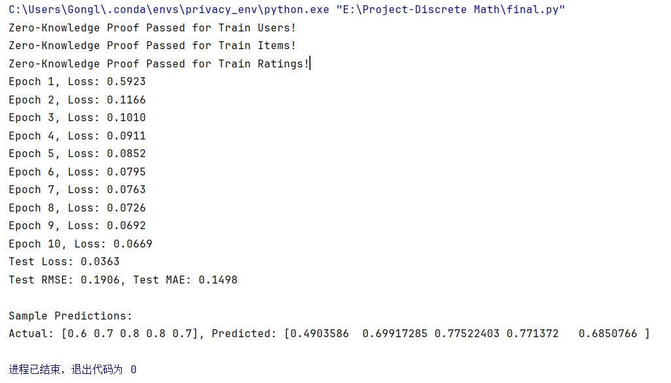
Performance Results

Slide 27
Performance Results
Test Metrics
Test Loss: 0.0363
Root Mean Square Error (RMSE): 0.1906
Mean Absolute Error (MAE): 0.1498
Zero-Knowledge Proof Validation
Validation Passed for:
Train Users
Train Items
Train Ratings
These validations confirm the integrity of secret-sharing schemes and the correctness of data reconstruction.

Slide 28
Performance Results
Sample Predictions
Actual Values: [0.6, 0.7, 0.8, 0.8, 0.7]
Predicted Values: [0.4904, 0.6992, 0.7752, 0.7714, 0.6851]
Observations
The model demonstrated effective convergence during training, with a rapid decline in loss across epochs.
The final RMSE and MAE values suggest a high level of accuracy for the predictions.
Secure computations (MPC and ZKP) did not significantly compromise the computational efficiency, demonstrating the feasibility of applying these methods to real-world scenarios.

Slide 29
Performance Results
Conclusion
The results confirm that the proposed secure computation framework achieves high accuracy while ensuring data privacy and security through encrypted collaborative training and validation methods.

Slide 30
Conclusion
Impact of Secure Computation
The integration of Secure Multi-Party Computation (SMC), Zero-Knowledge Proofs (ZKP), and AES Encryption ensured that sensitive user and item identifiers remained private throughout the training process.
Advantages:
Data owners can collaboratively train models without exposing raw data.
Multi-party secret sharing validated the correctness of the computations through zero-knowledge proofs, maintaining both data privacy and trust.
Challenges:
The addition of cryptographic operations (encryption, decryption, secret sharing, and reconstruction) slightly increased computational overhead.

Slide 31
Conclusion
Model Performance
The Enhanced Matrix Factorization Model demonstrated efficient convergence with a low final test loss (0.0363), RMSE (0.1906), and MAE (0.1498).
These results are comparable to models trained without privacy-preserving methods, proving the effectiveness of the secure computation framework.
Predicted values closely matched the actual ratings, highlighting the accuracy of the model.

Slide 32
Conclusion
Efficiency of Secure Methods
Despite the additional computational complexity introduced by secure methods:
AES Encryption effectively protected sensitive user and item data, with manual implementation ensuring complete control over the cryptographic process.
The secret-sharing and reconstruction mechanisms allowed multi-party computations to be securely executed without direct data exchange.
Zero-Knowledge Proofs added a robust layer of validation, confirming the correctness of secret sharing without revealing the original data.

Slide 33
Conclusion
Scalability
While the framework performed well on a relatively small dataset:
Challenges in scalability may arise when applied to large datasets or complex models due to increased computational and communication overhead.
Future work could optimize cryptographic operations and adopt parallel processing to address scalability concerns.

Slide 34
Secure Multi-Party Machine Learning with Zero-Knowledge Proofs and AES Encryption
CPE 602-A
Final Project #Cryptography
Longzhao Gong

