Slide 1
Summer Internship
Travel and Tourism
Presented by:
22A91A6102 – A.Bharathi
Faculty Guide:

Slide 2
PROBLEM STATEMENT:
Explore tourist destinations with detailed descriptions, images and booking buses.
Compare seats and book travel packages conveniently.
Users can view travel packages and book trips.
Enable administrators to easily manage destinations, packages, and bookings.

Slide 3
Objectives & Scope:
The main objective of the Travel and Tourism web application is to provide a user-friendly platform where tourists can explore destinations, online payments, view tour packages, and make secure bookings online. The scope of the project covers both user and admin modules users can register, browse, and book trips. Built with Django, Python, HTML, and CSS, the system ensures scalability, easy maintenance, and can be extended with features like payment integration and real-time updates in the future.

Slide 4
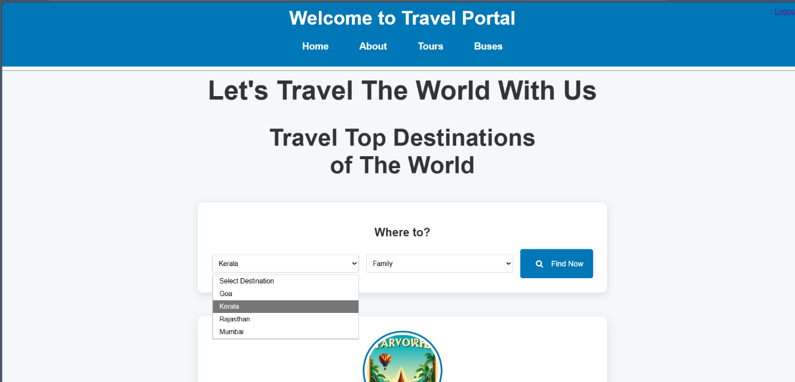
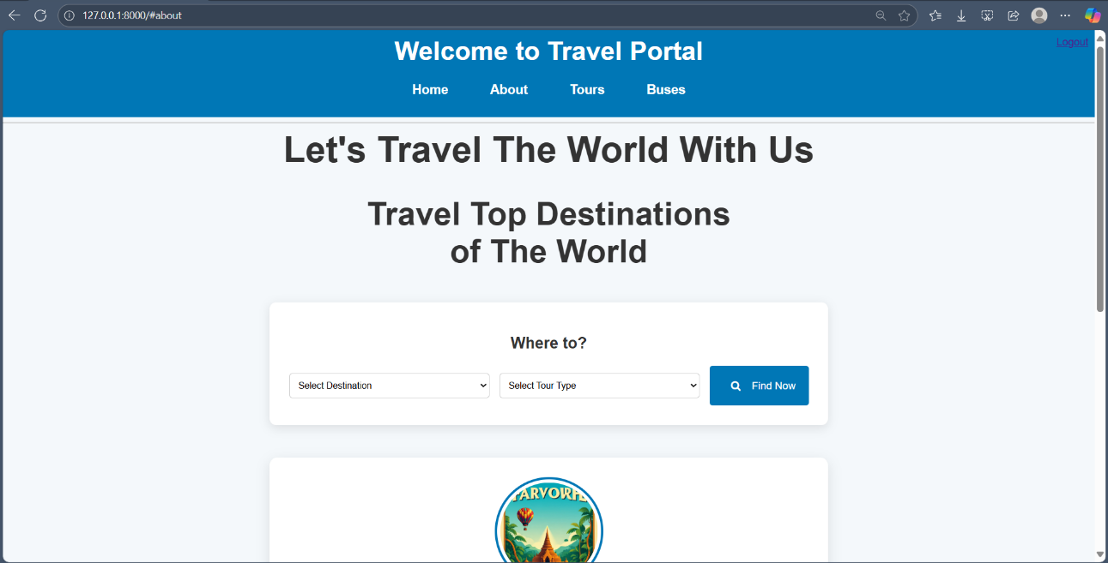
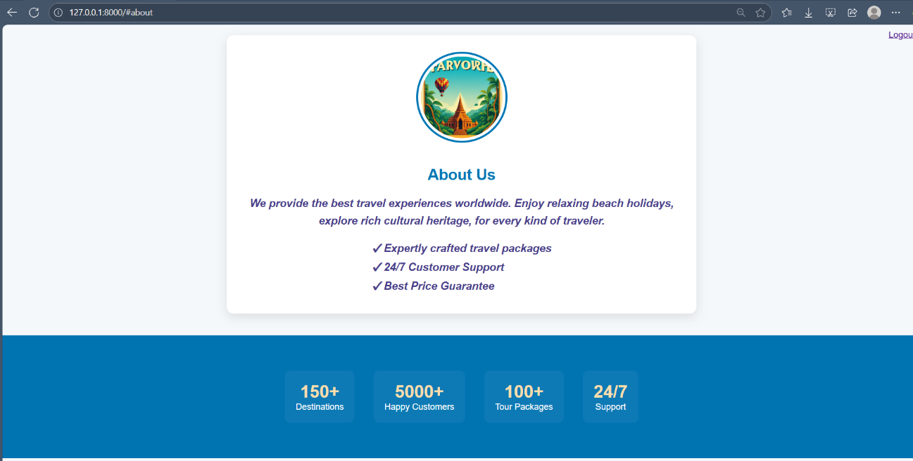
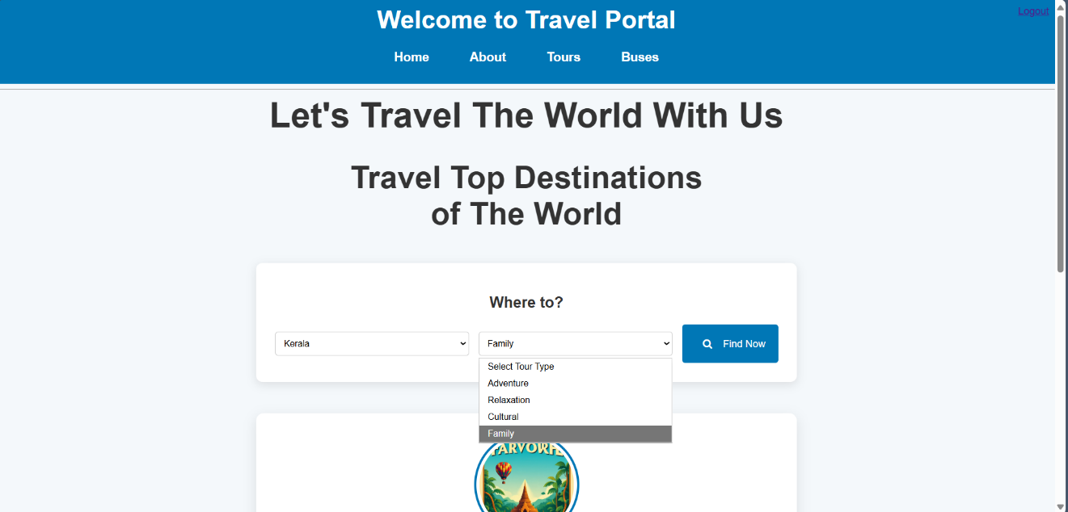

Slide 5
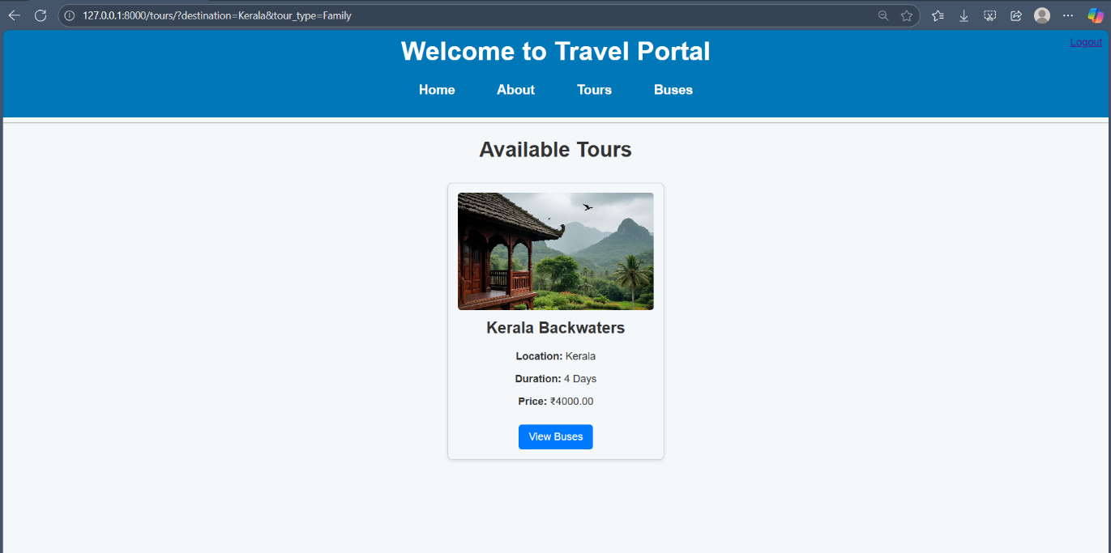
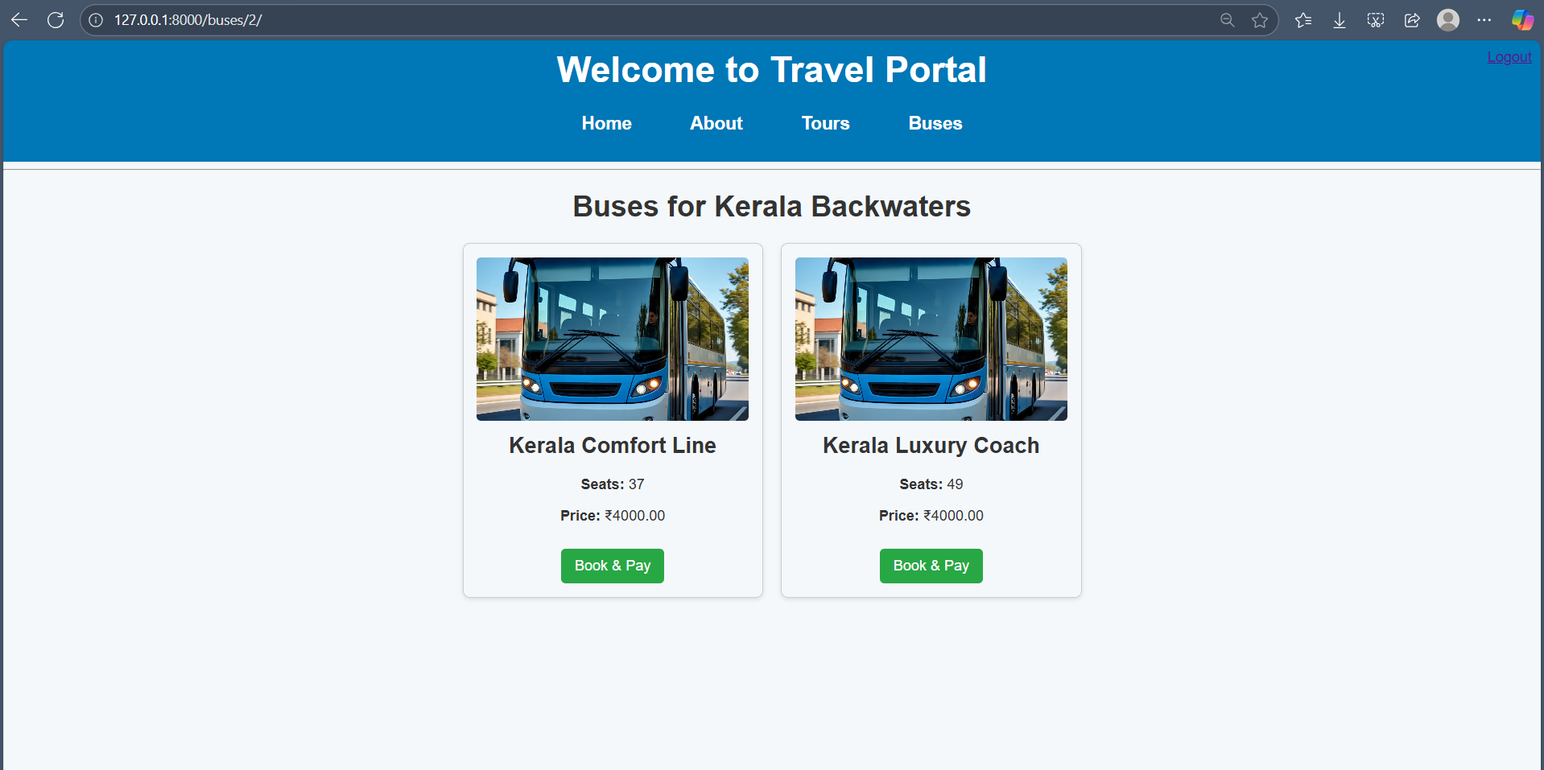

Slide 6
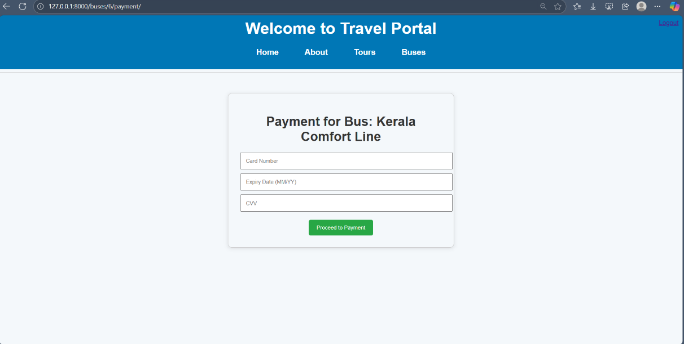
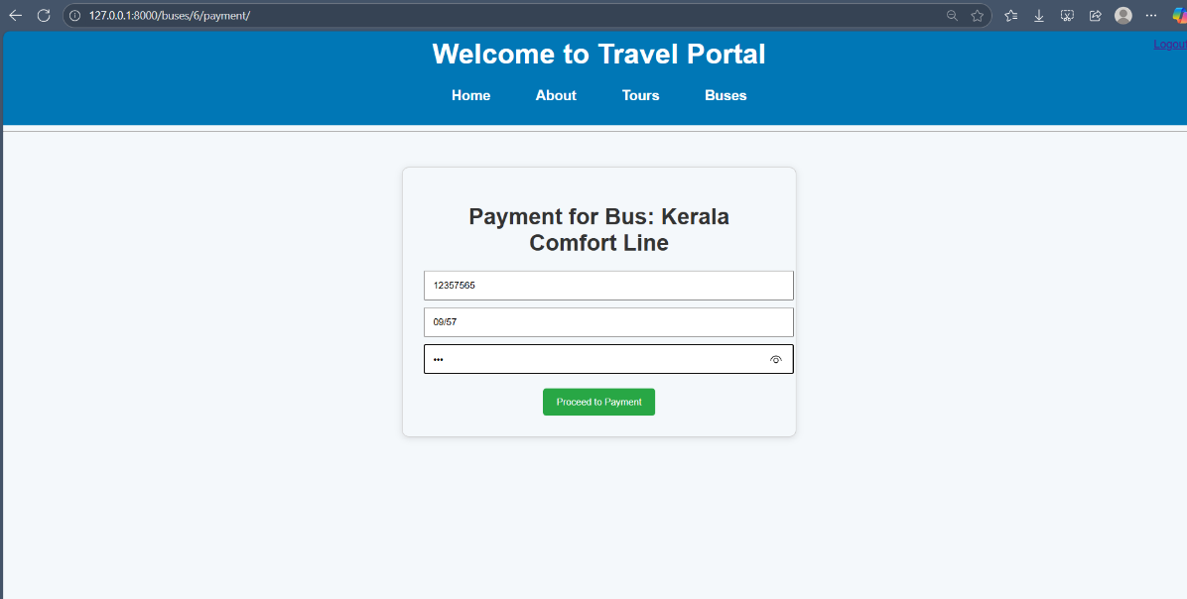
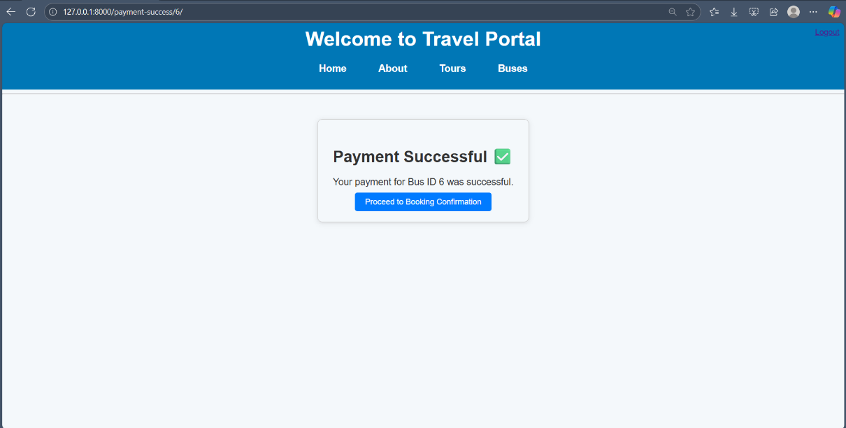
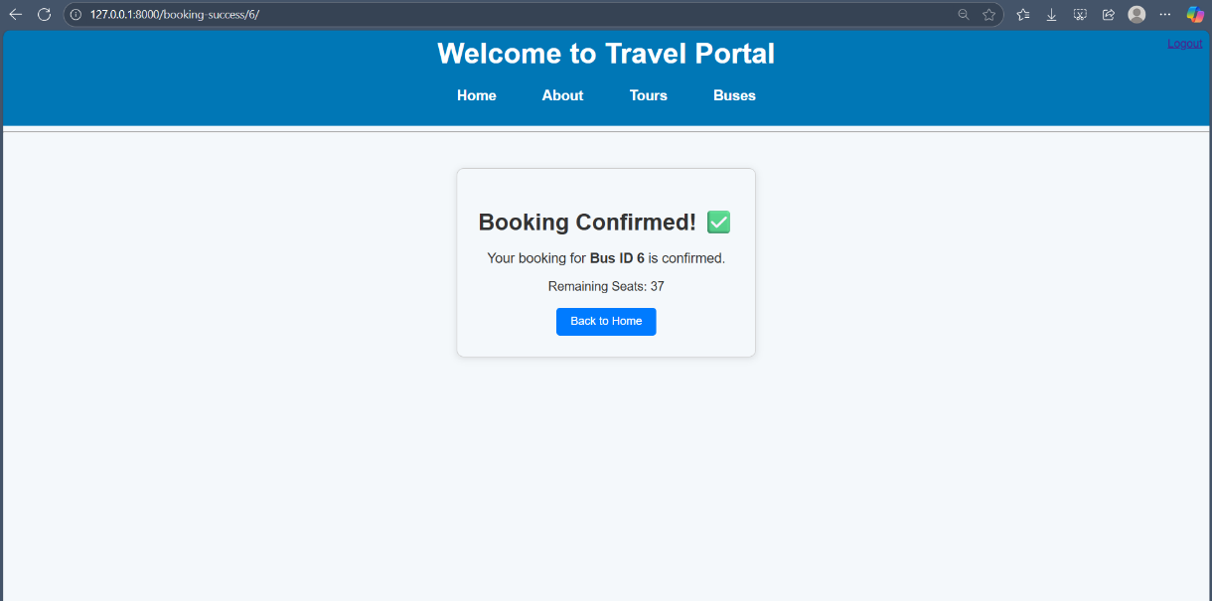

Slide 7
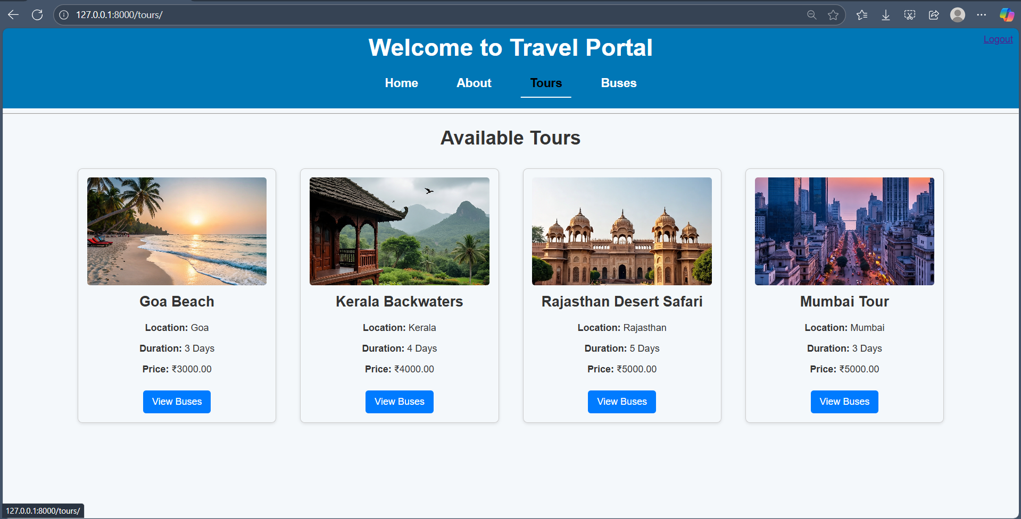

Slide 8
TOOLS REQUIRED
Python – Programming Language
Django – Web Framework
HTML & CSS – Frontend Design
VS Code – Code Editor
Web Browser – For Testing

Slide 9
Challenges Faced:
User Experience Design
Designing a clean and responsive interface for better usability, including forms, cards, and payment flow.
Accurate Information
Difficulty in gathering and maintaining up-to-date, reliable travel details like locations, prices, and availability.
Search & Filtering
Efficiently building database queries to filter destinations, tours, and buses based on user input.
Payment Integration
Implementing a simple but functional payment flow to simulate booking confirmation.

Slide 10
THANK YOU

