Slide 1
Father
Mother
Father
Mother
Father
Mother
Father
Mother
Gen-3
Father
Mother
Father
Mother
Gen-2
Father
Mother
Gen-1
Generic model
Person
>start<
Partner
Gen0
Child
Partner
Child
Partner
Child
Partner
Gen+1
Child
Partner
Child
Partner
Child
Partner
Gen+2

Slide 2
(Father)
Gen-3
ExLin1
(Mother) Gen-3
ExLin5
(Father)
Gen-3
ExLin3
(Mother) Gen-3
ExLin6
Father
Gen-3
ExLin2
Mother
Gen-3
ExLin7
(Father)
Gen-3
ExLin4
(Mother)
Gen-3
ExLin8
30
31
32
33
34
35
36
37
Gen-3
(Father)
Gen-2
ExLin1
(Mother)
Gen-2
ExlLin3
(Father)
Gen-2
ExLin2
(Mother)
Gen-2
ExLin4
26
27
28
29
Gen-2
(Father)
Gen-1
ExLin1
Mother
Gen-1
Exlin2
24
25
Gen-1
TEST DATA
(Father)
Gen-0
ExLin1
(Mother)
Gen-0
ExLin0
Gen0
22
23
(Child)
Gen+1#1
ExLin1
(Partner)
Gen+1#1
ExLinA
(Child)
Gen+1#2
ExLin1
(Partner)
Gen+1#1
ExLinB
(Child)
Gen+1#1
ExLin0
(Partner)
Gen+1#1
ExLinC
38
39
40
41
42
43
Gen+1
(Partner)
Gen+3#1
ExLinE
(Child)
Gen+2#1
ExLin0
(Partner)
Gen+2#1
ExLinF
Child
Gen+2
ExLin1
45
46
47
Gen+2
44
Gen+3
(Child)
Gen+4#1
ExLin1
(Partner)
Gen+4#1
ExLinF
48
49

Slide 3
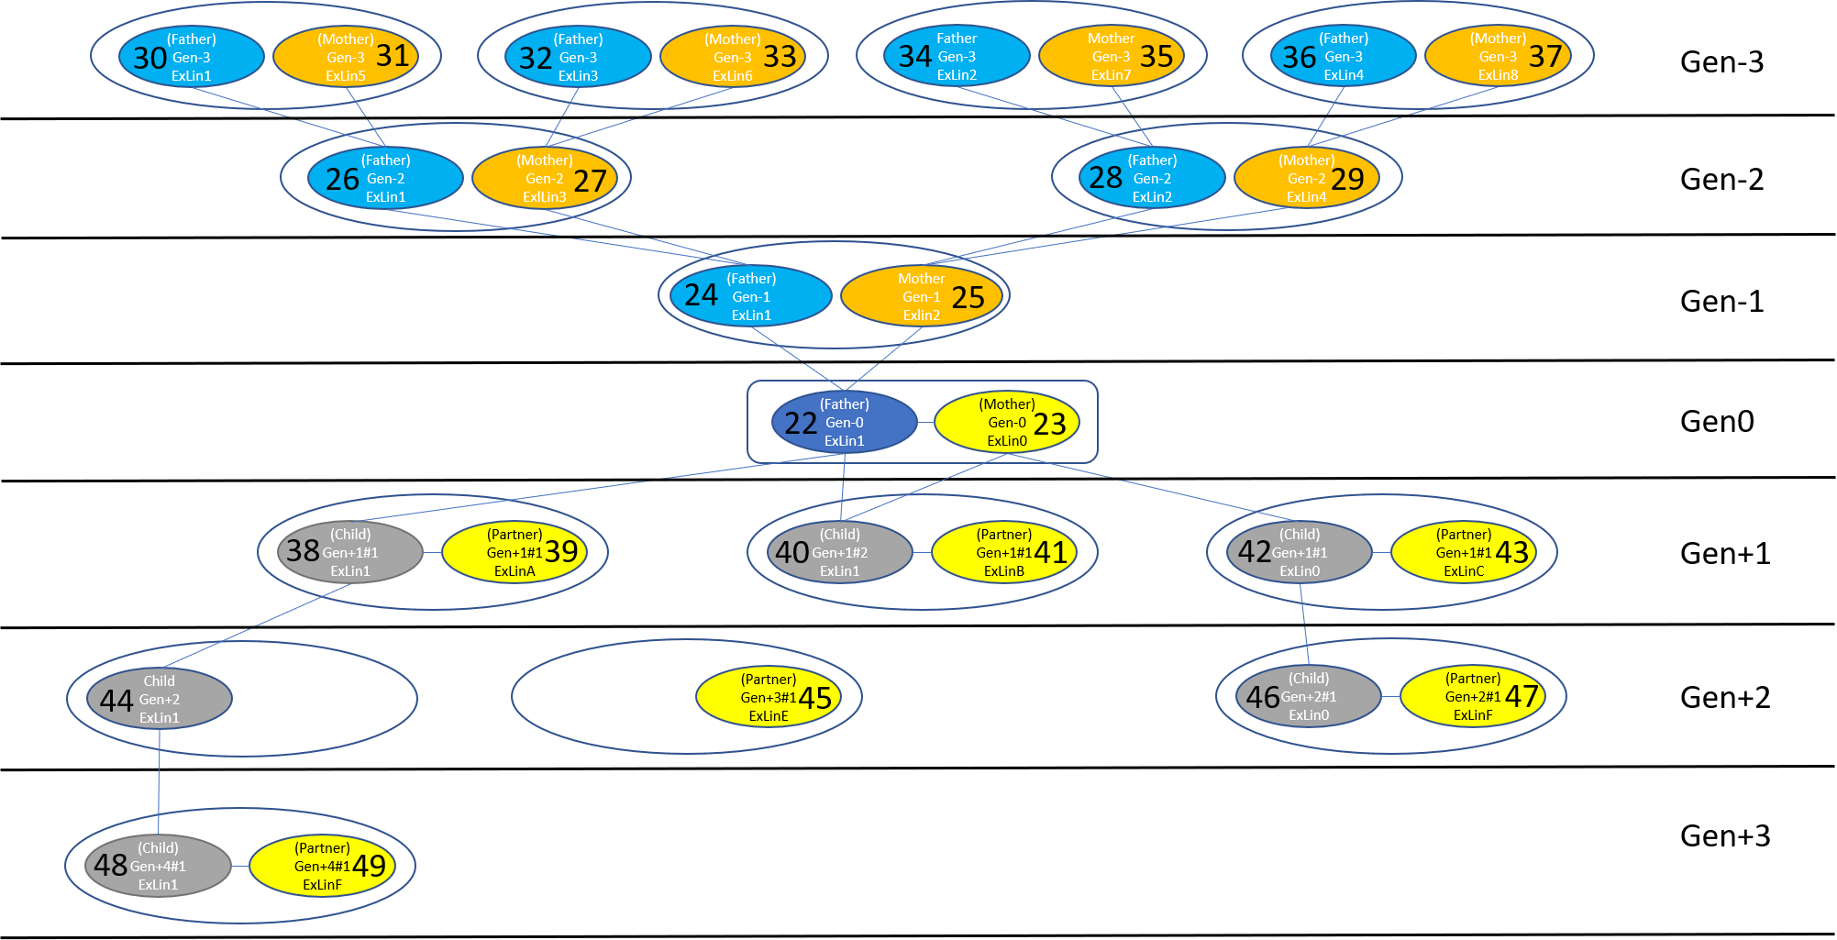
Depended on a parameter determine to get to which level of forefathers (or Generation minus / Gen-).
Depended on a parameter determine to get to which level of (grand)children fathers (or Generation plus / Gen+).
First parents (= ancestors) are handled, then (grand) children
‘(Business’) Rules

