Slide 1
Whereabouts Clock
Internet of Things Family Location Clock

Slide 2
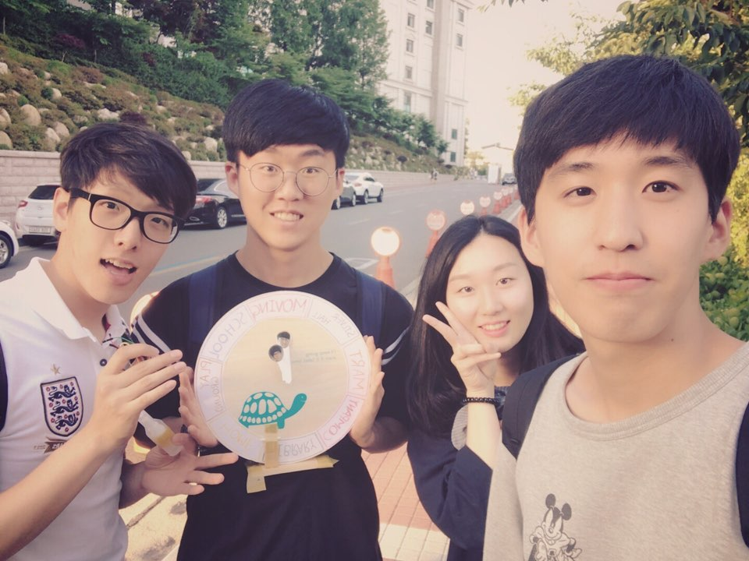
Whereabouts Clock Team
Software Developer
Juhyeok Bae
Developer Manager
Byeonggon Lee
User
Sowon Park
Customer
Jaehyun Byeon

Slide 3
Contents
01
05
Introduction
Demo Video
02
04
03
Testing Whereabouts clock
goal
goal
Composition

Slide 4

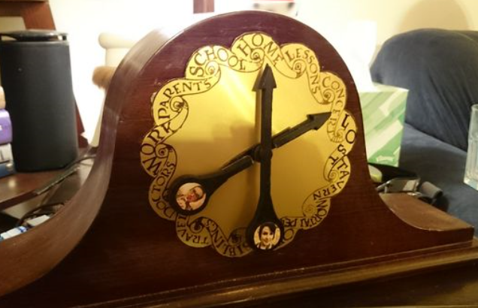
1. Introduction
Harry Potter
Real-Life Weasley Clock

Slide 5



2. goal
Whereabouts Clock??
Senior
Family
Children

Slide 6
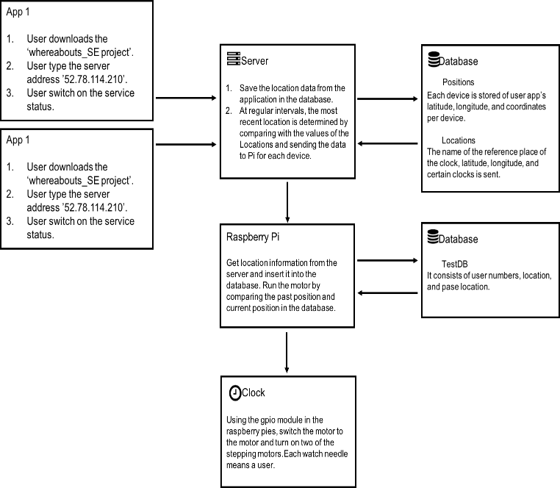
3. Composition - 1

Slide 7
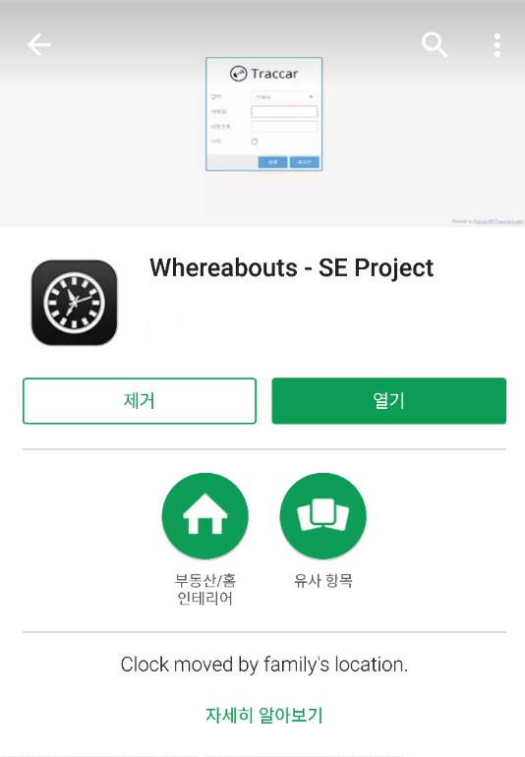
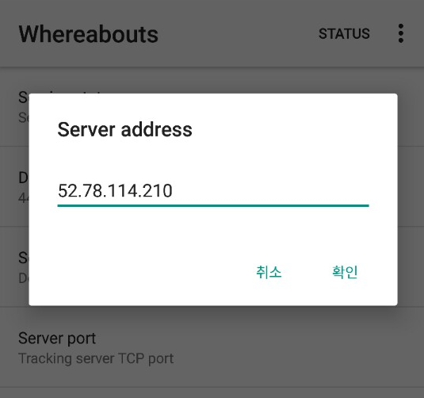
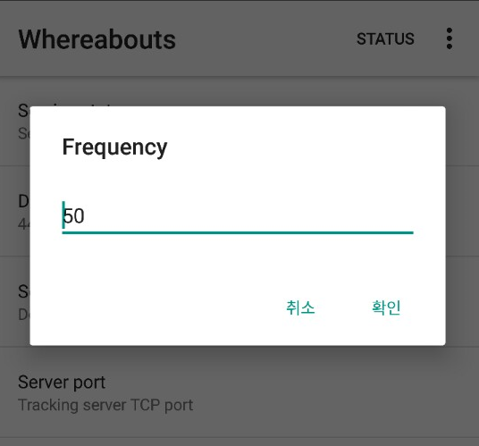
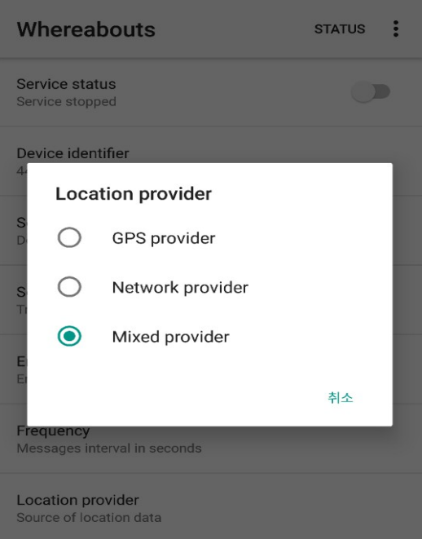
3. Composition – Application
Our Whereabouts clocks uses the Traccar Open Source to obtain location information.
Put the Amazon EC2 Server Address in the Whereabouts – SE Project App.
Set the Frequency that request to the Amazon EC2 Server.
Select location provider between GPS mode and Network mode.

Slide 8


3. Composition – Server
Amazon EC2
The server stores the location information that the application sends to the Positions DB.
The Server sends the real-time location to the Raspberry Pi by comparing the location of the latest location to the Data Set.

Slide 9
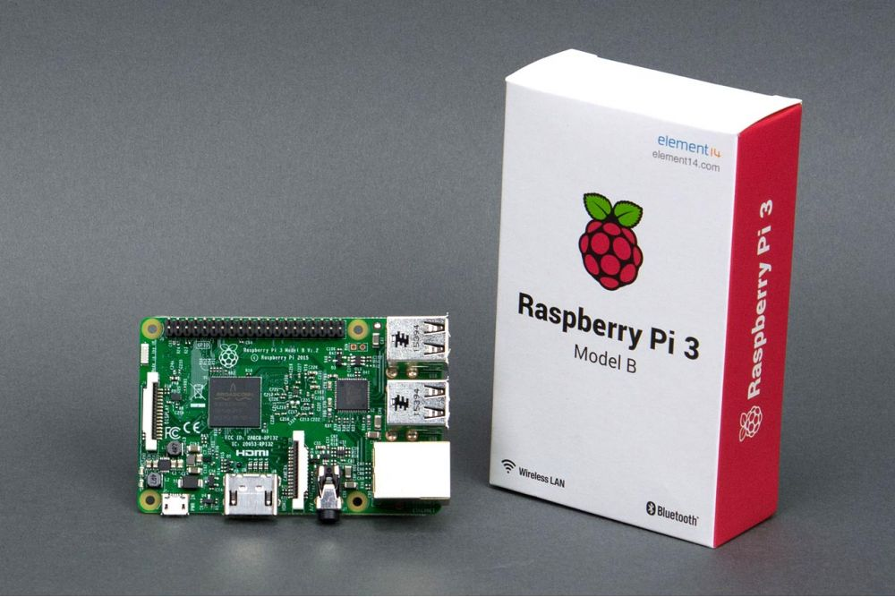
3. Composition – Raspberry pi 3
Raspberry pi 3
Get location information from the server and insert it into the MYSQL DB.
Run the motor by comparing the past location and current position in the MYSQL DB.

Slide 10
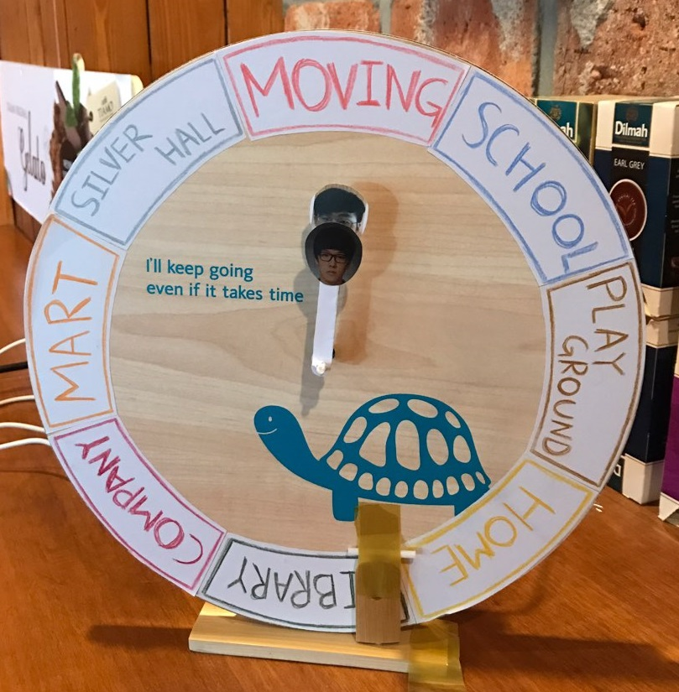
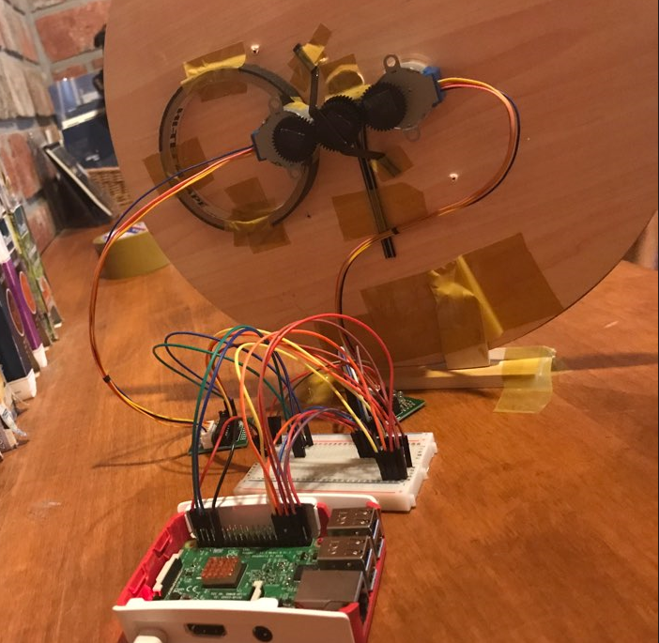
3. Composition – Clock
Clock Front
Clock Back
1. The gears of the stepping motor and the gears of the clock turn the our whereabouts clock.
2. Hands of a clock refers to a family member and the clock shows the location instead of the time.

Slide 11
5. Demo Video
https://youtu.be/IsUer-2UNmQ

Slide 12
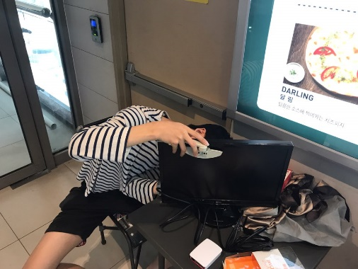

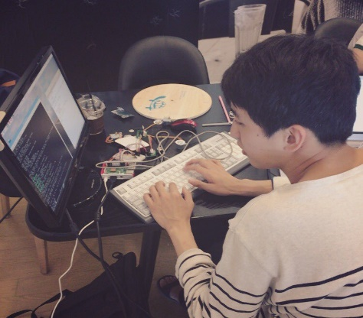

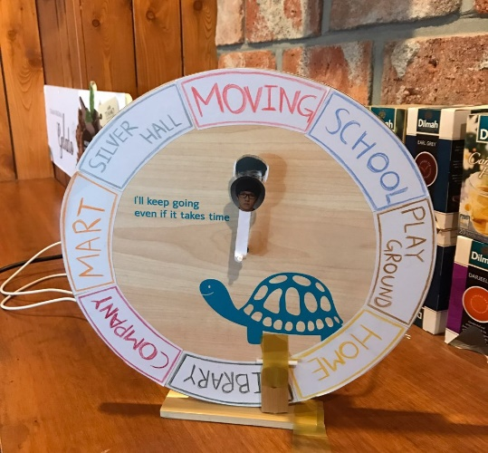
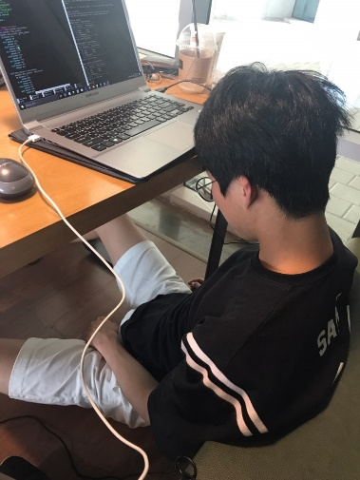
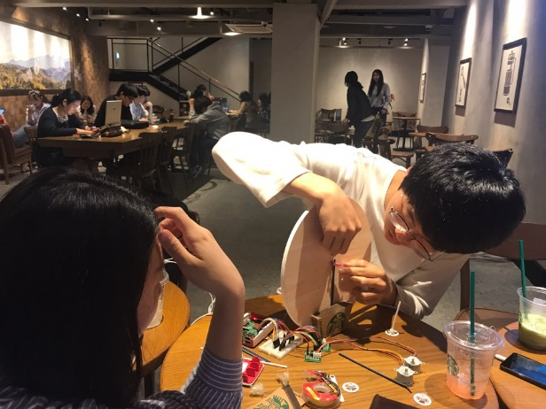
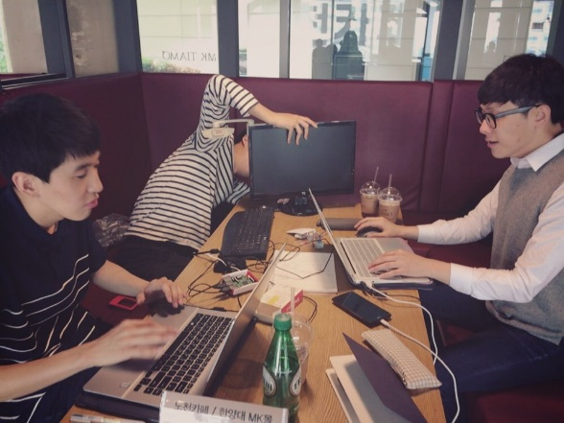
Thank you

