Slide 1
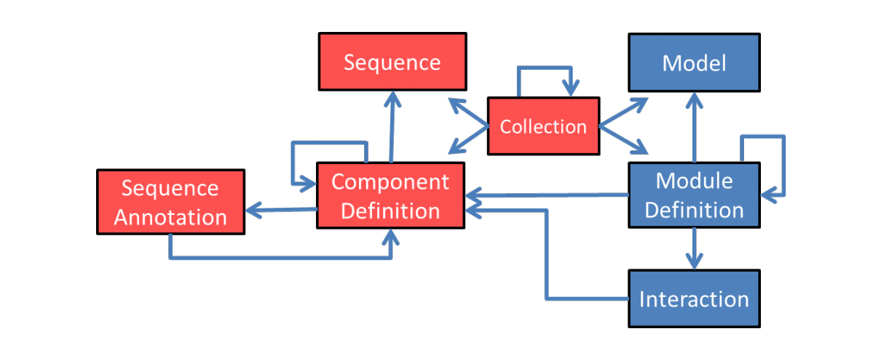
SBOL v1

Slide 2
SBOL v2.0
SBOL v1

Slide 3
SBOL v2.2
SBOL v2.0
SBOL v1
Provenance
Combinatorial Derivation
Implementation
Attachment

Slide 4
SBOL v2.3
SBOL v2.2
SBOL v2.0
SBOL v1
Provenance
Combinatorial Derivation
Implementation
Attachment
Experiment
Experimental
Data
Measure

Slide 5
ComponentDefinition
ComponentDefinition
identity: iGEM#I13504
name: “iGEM 2016 interlab reporter”
description: “GFP expression cassette used for 2016 iGEM interlab”
type: biopax#DnaRegion
role: SO:0000804 (Engineered Region)

Slide 6
Component
CD: iGEM#I13504
component
Component
Component
Component
definition
definition
definition
ComponentDefinition
identity: iGEM#B0034
name: RBS (Elowitz 1999)
type: biopax#DnaRegion
role: SO:0000139 (Ribosome Entry Site)
ComponentDefinition
identity: iGEM#E0040
name: GFP
type: biopax#DnaRegion
role: SO:0000316 (CDS)
ComponentDefinition
identity: iGEM#B0015
name: double terminator
type: biopax#DnaRegion
role: SO:0000141 (Terminator)

Slide 7
SequenceConstraint
CD: iGEM#I13504
sequenceConstraint
component
sequenceConstraint
Component
Component
Component
definition
definition
definition
subject
object
subject
object
SequenceConstraint
restriction: sbol#precedes
SequenceConstraint
restriction: sbol#precedes
CD: iGEM#B0034
CD: iGEM#E0040
CD: iGEM#B0015

Slide 8
Sequence, SequenceAnnotation
CD: iGEM#I13504
sequence
sequenceAnnotation
component
Sequence
encoding: iupac#naseq
elements: aaagagga…
Component
component
definition
SequenceAnnotation
CD: iGEM#B0015
location
SequenceAnnotation
role: SO:0001953 (Assembly Scar)
Range
start: 746
end: 875
sequence
location
Sequence
encoding: iupac#naseq
elements: ccaggcatca…
Range
start: 738
end: 745

Slide 9
Reusing Components
CD: iGEM#interlab16device1
CD: iGEM#interlab16device2
sequenceConstraint
component
sequenceConstraint
component
SC: precedes
SC: precedes
subject
object
object
subject
Component
Component
Component
Component
definition
definition
definition
definition
CD: iGEM#J23101
CD: iGEM#I13504
CD: iGEM#J23106

Slide 10
Collection
Collection:
identity: iGEM#interlab16
name: “iGEM 2016 interlab parts”
description: “Collection of parts used for 2016 iGEM interlab”
CD: iGEM#interlab16device1
member
CD: iGEM#interlab16device2
CD: iGEM#interlab16device3
CD: iGEM#interlab16positiveControl
CD: iGEM#interlab16negativeControl

Slide 11
ModuleDefinition
Model:
identity: my-iBioSim-ODE
source: https://synbiohub…
language: edam#2585 (SBML)
framework: SBO:0000062 (continuous)
ModuleDefinition: iGEM#M-I13504
GFP
model
functionalComponent
interaction
Interaction:
type: SBO:0000589 (genetic production)
Functional Component
participation
Functional Component
definition
Participation:
role: SBO:0000645 (template)
Participation:
role: SBO:0000011 (product)
definition
participant
participant
CD: iGEM#I13504
CD: GFP
type: biopax#Protein
GFP

Slide 12
Composing Modules
ModuleDefinition: AraInducedGFP
module
Ara
GFP
module
functionalComponent
Module
definition
Functional Component
definition
Module
definition
ModuleDefinition: AraInduction
ModuleDefinition: iGEM#M-I13504
Ara
GFP
functionalComponent
functionalComponent
Functional Component
CD: pBAD-GFP
Functional Component
definition
definition
CD: iGEM#I13453
component
CD: iGEM#I13504
definition
definition
Component
Component

Slide 13
Linking Designs, Protocols, and Data
ModuleDefinition: AraInducedGFP
Ara
GFP
definition
definition
MD: M9 Media
Functional Component
Module
module
Module
module
definition
ModuleDefinition: AraInducedGFP transformed E.coli grown in M9 Media with 1mM Ara
CD: E. Coli DH5-Alpha
Functional Component
definition
built
built
built
Implementation
Implementation
Implementation

Slide 14
MD: AraInducedGFP
CD: E. Coli DH5-Alpha
built
built
Implementation
Implementation
MD: M9 Media
Activity:
transform
[Usage link]
built
Implementation
Implementation
wasGeneratedBy
Activity:
culture
[Usage link]
MD: AraInducedGFP
transformed E.coli grown in M9 Media with 1mM Ara
Implementation
wasGeneratedBy
built
Activity:
flow cytometry
[Usage link]
Experiment
experimentalData
Experimental Data
wasGeneratedBy
module
Activity:
curve fit
[Usage link]
attachment
Attachment
Measure
measure
Module
wasGeneratedBy

