Slide 1


SBOL Visual 2.0 update
Jacob Beal (on behalf of the SBOLv community)
September, 2016

Slide 2

SBOL Visual 1.0:
gfp
tetR
Synthetic Biology Open Language - Visual
Community standards in development since 2008
SBOL Visual 1.0: BBF RFC #93 doi: 1721.1/78249

Slide 3
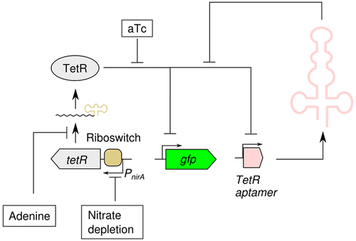
Drivers for SBOL 2.0
There’s a lot more to talk about in genetic designs:
Example from: Higo et al, “Designing Synthetic Flexible Gene Regulation Networks Using RNA Devices in Cyanobacteria,” ACS Synthetic Biology, online September, 2016
Notes:
I'm not picking on anybody - I just took the most recent 5 "just publishable" papers with constructs

Slide 4
SBOL Visual 2.0 (draft)
Nucleic Acid Component Glyphs
Other Component Glyphs
GFP
gfp
pTet
tetR
Interactions
Display IDs
TetR-repressible GFP
Reverse Complement Nucleic
Acid Component Glyphs
Nucleic Acid Backbone
Module Definition
Draft: https://github.com/SynBioDex/SBOL-visual

Slide 5
Requirements for Glyphs
Defined by ontology (preferably SO / SBO)
Easy to sketch by hand
Only solid black lines: user has free choice on color, dash style, fill, scaling, styling, and text
Difficult to confuse when hand-sketched, scaled
Vertically and horizontally asymmetric
Clear interior/exterior distinction for closed paths

Slide 6
Challenges
Conflicting principles
Maintain graphical design requirements
Cover all major features in SBOL 2.x data standard
Maintain compatibility with SBGN (probably AF)
Problem glyphs
Adding glyphs
Lots of proposal; hash out now or save for 2.1?

Slide 7
Where we stand today:
Glyph requirements: rough consensus
Single/double strand: rough consensus
Glyph variants: rough consensus
Interactions: rough consensus on stimulation, inhibition, regulation; question whether stimulation needs to be split into production vs. regulation, how to interpret multi-head/tail interactions, representation of reactions
Modules: rough consensus on module, mappings; not yet on ports & cross-module interactions
Non-DNA components: rough consensus on generic, not yet on anything else
Labels, annotations: rough consensus

