Slide 1
ICE Software Platform
Nathan J. Hillson (njhillson@lbl.gov) and
Hector A. Plahar (haplahar@lbl.gov)
Software for Synthetic Biology Workflows Workshop
Scottsdale, Arizona
June 7, 2018

Slide 2
Introduction
ICE is an informatic repository (along with physical sample information) for DNA and protein sequences, microbial strains, and plant seeds
ICE has a well-defined and documented API (http://ice.jbei.org)
ICE is freely available (modified BSD license) at https://github.com/JBEI/ice
Examples of ICE instances available to the general public:
https://public-registry.jbei.org
https://registry.jgi.doe.gov
https://synberc-registry.jbei.org
https://acs-registry.jbei.org

Slide 3
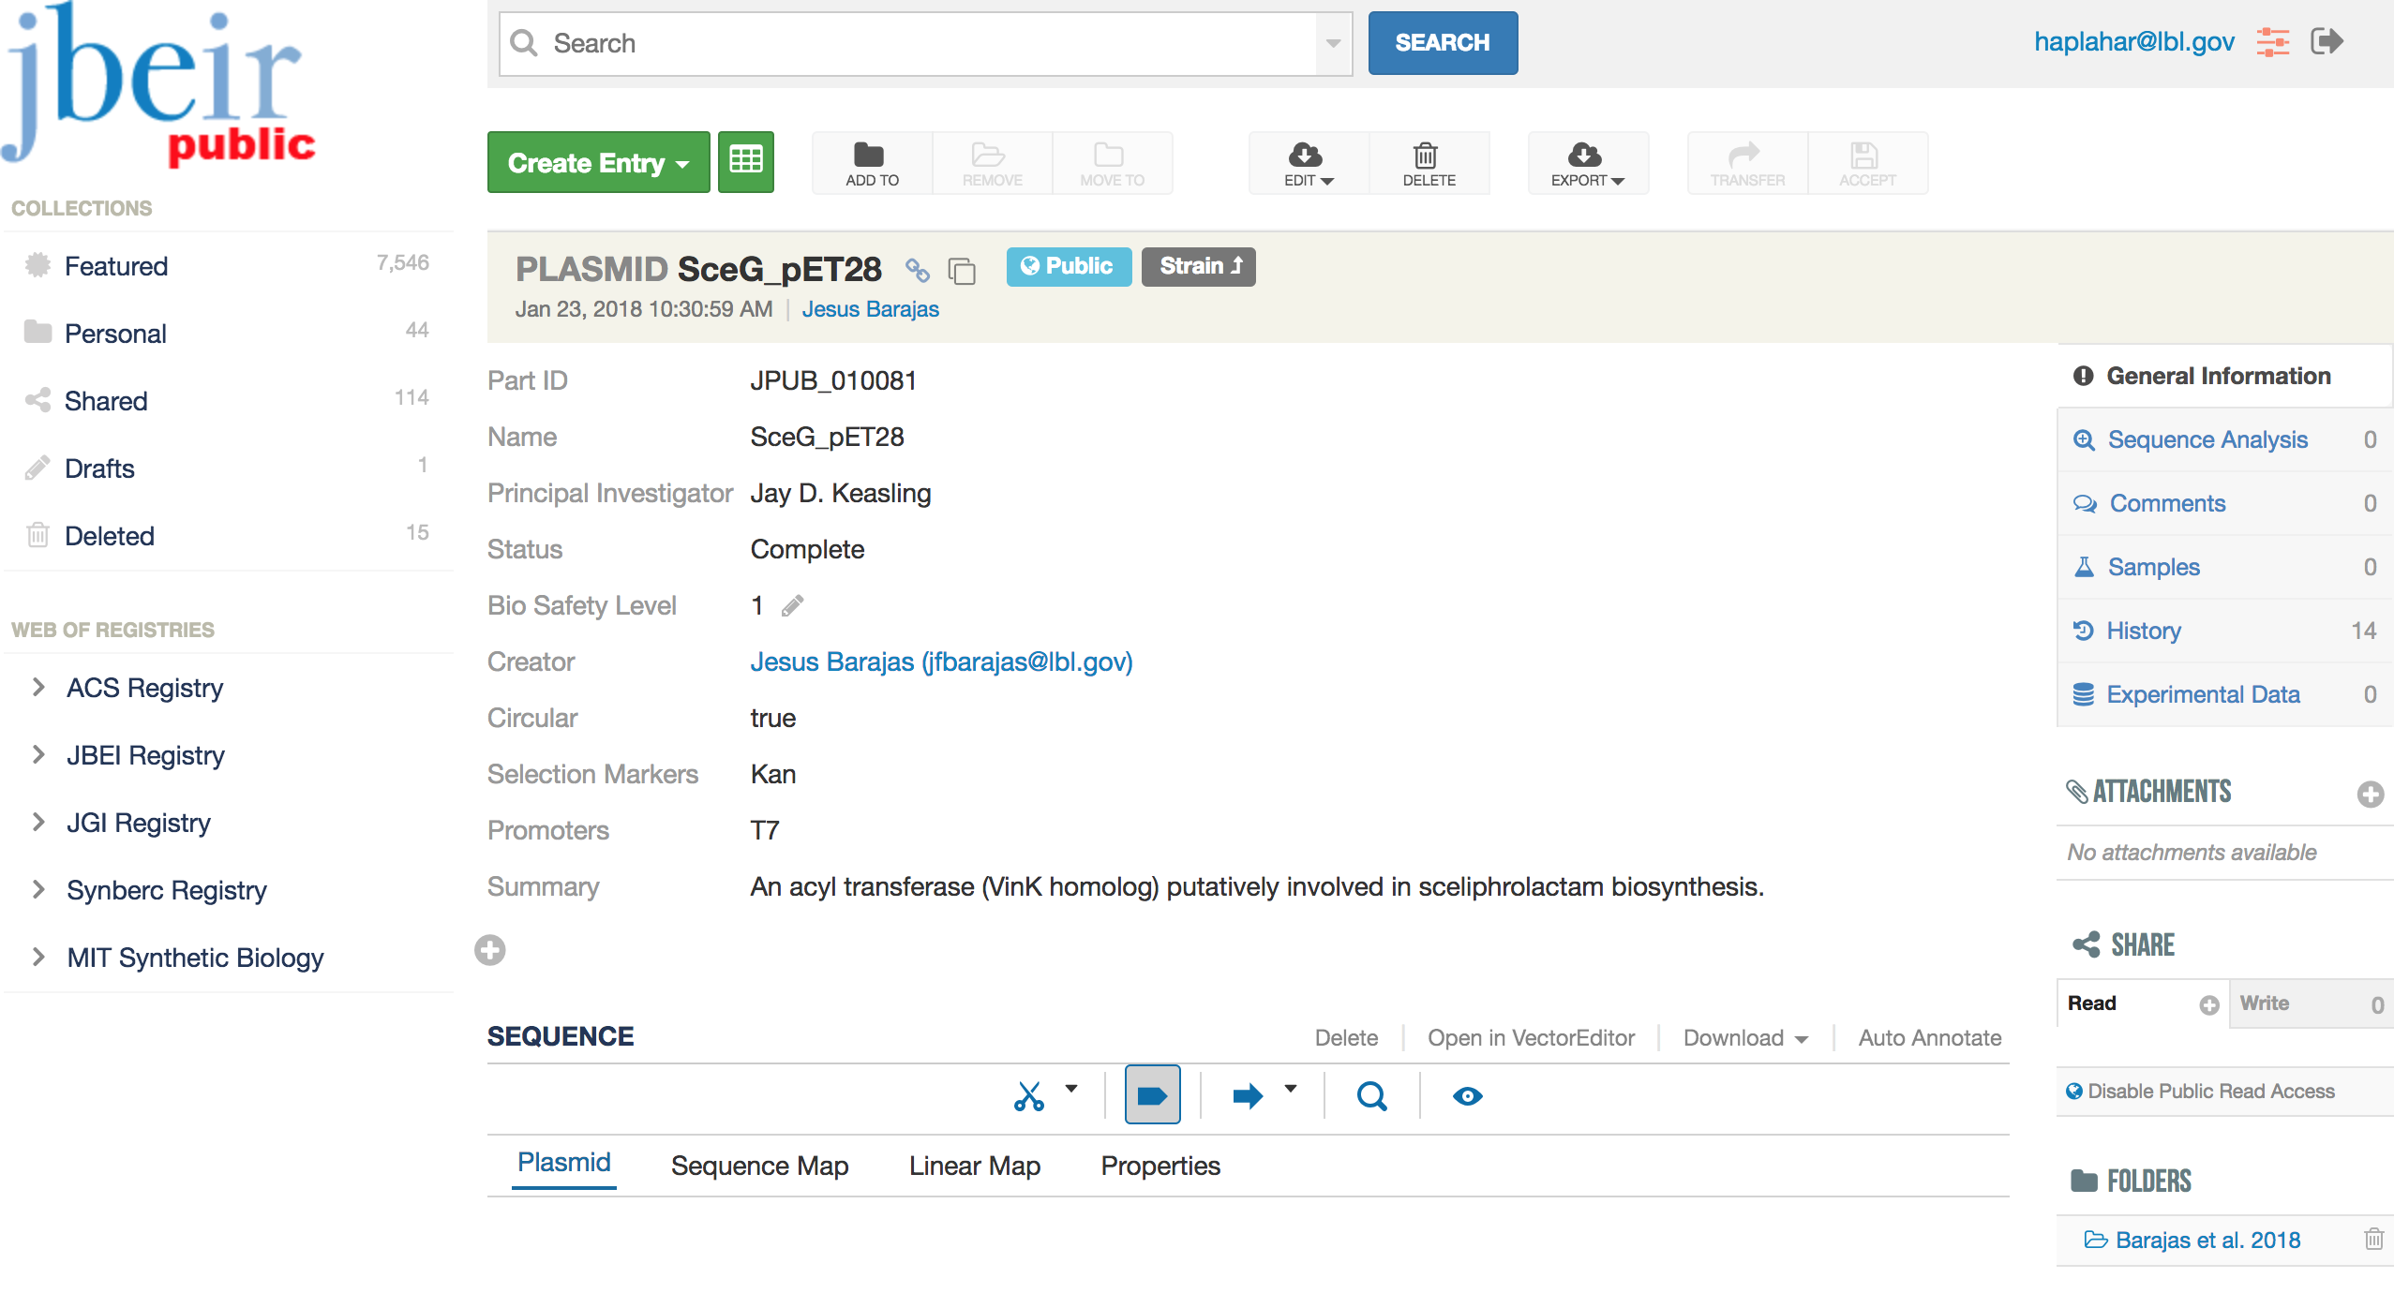
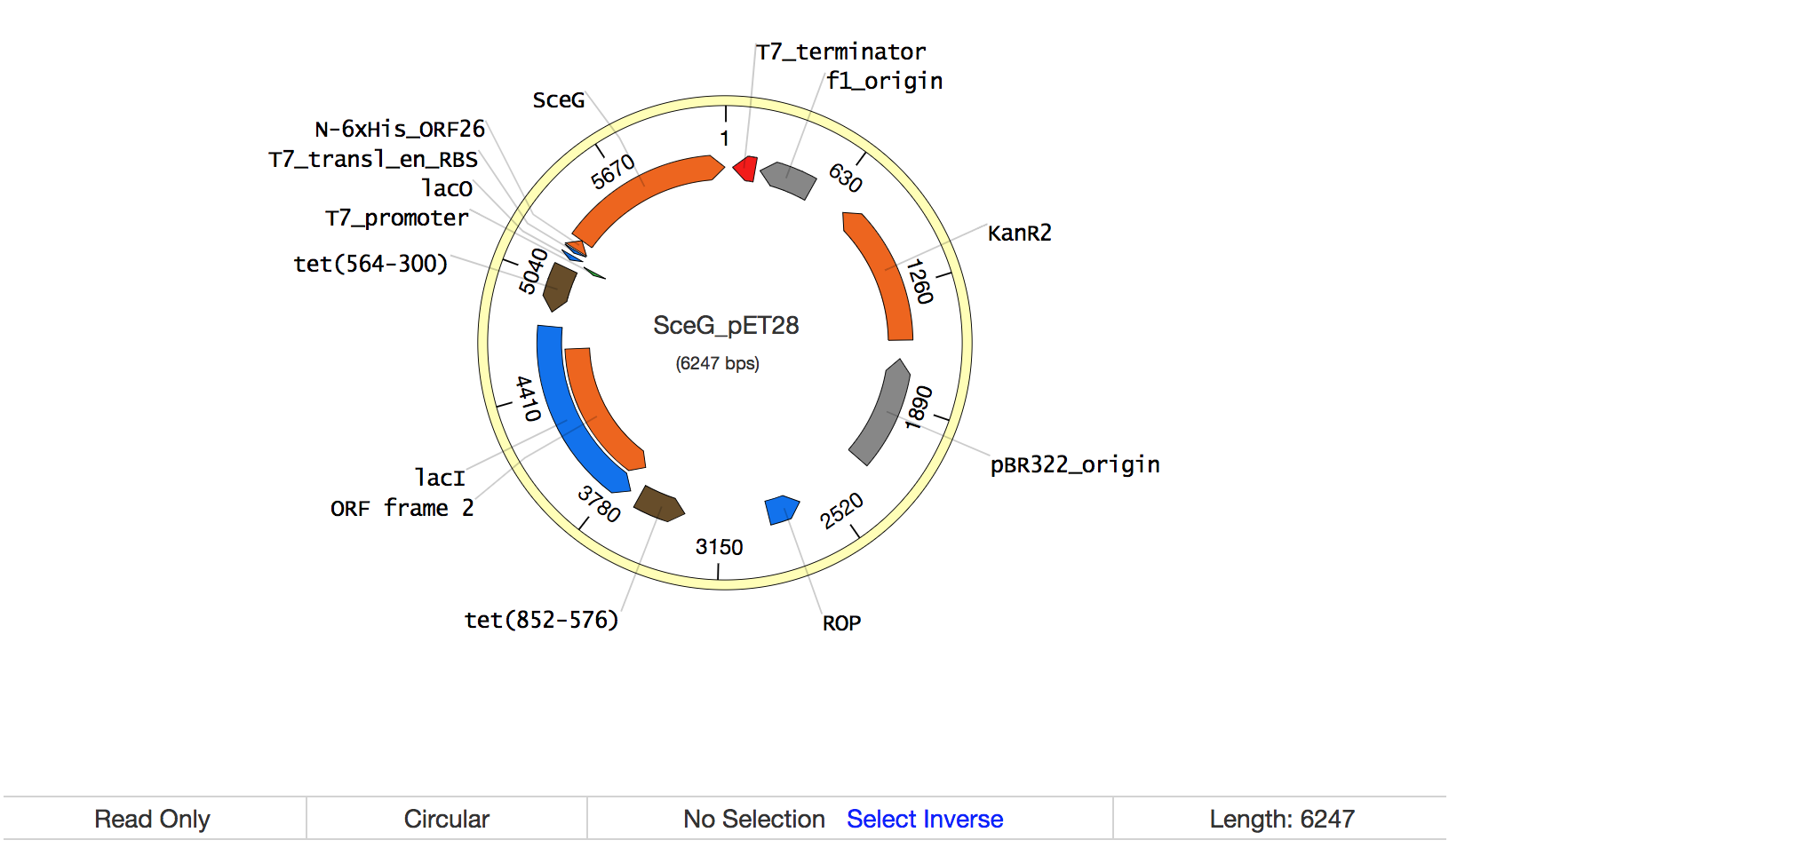
Plasmid Entry View

Slide 4
Additional Features
ICE supports Genbank, FASTA, and SBOL (v1.1 and 2.0) DNA sequence formats and can convert between formats
ICE supports FASTA protein sequence formats
ICE enables fine-grained permissions for individuals or groups on a per-entry or set-of-entries basis
ICE generates API keys to enable an ICE instance to interact with a third-party application
ICE serves as a repository for physical sample tracking information
ICE offers advanced keyword and BLAST search capabilities

Slide 5
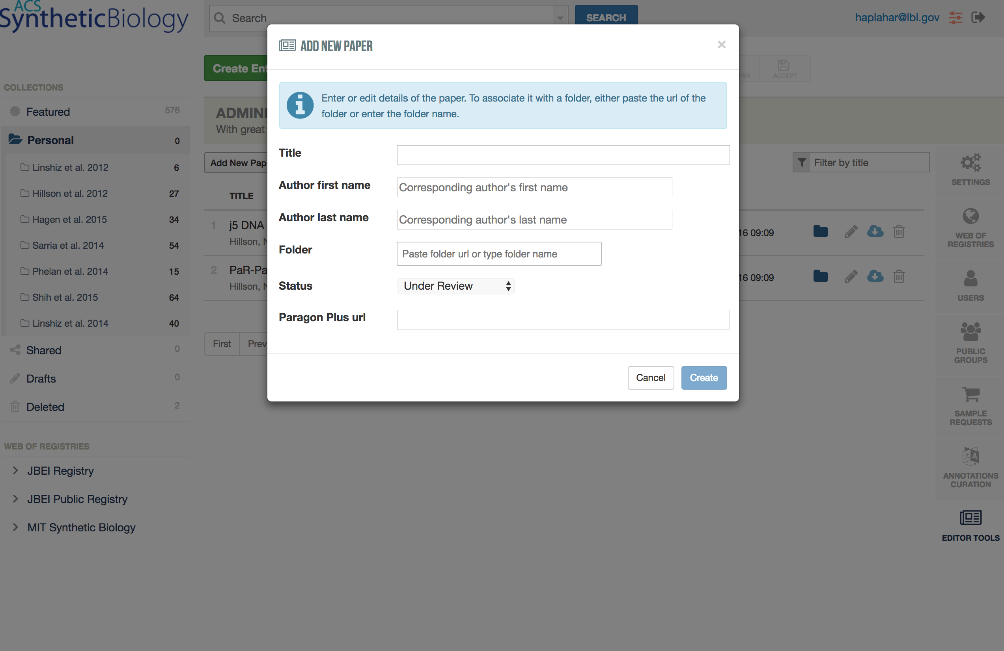
Scientific Journal Editor Tools

Slide 6
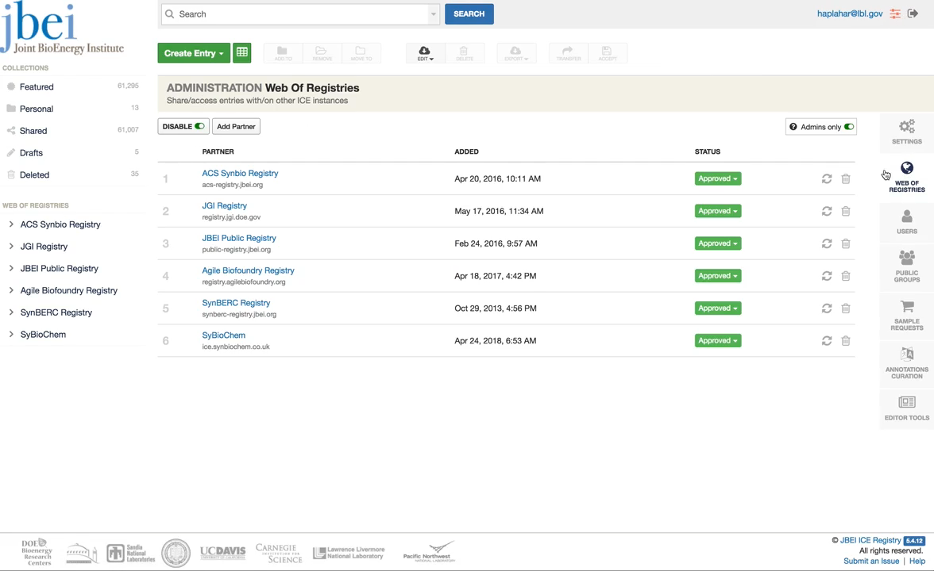
Web of Registries

Slide 7
