Slide 1
Cello: genetic circuit design automation A programming language for cells
Shuyi Zhang
Massachusetts Institute of Technology

Slide 2
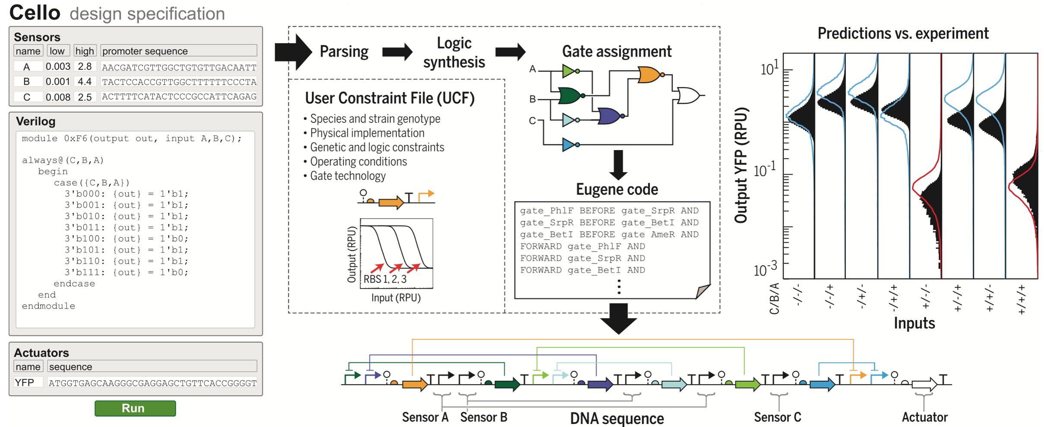
Cello workflow
Nielsen et al., Science (2016)

Slide 3

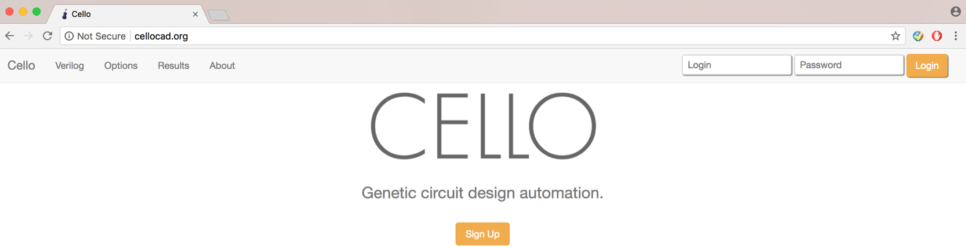
A user friendly web version
Nielsen et al., Science (2016)

Slide 4
Cello is a flexible platform
User Constrained File (UCF) Eco1C1G1T1
Experimental system
Genetic gates library
Circuit DNA sequence
header
response function
gate parts
genetic location
measurement std
gate cytometry
gate toxicity
eugene rules
Cello
UCF_Eco1C2G2T2
UCF_Bth1C1G1T1
UCF_SC1C1G1T1
response function
measurement std
gate parts
genetic location
gate parts
gate parts
measurement std

Slide 5
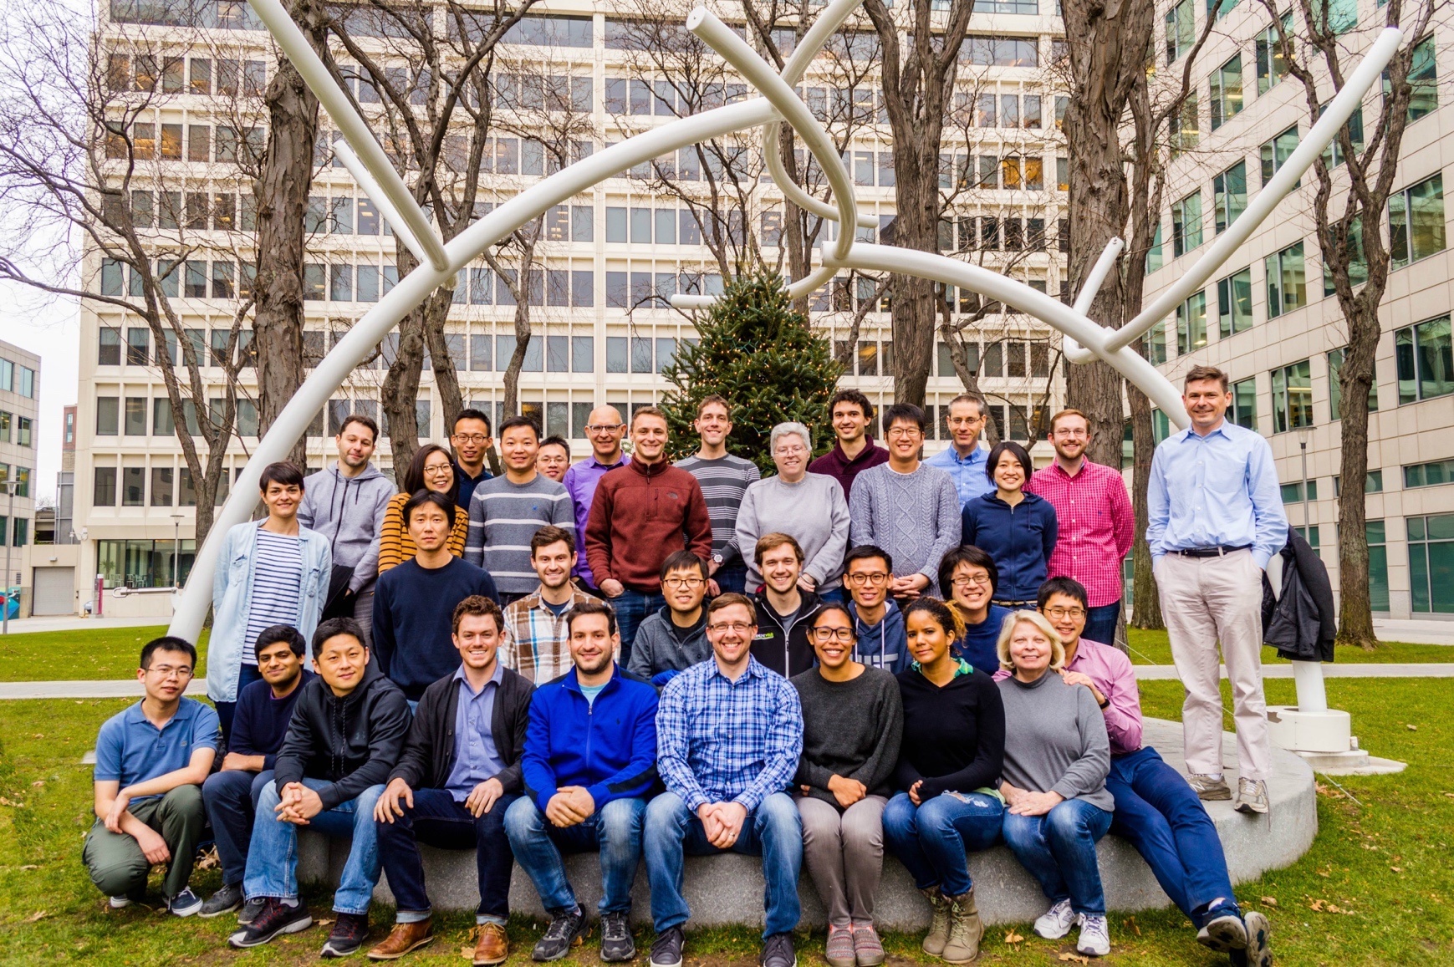

Acknowledgement

