Slide 1

The Synthetic Biology Open Language 2.0
Bryan Bartley, Jacob Beal, Kevin Clancy, Goksel Misirli, Nicholas Roehner, and Matthew Pocock
IWBDA 2015, Aug 20th

Slide 2
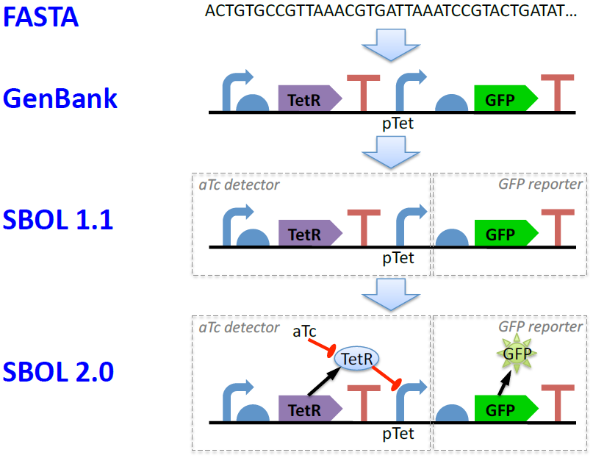
Hierarchy of Biodesign Standards

Slide 3
Hierarchy of Biodesign Standards

Slide 4
Hierarchy of Biodesign Standards

Slide 5
Hierarchy of Biodesign Standards

Slide 6
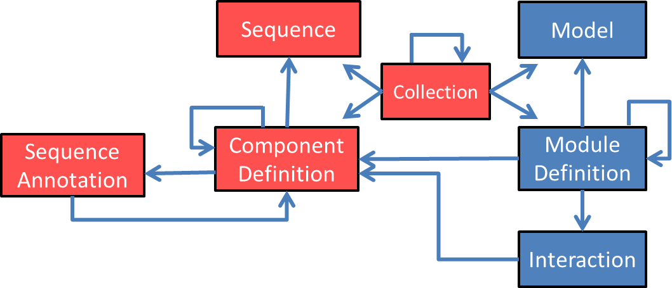
Simplified SBOL 2.0 Data Model

Slide 7
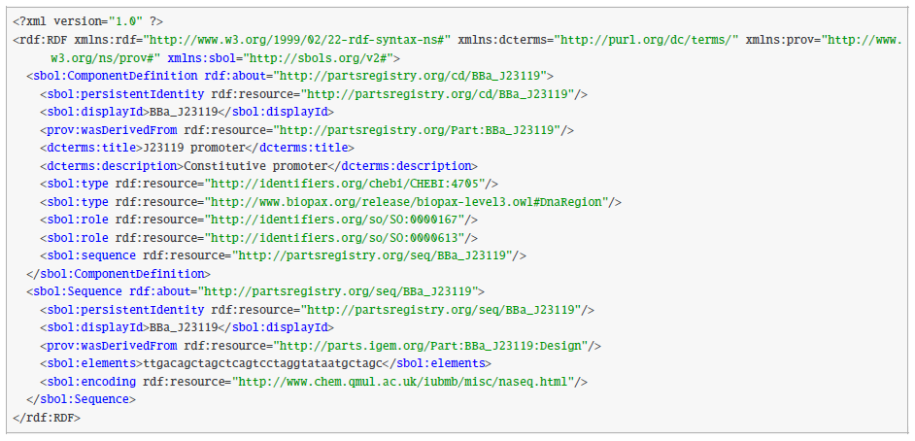
SBOL 2.0 Serialization

Slide 8
SBOL 2.0 Serialization

Slide 9
SBOL 2.0 Serialization

Slide 10
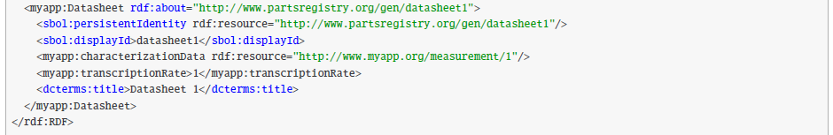
SBOL 2.0 Custom Annotation

Slide 11

Examples

Slide 12
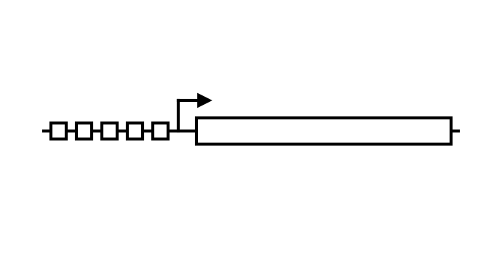
HIV-1 Signaling Device
Cell Membrane
HIV-1 protease cleavage site
HIV-1
protease
Gal4-VP16
Nucleus
nuclear Gal4-VP16
GAL4 Operators
Antiviral Defense Genes
Andreja Majerle, Rok Gaber, Mojca Bencina, and Roman Jerala. Function-Based Mutation-Resistant Synthetic Signaling Device Activated by HIV-1 Proteolysis.
ACS Synth. Biol. 2015, 4, 667-672.

Slide 13
HIV-1 Signaling Components
Composite
Cell Membrane
Component
Composite Protein Component
Protein Component
Protein Component
Composite
Nucleus
Component
Composite DNA
Component
Protein Component
Andreja Majerle, Rok Gaber, Mojca Bencina, and Roman Jerala. Function-Based Mutation-Resistant Synthetic Signaling Device Activated by HIV-1 Proteolysis.
ACS Synth. Biol. 2015, 4, 667-672.

Slide 14
HIV-1 Signaling Interactions
Cleavage Interaction
Transport Interaction
Activation Interaction
Andreja Majerle, Rok Gaber, Mojca Bencina, and Roman Jerala. Function-Based Mutation-Resistant Synthetic Signaling Device Activated by HIV-1 Proteolysis.
ACS Synth. Biol. 2015, 4, 667-672.

Slide 15
HIV-1 Signaling Module
Signaling Module
Cleavage Interaction
Activation Interaction
Antiviral Module
Andreja Majerle, Rok Gaber, Mojca Bencina, and Roman Jerala. Function-Based Mutation-Resistant Synthetic Signaling Device Activated by HIV-1 Proteolysis.
ACS Synth. Biol. 2015, 4, 667-672.

Slide 16
HIV-1 Signaling Module
Signaling Module
Mapping
Transport Interaction
Antiviral Module
Mapping
Andreja Majerle, Rok Gaber, Mojca Bencina, and Roman Jerala. Function-Based Mutation-Resistant Synthetic Signaling Device Activated by HIV-1 Proteolysis.
ACS Synth. Biol. 2015, 4, 667-672.

Slide 17
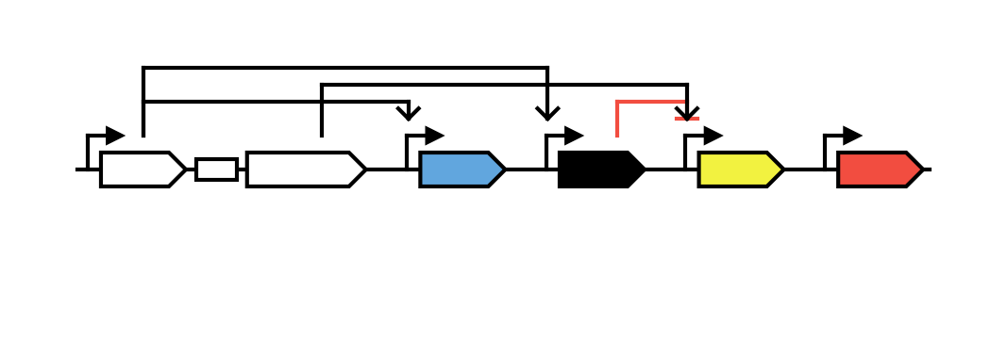
EQuIP Characterization Circuit
Dox
pCAG
pTRE
pTRE
pUAS-rep
pCAG
rtTA3
T2A
VP16Gal4
EBFP2
R1
EYFP
mkate
Noah Davidsohn, Jacob Beal, Samira Kiani, Aaron Adler, Fusun Yaman, Yingqing Li, Zhen Xie, and Ron Weiss. Accurate Predictions of Genetic Circuit Behavior from Part Characterization and Modular Composition. ACS Synth. Biol. 2015, 4, 673-681.

Slide 18
EQuIP Char. Components
Small Molecule Component
Composite
DNA
Components
Partial
Composite
DNA
Component
Composite
DNA
Components
Noah Davidsohn, Jacob Beal, Samira Kiani, Aaron Adler, Fusun Yaman, Yingqing Li, Zhen Xie, and Ron Weiss. Accurate Predictions of Genetic Circuit Behavior from Part Characterization and Modular Composition. ACS Synth. Biol. 2015, 4, 673-681.

Slide 19
EQuIP Char. Interactions
Activation Interactions
Repression
Interaction
Noah Davidsohn, Jacob Beal, Samira Kiani, Aaron Adler, Fusun Yaman, Yingqing Li, Zhen Xie, and Ron Weiss. Accurate Predictions of Genetic Circuit Behavior from Part Characterization and Modular Composition. ACS Synth. Biol. 2015, 4, 673-681.

Slide 20
EQuIP Characterization Module
Sensor Module
Repressor Module
Output Module
Const. Module
input
output
output
output
Noah Davidsohn, Jacob Beal, Samira Kiani, Aaron Adler, Fusun Yaman, Yingqing Li, Zhen Xie, and Ron Weiss. Accurate Predictions of Genetic Circuit Behavior from Part Characterization and Modular Composition. ACS Synth. Biol. 2015, 4, 673-681.

Slide 21
EQuIP Characterization Module
Sensor Module
Repressor Module
Output Module
Const. Module
input
output
output
output
TAL14
Noah Davidsohn, Jacob Beal, Samira Kiani, Aaron Adler, Fusun Yaman, Yingqing Li, Zhen Xie, and Ron Weiss. Accurate Predictions of Genetic Circuit Behavior from Part Characterization and Modular Composition. ACS Synth. Biol. 2015, 4, 673-681.

Slide 22
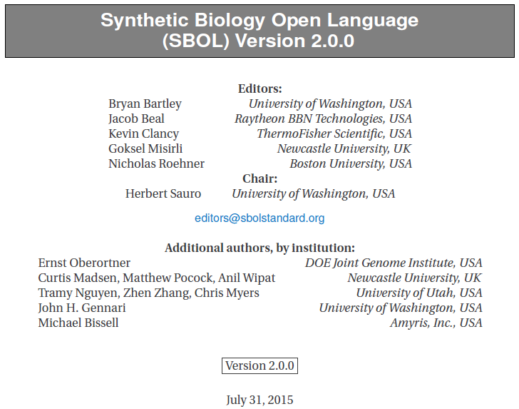
SBOL 2.0 Specification
More examples can be found in the SBOL 2.0 spec at http://sbolstandard.org/downloads/specification-data-model-2-0/

Slide 23

SBOL 2.0 Libraries
The Java library supporting SBOL 2.0 is available as a beta release at
http://sbolstandard.org/libsbol/get-the-libraries/java/
C and Python libraries supporting SBOL 1.1 are also available and are undergoing development to support SBOL 2.0

Slide 24

Beyond SBOL 2.0
Labs doing similar research need to exchange SBOL 2.0 files so that new best practices and meta -standards can be defined for different areas of synthetic biology.

Slide 25
Beyond SBOL 2.0
SBOL needs to enable researchers and tools to designate design context.
Conditions under which the design operates properly
Marking which structural and functional entities are part of the design environment

Slide 26
Summary
SBOL 2.0 enables researchers and software tools to specify, exchange, and reuse unambiguous, heterarchical, modular descriptions of both the structure and function of biological designs.

Slide 27


Acknowledgements
University of Utah
Prof. Chris Myers
Tramy Nguyen
Zhen Zhang
Newcastle University
Prof. Anil Wipat
Curtis Madsen
DOE JGI
Ernst Oberortner
University of Washington
Prof. Herbert Sauro
Prof. John Gennari
Amyris, Inc.
Michael Bissell
NSF Grants DBI-1356041 and DBI-1355909
EPSRC Grant EP/J02175X/1

