Slide 1


3 Use Cases for SBOL
Construct high level design in CAD → Construct low level sequence design in DNA editor
Devise cloning strategy in DNA editor → Generate construction diagram in CAD
Perform sequence analysis and verify construct in DNA editor
Parts sharing
Template re-use
Failure analysis
SBOL

Slide 2
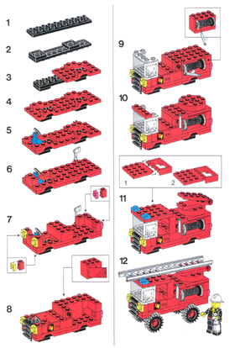
3 Use Cases for SBOL
Construct high level design in CAD → Construct low level sequence design in DNA editor
Devise cloning strategy in DNA editor → Generate construction diagram in CAD
Perform sequence analysis and verify construct in DNA editor
Parts sharing
Template re-use
Failure analysis
Design

Slide 3
3 Use Cases for SBOL
Construct high level design in CAD → Construct low level sequence design in DNA editor
Devise cloning strategy in DNA editor → Generate construction diagram in CAD
Perform sequence analysis and verify construct in DNA editor
Parts sharing
Template re-use
Failure analysis
Construction
Diagram
Design

Slide 4
3 Use Cases for SBOL
Construct high level design in CAD → Construct low level sequence design in DNA editor
Devise cloning strategy in DNA editor → Generate construction diagram in CAD
Perform sequence analysis and verify construct in DNA editor

Slide 5
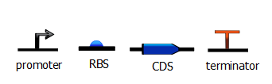
pSB1A2
1. High-level design in CAD
Notes:
SUBLIME is a STTR collaboration between Gennari & Clark & Parsia. SUBLIME background – why recording sequence annotations is important, to encourage parts re-use and exchange as well as failure analysis – as SBOL is extensible, SBOL Enables Sequence Verification Workflow

Slide 6
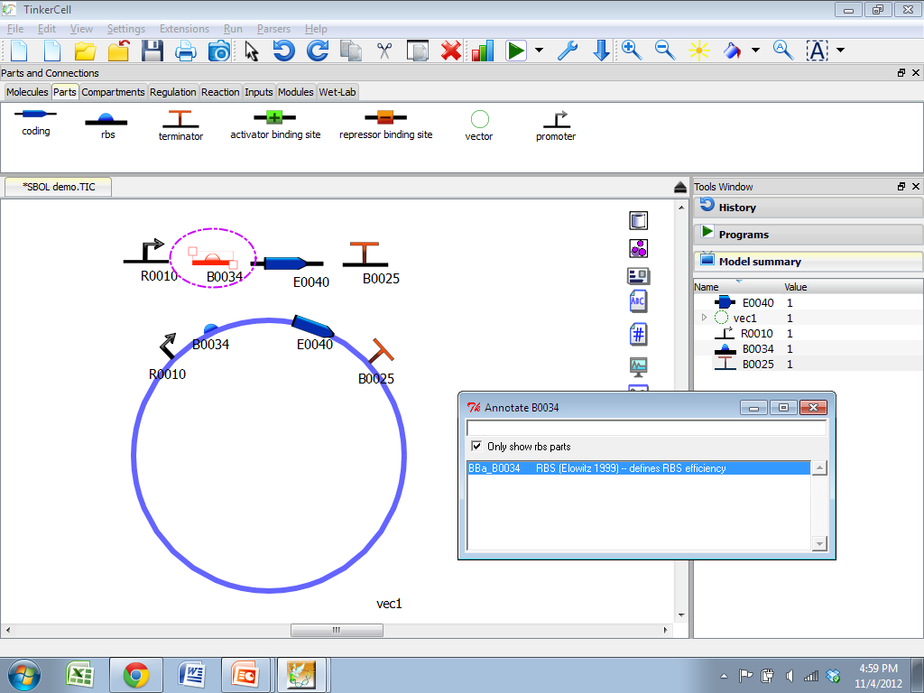
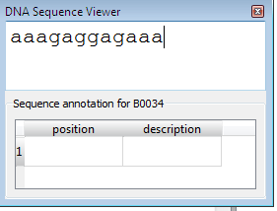
pSB1A2
2. Annotate sequence from parts database

Slide 7
SBOL
3. Export high level design from CAD to DNA editor

Slide 8
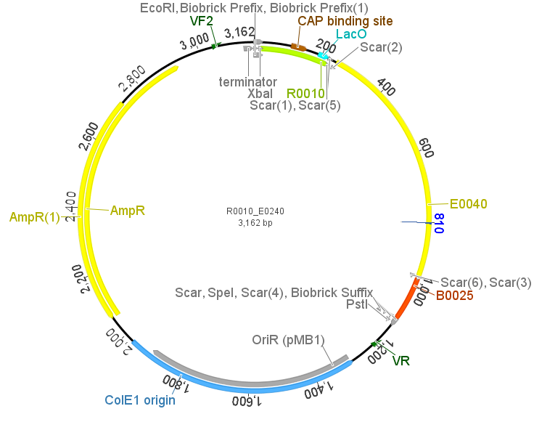
4. Automatically generate design sequence in Geneious

Slide 9
3 Use Cases for SBOL
Construct high level design in CAD → Construct low level sequence design in DNA editor
Devise cloning strategy in DNA editor → Generate construction diagram in CAD
Perform sequence analysis and verify construct in DNA editor

Slide 10
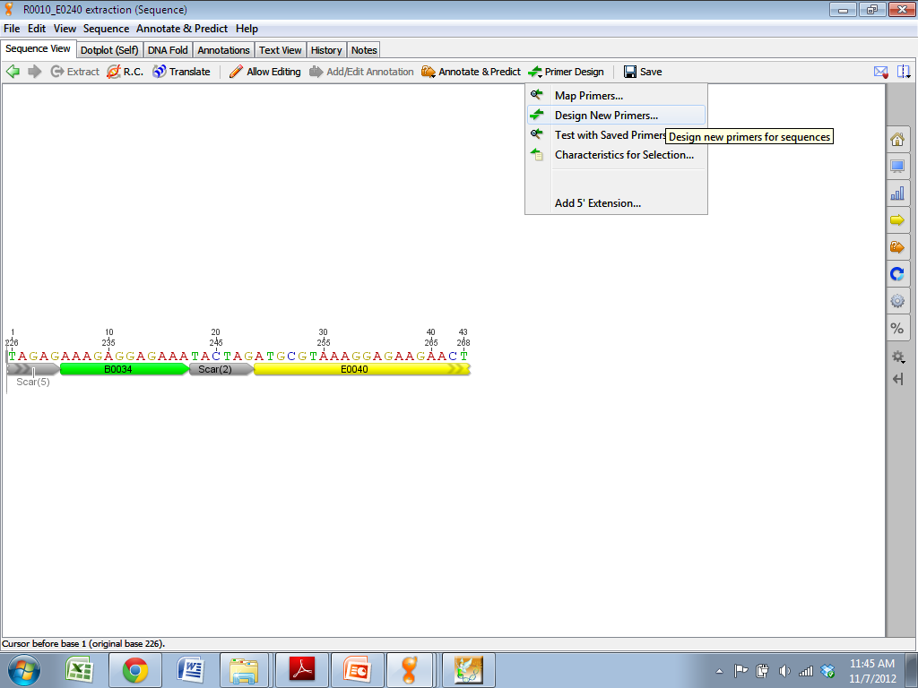
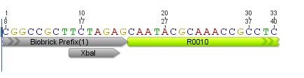
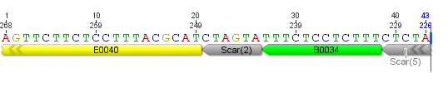
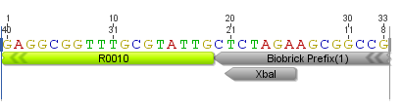
BB1(+)
BB1(-)
BB2(+)
BB2(-)
1. Design primers used for cloning

Slide 11
SBOL
2. Export SBOL from DNA editor to CAD

Slide 12
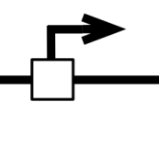
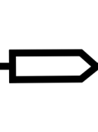



Finished circuit
BB2(+)
BB1(+)
BB1(-)
BB2(-)
R0010 template
E0240 template
3. Automatically generate construction diagram

Slide 13
3 Use Cases for SBOL
Construct high level design in CAD → Construct low level sequence design in DNA editor
Devise cloning strategy in DNA editor → Generate construction diagram in CAD
Perform sequence analysis and verify construct in DNA editor

Slide 14
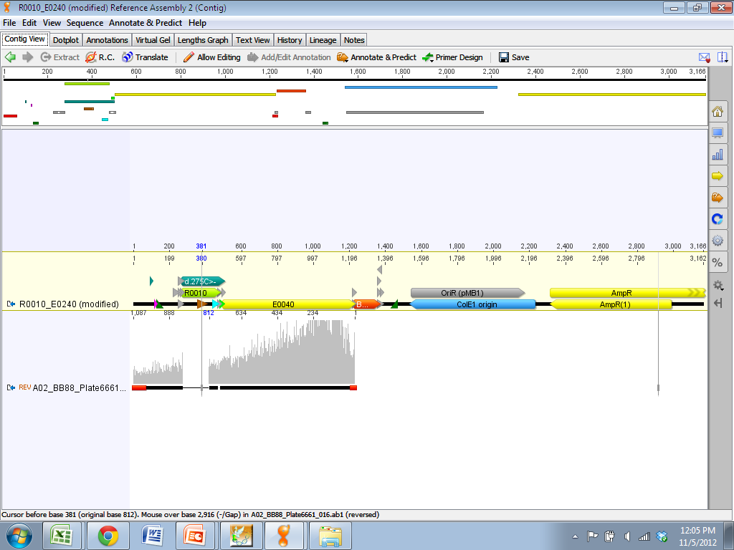
1. Sequence construct and align to design sequence

Slide 15
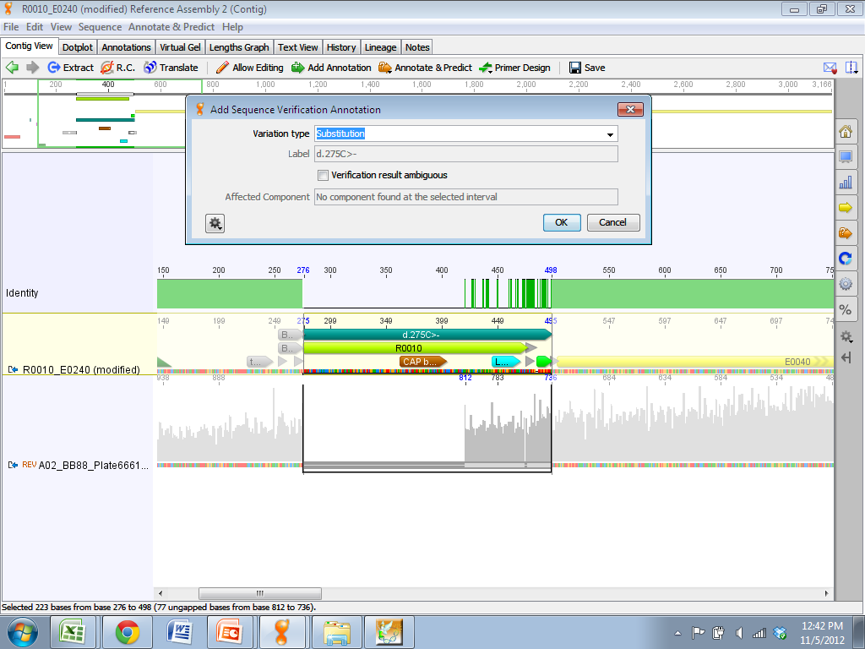
2. Inspect sequence and annotate discrepancies with design

Slide 16
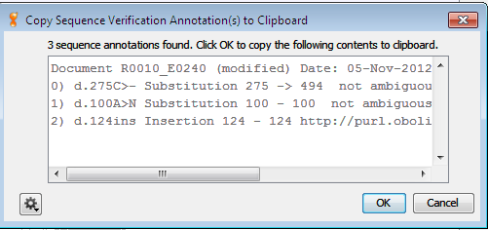
3. Copy summary of sequence analysis to notebook
4. Generate sequencing statistics
Notes:
As SBOL is extensible we are using the extension mechanism to store sequence verification annotations in an SBOL file. Mike will discuss the extension mechanism in terms of the serialization tomorrow
Parts sharing
Template re-use
Failure analysis

Slide 17

SBOL
5. Export sequence annotations & statistics to repository database
as SBOL extension

Slide 19




precedes
precedes
precedes
precedes
NNNN…
…NNN…
…NNN…
…NNN…
…NNNN

