Slide 1
SBOL Core
Ernst Oberortner
CIDAR Lab
Boston University

Slide 2
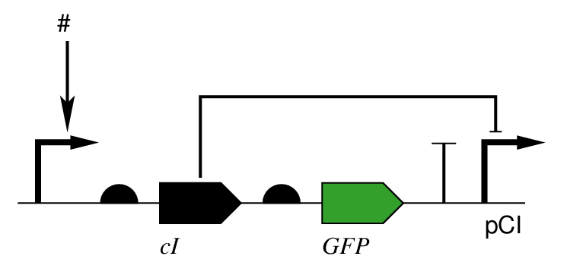
Problem
Example: Regulatory Interactions
In SBOL, no Relationships
between DNAComponents possible!

Slide 3
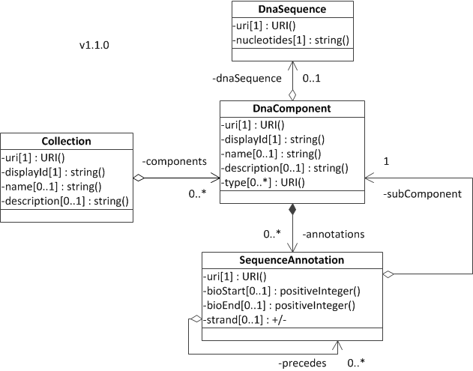
Relation
type: string()
. . .
0..1
-relates_to
0..1

Slide 4
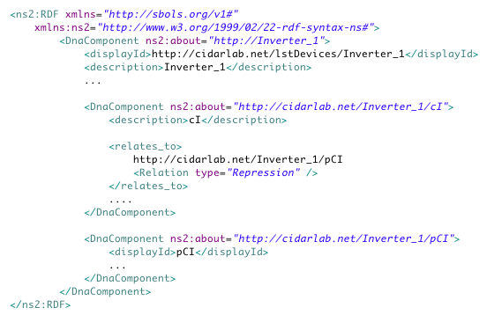
Example

Slide 5
Suggestions?

