Slide 1

Synthetic Biology Open Language
Presenter: Ernst Oberortner (DOE JGI)
NonaTalks, July 17th, 2016
Chicago, IL
Editors: Bryan Bartley (UW), Jacob Beal (Raytheon), Robert Sidney Cox III (Kobe University),
Raik Gruenberg (KAUST), James McLaughlin (Newcastle University)
Chair: Anil Wipat (Newcastle University)
SBOL Development Group: 120 members from more than 50 academic and industrial organizations.

Slide 2
Standards are a foundational principle of synthetic biology
Three foundational principles of synthetic biology based on engineering practice (Endy 2005):
Standardization
Abstraction
Decoupling
Synthetic biology was born with the broad goal of engineering or 'wiring' biological circuitry — be it genetic, protein, viral, pathway or genomic — for manifesting logical forms of cellular control. (Collins 2010)
Biology has long surpassed its mainly descriptive stage, and the questions now asked are increasingly amenable to experimental approaches and theoretical concepts taken from the physical and engineering sciences. (Scwhille 2011)
Notes:
The last few slides have introduced the vocabulary of synthetic biology and highlighted engineering principles. Let’s review some of these principles. Ask class, what are other engineering principles? CAD, mathematical modeling, simulation, Modularity
Decoupling: you don’t have to build it to understand how it works, mention R&D costs in biotech vs classical engineering
Composition use the metaphor of a wrench and bolt

Slide 3
What is SBOL?
SBOL actually consists of 2 standards:
SBOL Data model
a formalized representation of data objects
SBOL Visual
a standardized set of schematic symbols for genetic design
To guarantee interoperability between tools and standards, SBOL leverages ontologies, such as the Sequence Ontology (SO), Systems Biology Ontology (SBO).

Slide 4
Milestones in the history of SBOL
Kick-off at a computational synthetic biology workshop at the University of Washington
Apr, 2008
The SBOL Developers Group was officially established with adoption of formal rules of governance and election of editors
Jun, 2011
First version of the SBOL data model was released
(BB FRFC 84)
Sep, 2011
First version of the SBOL Visual standard was released
(BBF RFC 93)
Mar, 2013
SBOL Version 2.0 was officially released
(BBF RFC 108)
Jul, 2015
Jun, 2016
ACS Synthetic Biology adopts SBOL as publication standard
Notes:
The last few slides have introduced the vocabulary of synthetic biology and highlighted engineering principles. Let’s review some of these principles. Ask class, what are other engineering principles? CAD, mathematical modeling, simulation, Modularity
Decoupling: you don’t have to build it to understand how it works, mention R&D costs in biotech vs classical engineering
Composition use the metaphor of a wrench and bolt

Slide 5
Evolution of standards for Bioinformatics
FASTA
GenBank
SBOL 1.1
SBOL 2.0
ACTGTGCCGTTAAACGTGATTAAATCCGTACTGATAT…
Raw sequence information
TetR
GFP
Contains sequence features
pTet
aTc detector
GFP reporter
Represents sequence features hierarchically
TetR
GFP
pTet
aTc
Represents additional molecule types
Represents modules with inputs and outputs
TetR
TetR
GFP
TetR
GFP
pTet

Slide 6
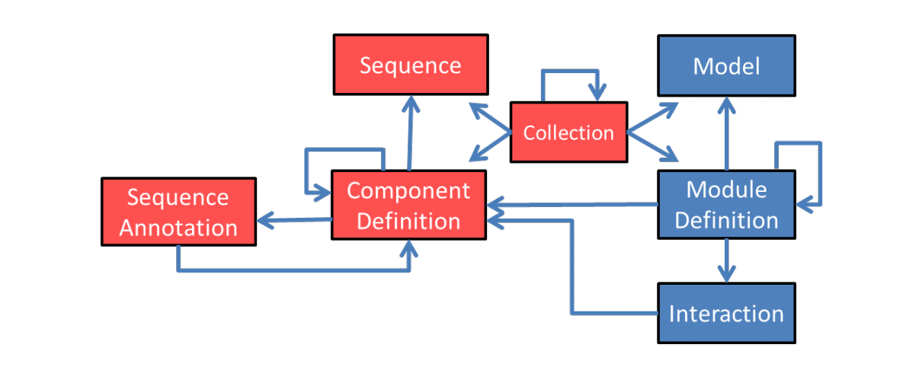
SBOL Data Model
SBOL v2.0.0
SBOL v1.1.0

Slide 7
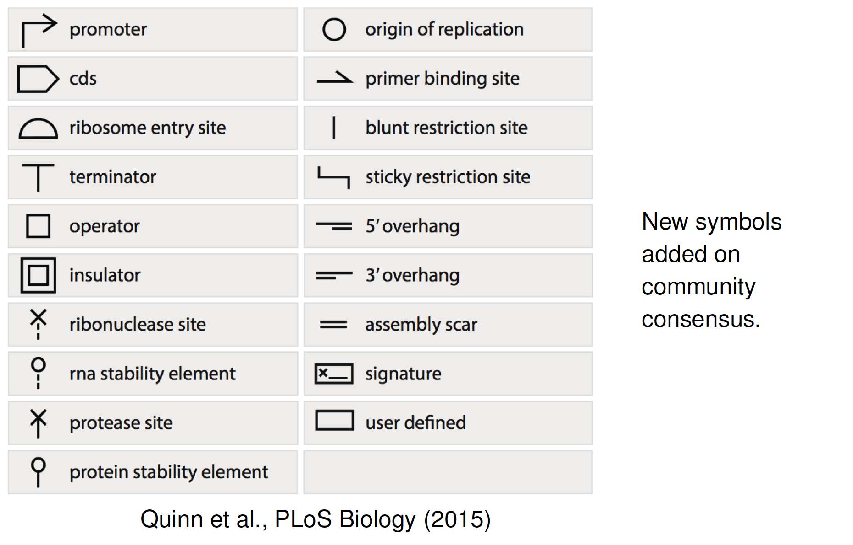
SBOL Visual v1.0.0

Slide 8
Relation between SBOL Visual and SBOL Data Model
Notes:
The last few slides have introduced the vocabulary of synthetic biology and highlighted engineering principles. Let’s review some of these principles. Ask class, what are other engineering principles? CAD, mathematical modeling, simulation, Modularity
Decoupling: you don’t have to build it to understand how it works, mention R&D costs in biotech vs classical engineering
Composition use the metaphor of a wrench and bolt

Slide 9


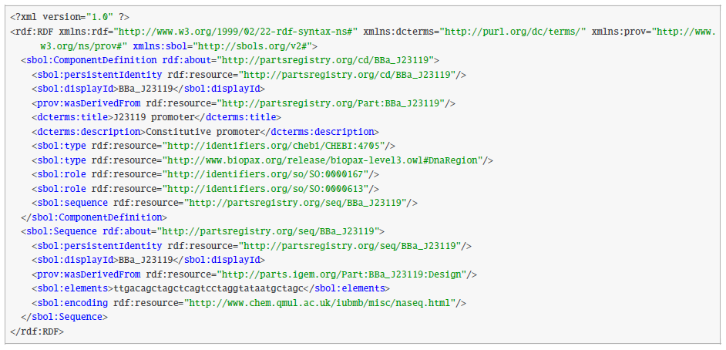
SBOL is serialized in RDF/XML Format
XML allows data to be structured in hierarchical trees, is well-supported and well-understood by software developers
RDF makes data integration across networks easier

Slide 10


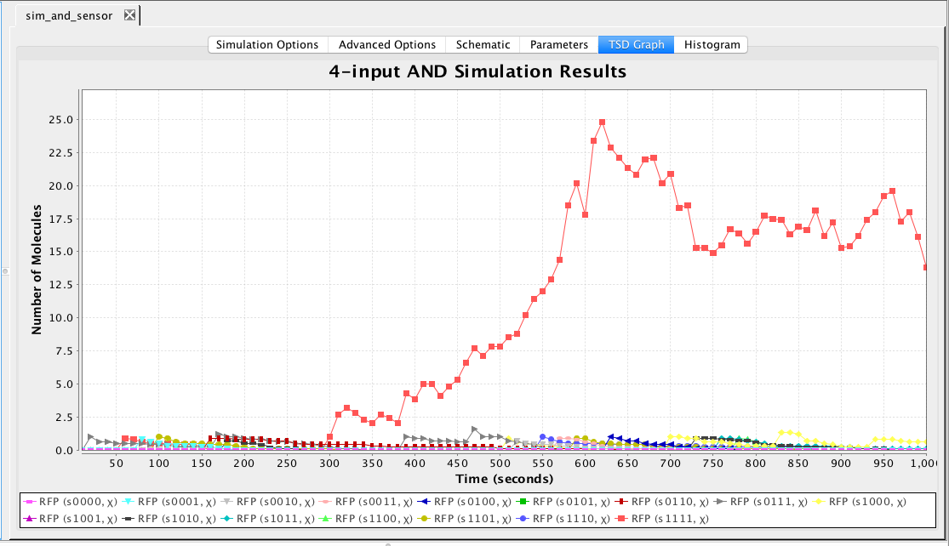




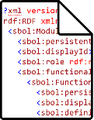


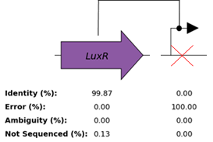

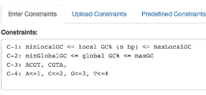
SBOL helps synthetic biologists to collaborate across different stages of (automated) workflows
Computer Aided
Engineering (CAE)
Publication
Parts Repositories
SBOL
Computer Aided
Design (CAD)
Quality Control (QC)
Computer Aided Manufacturing (CAM)
Notes:
Computer-aided Engineering (CAE) is the use of simulation tools for forward engineering of products. For example CAE is often used for design of electronic circuits like radios and microwaves. SBOL enables forward-design of genetic, metabolic, and protein networks using components obtained from parts repositories. SBOL is used to represent the qualitative structure and function of these networks. SBOL is interconvertible with Systems Biology Markup Language (SBML) for biosimulation.
Computer-aided Design (CAD) is often used by engineers to represent 2D and 3D objects like mechanical components.
CAD for synthetic biology is a relatively new application that involves reasoning about the structure of genetic information. SBOL supports design abstraction, modularity, and hierarchy.
Reproducibility is still a major challenge for synthetic biologists. In many cases the full sequence of a genetic circuit is not even included in scientific publications. The SBOL community is working closely with publications like ACS Synthetic Biology to encourage authors submit designs / sequences / strains to repositories along with their manuscripts.
Failure is the norm in synthetic biology. Often many variations of a design must be built and tested before a successful design is found. Failure Modes and Effects Analysis (FMEA) are methodologies that help engineers learn from failure, continuously improve, and construct complex systems. SBOL enables novel Quality Control (QC) visualization tools and FMEA analysis for mutations, assembly errors, and their effect on circuit function.
SBOL Stack and VirtualParts repositories can be accessed through the cloud using a Web interface, a RESTful API, or SPARQL queries.
The Joint Bioenergy Institute’s public repository (JBEIR) supports uploading and downloading of SBOL
Inventories of well-defined bioparts are necessary to construct synthetic systems of interesting complexity. The DICOM-SB standard enables measurement data to be stored as standard data sheets.
Computer-aided manufacturing (CAM) is often a scripted procedure of steps like rough cutting and finishing a manufactured good. In synthetic biology CAM tools help refine DNA sequences to meet manufacturing constraints, such as %GC or optimal codon usage. SBOL enables annotation of optimization targets and communication of designs to DNA synthesis and construction vendors

Slide 11
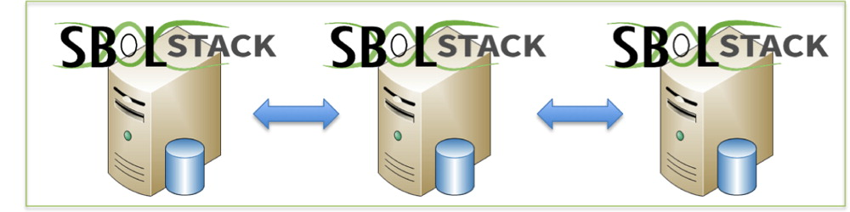
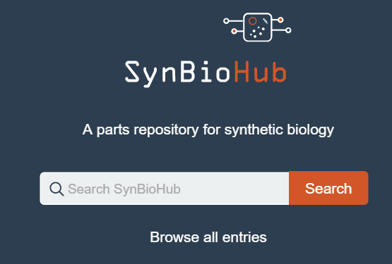
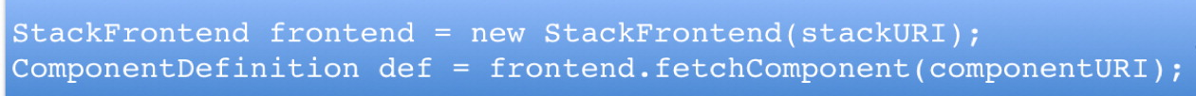
Share and re-use biological parts with repositories
Search for parts through a web interface or programmatically
Journal integration for "one-click" private review
Import SBOL/FASTA/GenBank, Export SBOL
The SBOL Stack: A Platform for Storing, Publishing, and Sharing Synthetic Biology Designs
Curtis Madsen, James Alastair McLaughlin, Göksel Mısırlı, Matthew Pocock, Keith Flanagan, Jennifer Hallinan, and Anil Wipat
ACS Synthetic Biology 2016 5 (6), 487-497
DOI: 10.1021/acssynbio.5b00210

Slide 12
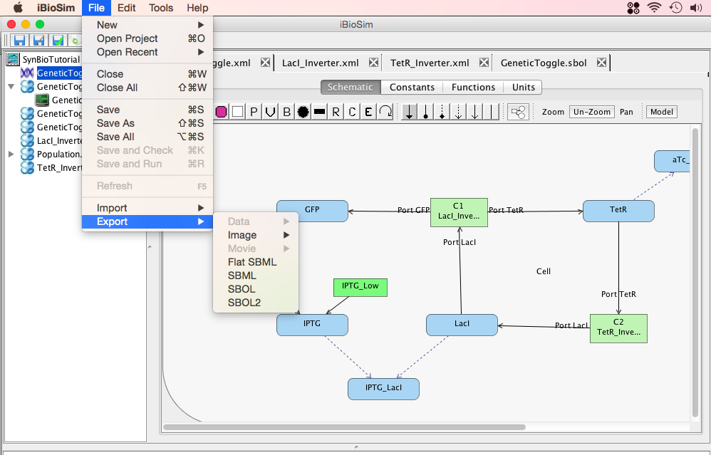
Computer Aided Engineering (CAE)
Forward-engineering Biological Systems
iBioSim
Graphical design of reaction networks
Simulate ordinary differential equations (ODEs), SSA (Stochastic Simulation Algorithm)
Import or export both SBML and SBOL 2.0
www.async.ece.utah.edu/ibiosim/

Slide 13
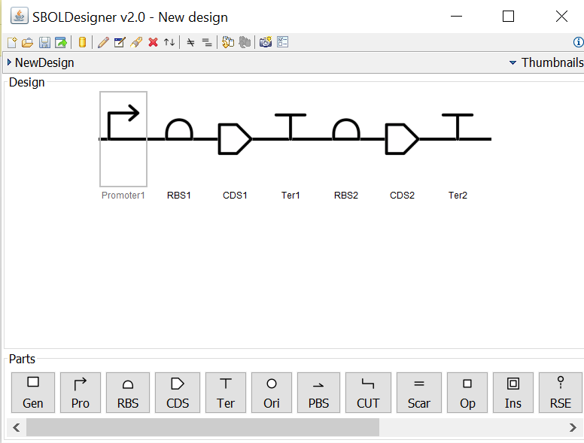
Computer Aided Design (CAD)
Sequence assembly
without cutting and pasting
SBOLDesigner
Connect to parts repositories in the cloud
Design hierarchical sequences
Switch between nucleotide and schematic representations
www.async.ece.utah.edu/SBOLDesigner/

Slide 14

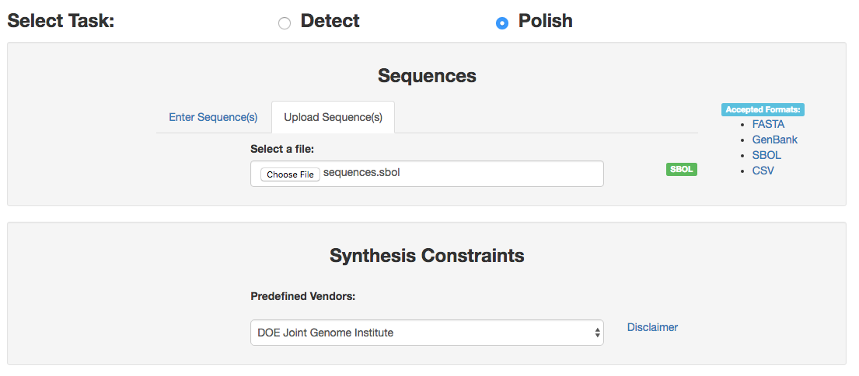

Computer Aided Manufacturing (CAM) Design sequences for DNA synthesis
https://boost.jgi.doe.gov
Build-Optimization Software Tools (BOOST)
Scans a sequence against DNA synthesis constraints (eg, repeats, %GC content, hairpins)
Makes necessary corrections (if desired)
Partitions sequences into synthesizable building blocks
Import/Export as FASTA, GenBank, or SBOL

Slide 15
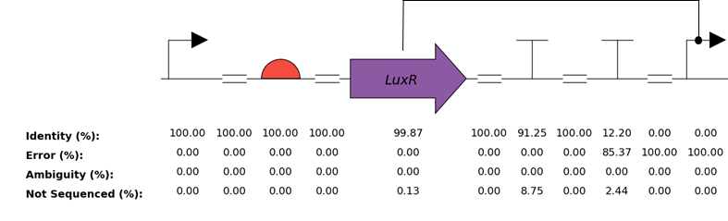
Quality Control (QC)
Automated screening and failure analysis of DNA constructs
SBOL-QC
Python package for creating automated quality control reports
SBOL import/export
https://github.com/SynBioDex/SBOL-QC
https://github.com/SynBioDex/dnaplotlib

Slide 16
Open Source Libraries
Software libraries which import and export SBOL files are freely available at the Synthetic Biology Data Exchange on GitHub under the Apache 2.0 license. Libraries are implemented in:
Java
Javascript
C/C++
Python
Developer support includes (see http://sbolstandard.org/software/libsbol)
Online documentation
Getting started tutorials
Sample projects
Code examples

Slide 17
ACS Synthetic Biology has officially adopted SBOL as publication standard
SBOL Visual is the recommended graphical notation for depicting genetic constructs
SBOL 2.0 Data Model is the preferred format for nucleic acid sequences.
Manuscript submission, review, and production process is linked to SBOL-enabled repositories
Joint Bioenergy Institute (JBEI) has set up an initial repository to be integrated.
Read all about it in the ACS Synthetic Biology viewpoint article: Improving Synthetic Biology Communication: Recommended Practices for Visual Depiction and Digital Submission of Genetic Designs, or listen to the interview with Jake Beal and Nathan Hillson.

Slide 18
Read more about SBOL (feel free to contact authors for an unedited manuscript)
“Improving Synthetic Biology: Recommended Practices for Visual Depiction and Digital Submission of Genetic Designs”, ACS Synthetic Biology, vol. 5, no. 6, pp. 449-451, Jun. 2016.doi: 10.1021/acssynbio.6b00146
“Sharing structure and function in biological design with SBOL 2.0,” ACS Synthetic Biology, vol. 5, no. 6, pp. 498-506, Apr. 2016.doi: 10.1021/acssynbio.5b00215
“libSBOLj 2.0: A Java Library to Support SBOL 2.0,” IEEE Life Sciences Letters, vol. 1, no. 4, pp. 34-37, Mar. 2016. doi:10.1109/LLS.2016.2546546
“SBOL Visual: A Graphical Language for Genetic Designs,” PLoS Biol, vol. 13, no. 12, Dec. 2015. doi:10.1371/journal.pbio.1002310
Visit us at
sbolstandard.org

Slide 19
Join SBOL!
To join our group contact the editors at:
sbol-editors@googlegroups.com
There will be a one-day workshop to introduce software developers to SBOL on August 15th, 2016. The workshop will be held immediately before the International Workshop for Bio-design Automation (IWBDA) at Newcastle University, Newcastle-upon-Tyne, UK.
The next official SBOL workshop will be held concurrent with the COMBINE workshop in Newcastle-upon-Tyne, UK in September 19 -23, 2016.
http://co.mbine.org/events/COMBINE_2016

Slide 20





Acknowledgments
SBOL Stack
SBOL-QC
DNAPlotlib
iBioSim
BOOST
SBOLDesigner

