Slide 1
Provenance and Prov – a refresher
Anil Wipat, Newcastle

Slide 2
Provenance
“Provenance is a record that describes the people, institutions, entities, and activities, involved in producing, influencing, or delivering a piece of data or a thing”

Slide 3
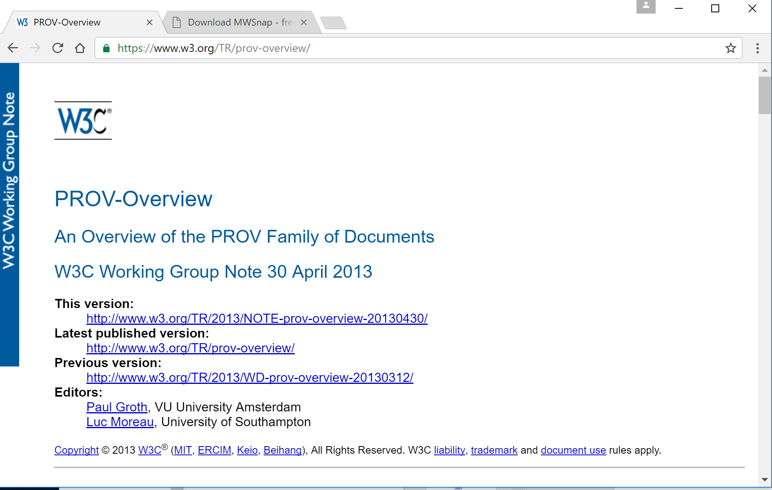
Provenance using PROV
Aims to: “achieve the vision of inter-operable interchange of provenance information in heterogeneous environments”

Slide 4
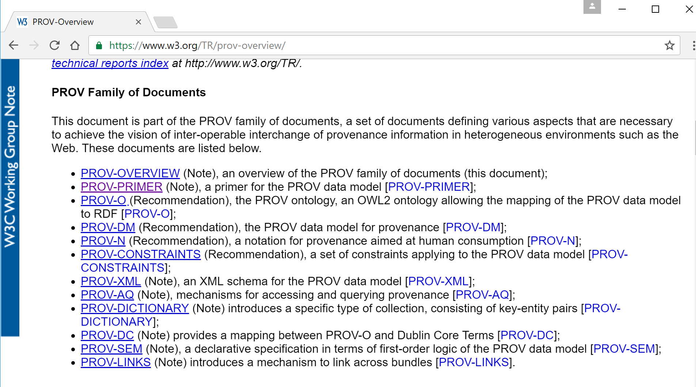
Provenance and Prov – a refresher

Slide 5
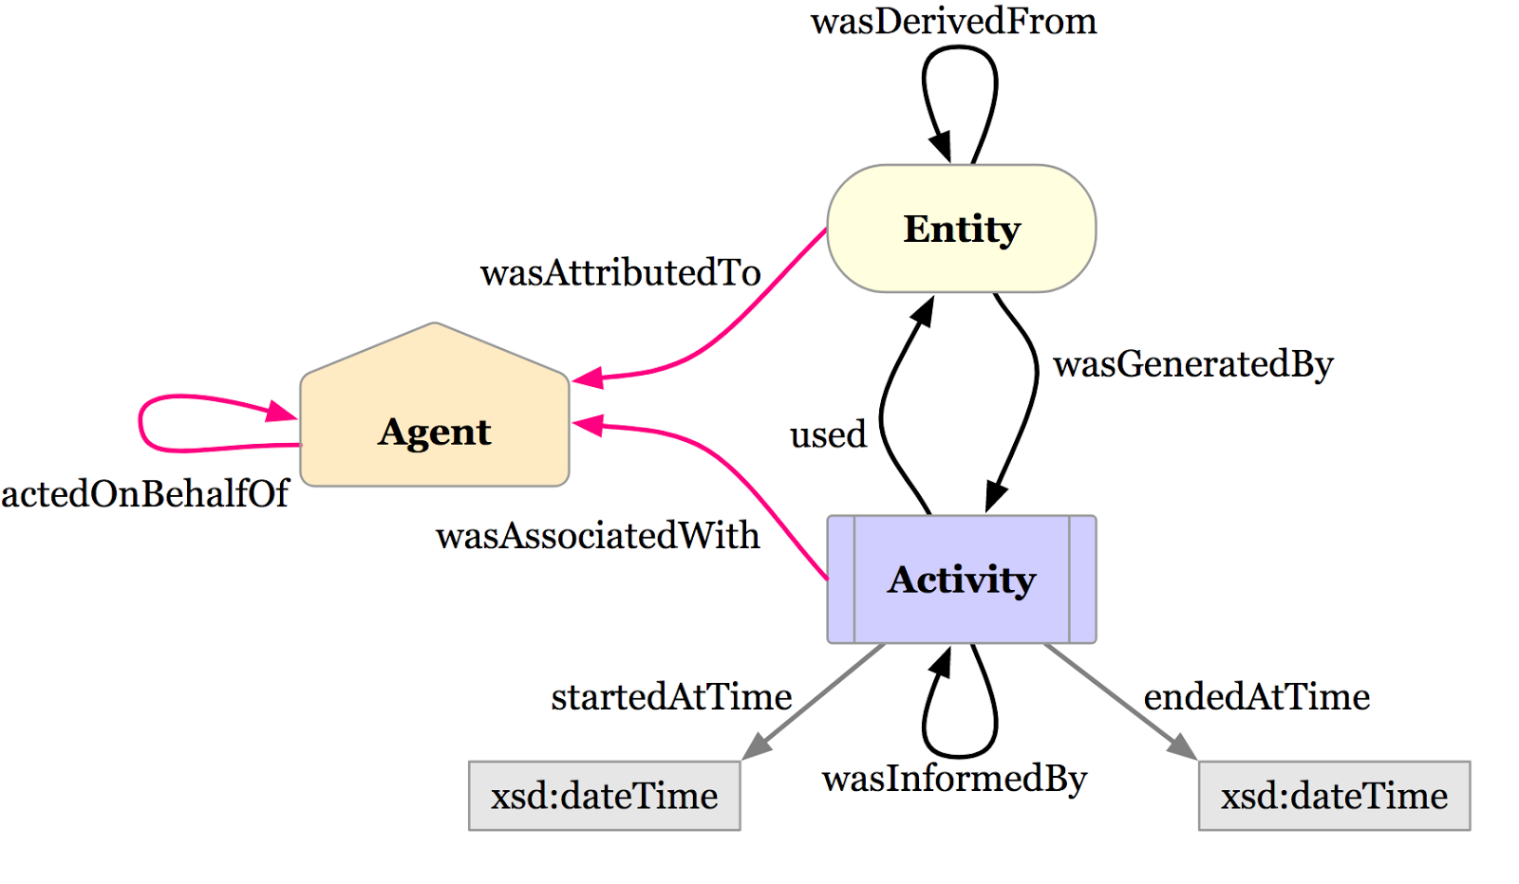
The bit that matters

Slide 6
Attaching provenance to experimental data

Slide 7
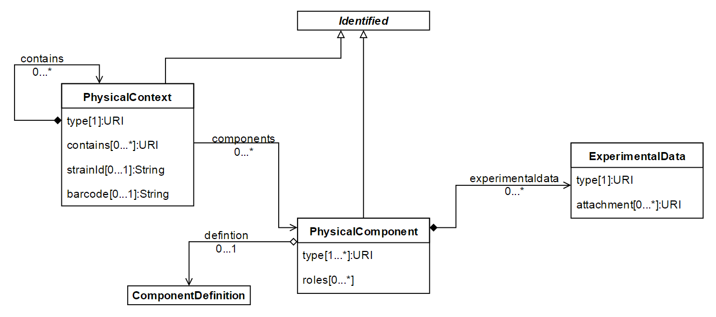
Reminder: Unified Approach
Test
(Host context)
(Build)
(Design – already in SBOL?)

Slide 8
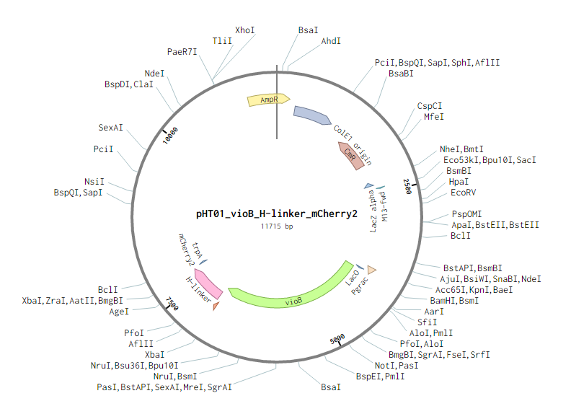
More complex example in practice: The design

Slide 9
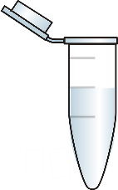
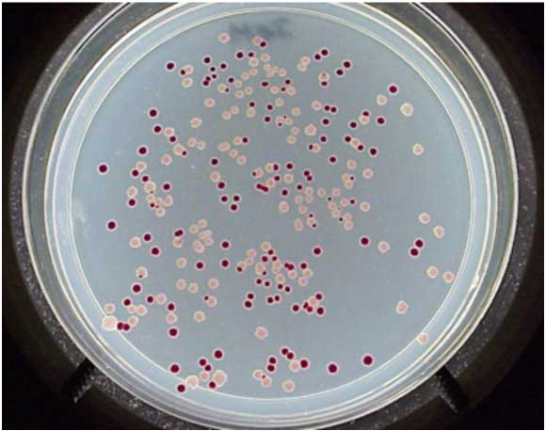
Realisation/implemenation of the design
Synthesise
Transform

Slide 10

Capturing the realisation data
Eppendorf2738
PhysicalContext
pSB1AT3-GFP_TU
ComponentDefinition
definition
pSB1AT3-GFP_TU
PhysicalComponent
PpSb1AT3
GFP_TU
Activity: transformation
(PROV-O)
wasDerivedFrom
E. coli HB101
PhysicalContext
pSB1AT3-GFP
PhysicalComponent
Plate Reader
Test
Experimental data

Slide 11

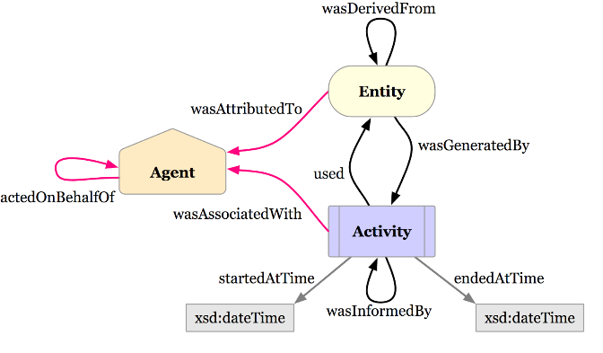



Capturing the provenance of the realisation data
Eppendorf2738
PhysicalContext
pSB1AT3-GFP_TU
PhysicalComponent
prov:used
EcoliTransformationActivity
rdf:type OBI:0302912 (electroporation)
prov:endedAtTime …
prov:wasInformedBy …
Plate Reader
Test
E. coli HB101
PhysicalContext
prov:wasAssociatedWith
prov:wasGeneratedBy
pSB1AT3-GFP_TU
PhysicalComponent
a prov:Person
dcterms:title “Wendy Smith”
prov:actedOnBehalfOf…

Slide 12
