Slide 1
A Repository of Standard Virtual Parts for Bacillus subtilis
G. Misirli, M. Pocock, J. Hallinan & A. Wipat
Newcastle University

Slide 2
Motivation
Computational modelling is important for synthetic biology
Increasing interest in flexible, simulateable models composed of standard parts
Physical parts (e.g. BioBricks) often do not map directly onto virtual parts
Need a library of low-level, computational parts models which can be used to build high-level designs
Automated model composition
Easy mapping to DNA sequences

Slide 3



Parts and virtual parts
What’s the difference?
Parts are descriptions of genetic features
Virtual parts also include simulatable models
Notes:
So as I explained before, synthetic biology proposes a parts based approach to the composition of biological systems that can be done in a bottom up way by assembling genetic parts.
Repositories like the MIT registry already provide a useful source of modular parts for genetic engineering.
The registry contains information about the standard, information about the physical content and genetic context of the parts and data about the data – metadata.
The parts can be assembled using manual approaches to form quite designs for quite complex devices based on a users knowledge of biology and on information gleamed from the registry
This is OK for small designs were usually Biologists can model the systems behaviour in their head, but does not scale well to a pathway or genome scale
For building large scale systems it is necessary to simulate computationally whether the devices will work as required – i.e. do some modelling, the modelling has to be developed by hand from scratch, again difficult for large and complex models.
Fortunately we can borrow bioinformatics tools and approaches from systems biology to help with this task
One way to overcome this problem with bottom-up composition is to use virtual representations of biological parts. These are essentially miniature mathematical models of each part that can be composed in a modular fashion to produce larger in-silico models of the system being constructed.
Virtual parts complement the sequence based information about parts needed for their synthesis, by allowing a system to be designed, modelled and simulated in-silico prior to assembly

Slide 4

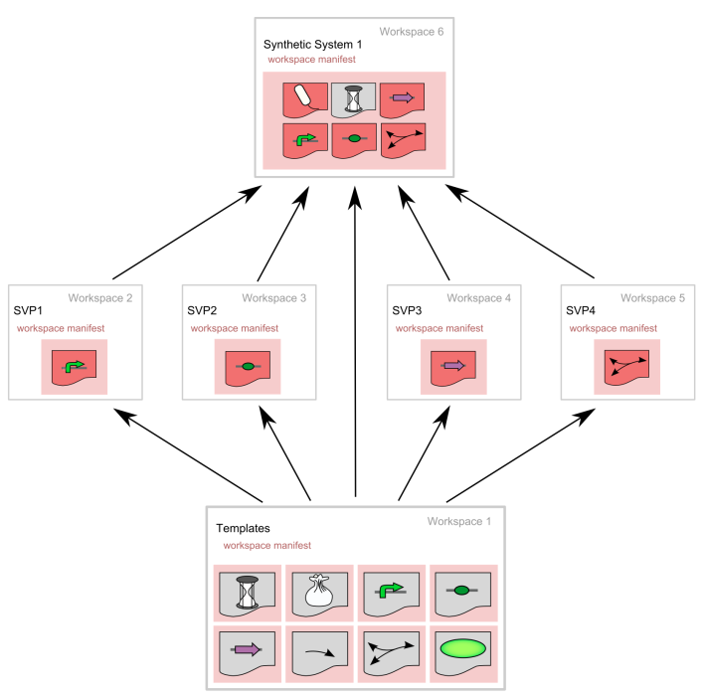

A repository of standard virtual parts (SVPs) for synthetic biology
Cooling et al., 2009. Standard Virtual Biological Parts: A Repository of Modular Modeling Components for Synthetic Biology : Bioinformatics, 2010, 26:925-931
4
Notes:
One of the aims of our group’s research is to build on the lessons learned from the systems biology community who have a wealth of knowledge in modelling biological systems.
We wanted to work towards this holy grail of being able to reliably design biological systems in-silico prior to fabrication
Together with colleagues from The Auckland Bioinengineering Institute in New Zealand we developed a proposed standard for a repository of standard virtual parts to complement the registry at MIT.
Our repository contains small mathematical models corresponding to parts in the MIT registry.
The models are derived from templates representing parts such as promoters, ribosome binding sites and coding sequences.

Slide 5


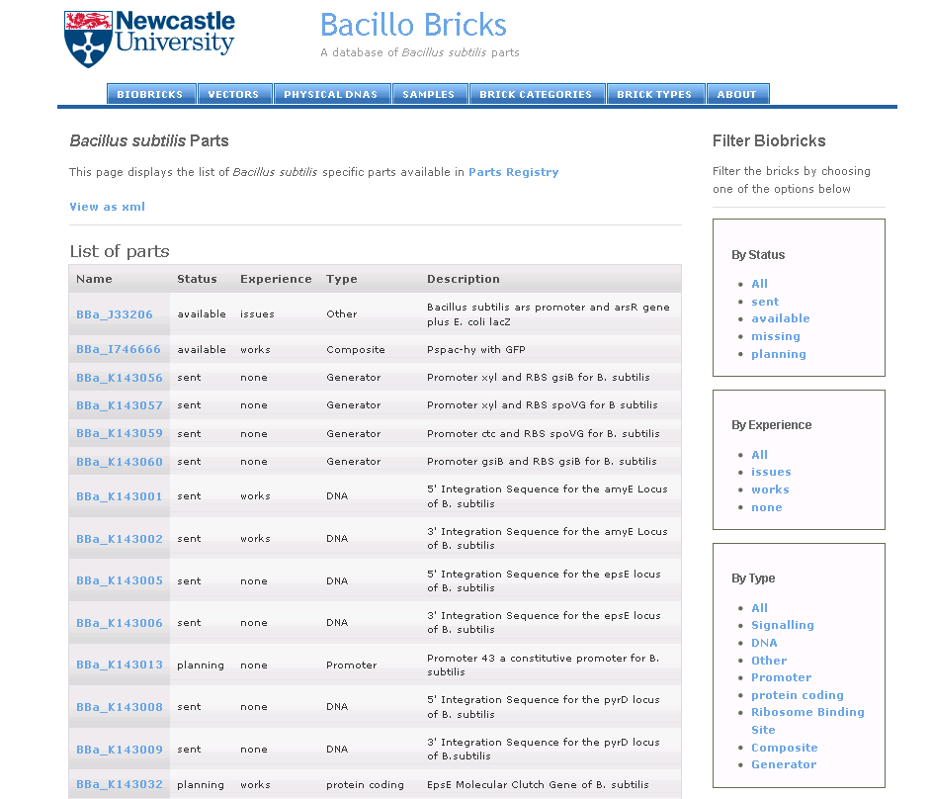
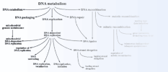

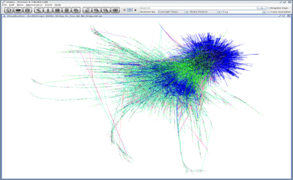

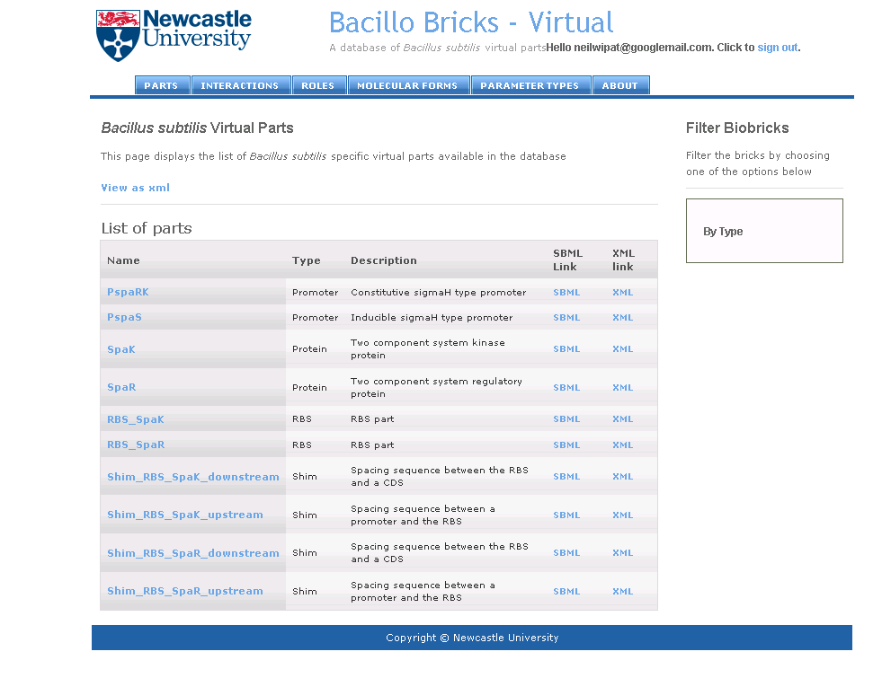


Integrating and mining multiple databases for parts data
Gene Ontology
ONDEX

Slide 6
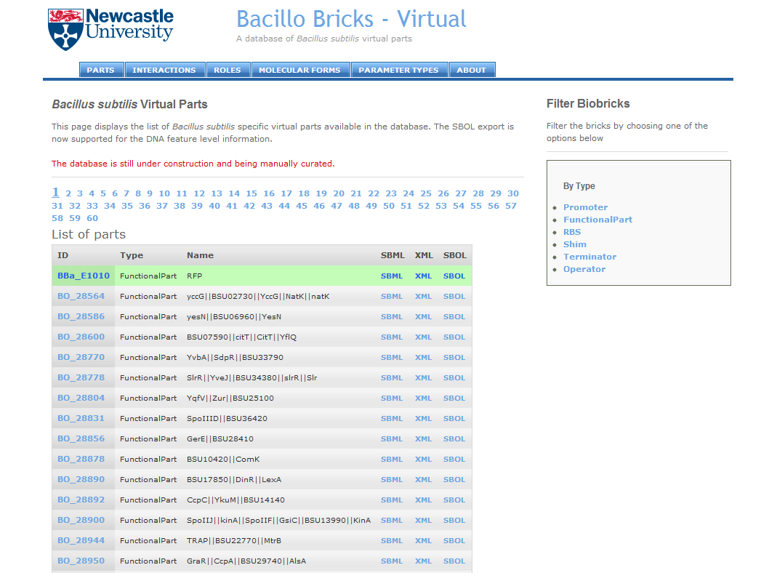
BacilloBricks http://atgc-eidos.appspot.com

Slide 7
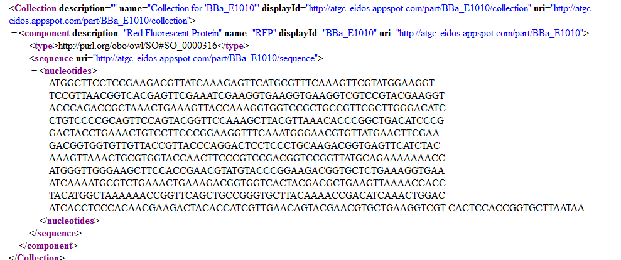
An SVP in SBOL format

Slide 8
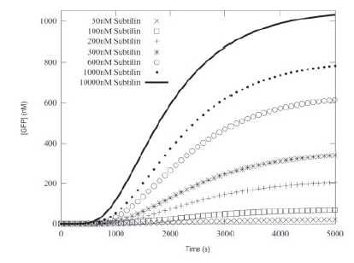
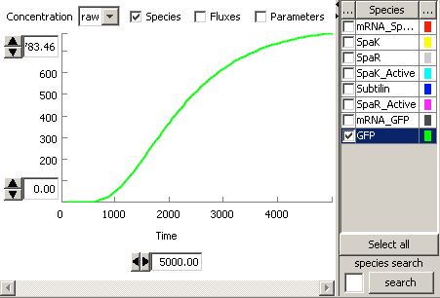
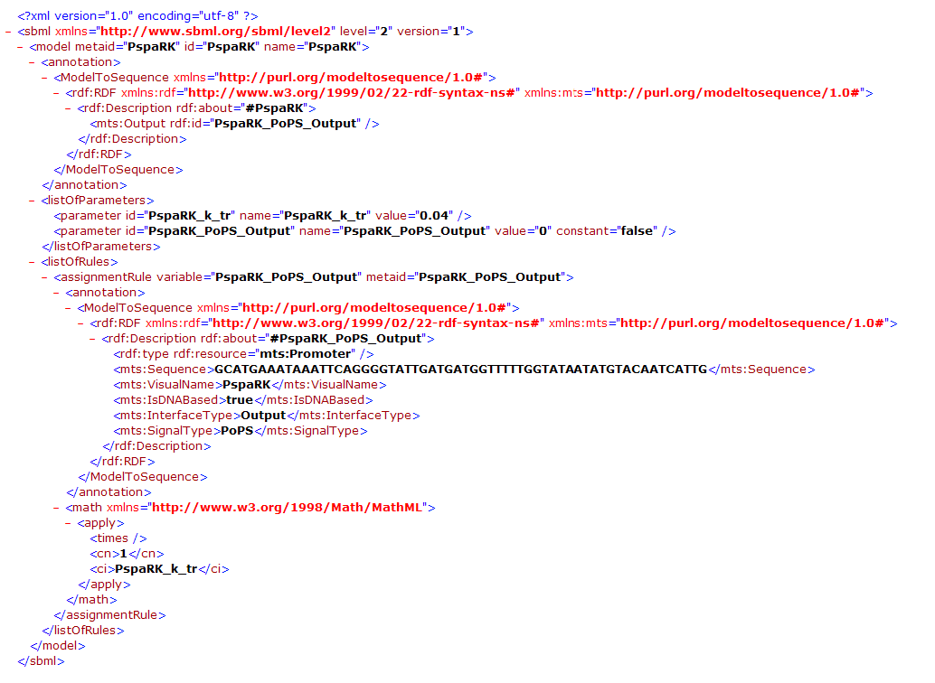
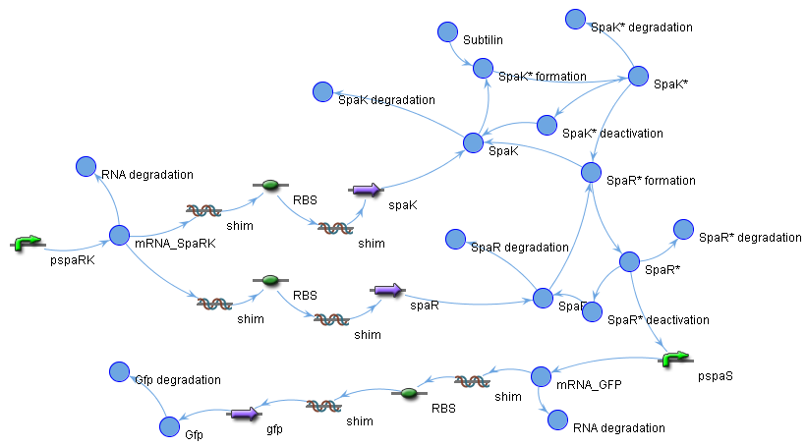

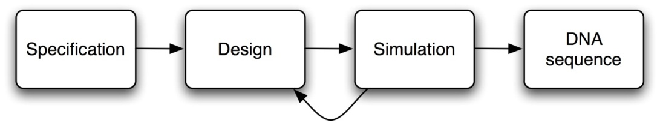
Virtual parts can be assembled to produce a simulatable model of the system
Does our design behave as we wished?
Notes:
At least as far as in-silico predictions can go
Great for large complex systems

Slide 9
Conclusions
BacilloBricks is a repository of parts models for B. Subtilis
Informed by data integration
Extensible to other species
Currently supports CellML, SBML, XML and SBOL
SVPs can be composed to form simulateable models
Provides support for automated circuit design and evaluation
Computationally accessible
RESTful interface
Looking for collaborators / users

Slide 10





Acknowledgements
Jochen Wiele and the Ondex project
Katherine James
Mike Cooling et al., Auckland Bioengineering Institute

