Slide 1
Tracking Sequence Verification Results
“To aid the synthetic biologist before & after the benchwork, not the design”
Michal Galdzicki
June 5, 2012

Slide 2
Failure Analysis for the working synthetic biologist
To determine the cause(s) of failure
Collect failed components for examination
and analyze data
Analogous to source code management
A version control system
failure analysis for synthetic biology

Slide 3
Systematize the collection of failures
Improve builds
Assembly failure
Improve performance
Functional failure
Low fruit is sequence verification
Design versus Trace File
SBOL file v AB1 files
Consensus
Zoom-in
Design
Trace
ATCGGGACT
ATCNGGCCT

Slide 4
Positive statements
Matches [expected|design]
Correct
Potentially correct
[Point mutation is] repaired
Confirm
Successfully Transferred
Negative statements
Mutation(s)
Duplicated
Deletion
Point
Missense
Ser->Gly
Nonsense
(NNN->stop codon)
Poor read
Unreadable
Wrong
Expected entity scope (in the design)
Promoter seq
Vector (implies outside of circuit)
Deletion site (implies intent to remove segment)
Part
Suffix
Prefix
"ID" of strain
Position (in design coordinates)
283
Etc
+ Qualifying statements

Slide 5
HGVS DNA sequence variants - v2.0
c.76A>T
“d." for a design DNA sequence (like d.76A>T)
specific changes
">" indicates a substitution at DNA level (like c.76A>T)
"_" (underscore) indicates a range of affected residues, (like c.76_78delACT)
"del" indicates a deletion (like c.76delA)
"dup" indicates a duplication (like c.76dupA);
"ins" indicates a insertion (like c.76_77insG)
…
http://www.hgvs.org/mutnomen/recs-DNA.html#number

Slide 6
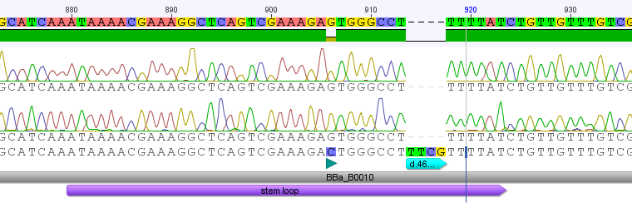
Demo Geneious Sublime Plugin

Slide 7
Record the Verification information
Document BBa_B0010 (modified) Date: 01-Jun-2012 12:27:48
0) d.38C>G
Substitution 38 – 38
http://purl.obolibrary.org/obo/C_to_G_transversion not ambiguous
1) d.46_49del
Deletion 46 -> 49
http://purl.obolibrary.org/obo/deletion not ambiguous

Slide 8
Identify affected features (sub-components)
d.38C>G
B0010
Design
stemloop
d.27C>G

Slide 9
Basic seq verification data model
Change
- SO alteration type
- found_in (DnaComponent)
- at position (position)
- observed in (seq data)
Position
-located_in (DnaComponent)
Sequencing Data
-file
DnaComponent
- annotation

Slide 10
End

Slide 11
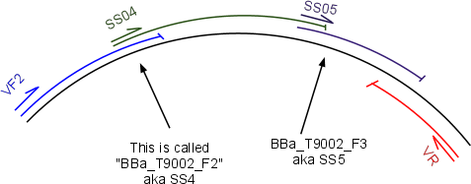

Sequence Verification
VF2
SS04
VR
Example result annotations
- looks correct - sequenced part of circuit (not worthwhile to do whole thing when using it as an intermediate in assembly) - unexpected mutation - correct, except entire promoter not verified - VF2 (noisy) <- that seq was noisy but ignored - ends confirmed - ends and GFP-kan junction verified
Reverse complement of data

Slide 12
HGVS DNA sequence variants - v2.0
"c." for a coding DNA sequence (like c.76A>T)
"g." for a genomic sequence (like g.476A>T)
"m." for a mitochondrial sequence (like m.8993T>C)
"r." for an RNA sequence (like r.76a>u)
"p." for a protein sequence (like p.Lys76Asn)
nucleotide numbering
coding DNA reference sequence
there is no nucleotide 0
nucleotide 1 is the A of the ATG-translation initiation codon
the nucleotide 5' of the ATG-translation initiation codon is -1, the previous -2, etc.
the nucleotide 3' of the translation stop codon is *1, the next *2, etc. ...
genomic reference sequence
nucleotide numbering starts with 1 at the first nucleotide of the sequence
NOTE: the sequence should include all nucleotides covering the sequence (gene) of interest and
should start well 5' of the promoter of a gene
no +, - or other signs are used
when the complete genomic sequence is not known, a coding DNA reference sequence should be used
for all descriptions the most 3' position possible is arbitrarily assigned to have been changed
specific changes
">" indicates a substitution at DNA level (like c.76A>T)
"_" (underscore) indicates a range of affected residues, separating the first and last residue affected (like c.76_78delACT)
"del" indicates a deletion (like c.76delA)
"dup" indicates a duplication (like c.76dupA);
"ins" indicates a insertion (like c.76_77insG)
"inv" indicates an inversion (like c.76_83inv)
"con" indicates a conversion (like c.123_678conNM_004006.1:c.123_678)
"[]" indicates an allele (like c.[76A>T])
"()" the exact position of a change is not known, the range of the uncertainty listed between brackets (like c.(67_70)insG)
http://www.hgvs.org/mutnomen/recs-DNA.html#number

Slide 13
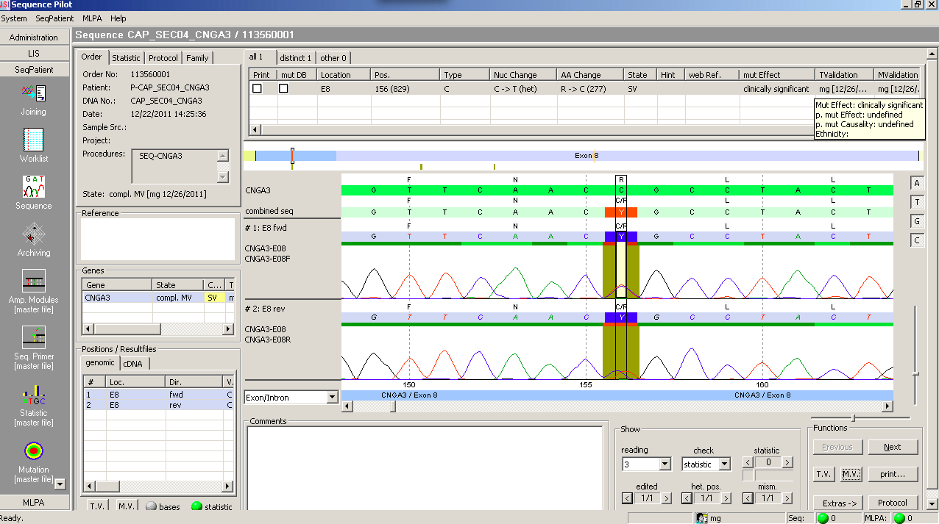
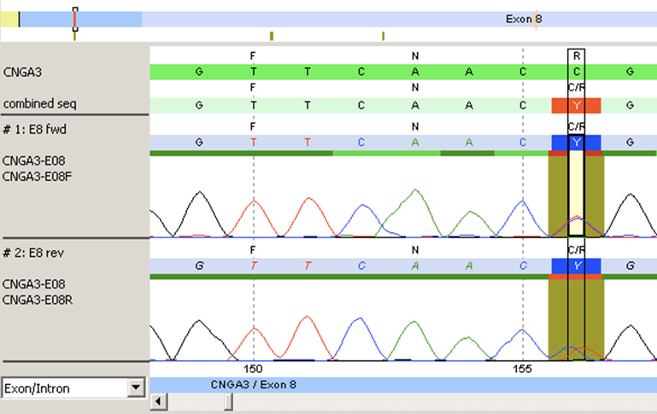
c.829C>T
Note: 156(829)

Slide 14
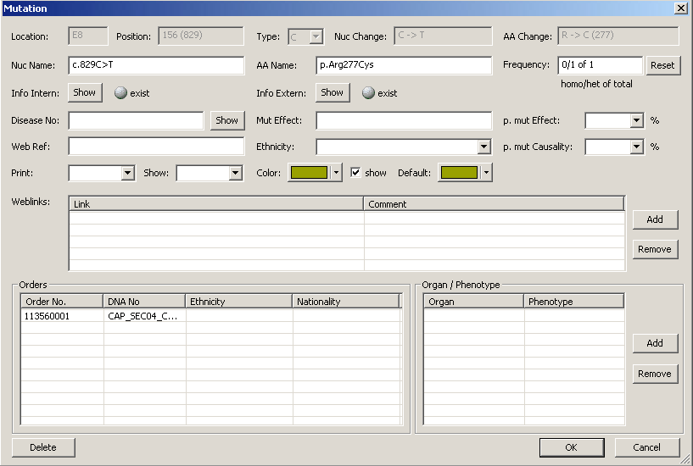
c.829C>T

Slide 15
SS136a
294
VF2
295
VR
AraC- pBAD
LacZ
pTet
LuxR
pLux
GFP
pLac
mRFP
x
SS136a – clone – 2 PCR products sequenced
Note: SS136 was grown with and without Arabinose (inducer for pBAD promoter),

Slide 16
SO:sequence_alteration
SBOL:DnaComponent
SO:substitution
pSB1A2_B0010
SO:C_to_G_transversion
found_in
annotation
located in
position
sa1:152-195+
at_position
Change1
178
subComponent
found_in
dc2
SO:stemloop
observed in
SO:terminator
Sequencing Data
BB30
Add date

Slide 17
Why?
identifying the configuration of a system at discrete points in time for purposes of systematically controlling changes to this configuration and maintaining the integrity and traceability of this configuration throughout the system life cycle.
What is my current configuration?
What is its status?
How do I control changes to my configuration?
How do I inform everyone else of my changes?
What changes have been made (by others)?
Do anyone else's changes affect me?
E. Bersoff, V. Henderson, S. Siegel. Software Configuration Management, An Investment in Product Integrity. Prentice-Hall, 1980.

Slide 18
Assembly error types
2/8/2012

Slide 19
At junction site
junction site: Sequence that has homology between PCR products (insert and vector)
Sequence variants occur at junctions sites when using “In-Fusion” or SLIC assembly
because the repair step is in-vivo, this is potentially influenced by primer quality. Whereas,
in Gibson assembly, the repair step is in-vitro, therefore not as sensitive.
 | 3’ to 5’ Exonuclease | DNA Polymerase | Ligase
Gibson | X | X | X
In-Fusion | X
SLIC | X |  | (X)
junction site
sequence
variant
insert
vector

Slide 20
Outside junction site
this means anywhere else
This kind of error could occur during PCR: caused by Pol
or the Template DNA could have had a sequence variant
junction site
insert
sequence
variant
vector

Slide 21
Unexpected Assembly
An “unexpected error” is likely caused by an extra, “unexpected”, homologous sequence.
Maybe, this error could be averted by introducing a design rule.
A
B
C
A
B
C
correct
B
A
C
A
B
C
B
C
B
A
C
incorrect
A is “unexpectedly” homologous to B

Slide 22
Vector self-annealing
Poor vector design would lead to this error occurring some percent of the time
for BioBricks: the 2010 UW iGEM team removed the ‘N’ site
in plasmids which had cut sites E N X … S N P used earlier to create
pGA3K3
1A3
etc
improving Gibson assembly efficiency for BioBricks

Slide 23
Chromosome + plasmid
Sean: Rare event, likely homology between chromosome and plasmid.
Mike: I think integrases or some recombinase activity encourages this

Slide 24
Background
Plasmids used for template DNA in PCR reaction get transformed later.
This would occur for a number of reasons
by chance the “rare” template plasmid transformation
the assembly failed for another reason and the only plasmids around are the “background”
DpaI is used for this error, but it is often unnecessary.

Slide 25
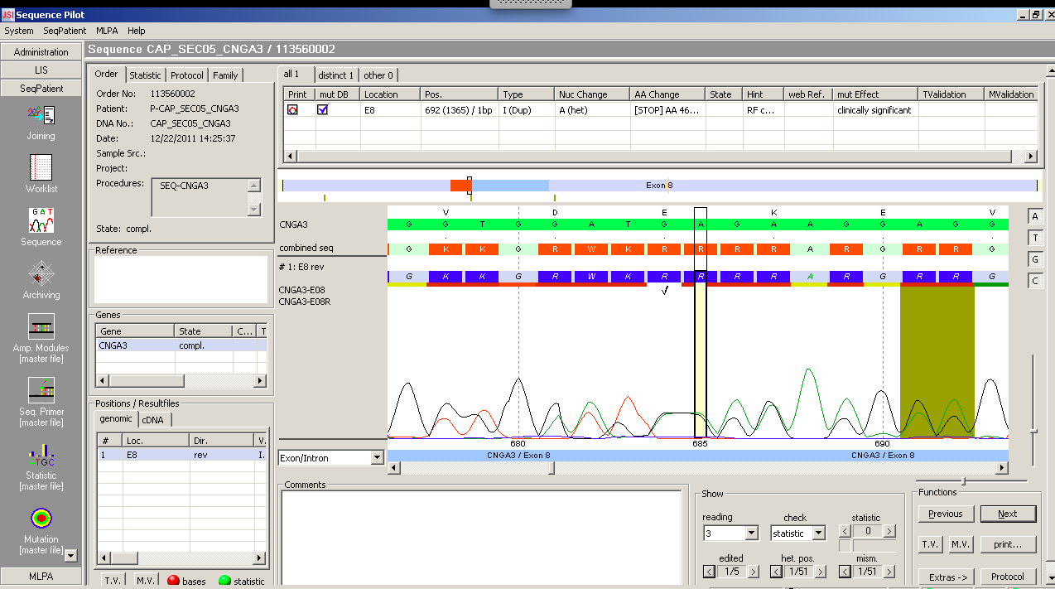

Slide 26
1 | 2 | 3 | 4 | 5 | 6 | 7 | 8 | 9 | 10 | 11 | 12 | 13 | 14 | 15 | 16 | 17
G | G | T | G | G | A | T | G | A | G | A | A | G | G | A | G | G
G | G | T | G | G | A | T | G | A | G | A | A | G | G | A | G | G
G | T | G | G | A | T | G | A | G | A | G | A | A | G | G | A | G
Design
1
2

Slide 27
1 | 2 | 3 | 4 | 5 | 6 | 7 | 8 | 9 | 10 | 11 | 12 | 13 | 14 | 15 | 16 | 17
 | G | T | G | G | A | T | G | A | G | A | A | G | G | A | G
 | G | T | G | G | A | T | G | A | G | A | A | G | G | A | G
G | T | G | G | A | T | G | A | G | A | G | A | A | G | G | A | G
Design
1
2

Slide 28
1 | 2 | 3 | 4 | 5 | 6 | 7 | 8 | 9 | 10 | 11 | 12 | 13 | 14 | 15 | 16 | 17
 | G | T | G | G | A | T | G | A | G | A | A | G | G | A | G
 | G | T | G | G | A | T | G | A | G | A | A | G | G | A | G
G | T | G | G | A | T | G | A | G | A | G | A | A | G | G | A | G
Design
1
2

Slide 29
1 | 2 | 3 | 4 | 5 | 6 | 7 | 8 | 9 | 10 | 11 | 12 | 13 | 14 | 15 | 16 | 17
 | G | T | G | G | A | T | G | A | G | A | A | G | G | A | G
 | G | T | G | G | A | T | G | A | G | A | A | G | G | A | G
G | T | G | G | A | T | G | A | G | A | G | A | A | G | G | A | G
Design
1
2
1 | 2 | 3 | 4 | 5 | 6 | 7 | 8 | 9 | 10 | 11 | 12 | 13 | 14 | 15 | 16 | 17
 | G | T | G | G | A | T | G | A | G | A | A | G | G | A | G
 | G | T | G | G | A | T | G | A | G | A | A | G | G | A | G
 | G | T | G | G | A | T | G | A | G | A | A | G | G | A | G
Design
1
2

Slide 30
