Slide 1

How to Contribute to SBOL
Presenter: Jacob Beal (BBN Technologies)
SBOL Workshop @ IWBDA, July, 2019
Cambridge, UK

Slide 2
SBOL Community Structure
sbol-announce@googlegroups.com
people who want to know what’s going on with SBOL; electorate
sbol-dev@googlegroups.com
people interested in contributing to standards, tools
community
managers
Editors
Chair
strategic
leadership
SBOL Industrial
Steering Comm.
Advisory Panel
Industrial user group
PIs helping chair
External perspective

Slide 3
How can I get involved?
Use SBOL & SBOL Visual!
Report issues and get help when you need it
Join sbol-announce, sbol-dev mailing lists
Organizations: join SBOL Industrial
Develop or contribute to libraries & tools
Help improve the standards
Help govern the community

Slide 4
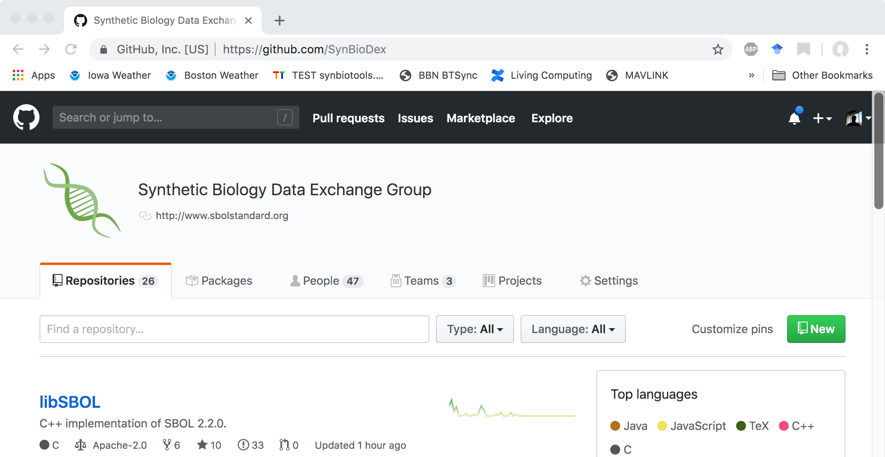
Community GitHub: SynBioDex
Development hub for specs, libraries, tutorials, etc.

Slide 5
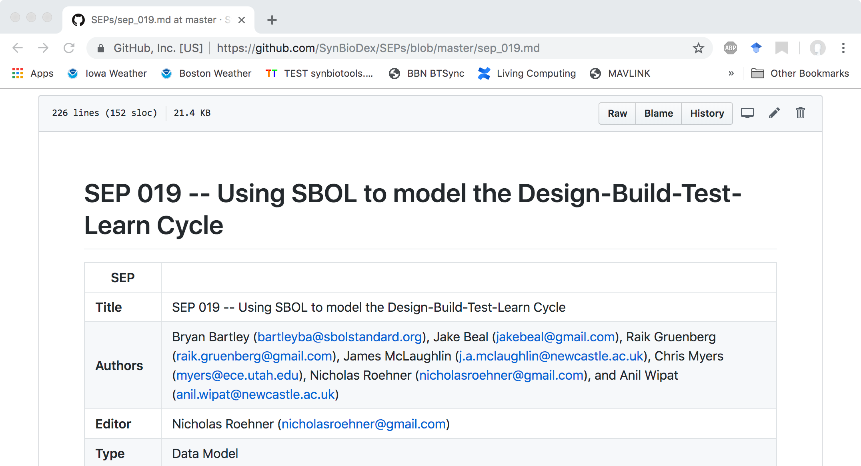
Improving the standards: SEPs
Spec changes via “SBOL Enhancement Proposals” (SEPs) voted on by sbol-dev community

Slide 6








SBOL Industrial Consortium
Pre-competitive organization:
Companies investing in SBOL
Coordination of priorities, sharing of best practices
Support community infrastructure & development

