Slide 1



SBOL Visual:
Standard for synthetic biology diagrams
Jacob Beal
SynBERC Fall Retreat
Sept. 2014

Slide 2
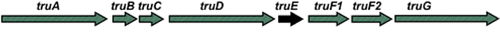
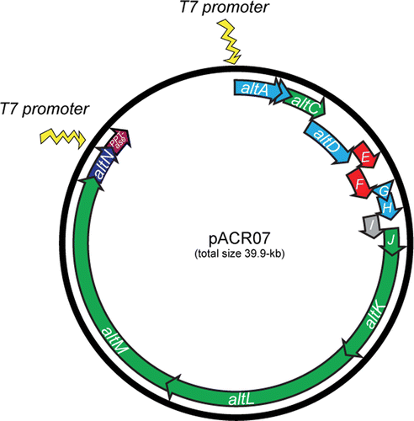
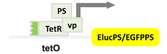
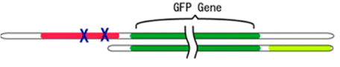
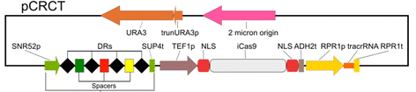
Problem: Communicating Gene Constructs
Construct diagrams from recent ACS Syn.Bio. papers:
Well, they're sort of similar…
Notes:
I'm not picking on anybody - I just took the most recent 5 "just publishable" papers with constructs

Slide 3
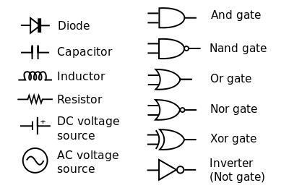
Standards simplify communication
Inspiration: Standard Electronic Symbols:
What is the equivalent for synthetic biology?
… and many others in IEEE Std. 91/91a; IEEE Std. 315
Notes:
Image courtesy of Wikipedia

Slide 4
SBOLv
Construct Icons
Backbone
pTet
GFP
TetR
Direction shown
by orientation
Regulatory Interactions
(in progress)
Synthetic Biology Open Language - Visual
Community standards in development since 2008
SBOL Visual 1.0: BBF RFC #93 doi: 1721.1/78249
(Prior versions: BBF RFC #68, #16)

Slide 5
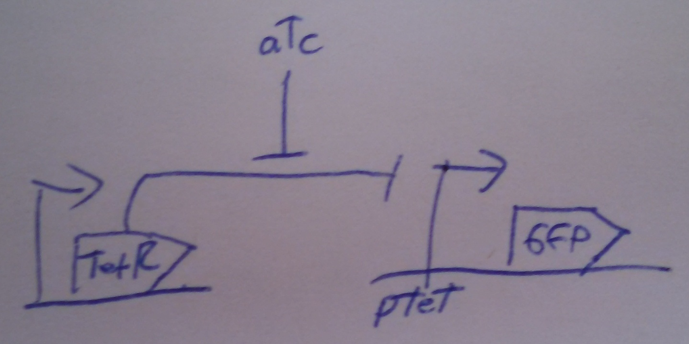
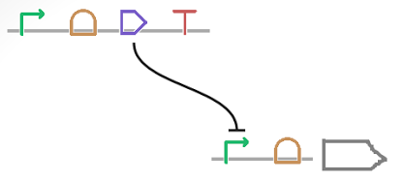
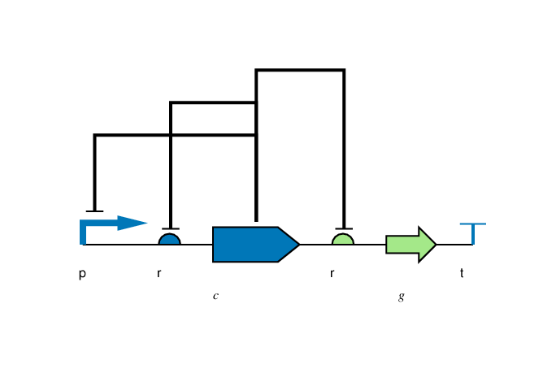
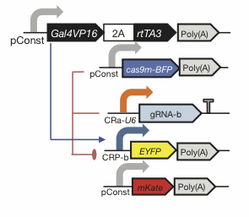
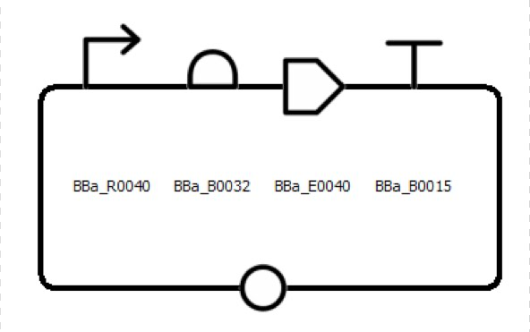
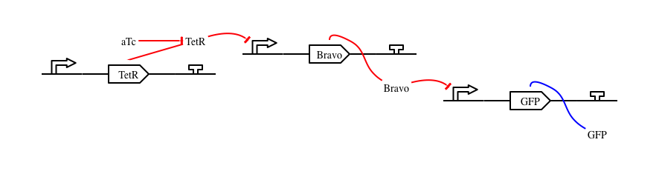
Flexibility of Style
Color, Text, Scaling, Strands: all your choice

Slide 6

Is anything prohibited?
Yes.

Slide 7
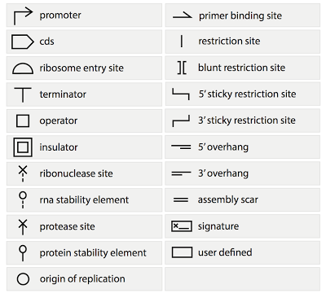
Current SBOLv Symbols:
New symbols added on community consensus

Slide 8
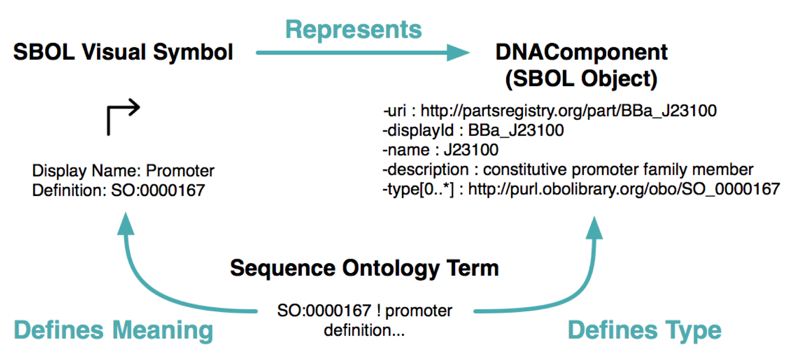
Backing by Formal Semantics

Slide 9
http://sbolstandard.org
Use the symbols in your papers & talks
Contribute opinions, use cases, new symbols
Community is open for anyone to join
Symbol Images
Diagram Webtool

