Slide 1
Introduction to SBOL Visual
SBOL Visual Community
Last revised: August 2016

Slide 2
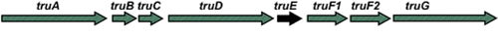
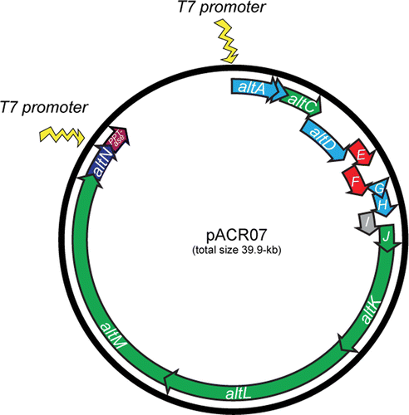
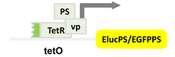
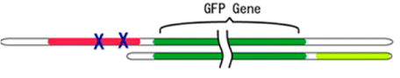
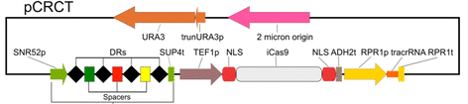
Problem: Communicating Gene Constructs
Construct diagrams from some recent ACS Syn.Bio. papers:
Well, they're sort of similar…
Notes:
I'm not picking on anybody - I just took the most recent 5 "just publishable" papers with constructs

Slide 3
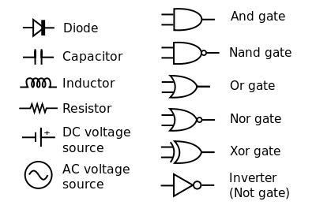
Standards simplify communication
Inspiration: Standard Electronic Symbols:
What is the equivalent for synthetic biology?
… and many others in IEEE Std. 91/91a; IEEE Std. 315
Notes:
Image courtesy of Wikipedia

Slide 4

Elements of SBOL Visual:
Nucleic Acid Component Glyphs
Other Component Glyphs
GFP
Interactions
gfp
pTet
tetR
Display IDs
Reverse Complement Nucleic
Acid Component Glyphs
Nucleic Acid Backbone
Synthetic Biology Open Language - Visual
Community standards in development since 2008
SBOL Visual 1.0: BBF RFC #93 doi: 1721.1/78249
SBOL Visual 2.0: https://github.com/SynBioDex/SBOL-visual

Slide 5
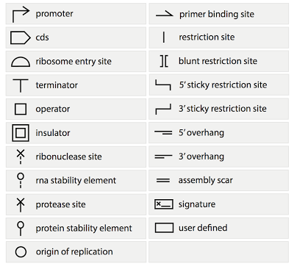
Current SBOLv Symbols:
New symbols, variants added by community consensus

Slide 6
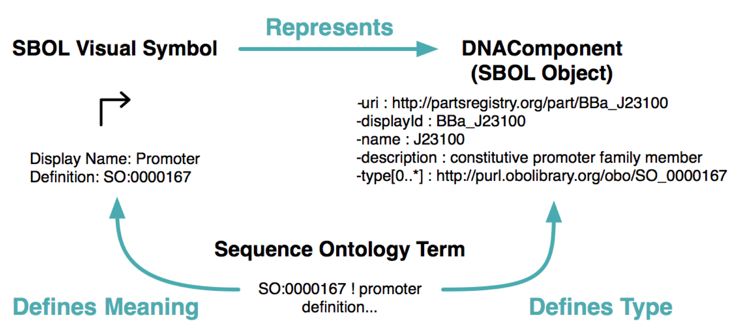
Backing by Formal Semantics

Slide 7
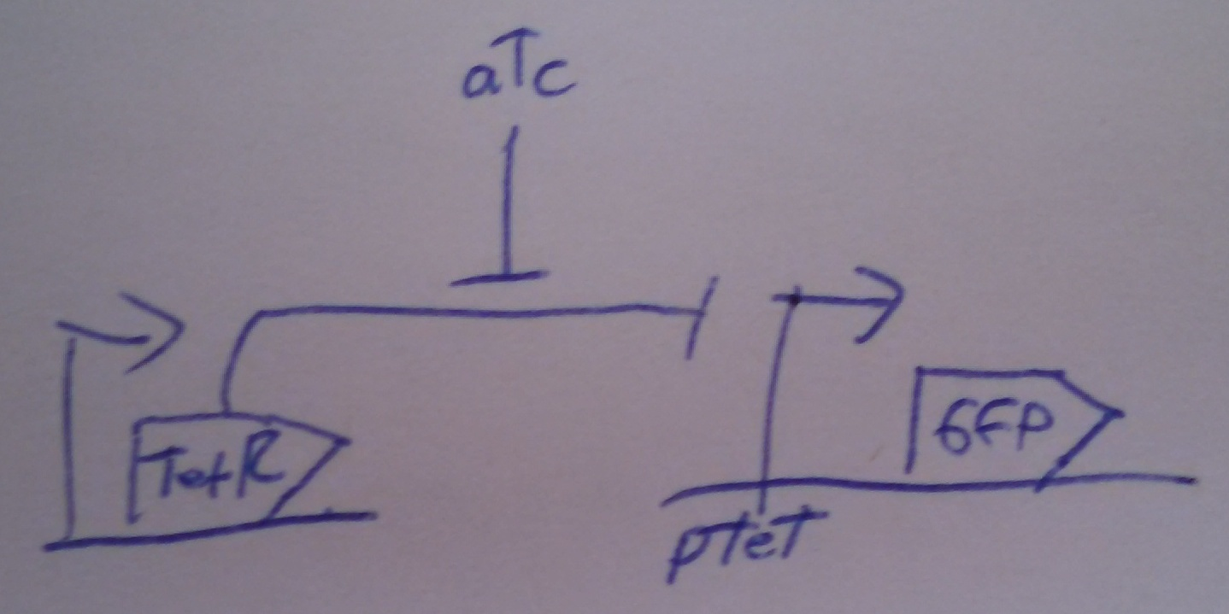
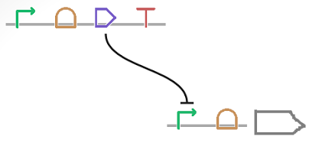
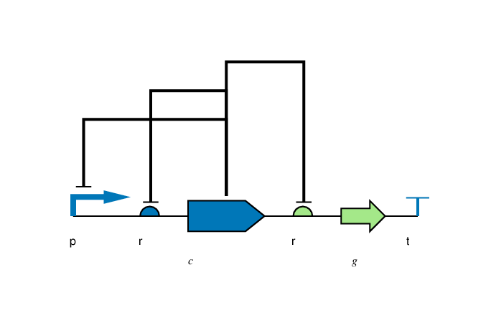
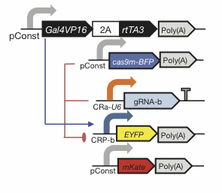
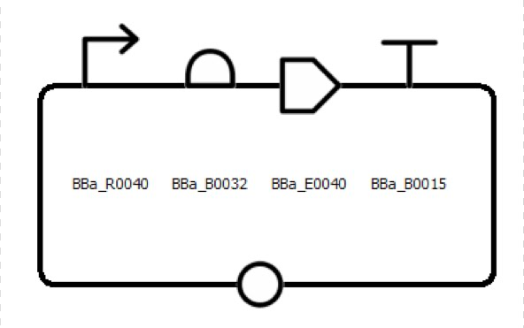
Flexibility of Style
Color, Text, Scaling, Line, Strands: all your choice

Slide 8

Is anything prohibited?
Yes.

Slide 9
Making SBOL Visual Diagrams
Using your favorite graphics editor:
Many icons can be drawn directly
Icons available from: http://sbolstandard.org/visual/
Specialized visualization tools:
Pigeon: http://pigeoncad.org/
VisBOL: http://visbol.org/design/
GraphViz: http://www.graphviz.org/
DNAPlotLib: https://github.com/VoigtLab/dnaplotlib

Slide 10
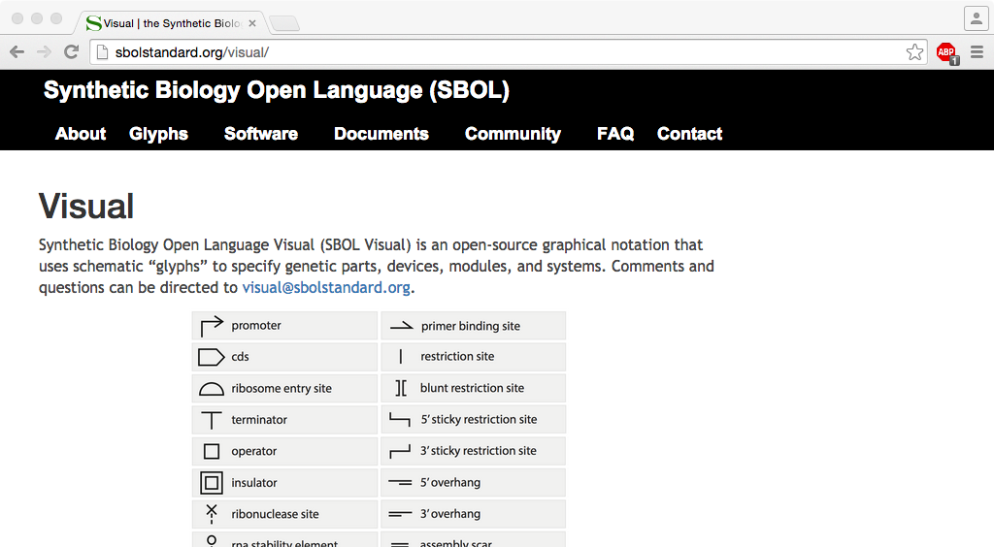
http://sbolstandard.org
Use the symbols in your papers & talks
Contribute opinions, use cases, new symbols
Community is open for anyone to join

