Slide 1
Demo of Version Control using the “SBOL Designer”
Michal Galdzicki
Bryan Bartley
Evren Sirin
Nikhil Gopal
John Gennari

Slide 2
Using semantics to better support design tasks
Demonstration:
Retrieval of DNA components from multiple repositories
Updated SBPkb to SBOL v1.1.0
Version control for synthetic biology
Nested components
Capabilities:
Commit
Branch
Merge
Version history view
“Clone” to import

Slide 3
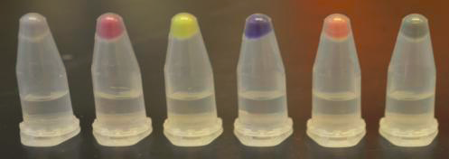
Demo of Version Control within SBOL-designer
Re-creating the CMY construct with SBOL Designer and version control
Three inducible reporter genes, and each of these reporter proteins producing a different color (such as cyan, magenta and yellow; hence “CMY”).
by Sean Sleight

Slide 4
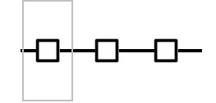

Master
C
M
Y
Sub-
module
“Branch”
ir-c
“Inducible”
Promoter
RBS
“Cyan”
Protein
Ter
ir-m
ir-y
ir-c.1
R0012
B0034
amilCP
B0014
ir-c.2
ir-m.1
R0012
B0034
eCFP
B0014
R0010
pLac
B0034
E1010
mRFP
B0015
“Merge”
C
M
Y
ir-y.1
C
M
Y
R0040
pTet
B0034
eGFP
B0011
R0012
B0034
eCFP
B0014
R0010
pLac
B0034
E1010
mRFP
B0015
R0040
pTet
B0034
eGFP
B0011

Slide 5
(Switch to Demo)

Slide 6






Introducing design tools into synthetic biologist’s workflow
On-line parts repository
Local Lab repository
LIMS
SBOL Designer
Seq Verification

Slide 7
Thank you!
Questions / Suggestions?

