Slide 1
Representing Biological Systems for the Flowers Consortium
25 April 2013
9th SBOL Workshop, Newcastle upon Tyne
Centre for Bacterial Cell Biology
Dr. Goksel Misirli

Slide 2




Flowers Consortium
A grant of £5 million for four years
“This investment will lay the groundwork for the commercialisation of research, ensuring academics and industry can realise the full potential of this exciting area of science” (David Willetts, Minister for Universities and Science).

Slide 3
The UK infrastructure for synthetic biology
Aims: “To create and develop platform technology for synthetic biology. The platform technology will be based on an information infrastructure which uses a web-based environment. The main components are: a professional parts and devices registry, a model registry and a suite of compatible BioCAD tools. The intention is to create, establish and support a UK infrastructure for synthetic biology which will act as a model for synthetic biology technology hubs across the UK.”
Several work packages, including both wet and dry

Slide 4
WP2d modelling - Objectives
To exploit existing formal languages for the description of parts and their dynamic characteristics, and organise them into a model-oriented virtual part repository
To develop executable descriptions of parts (virtual parts) for their flexible assembly into models following both reaction- and rule-based paradigms
To collate, integrate and curate existing synthetic biology models in a model repository cross-linked with the parts repository, and foster model reliability and reusability
To provide methods for in-silico device and systems design. These methods will allow the composition of virtual parts into models of devices and systems, and provide access to robust and scalable techniques for simulation, analysis, and parameter optimisation of these models.

Slide 5
WP2d modelling - Objectives
To exploit existing formal languages for the description of parts and their dynamic characteristics, and organise them into a model-oriented virtual part repository
To develop executable descriptions of parts (virtual parts) for their flexible assembly into models following both reaction- and rule-based paradigms
To collate, integrate and curate existing synthetic biology models in a model repository cross-linked with the parts repository, and foster model reliability and reusability
To provide methods for in-silico device and systems design. These methods will allow the composition of virtual parts into models of devices and systems, and provide access to robust and scalable techniques for simulation, analysis, and parameter optimisation of these models.

Slide 6
Model repository requirements
To provide and store:
A model(s) in any modelling formalism
Genetic description of the necessary parts
The necessary genetic context
Environment (e.g. host) to which the constructs are deployed
Environment/ Host
Model
System
Genetic context
Genetic description

Slide 7
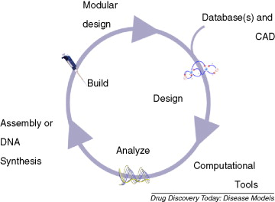
The model repository supports system design
A desired function is specified
The biological system is then designed to perform this desired function
It is modelled
It is fabricated
It is deployed to somewhere
Outputs are experimentally measured
Chandran et al. ,2008

Slide 8
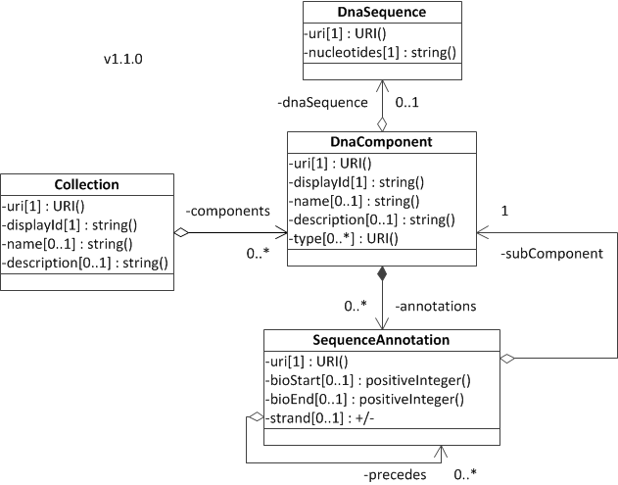
SBOL does DNA sequence information and ……
DNA sequences
Sequence annotations
Extensions
Modelling
Regulation
Laboratory measurement
Host

Slide 9
For our repository to use SBOL it needs to include:
Models
Dynamic models: SBML, CellML, BNGL, Kappa, Matlab
Agent-based models
Qualitative models
Biological environment
Genetic context
Subsystems for hierarchical system composition
We need the repository ASAP
So we needed to come up with something ….

Slide 10
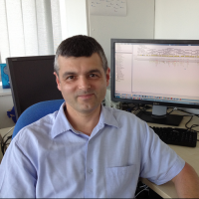
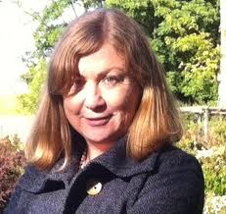

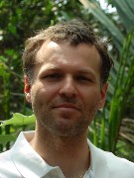
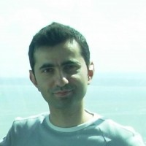



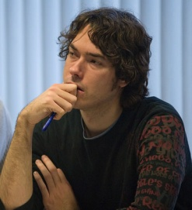
Discussions to represent biological systems
Discussed how to represent biological systems
Over two days
Driven by real use cases
Participants
Wipat and Hallinan group, Newcastle University, UK
Stalidzans group, Jelgava, Latvia
Amos group, Manchester Metropolitan University, UK
The outcome was a proposed data model, based on SBOL where possible, for representing a synthetic biological system

Slide 11
Overview of the data model
System
Environment
Model(s)
Genetic Incorporation(s)

Slide 12
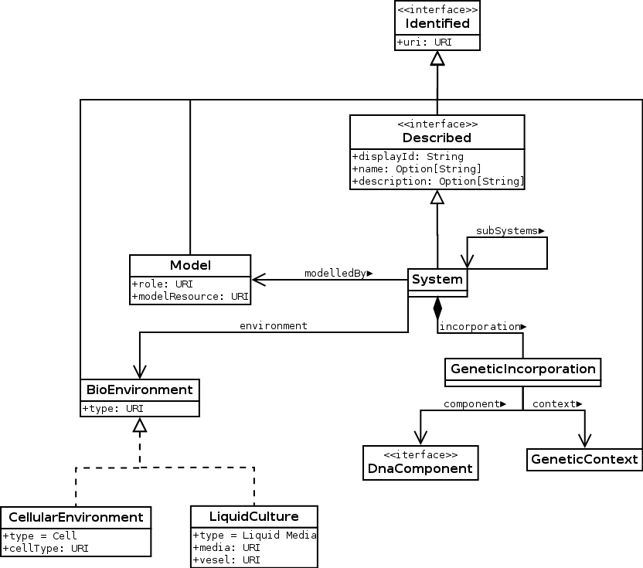
The data model

Slide 13
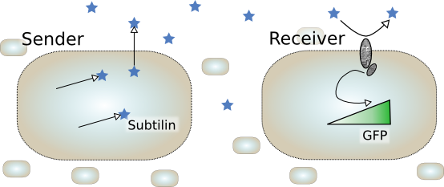
A use case: Subtilin sender/receiver system
Modelled using a rule-based modelling formalism

Slide 14
Subtilin sender system
SpaT
SpaC
SpaB
Subtilin
Sender
Modelled using a rule-based modelling formalism

Slide 15
Subtilin receiver system
Subtilin
SpaK*
SpaR
SpaK
GFP
SpaR*
Sensor
Reporter
Modelled using
a rule-based modelling formalism
SBML
CellML

Slide 16
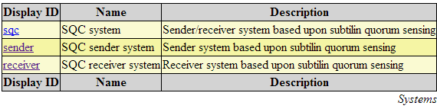
A simple Web service
Developed to retrieve
Systems
Models
Genetic Contexts
Host/Environment
REST-based
Uses JSON outputs

Slide 17
Retrieving systems
Retrieve the list of biological systems
/system
Retrieve by ID or URL
/system/[URI] or /system/[ID]
{
uri: "http://sbol.ncl.ac.uk:8081/system/subtilinsender",
name: "SQC sender system",
displayId: "sender",
description: "Sender system based upon subtilin quorum sensing",
subsystems: [ ],
environment: {
uri: "system/sender/168_standard_strain",
cellType: "bioEnvironment%3ABacillus+subtilis+168",
type: "bioEnvironment%3Acell"
},
models: [
{
uri: "http://sbol.ncl.ac.uk:8081/model/subtilinsystem/sender/bngl_model"
}
],
incorporation: [
{
component: "http://bacillobricks.co.uk/device/subtilinsender",
context: "http://sbol.ncl.ac.uk:8081/geneticcontext/genomicLocus/amyE"
}
]
}

Slide 18
Retrieving models
Retrieve the list of models
/model
Retrieve by ID or URI
/model/[URI]
/model/[ID]
{
displayId: "3",
uri: "http://sbol.ncl.ac.uk:8081/model/subtilinsystem/receiver/cellml_model",
format: "CellML",
modelResource: "http://sbol.ncl.ac.uk:8081/assets/models/subtilinsystem/recei
ver/subtilinreceiver_cellml10.cellml"
}

Slide 19
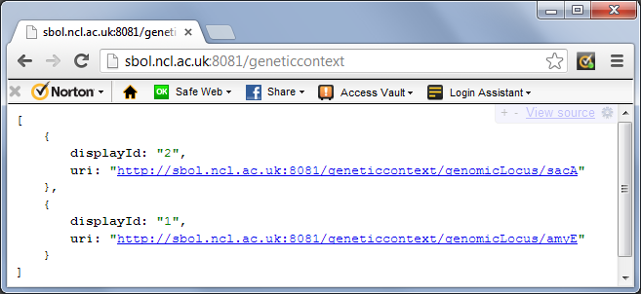
Retrieving genetic contexts
Retrieve the list of genetic contexts
/geneticcontext
Retrieve by ID or URI
/geneticcontext/[URI]
/geneticcontext/[ID]

Slide 20
Conclusions
SBOL will be used as much as possible through the projects in the Flowers consortium
We will also be developing standards to represent biological systems
SBOL can be extended for this purpose
Flowers consortium can be used as a way of promoting the use of data standards that we define

Slide 21
Acknowledgements
Dr. Matthew Pocock
Jurijs Meitalovs
Dr. Angel Goñi-Moreno
Prof. Martyn Amos
Dr. Jennifer Hallinan
Dr. Paolo Zuliani
Dr. Egils Stalidzans
Prof. Anil Wipat

