Slide 1
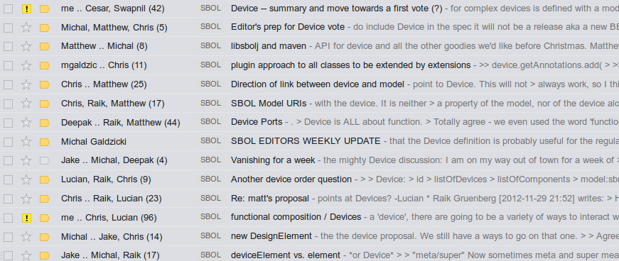
The Device
Functional Composition in SBOL
or:
the longest thread on sboldev

Slide 2
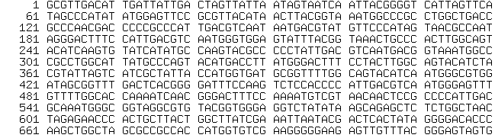





SBOL 1.0 deals with sequences... and sequence composition
http://registry.jbei.org/dc#a566fb4beb...
RDF / XML
SO classification

Slide 3
SBOL 1.0 does not deal with functional composition
http://registry.jbei.org/dc#a566fb4beb...
RDF / XML
SO classification
interface?
Kd measurement?
kon
ODEs
cross-reactions?
koff
half-life?
stochastic
relative performance?

Slide 4
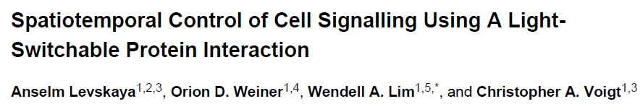
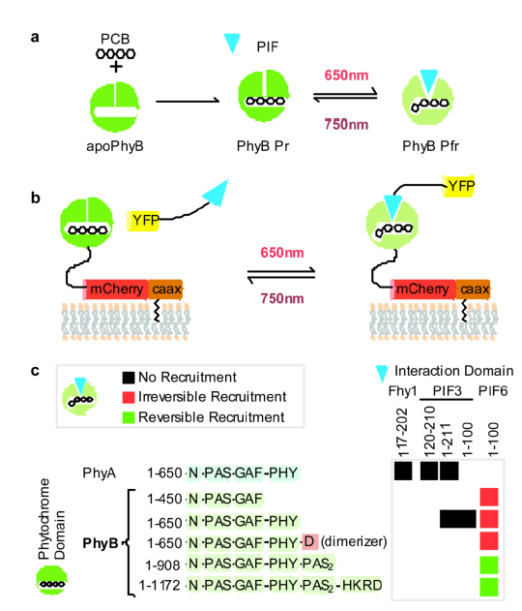
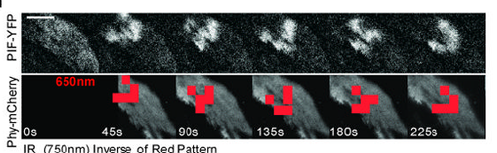

Slide 5
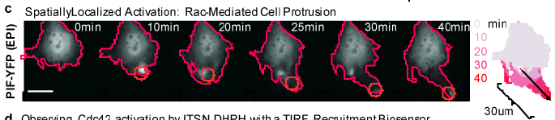
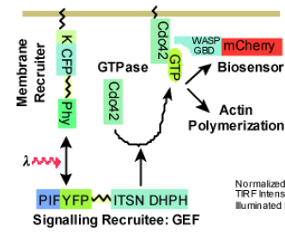
no DNA here nowhere!!

Slide 6
We need the concept of "Device" as a basic *functional* unit.
A Device would package one or several DnaComponents into a functional unit
with a defined functional interface.
Different categories of devices would have different types of input and output.
A given Device category would require a standard set of characterization data.
These characterization data would be used to populate parameters in the default
SBML model for this category of device.
Certain types of devices could be connected by defined regulatory interactions etc.
None of this would m

Slide 7
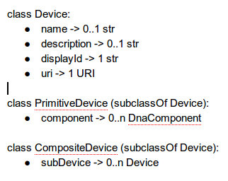

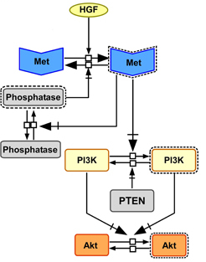

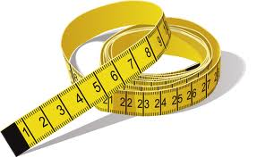
approved RFC
"A Device is a (re)usable portion of functional or behavioral design, enabling annotation, composition and experimental characterization".
SBOLv
discussion postponed:
type -> URI
mathematical
models
search
measurements

Slide 8
Most urgently needed:
Device.type == DeviceClass (?)
ProteinComponent
ChassisComponent
RNAComponent
ChemicalComponent
Hook for measurements -> Device
(depending on class of device)

