Slide 1
SBOL
Regulatory Interactions
Ernst Oberortner,
Matthew Pocock,
Nicholas Roehner

Slide 2
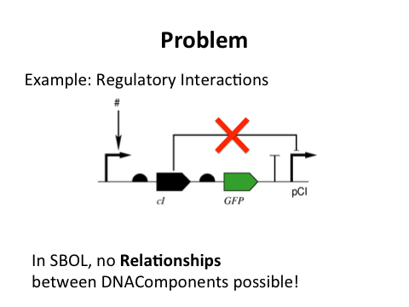
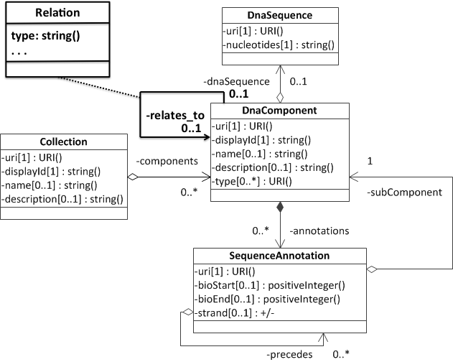
Purpose
@ SBOL8 - Boston

Slide 3
Achievements (libSBOLj)
- Implementation of Device classes (SBOL Core)
- Definition of Regulatory Interactions
- Visualization using Pigeon (pigeoncad.org)
- Core + Regulations
- Extension Providers

Slide 4
Use Cases
- Toggle Switch
DNA Component with Sequence Annotations
and Subcomponents
- NOR Gate
Primitive Device consisting of DNA Components
- Repressilator
Composite Device consisting of 2 Primitive Devices

Slide 5
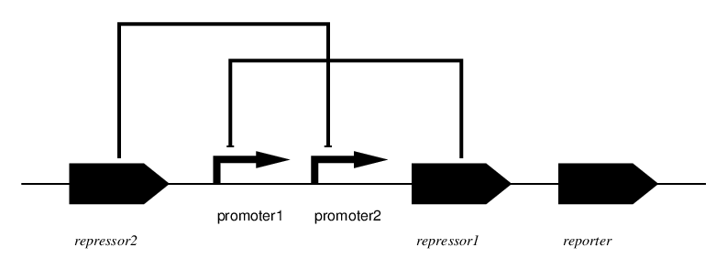
Toggle Switch (Live Demonstration)
Regulatory Interactions
repressor2: DNAComponent
anno1: SequenceAnnotation
ToggleSwitch:
DNAComponent

Slide 6
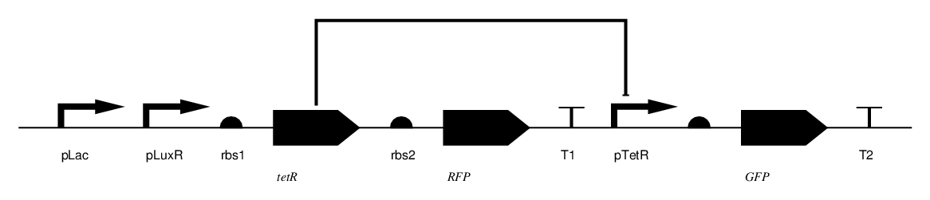
NOR GATE (Live Demonstration)
Regulatory Interactions
tetR:
DNAComponent
pTetR:
DNAComponent
NORGate:
Primitive Device

Slide 7
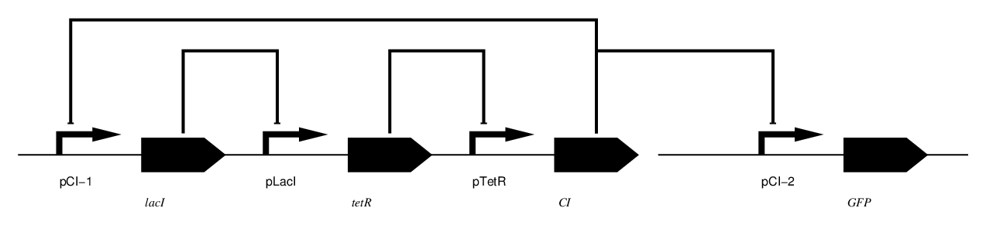
Repressilator
Regulatory Interactions
lacI: DNAComponent
repressilator: PrimitiveDevice
Repressilator:
CompositeDevice

Slide 8
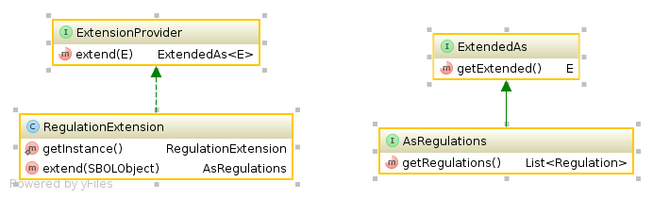
Extension Mechanism
public interface ExtensionProvider<E> {
public ExtendedAs<E> extend(E e);
}
public class RegulationExtension
implements ExtensionProvider<SBOLCoreObject> {
public AsRegulations extend(final SBOLCoreObject obj) {
return new AsRegulationsImpl(obj, new ArrayList<Regulation>());
}
}
public interface ExtendedAs<E> {
public E getExtended();
}
public interface AsRegulations
extends ExtendedAs<SBOLCoreObject>
{
List<Regulation> getRegulations();
SBOLCoreObject getExtended();
}

Slide 9
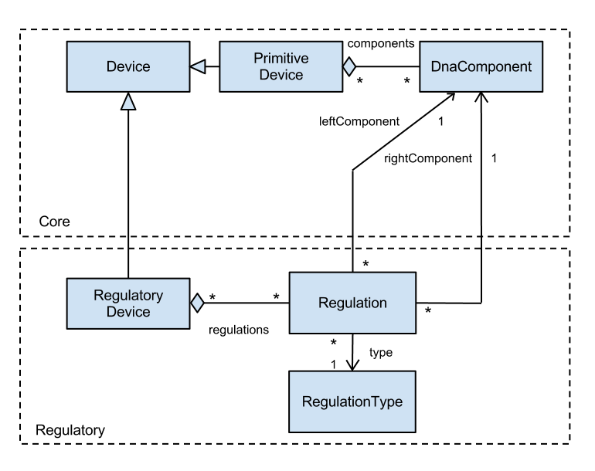
Data Model 1

Slide 10
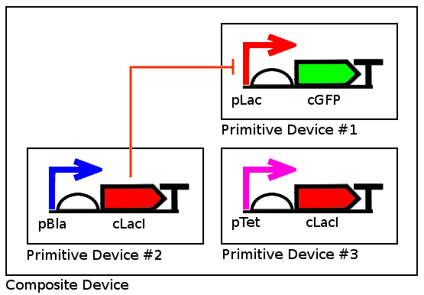
The Instance Problem

Slide 11
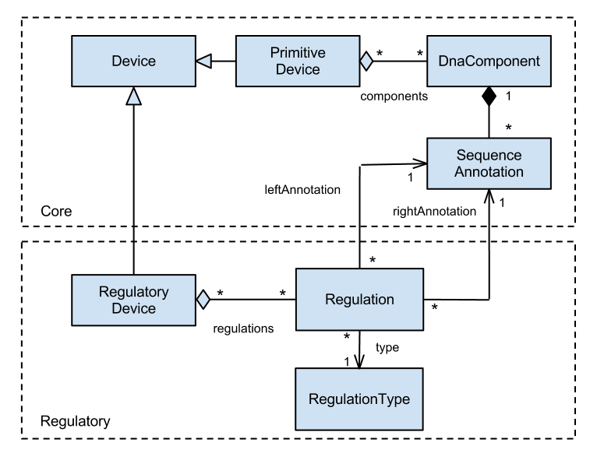
Data Model 2

Slide 12
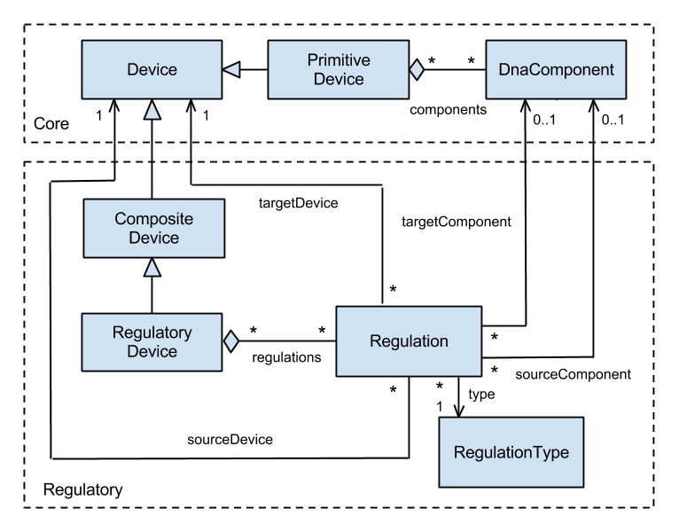
Data Model 3

Slide 13
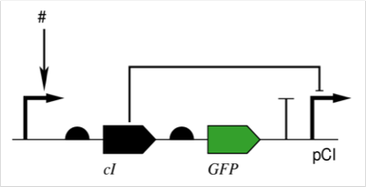
Future Work
- Serialization to XML/RDF
- Validations
- Environmental signaling molecules
- BBF RFC

