Slide 1


SBOL Script
Ernst Oberortner

Slide 2
SBOL Script
Textual UI to SBOL
Goal:
Standardized Synthetic Biology Language
Requirements:
Human- and Machine-readable
Easy to Learn, Read, Write and Exchange

Slide 3
SBOL Script -- Example:
// Data Extraction
Use components from
biofab.org and
partsregistry.org.
// Composition of DNA Components
Construct device alpha
with components
apFAB70, BBa_J61100,
BBa_K590022, apFAB390.

Slide 4
Current State
Prototype
Core
Comments
Integration into Clotho
Regulatory Interactions
alpha.Bba_K59002 represses beta.apFAB70

Slide 5
Future of SBOL Script
Standardized
Synthetic Biology Language
Eugene [BU]
Proto [BBN]
Antimony [UW]
GenoCAD [Peccaud Lab]

Slide 6

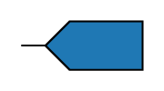

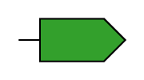
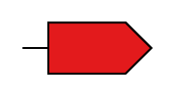
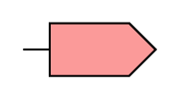

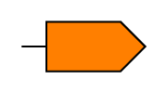
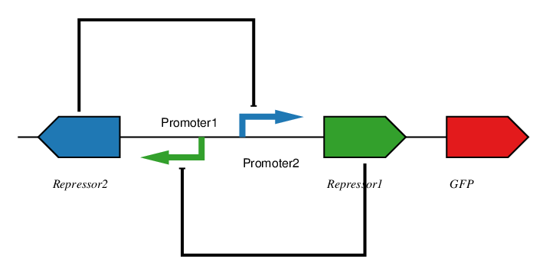
Library of
Genetic Parts
Constraints
Device ToggleSwitch(
Repressor, Promoter,
Promoter, Repressor,
Reporter);
Repressor1.represses EQUALS Promoter1
Repressor2.represses EQUALS Promoter2
Promoter1.direction == “backward”
Eugene is a programming language for synthetic biology that defines devices, part types, part properties, and how parts should be put together using design constraints (rules).
Genetic Toggle-Switch

Slide 7
Questions?
Ernst Oberortner
Cesar Rodriguez

