Slide 1



Synthetic Biology Open Language (SBOL): Community-Driven Standard for Communi-cation of Synthetic Biology Designs
Jacob Beal, Bryan Bartley, Kevin Clancy, Goksel Misirli, Nicholas Roehner (Editors), Herbert Sauro (Chair), & SBOL community
SEED Conference
Boston, MA
June, 2015

Slide 2
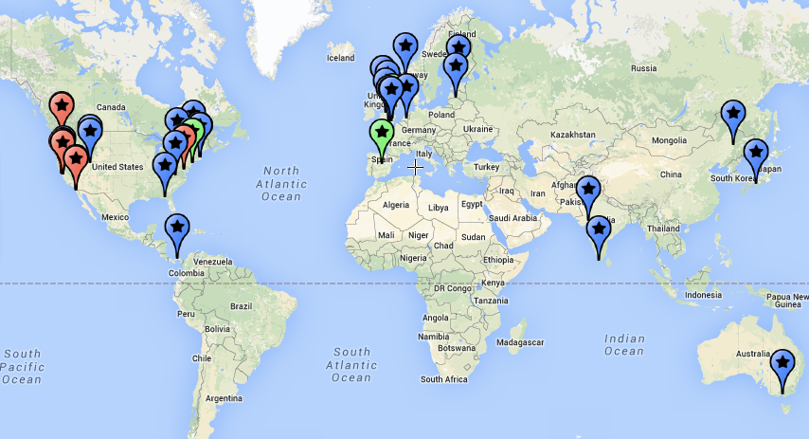


The SBOL Community
100+ people from all around the world
30 universities, 14 companies, 8 others
Ongoing development starting 2008
Major
funders:
Notes:
Community has: more than 100 people, representing 30 universities, 14 companies, 8 other institutions

Slide 3
Synthetic Biology Open Language
FASTA
GenBank
SBOL 1.1
SBOL 2.0
ACTGTGCCGTTAAACGTGATTAAATCCGTACTGATAT…
TetR
GFP
pTet
aTc detector
GFP reporter
TetR
GFP
pTet
aTc detector
aTc
GFP reporter
TetR
GFP
TetR
GFP
pTet

Slide 4
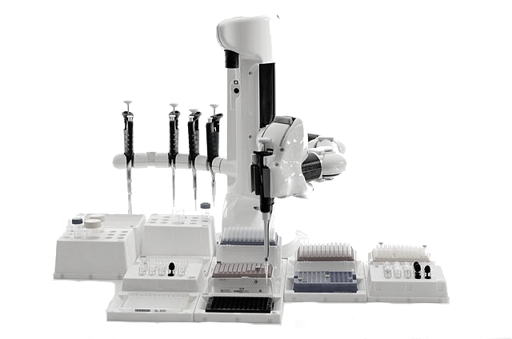



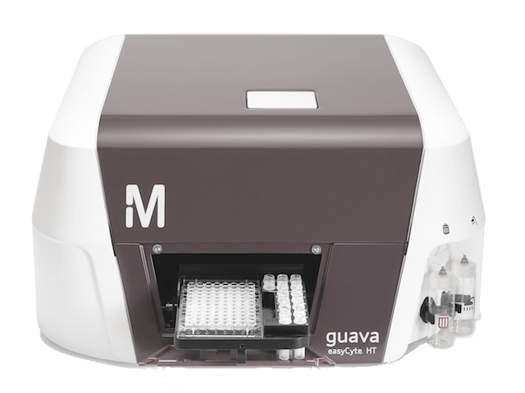









Purpose of SBOL 2.0
Lots of different synthetic biology resources…
Repositories & Databases
Automation & Integration
Lab Automation
LIMS
GenBank
HT Assays
Modeling
Emerging Approaches
Sequencing & Synthesis
SO
Strain Data
BioPAX
ChEBI
BioModels.Net
Measurement Data
… SBOL is a "hub" for linking them together
Notes:
SBOL 2.0 describes sequence, plus just enough information about function to provide hooks for integrating a broad range of resources together.

Slide 5

Components of SBOL
SBOL
documents
Tool
Tool
SBOL
documents
images
fonts
SBOLv Glyphs
Tool
ontologies
libSBOL
Developer Community
SBOL 2.0
Data Model
serialization
Tool
examples
Tool
Other standards
& resources
SBOL
documents
GenBank

Slide 6
What SBOL 2.0 Represents
aTc detector
aTc
GFP reporter
TetR
GFP
TetR
GFP
pTet
Measurement Data
GenBank
Strain Information
Sequence structure
Incomplete designs
Qualitative function
Heterarchical composition
Links to other information

Slide 7
Integration with non-SBOL Data
aTc detector
aTc
GFP reporter
TetR
GFP
TetR
GFP
pTet
Strain Information
Embed SBOL in data
Embed data in SBOL
Link SBOL to data
Links data to SBOL
Whatever model works best for the tools…

Slide 8



SBOL supports many workflows
Repositories
User
User
Automation
Vendors

Slide 9
SBOL supports many workflows
Repositories
User
User
Reuse/Share
Automation
Vendors

Slide 10
SBOL supports many workflows
Repositories
User
User
Reuse/Share
Visualize
Automation
Vendors

Slide 11
SBOL supports many workflows
Repositories
User
User
Reuse/Share
Visualize
Design/Model
Automation
Vendors

Slide 12
SBOL supports many workflows
Repositories
User
User
Reuse/Share
Visualize
Design/Model
Synthesize/Build
Automation
Vendors

Slide 13
SBOL supports many workflows
Repositories
User
User
Reuse/Share
Visualize
Design/Model
Synthesize/Build
Automate
Automation
Vendors

Slide 14
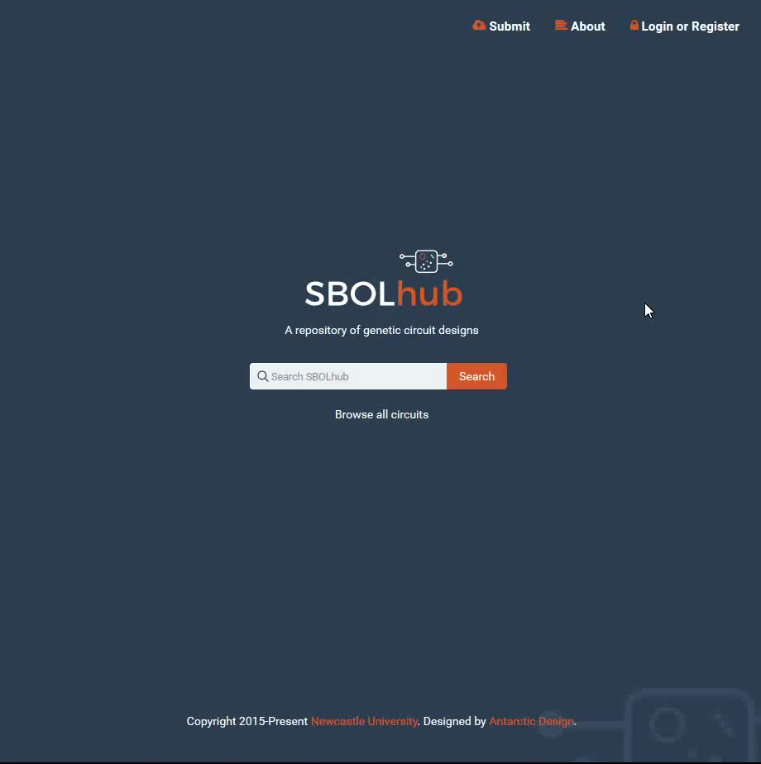

Workflow: Reuse & Share
SBOLhub
Searchable repository for public, private designs
Journal integration for "one-click" private review
Import SBOL/FASTA/GenBank, Export SBOL

Slide 15
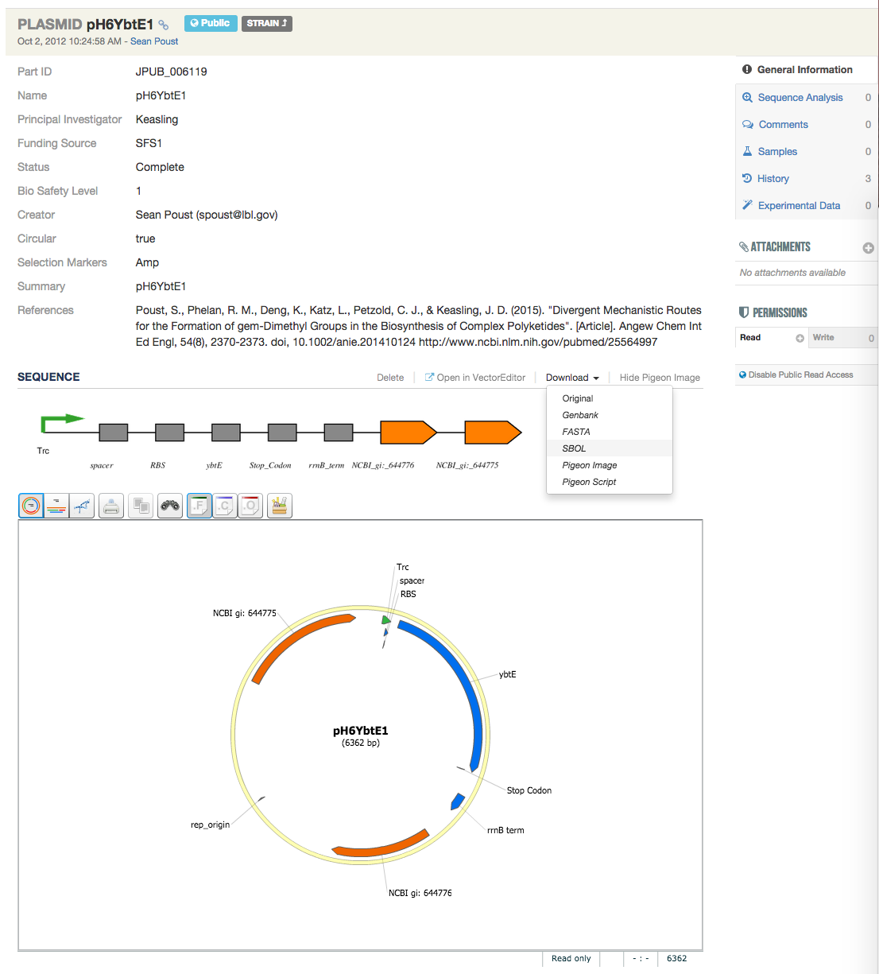

Workflow: Reuse & Share
ICE
Web of integrated public and private design registries
Sequences, plasmids, strains, visualization
SBOL, Genbank, FASTA
http://github.com/JBEI/ice
Notes:
1. It is marked "Public" which makes it available on the web of registries and accessible through an API to other ICE instances and third-party synthetic biology software tools.
2. The annotated sequence is also visually represented using Pigeon/SBOLv
3. The sequence information can be downloaded in SBOL format (from Genbank or Fasta) and therefore uploaded to other tools that support SBOL. I activated the download dropdown in the screen shot to show the options. ICE also supports SBOL uploads.
4. The strain it is contained in, is a separate entry (accessible via the "Strain" link) via a hierarchical relationship allowing this plasmid to be contained in other strains as well.

Slide 16
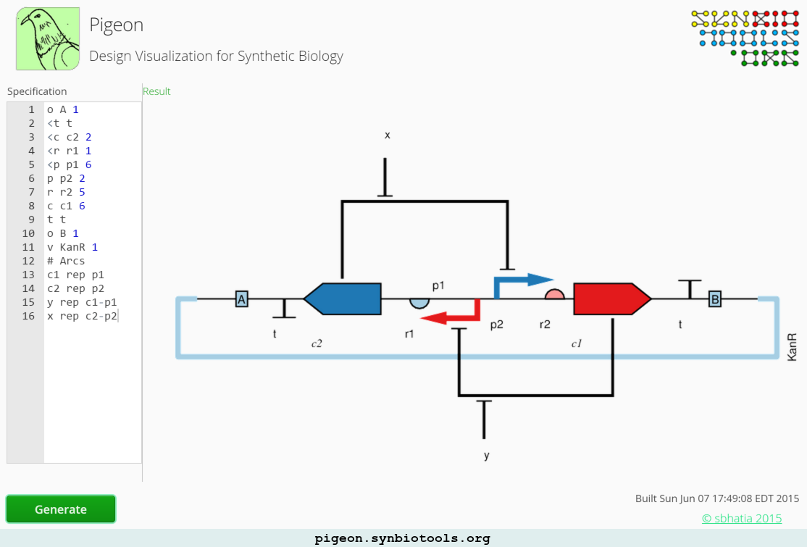

Workflow: Visualize
Pigeon
Input simple network description language
Design visualization using SBOL glyphs
http://pigeon.synbiotools.org/

Slide 17
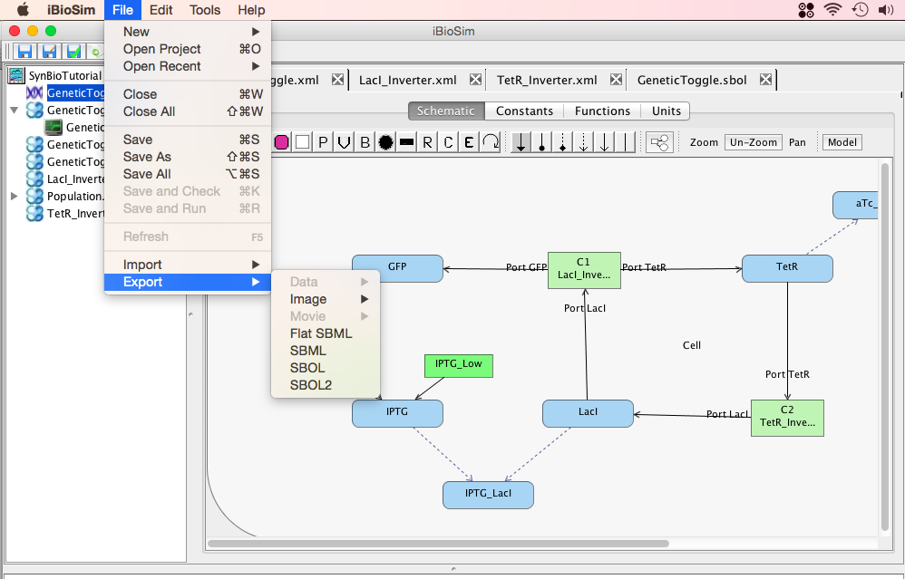

Workflow: Design & Model
iBioSim
Graphical design of reaction networks
Import or export both SBML and SBOL 2.0
Simulate ODE, SSA
www.async.ece.utah.edu/iBioSim/
Notes:
1) This is a hierarchical model of the genetic toggle switch encoded in SBML.
2) The LacI and TetR inverter modules have SBOL associated with them to provide hierarchical annotated sequence annotations of the DNA components that they are made of.
3) iBioBim will automatically construct a composite sequence when the parts are put together in this top level module and save off the resulting SBOL to the SBOL library file.
4) iBioSim also supports conversion of the SBML file into an SBOL 2.0 file, as well as, conversion from SBOL 2.0 to SBML. So, if you build a model you can extract the structure and qualitative behavior, OR if you have a design already you can generate a quantitative model to simulate.

Slide 18
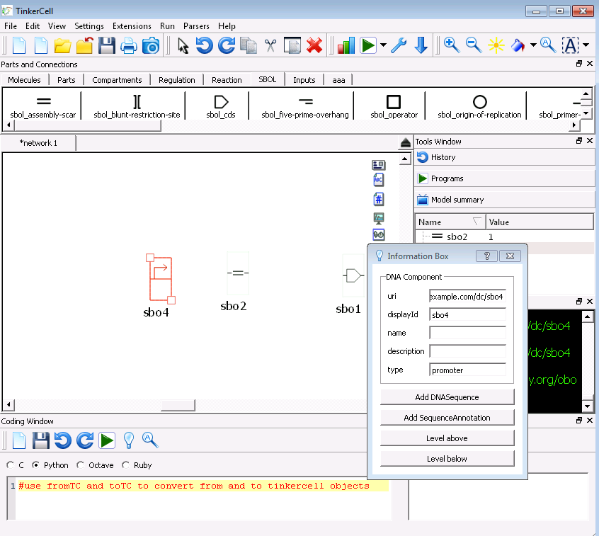

Workflow: Design & Model
TinkerCell
Modular graphical design of GRNs
SBOL import/export
Simulate ODE, SSA
http://www.tinkercell.com/

Slide 19
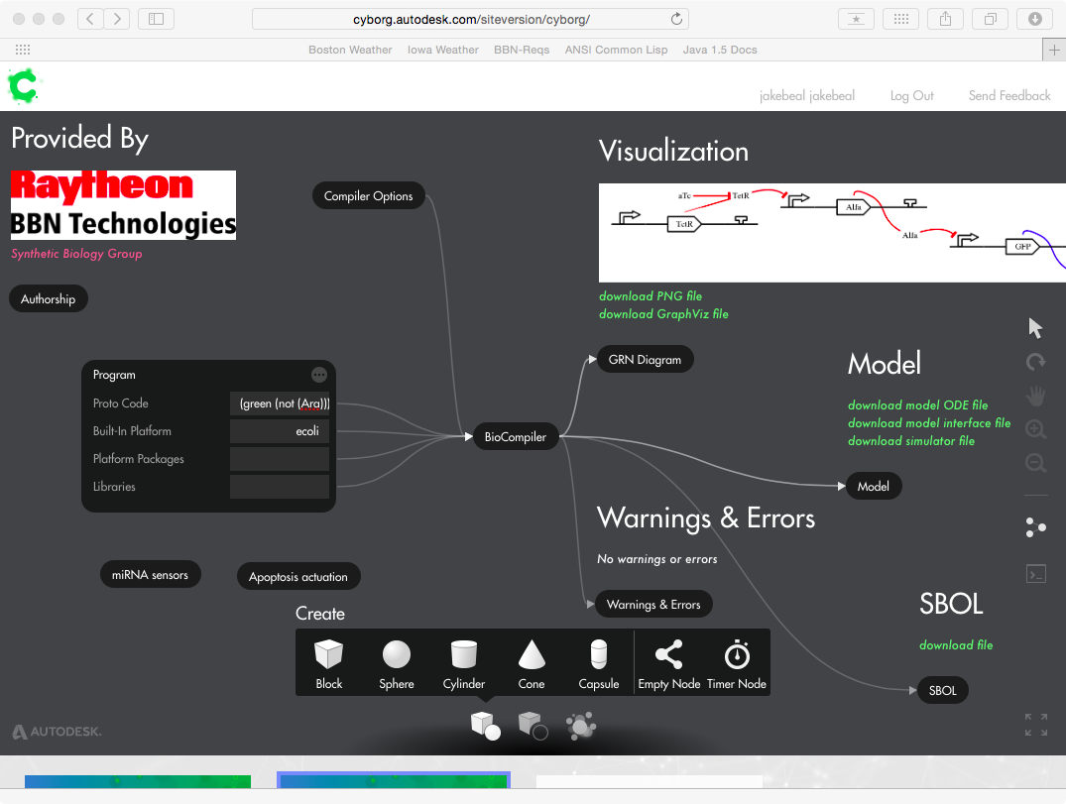
Workflow: Design & Model
BioCompiler
Generate GRN design from functional program
SBOL visualization and design output
ODE simulations
https://synbiotools.bbn.com/

Slide 20
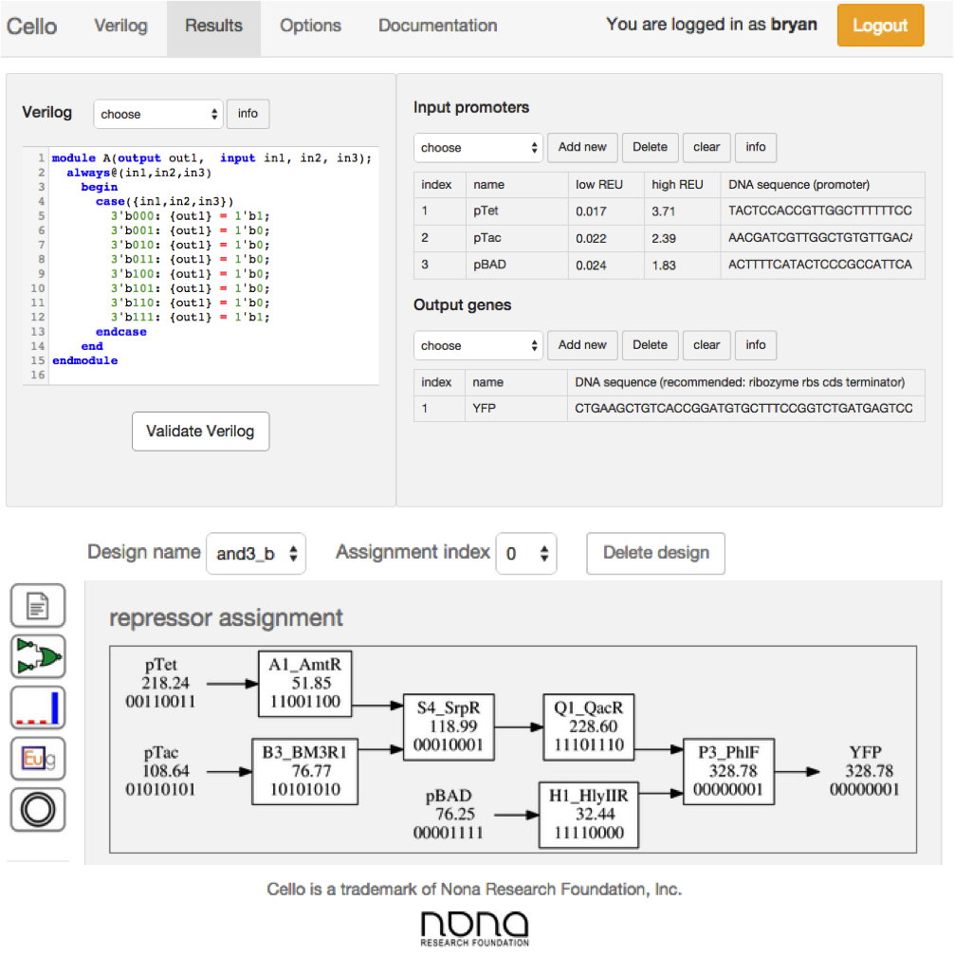

Workflow: Design & Model
Cello
Generate repressor design from logic spec
SBOL encodes gate library and outputs
Used w. TetR homologs
Notes:
Cello automates the design of genetically encoded combinational logic circuits
Input: high-level logic specification and a gates library
Logic synthesis and repressor assignment are the main steps
Output: one or more DNA sequences encoding the transcriptional network

Slide 21
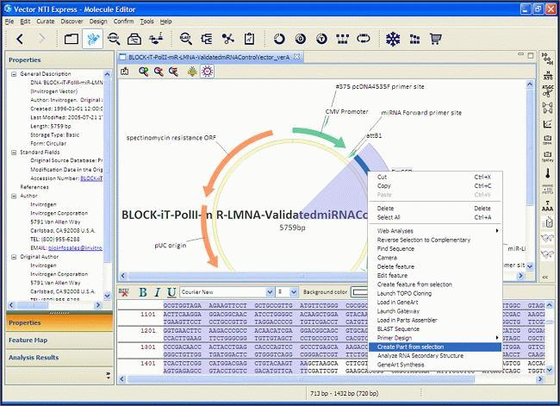

Workflow: Synthesize/Build
VectorNTI
SBOL import/export
Sequence analysis, editing, and design
Primer design for cloning, assembly
http://www.thermofisher.com/

Slide 22
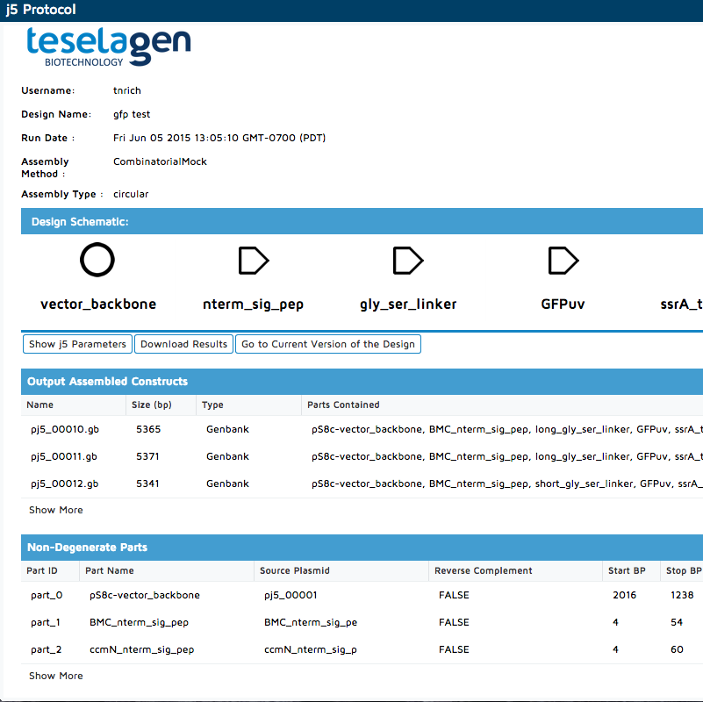

Workflow: Automate
j5
Import SBOL designs
Generate assembly plans, oligos, protocols
Support for onward laboratory automation
http://www.teselagen.com
Notes:
The j5 protocol view (accessible after assembling a design with j5) gives users quick access to their newly created constructs along with the oligos and assembly instructions necessary to make those constructs in the lab.

Slide 23
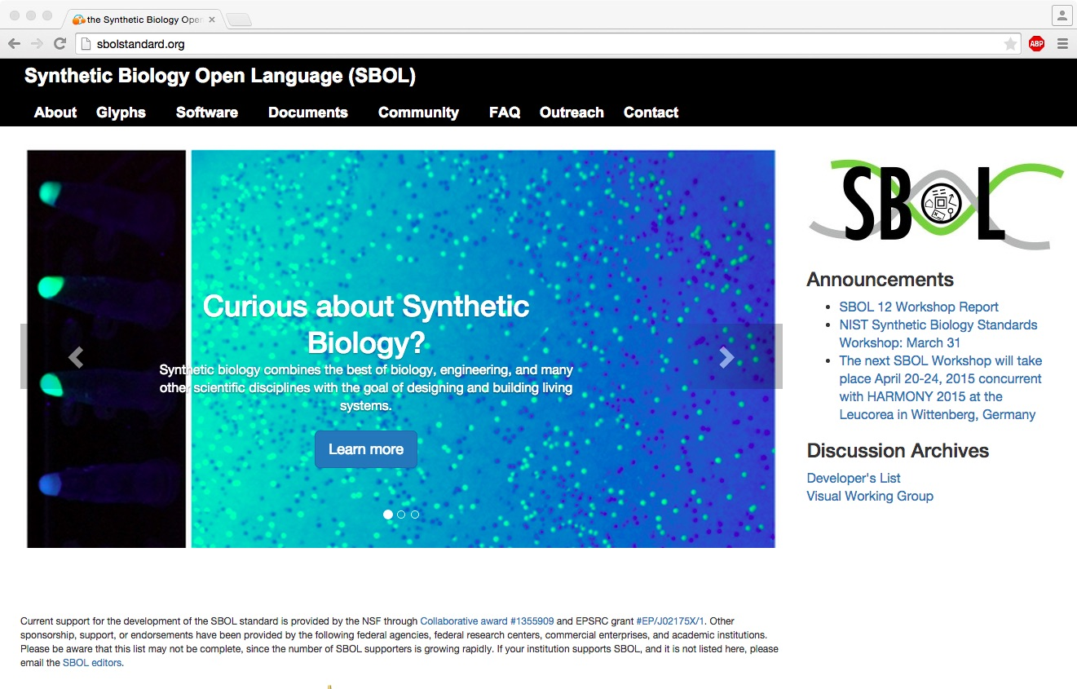
Resources for Users/Developers
http://sbolstandard.org/

Slide 24




Call to Action!
Tool builders, use SBOL
Laboratory practitioners, send your designs and tell us about what tools you need
NIST S.B. Standards Consortium
Digital Biological Information WG
Community meeting at IWBDA
August 19-21, Seattle
http://sbolstandard.org/

